Slide 1
CMSC 611: Advanced Computer Architecture
Pipelining
Some material adapted from Mohamed Younis, UMBC CMSC 611 Spr 2003 course slides
Some material adapted from Hennessy & Patterson / © 2003 Elsevier Science

Slide 2
Data Hazards
Time (clock cycles)
IF
ID/RF
EX
MEM
WB
I
n
s
t
r.
O
r
d
e
r
add r1,r2,r3
Reg
Ifetch
Reg
ALU
DMem
sub r4,r1,r3
Ifetch
Reg
ALU
DMem
Reg
and r6,r1,r7
Ifetch
Reg
ALU
DMem
Reg
or r8,r1,r9
Ifetch
Reg
ALU
DMem
Reg
xor r10,r1,r11
Ifetch
Reg
ALU
DMem
Reg
Slide: David Culler

Slide 3
Forwarding to Avoid Data Hazard
Time (clock cycles)
I
n
s
t
r.
O
r
d
e
r
add r1,r2,r3
Ifetch
Reg
ALU
DMem
Reg
sub r4,r1,r3
Ifetch
Reg
ALU
DMem
Reg
and r6,r1,r7
Ifetch
Reg
ALU
DMem
Reg
or r8,r1,r9
Ifetch
Reg
ALU
DMem
Reg
xor r10,r1,r11
Ifetch
Reg
ALU
DMem
Reg
Slide: David Culler

Slide 4
HW Change for Forwarding
NextPC
ID/EX
EX/MEM
MEM/WR
mux
Registers
ALU
Data
Memory
mux
mux
Immediate
Slide: David Culler

Slide 5
Data Hazard Even with Forwarding
Time (clock cycles)
I
n
s
t
r.
O
r
d
e
r
lw r1, 0(r2)
Ifetch
Reg
ALU
DMem
Reg
sub r4,r1,r6
Ifetch
Reg
ALU
DMem
Reg
and r6,r1,r7
Ifetch
Reg
ALU
DMem
Reg
or r8,r1,r9
Ifetch
Reg
ALU
DMem
Reg
Slide: David Culler
Notes:
MIPS actutally didn’t interlecok: MPU without Interlocked Pipelined Stages

Slide 6
Resolving Load Hazards
Adding hardware? How? Where?
Detection?
Compilation techniques?
What is the cost of load delays?
Slide: David Culler

Slide 7
Resolving the Load Data Hazard
Time (clock cycles)
I
n
s
t
r.
O
r
d
e
r
lw r1, 0(r2)
Ifetch
Reg
ALU
DMem
Reg
Bubble
sub r4,r1,r6
Ifetch
Reg
ALU
DMem
Reg
Bubble
and r6,r1,r7
Ifetch
Reg
ALU
DMem
Reg
Bubble
ALU
or r8,r1,r9
Ifetch
Reg
DMem
How is this different from the instruction issue stall?
Slide: David Culler

Slide 8
Software Scheduling to Avoid Load Hazards
Try producing fast code for
a = b + c;
d = e – f;
assuming a, b, c, d ,e, and f in memory.
Slow code:
LW Rb,b
LW Rc,c
ADD Ra,Rb,Rc
SW a,Ra
LW Re,e
LW Rf,f
SUB Rd,Re,Rf
SW d,Rd
Fast code:
LW Rb,b
LW Rc,c
LW Re,e
ADD Ra,Rb,Rc
LW Rf,f
SW a,Ra
SUB Rd,Re,Rf
SW d,Rd
Slide: David Culler

Slide 9
Instruction Set Connection
What is exposed about this organizational hazard in the instruction set?
k cycle delay?
bad, CPI is not part of ISA
k instruction slot delay
load should not be followed by use of the value in the next k instructions
Nothing, but code can reduce run-time delays
MIPS did the transformation in the assembler
Slide: David Culler

Slide 10
Pipeline Hazards
Cases that affect instruction execution semantics and thus need to be detected and corrected
Hazards types
Structural hazard: attempt to use a resource two different ways at same time
Single memory for instruction and data
Data hazard: attempt to use item before it is ready
Instruction depends on result of prior instruction still in the pipeline
Control hazard: attempt to make a decision before condition is evaluated
branch instructions
Hazards can always be resolved by waiting

Slide 11
Control Hazard on Branches Three Stage Stall
10: beq r1,r3,36
Ifetch
Reg
ALU
DMem
Reg
14: and r2,r3,r5
Ifetch
Reg
ALU
DMem
Reg
18: or r6,r1,r7
Ifetch
Reg
ALU
DMem
Reg
22: add r8,r1,r9
Ifetch
Reg
ALU
DMem
Reg
36: xor r10,r1,r11
Ifetch
Reg
ALU
DMem
Reg
Slide: David Culler

Slide 12
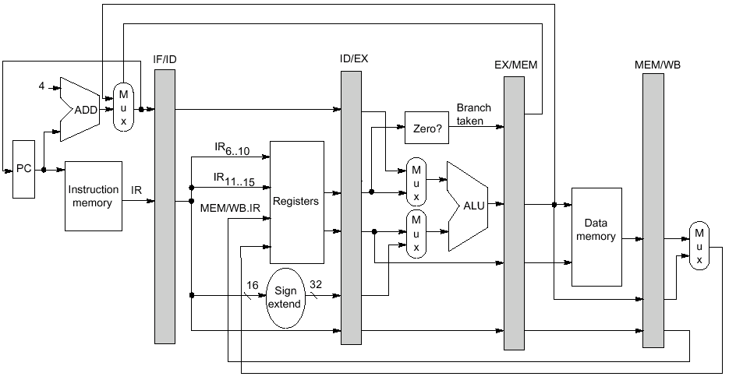
Datapath Reminder

Slide 13
Example: Branch Stall Impact
If 30% branch, 3-cycle stall significant!
Two part solution:
Determine branch taken or not sooner, AND
Compute taken branch address earlier
MIPS branch tests if register = 0 or ≠ 0
MIPS Solution:
Move Zero test to ID/RF stage
Adder to calculate new PC in ID/RF stage
1 clock cycle penalty for branch versus 3
Slide: David Culler

Slide 14
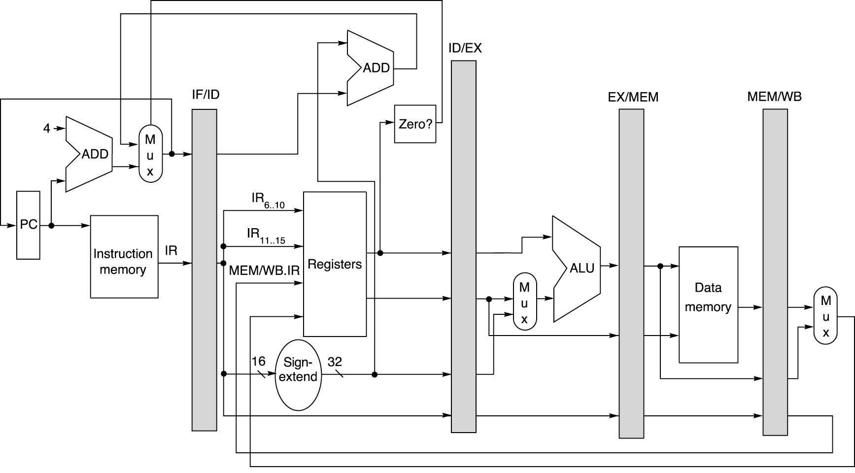
Pipelined MIPS Datapath
Add
Zero?
Figure: Dave Patterson

Slide 15
Four Branch Hazard Alternatives
Stall until branch direction is clear
Predict Branch Not Taken
Execute successor instructions in sequence
“Squash” instructions in pipeline if branch taken
Advantage of late pipeline state update
47% MIPS branches not taken on average
PC+4 already calculated, so use it to get next instruction
Predict Branch Taken
53% MIPS branches taken on average
But haven’t calculated branch target address in MIPS
MIPS still incurs 1 cycle branch penalty
Other machines: branch target known before outcome
Slide: David Culler

Slide 16
Four Branch Hazard Alternatives
Delayed Branch
Define branch to take place AFTER a following instruction branch instruction sequential successor₁ sequential successor₂ ........ sequential successor_{n} ........
branch target if taken
1 slot delay allows proper decision and branch target address in 5 stage pipeline
MIPS uses this
Branch delay of length n
Slide: David Culler

Slide 17
Branch-Delay Scheduling Requirements
Limitation on delayed-branch scheduling arise from:
Restrictions on instructions scheduled into the delay slots
Ability to predict at compile-time whether a branch is likely to be taken
May have to fill with a no-op instruction
Average 30% wasted
Additional PC is needed to allow safe operation in case of interrupts (more on this later)

Slide 18
Example: Evaluating Branch Alternatives
Assume:
14% Conditional & Unconditional
65% Taken; 52% Delay slots not usefully filled
Scheduling Scheme | Branch Penalty | CPI | Pipeline Speedup | Speedup vs stall
Stall pipeline | 3.00 | 1.42 | 3.52 | 1.00
Predict taken | 1.00 | 1.14 | 4.39 | 1.25
Predict not taken | 1.00 | 1.09 | 4.58 | 1.30
Delayed branch | 0.52 | 1.07 | 4.66 | 1.32
Slide: David Culler
Notes:
Stall: 1+.14(branches)*3(cycle stall)
Taken: 1+.14(branches)*(.65(taken)*1(delay to find address)+.35(not taken)*1(penalty))
Not taken: 1+.14*(.65(taken)*1+[.35(not taken)*0])
Delayed: 1+.14*(.52(not usefully filled)*1)

