Slide 1
Basic Ray Tracing
CMSC 435/634

Slide 2
Visibility Problem
Rendering: converting a model to an image
Visibility: deciding which objects (or parts) will appear in the image
  Object-order
    One object at a time for all pixels it covers
    Rasterization (later)
  Image-order
    One pixel at a time, for all of the objects
    Ray Tracing (now)

Slide 3
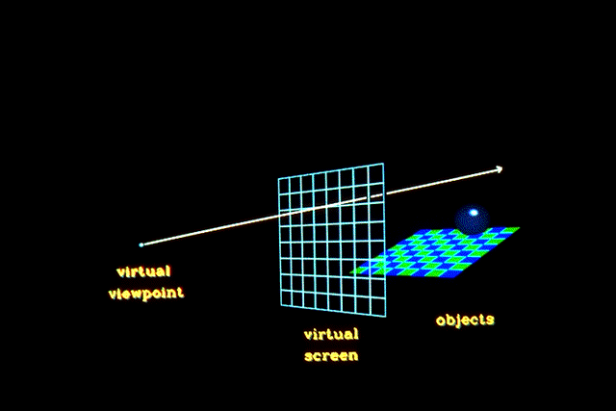
Raytracing
Given
  Scene
  Viewpoint
  Image Plane
Cast ray from viewpoint through pixels into scene

Slide 4
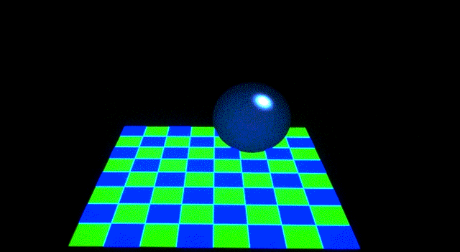
View

Slide 5
Parametric and Implicit Forms
Want to describe an object
  plane / sphere / triangle / ray / …
Parametric: equation with parameters
  Varying parameters sweeps out object
Implicit: equation(s) true on the object

Slide 6



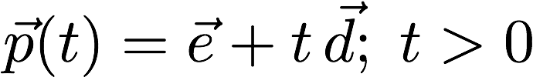
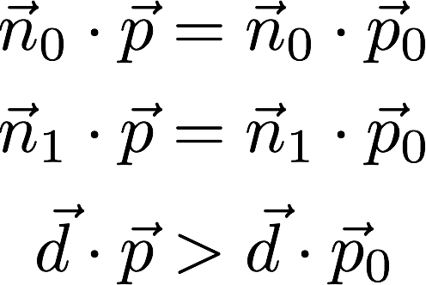
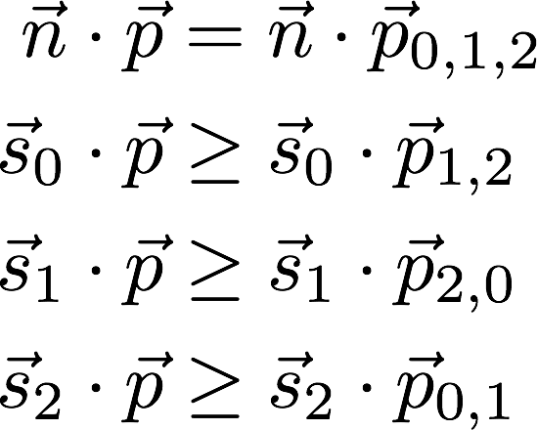
Parametric vs Implicit
Object
Parametric
Implicit
Plane
Sphere
Ray
Triangle

Slide 7
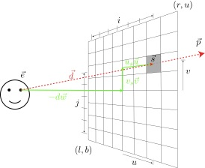
Computing Viewing Rays
Parametric ray
Camera frame
  : eye point
  : basis vectors
  right, up, backward
    Right hand rule!
Screen position

Slide 8
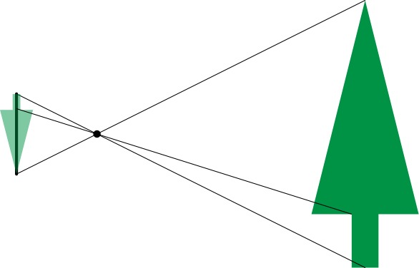
Pinhole Lens

Slide 9
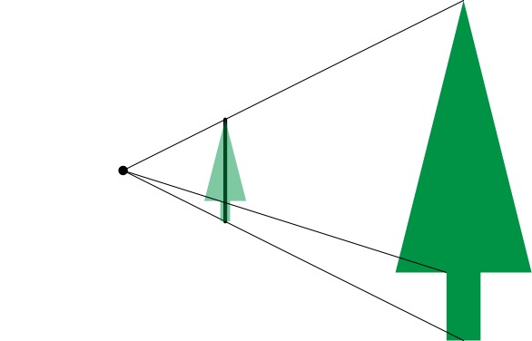
Lens Model

Slide 10
Lens Model

Slide 11
Field of View

Slide 12
Field of View

Slide 13
Field of View

Slide 14
Symmetric Window

Slide 15
Rectangular Windows
Width
Compute Height using Vertical
Field of View
Height

Slide 16
Off-center Projection
Used for display walls, image tiling, and VR
d is perpendicular distance to screen
Still need right triangles for trig

Slide 17
Calculating Intersections
Define ray parametrically:
If is center of projection and
is center of pixel
  : points between those locations
  : points behind viewer
  : points beyond view window

Slide 18
Ray-Sphere Intersection
Sphere in vector form
Ray
Intersection when

Slide 19

Ray-Sphere Problems
When can
go bad?
Division by 0?
  Only if , aka ray direction = 0
  No real intersections
  Happens when ray misses the sphere

Slide 20
Ray-Triangle Intersection
Intersection of ray with barycentric triangle
  4 linear equations (x,y,z and barycentric sum) in 4 unknowns
  In triangle if α ≥ 0, β ≥ 0, γ ≥ 0
  To avoid computing all three, can replace α ≥ 0 with β+ γ ≤ 1
boolean raytri (ray r, vector p0, p1, p2, interval [t₀,t₁] )
{
  compute t
  if (( t < t₀ ) or (t > t₁))
return ( false )
  compute γ
  if ((γ < 0 ) or (γ > 1))
return ( false )
  compute β
  if ((β < 0 ) or (β+γ > 1))
return ( false )
return true
}

Slide 21
Ray-Polygon Intersection
Given ray and plane containing polygon
What is ray/plane intersection?
Is intersection point inside polygon?

Slide 22
Point in Polygon?
Is P in polygon?
Cast ray from P to infinity
  1 crossing = inside
  0, 2 crossings = outside

Slide 23
Point in Polygon?
Is P in concave polygon?
Cast ray from P to infinity
  Odd crossings = inside
  Even crossings = outside

Slide 24
What Happens?

Slide 25
Raytracing Characteristics
Good
  Simple to implement
  Minimal memory required
  Easy to extend
Bad
  Aliasing
  Computationally intensive
    Intersections expensive (75-90% of rendering time)
    Lots of rays

