Slide 1
Graphics Pipeline Clipping
CMSC 435/634

Slide 2
Graphics Pipeline
Object-order approach to rendering
Sequence of operations
Vertex processing
Transforms
Vertex components of shading/texture
Clipping
Find the visible parts of any primitives
Rasterization
Break primitives into fragments/pixels
Fragment processing
Fragment components of shading/texture
Visibility & Blending
Which fragments can I see, how do they combine?

Slide 3
Clipping & Culling
Cull: decide not to draw an object at all
Clip: slice to keep just the visible parts
Trivial Reject: Entirely off-screen
Trivial Accept: Entirely on screen

Slide 4
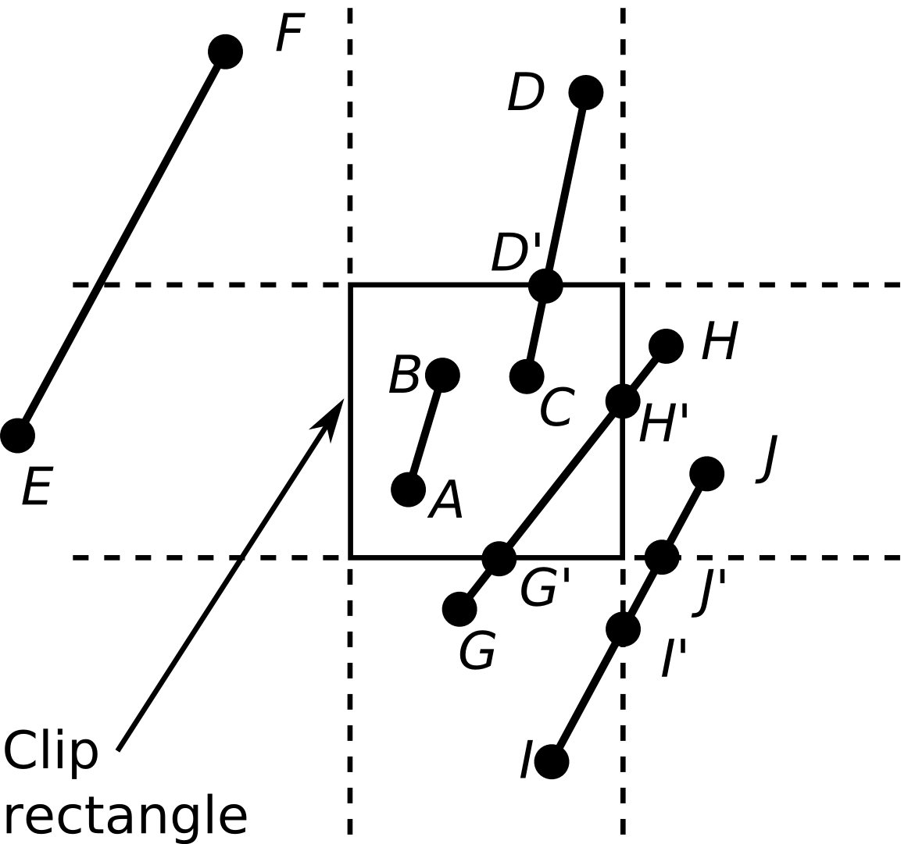
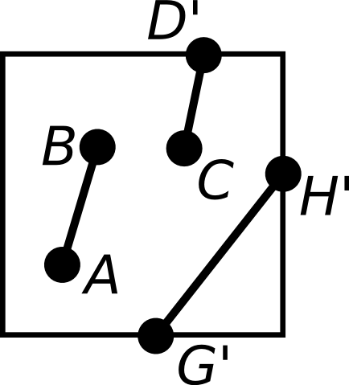
Clipping Lines
Lines intersecting a rectangular clip region are always clipped into a single line segment

Slide 5
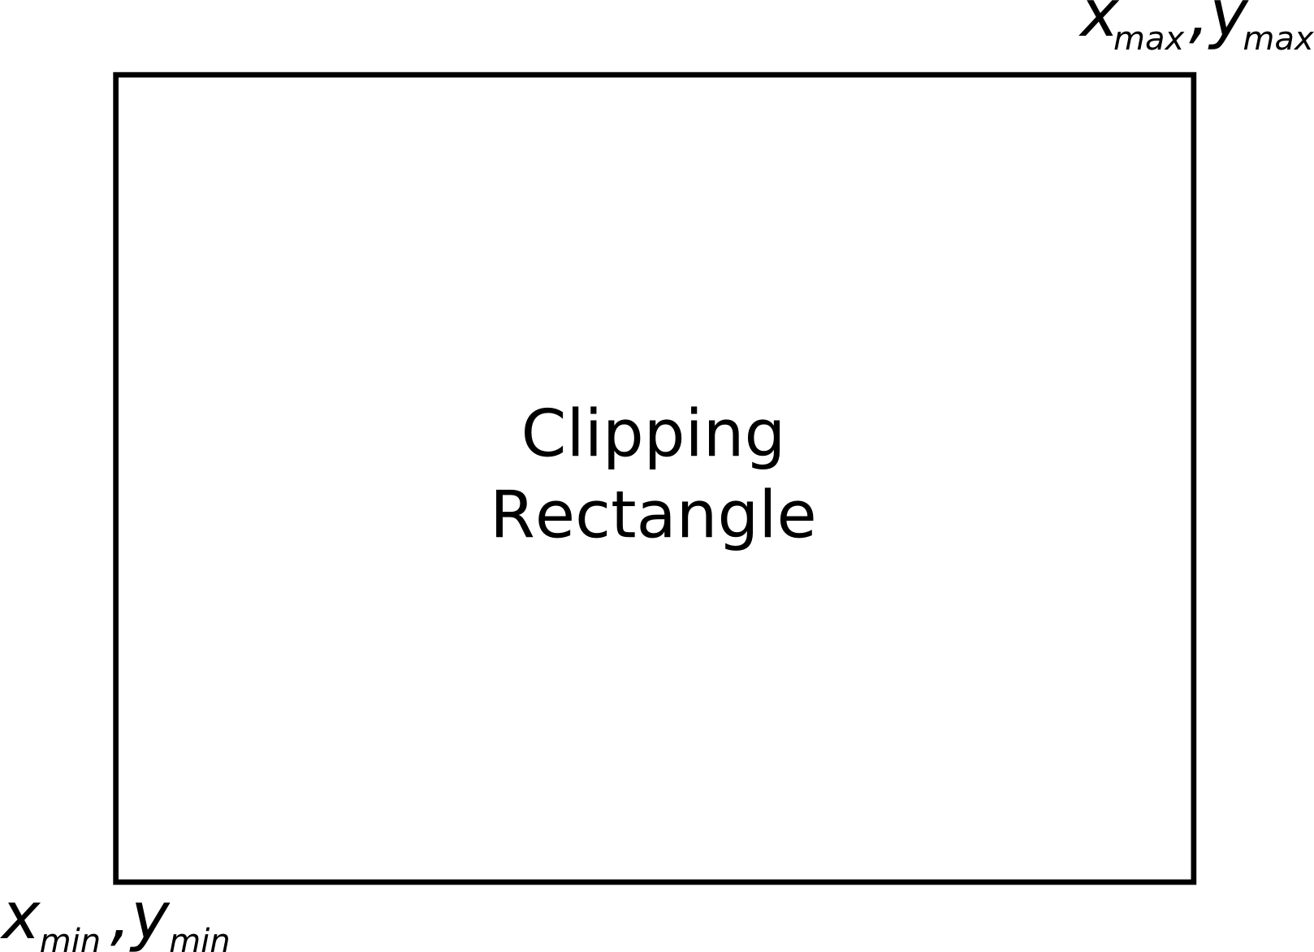
Clipping Endpoints
For a point at (x,y) to be inside the clipping rectangle
x_{min} ≤ x ≤ x_{max}, y_{min} ≤ y ≤ y_{max}

Slide 6
Clipping Conditions
Both endpoints are inside (AB)
One endpoint in, another end outside (CD)
Both outside (EF, GH, IJ)
May or may not be in, further calculations needed

Slide 7
Cohen-Sutherland Line Clipping
First, endpoint pairs are checked for trivial acceptance
If not, region checks are performed in order to trivially reject certain lines
If both x pairs are <0 or >1, then it lies outside (EF)
If both y pairs are <0 or >1, then it too lies outside

Slide 8
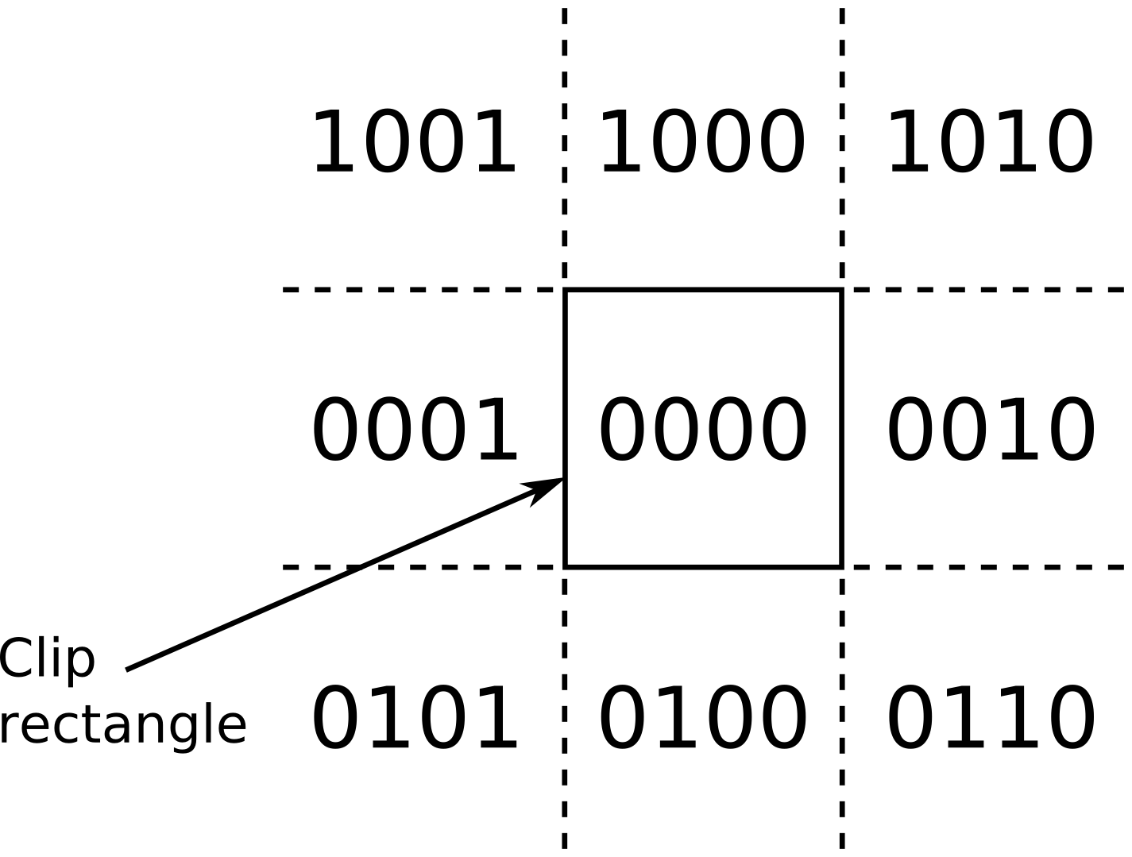
Cohen-Sutherland Line Clipping
Create bit code for each endopint
Each region is assigned a 4-bit code (outcode)
1st bit – above top edge
y > y_{max}
2nd bit – below bottom edge
y < y_{min}
3rd bit – right of right edge
x > x_{max}
4th bit – left of left edge
x < x_{min}

Slide 9
Efficient Computation of Bit-Code
Compute each bit
First bit is the sign bit of y_{max} – y
Second bit is y – y_{min}
Third bit is the sign bit of x_{max} – x
Forth bit is x – x_{min}

Slide 10
Bit-Code Trivial Rejects and Accepts
If both bit codes are zero – trivial accept
If endpoints are both outside of same edge, they will share that bit
This can easily be computed as a logical and operation – trivial reject if non-zero result
If not, then need to split line at clip edge, discard portion outside, continue testing

Slide 11
Cohen-Sutherland Line Clipping Algorithm
code1 = outcode from endpoint1
code2 = outcode from endpoint2
if (code1 == 0 && code2 == 0) then
trivial_accept
else if (code1 & code2 != 0) then
trivial_reject
else
clip against left
clip against right
clip against bottom
clip against top
if (anything is left) then
accept clipped segment

Slide 12
Homogeneous Clipping
Works for 3D planes
If point is inside clipping plane:
Point on line:
Intersection:

Slide 13
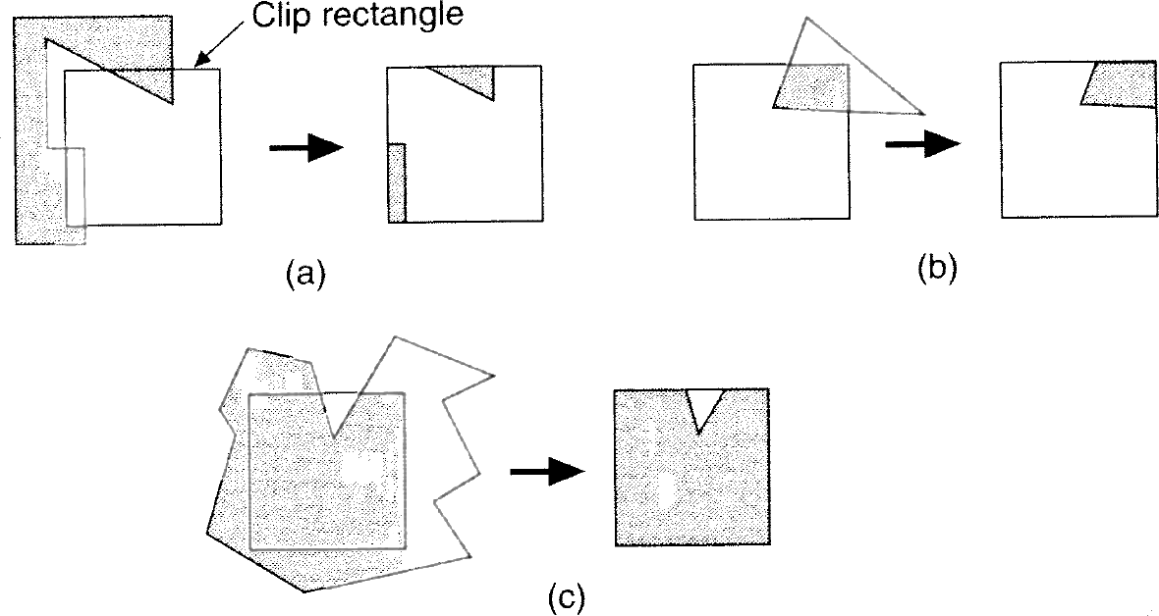
Polygon Clipping
Many cases (new edges, discarded edges)
Multiple polygons may result after clipping a single polygon

Slide 14
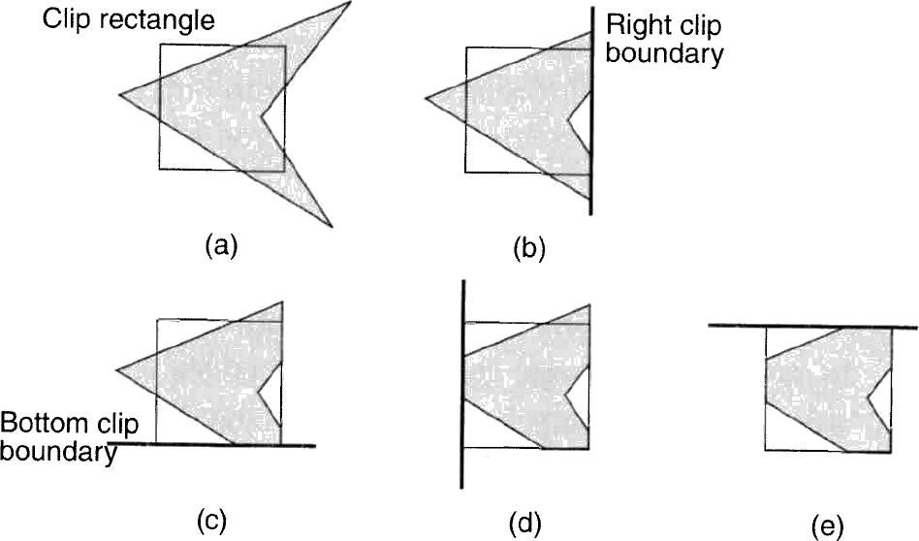
Sutherland-Hodgman Polygon Clipping
Divide and conquer
Simple problem is to clip polygon against a single infinite clip edge
Sequence of 4 clips against clipping rectangle

Slide 15
Sutherland-Hodgman Polygon Clipping
Algorithm moves around the polygon from v_{n} to v₁ and then on back to v_{n}
At each step
Check (v_{i} to v_{i+1}) line against the clip edge
Add zero, one, or two vertices to the output

Slide 16
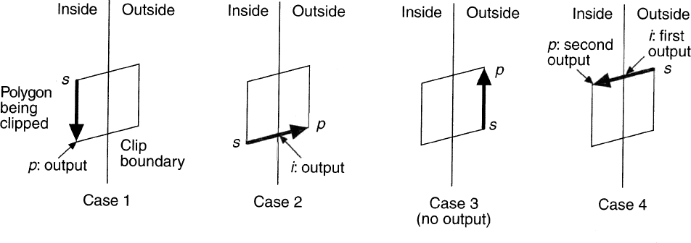
Sutherland-Hodgman Polygon Clipping
At each step, 1 of 4 possible cases arises
1) Edge is completely inside clip boundary, so add vertex p to the output list
2) Intersection i is output as vertex because it intersects with boundary
3) Both vertices are outside boundary, so neither is output
4) Intersection i and vertex p both added to output list

Slide 17
Sutherland-Hodgman Algorithm
Sutherland-Hodgman(array)‏
vertex S = array[ length(array) - 1 ]
for ( j = 0 ; j < length(array) ; j++ ) do
vertex P = array[ j ]
if ( P is inside clip plane ) then
if ( S is inside clip plane ) then /* case 1 */
Output( P )
else /* case 2 */
Output( ComputeIntersection( S, P, clip plane ) )‏
Output( P )‏
else if ( S is inside clip plane ) then /* case 2 */
Output( ComputeIntersection( P, S, clip plane ) )‏
else /* case 3 */
no op
S = P

