Slide 1
Basic Ray Tracing
CMSC 435/634

Slide 2
Visibility Problem
Rendering: converting a model to an image
Visibility: deciding which objects (or parts) will appear in the image
  Object-order
    OpenGL (later)
  Image-order
    Ray Tracing (now)

Slide 3
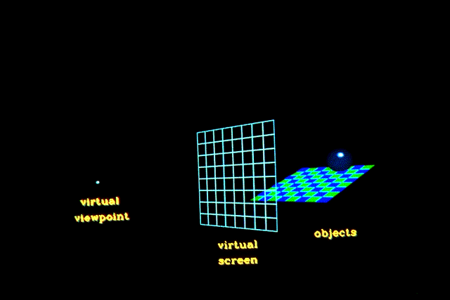
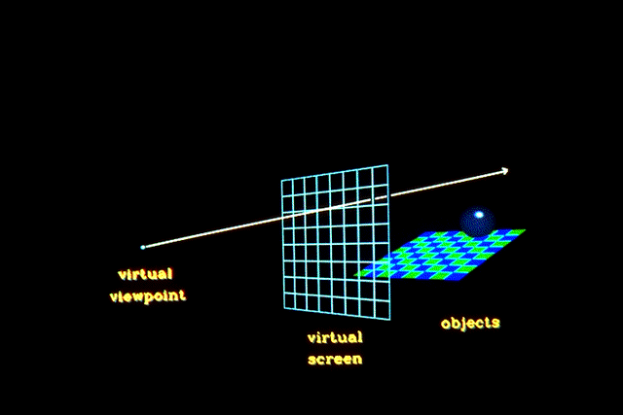
Raytracing
Given
  Scene
  Viewpoint
  Viewplane
Cast ray from viewpoint through pixels into scene

Slide 4
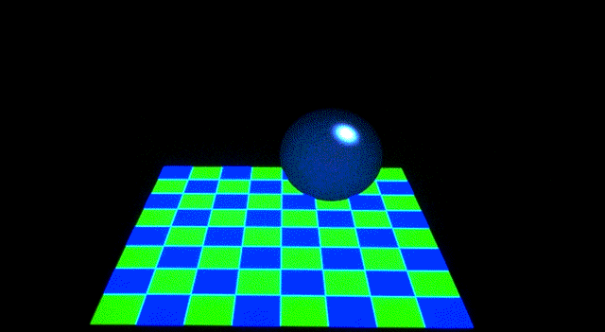
View

Slide 5
Raytracing Algorithm
Given
List of polygons { P₁, P₂, ..., P_{n} }
An array of intensity[ x, y ]
{
  For each pixel (x, y) {
    form a ray R in object space through the camera position C and the pixel (x, y)
    Intensity[ x, y ] = trace ( R )
    }
  Display array Intensity
}

Slide 6
Raytracing Algorithm
Function trace ( Ray )
{
  for each polygon P in the scene
    calculate intersection of P and the ray R
  if ( The ray R hits no polygon )
return ( background intensity )
  else {
    find the polygon P with the closest intersection
    calculate intensity I at intersection point
    return ( I ) // more to come here later
}
}

Slide 7
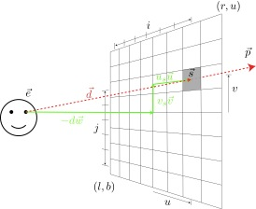
Computing Viewing Rays
Parametric ray
Camera frame
  : eye point
  : basis vectors
  right, up, backward
    Right hand rule!
Screen position

Slide 8
Calculating Intersections
Define ray parametrically:
If is center of projection and
is center of pixel, then
  : points between those locations
  : points behind viewer
  : points beyond view window

Slide 9
Ray-Sphere Intersection
Sphere in vector form
Ray
Intersection with implicit surface f(t) when
Normal at intersection p

Slide 10
Ray-Triangle Intersection
Intersection of ray with barycentric triangle
  In triangle if β > 0, γ > 0, β+ γ < 1
boolean raytri (ray r, vector p0, vector p1, vector p2, interval [t₀,t₁] ) {
  compute t
  if (( t < t₀ ) or (t > t₁))
return ( false )
  compute γ
  if ((γ < 0 ) or (γ > 1))
return ( false )
  compute β
  if ((β < 0 ) or (β > 1))
return ( false )
return true
}

Slide 11
Ray-Polygon Intersection
Given ray and plane containing polygon
What is ray/plane intersection?
Is intersection point inside polygon
  Is point inside all edges? (convex polygons only)
  Count edge crossings from point to infinity

Slide 12
Point in Polygon?
Is P in polygon?
Cast ray from P to infinity
  1 crossing = inside
  0, 2 crossings = outside

Slide 13
Point in Polygon?
Is P in concave polygon?
Cast ray from P to infinity
  Odd crossings = inside
  Even crossings = outside

Slide 14
What happens?

Slide 15
Raytracing Characteristics
Good
  Simple to implement
  Minimal memory required
  Easy to extend
Bad
  Aliasing
  Computationally intensive
    Intersections expensive (75-90% of rendering time)
    Lots of rays

Slide 16
Basic Concepts
Terms
  Illumination: calculating light intensity at a point (object space; equation) based loosely on physical laws
  Shading: algorithm for calculating intensities at pixels (image space; algorithm)
Objects
  Light sources: light-emitting
  Other objects: light-reflecting
Light sources
  Point (special case: at infinity)
  distributed

Slide 17
Lambert’s Law
Intensity of reflected light related to orientation

Slide 18
Lambert’s Law
Specifically: the radiant energy from any small surface area dA in any direction θ relative to the surface normal is proportional to cos θ

Slide 19
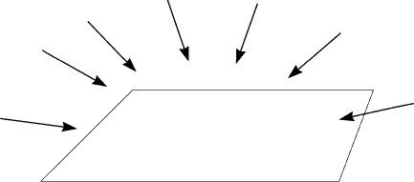
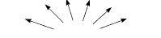
Ambient light
= intensity of ambient light
= reflection coefficient
= reflected intensity

Slide 20
Combined Model
Adding color:
For any wavelength λ:

