Slide 1
Advanced Effects
CMSC 435/634

Slide 2
General Approach
Ray Tracing
  Shoot more rays
Rasterization
  Render more images

Slide 3
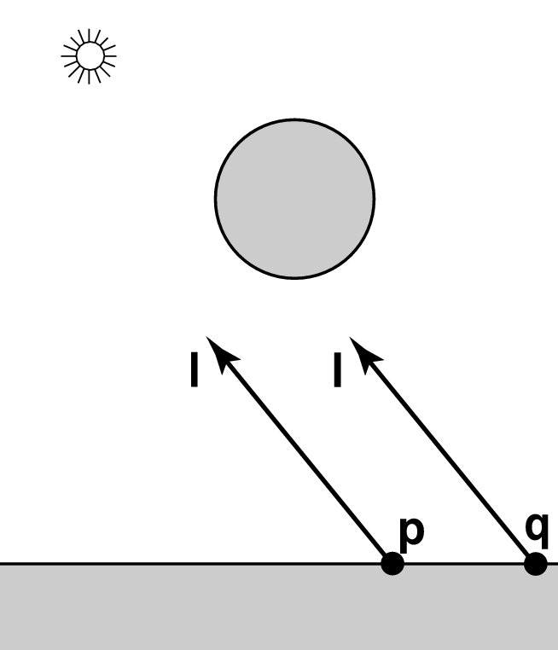
Shadows
Are p or q in shadow?
  Can they “see” the light?

Slide 4
Ray Traced Shadows
Rays from p/q to l known as shadow rays
“Bias” ray start to avoid self shadowing

Slide 5
Adding Shadows
No shadows
Shadows
Find an intersection
For each light
  Compute lighting
Find an intersection
For each light
  Cast a shadow ray
  If visible, compute lighting

Slide 6

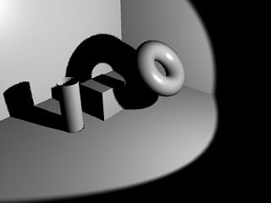
Rasterization Shadows
Render Shadow Map
  Image from the light
  Record depth of closest object
  along each ray
Use a shadow map
  Render a pixel/fragment
  Transform to light p/rojection
  Is pixel farther away
  Bias to avoid self shadowing

Slide 7
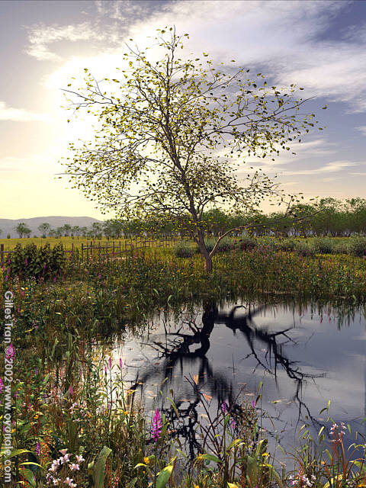
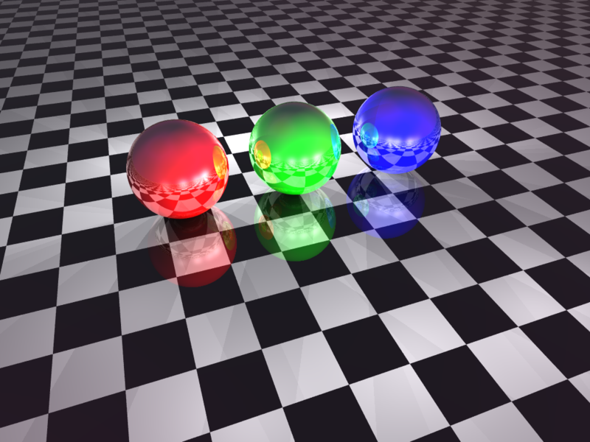
Reflection
Mirror-like reflection of light
Total color = diffuse + specular + reflection

Slide 8
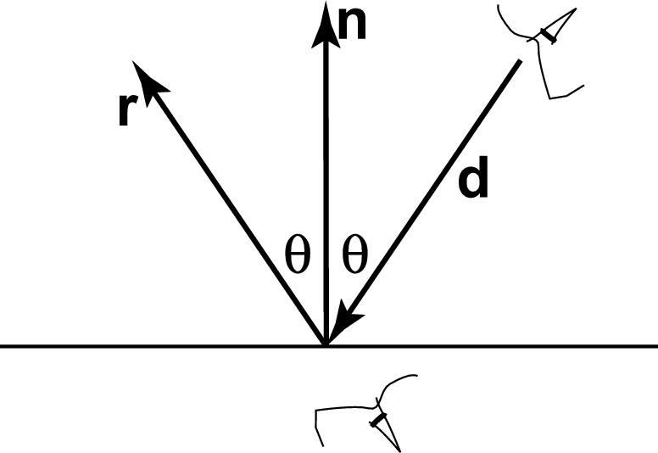
Ray Tracing Reflection
Viewer looking in direction d sees whatever the viewer “below” the surface sees looking in direction r
In the real world
  Energy loss on the bounce
  Loss different for different colors
New ray
  Start on surface, in reflection direction

Slide 9
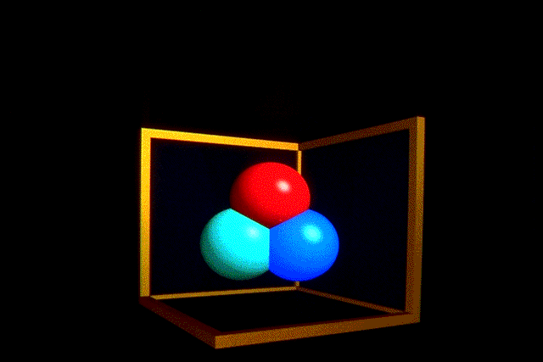
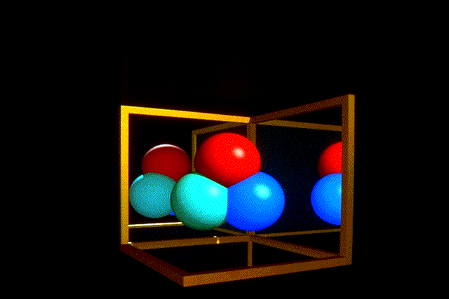
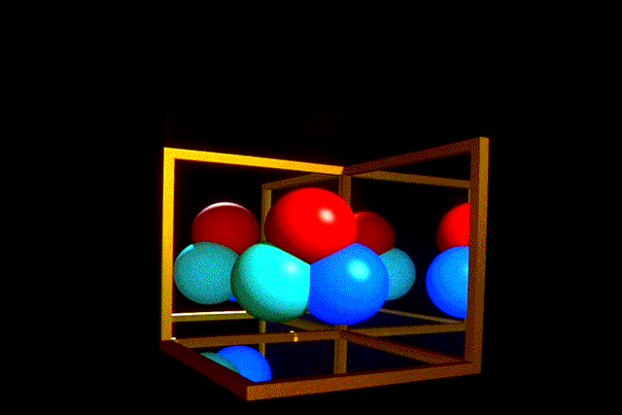
Ray Traced Reflection
Limit bounces or contribution

Slide 10
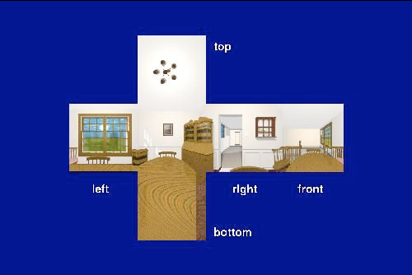
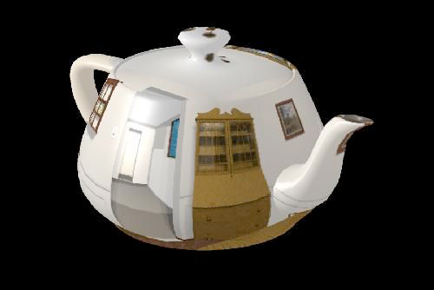
Rasterized Distant Reflection
Look up reflection direction in reflection or environment map

Slide 11
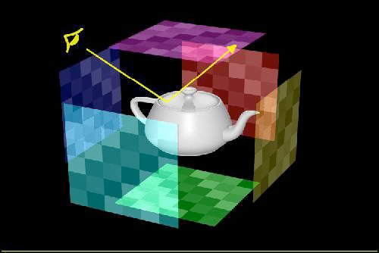
Environment Mapping
Surround scene with maps simulating surrounding detail

Slide 12
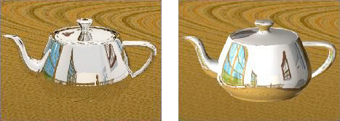
Ray Tracing vs. Environment Mapping
Ray Tracing
Environment Mapping

Slide 13
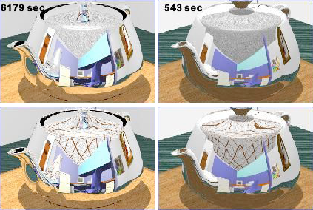
Ray Tracing vs. Environment Mapping
Ray Tracing
Environment Mapping

Slide 14
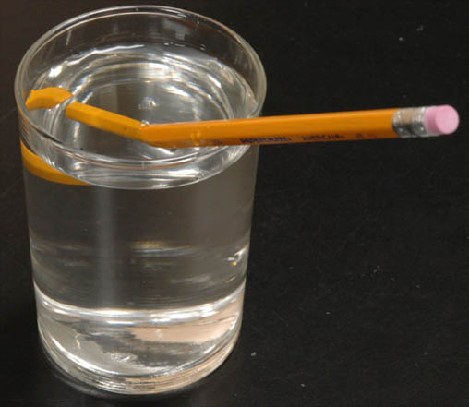
Refraction

Slide 15
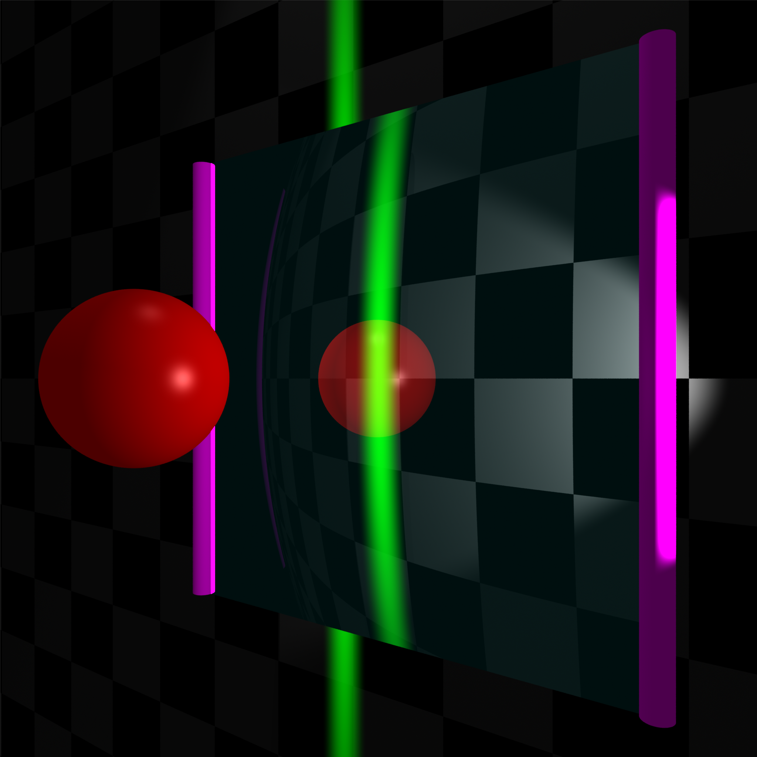
Side

Slide 16
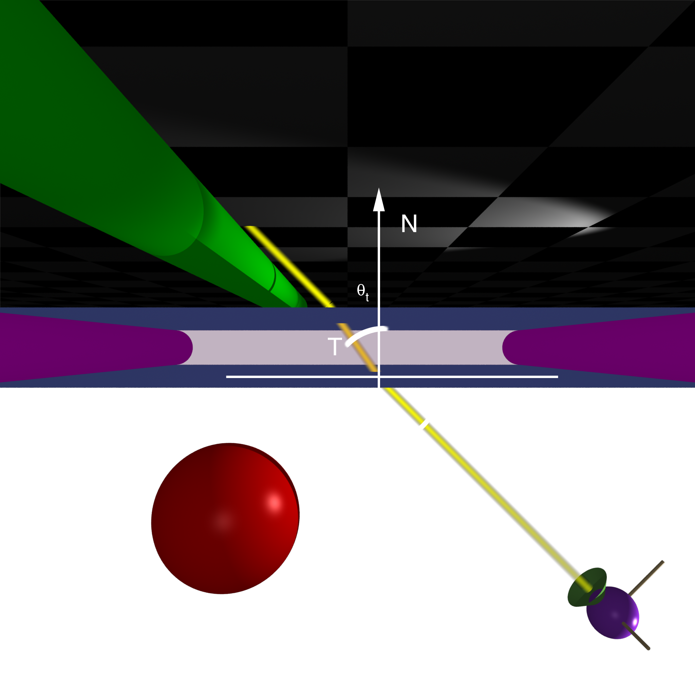
Top

Slide 17
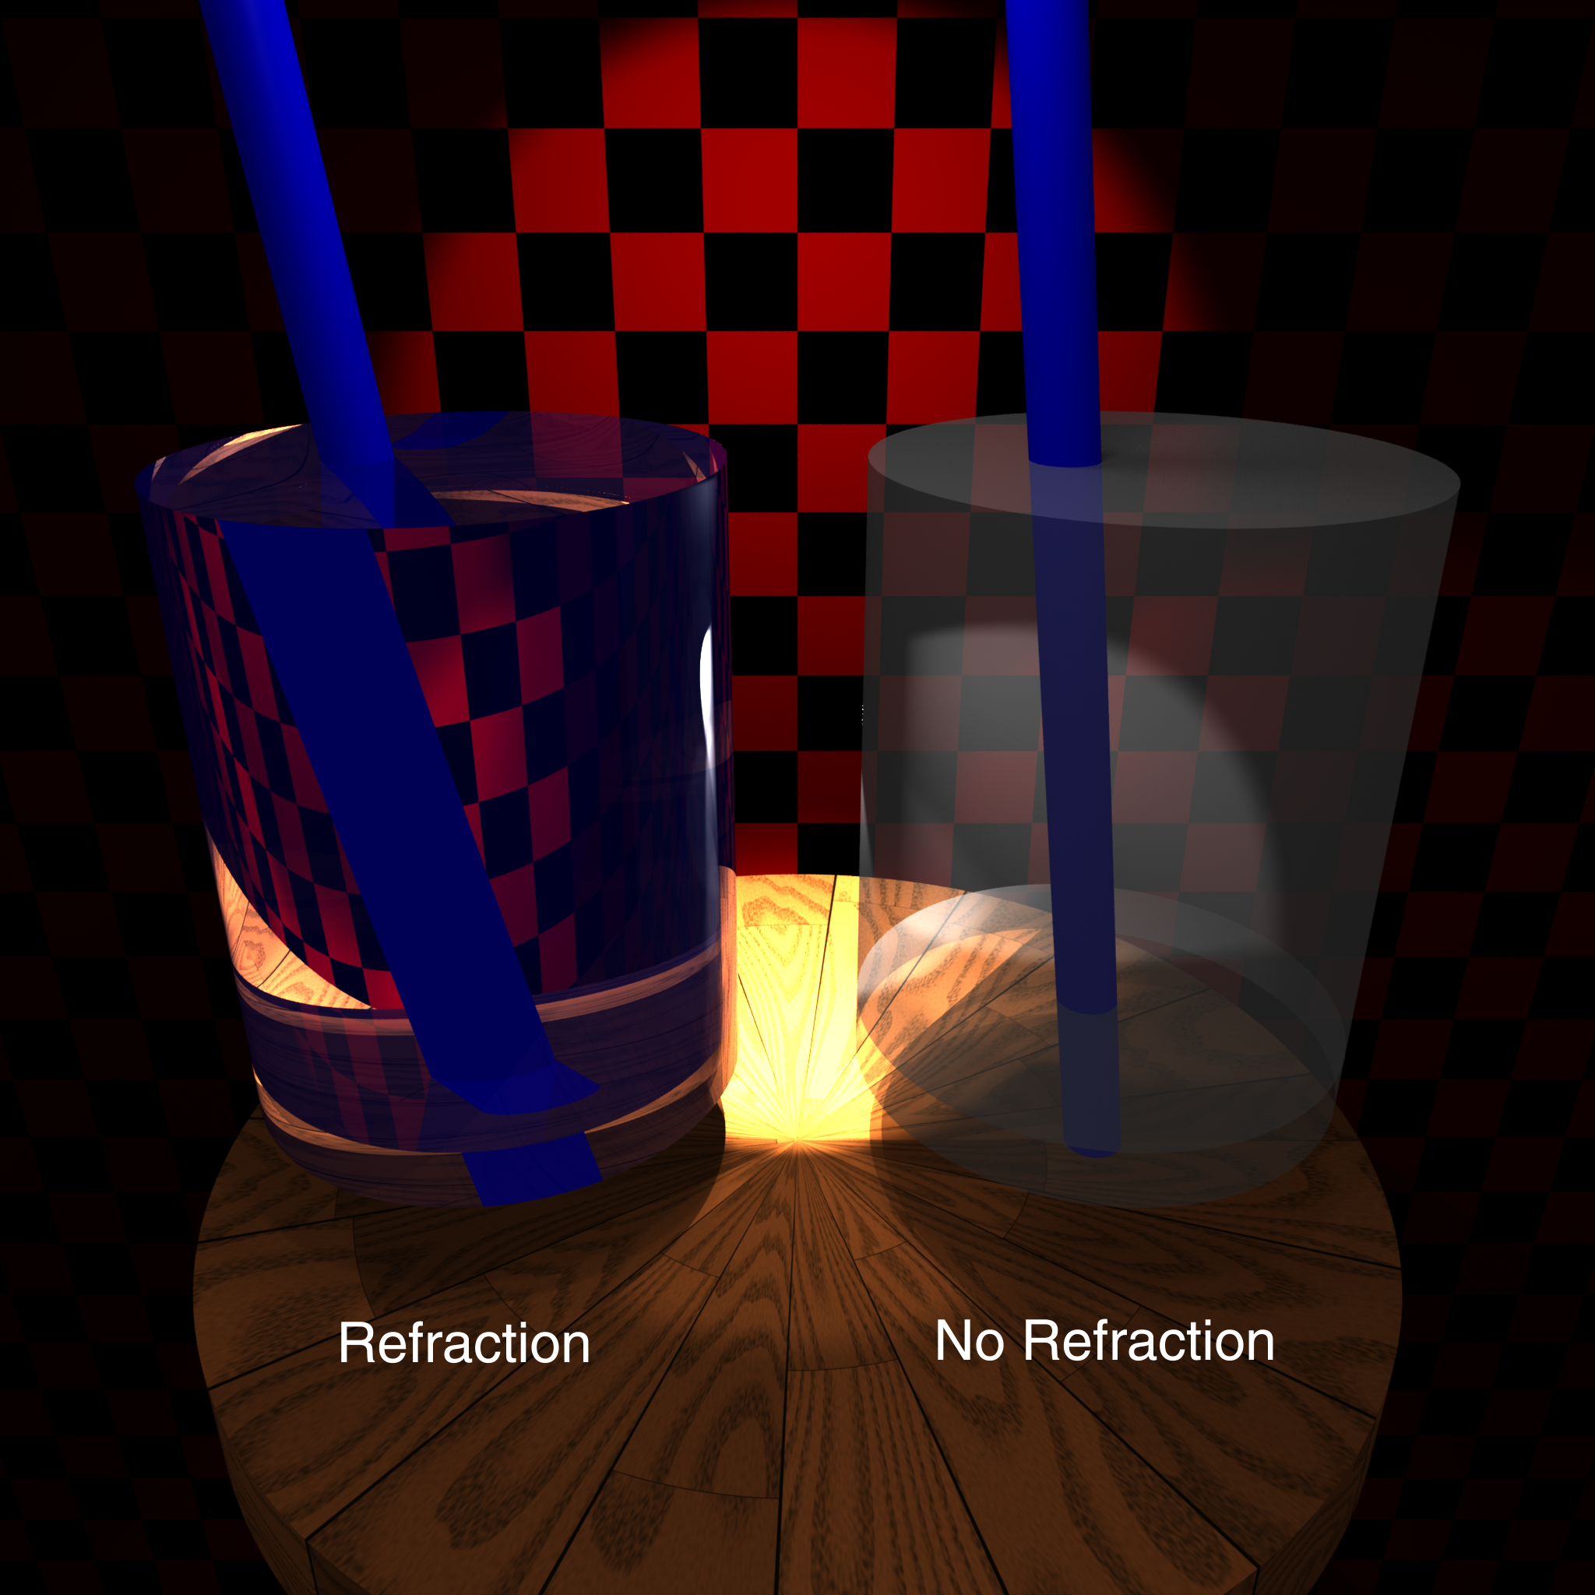

Slide 18
Calculating Refraction Vector
Snell’s Law
In terms of
term

Slide 19
Calculating Refraction Vector
Snell’s Law
In terms of
term

Slide 20
Calculating Refraction Vector
Snell’s Law
In terms of
In terms of and

Slide 21
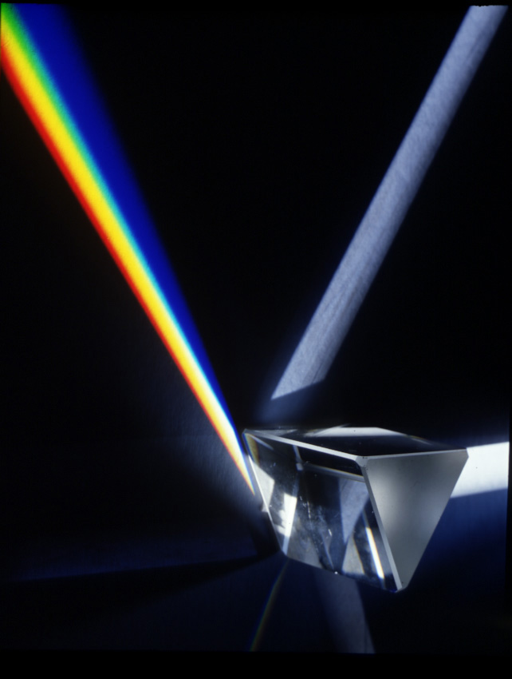
Refraction by Wavelength

Slide 22
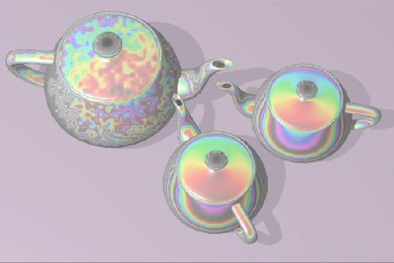
Refraction Mapping
Perturb refraction rays through transparent surface by disruption of surface normal

Slide 23
Alpha blending
How much makes it through
α = opacity
  How much of foreground color 0-1
1-α = transparency
  How much of background color
Foreground*α + Background*(1-α)

Slide 24
Refinements
One α vs. α per color (RenderMan)
Multiple layers
  Front to back
  Back to front
a₁ c₁ | (1-a₁)
a₁ c₁ + (1-a₁) a₂ c₂ | (1-a₁) (1-a₂)
a₁ c₁ + (1-a₁) a₂ c₂ + (1-a₁) (1-a₂) a₃ c₃ | (1-a₁) (1-a₂) (1-a₃)
c₃ a₃
(c₃ a₃ (1-a₂) + c₂ a₂)
(c₃ a₃ (1-a₂) + c₂ a₂) (1-a₁) + c₁ a₁

Slide 25
Refraction and α
Refraction = what direction
α = how much
  Can use Fresnel
Rasterization often just α without refraction
  Render opaque stuff (any order)
  Layer transparent stuff over opaque back-to-front

Slide 26
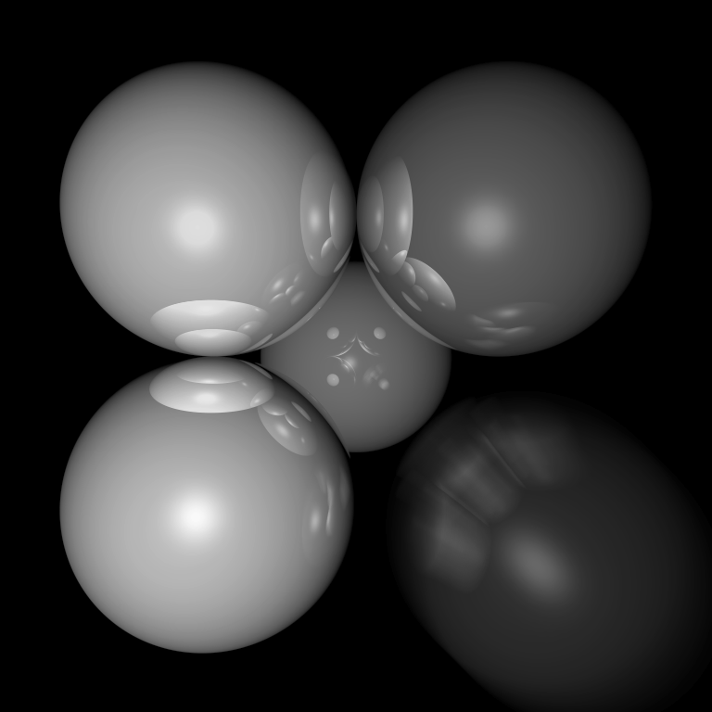
Motion Blur
Things move while the shutter is open

Slide 27
Ray Traced Motion Blur
Include information on object motion
Spread multiple rays per pixel across time

Slide 28
Rasterized Motion
Blend frames at different times
  Need a lot to avoid strobing
Analytically elongate and fade objects
Rasterize motion vectors and post-process

Slide 29
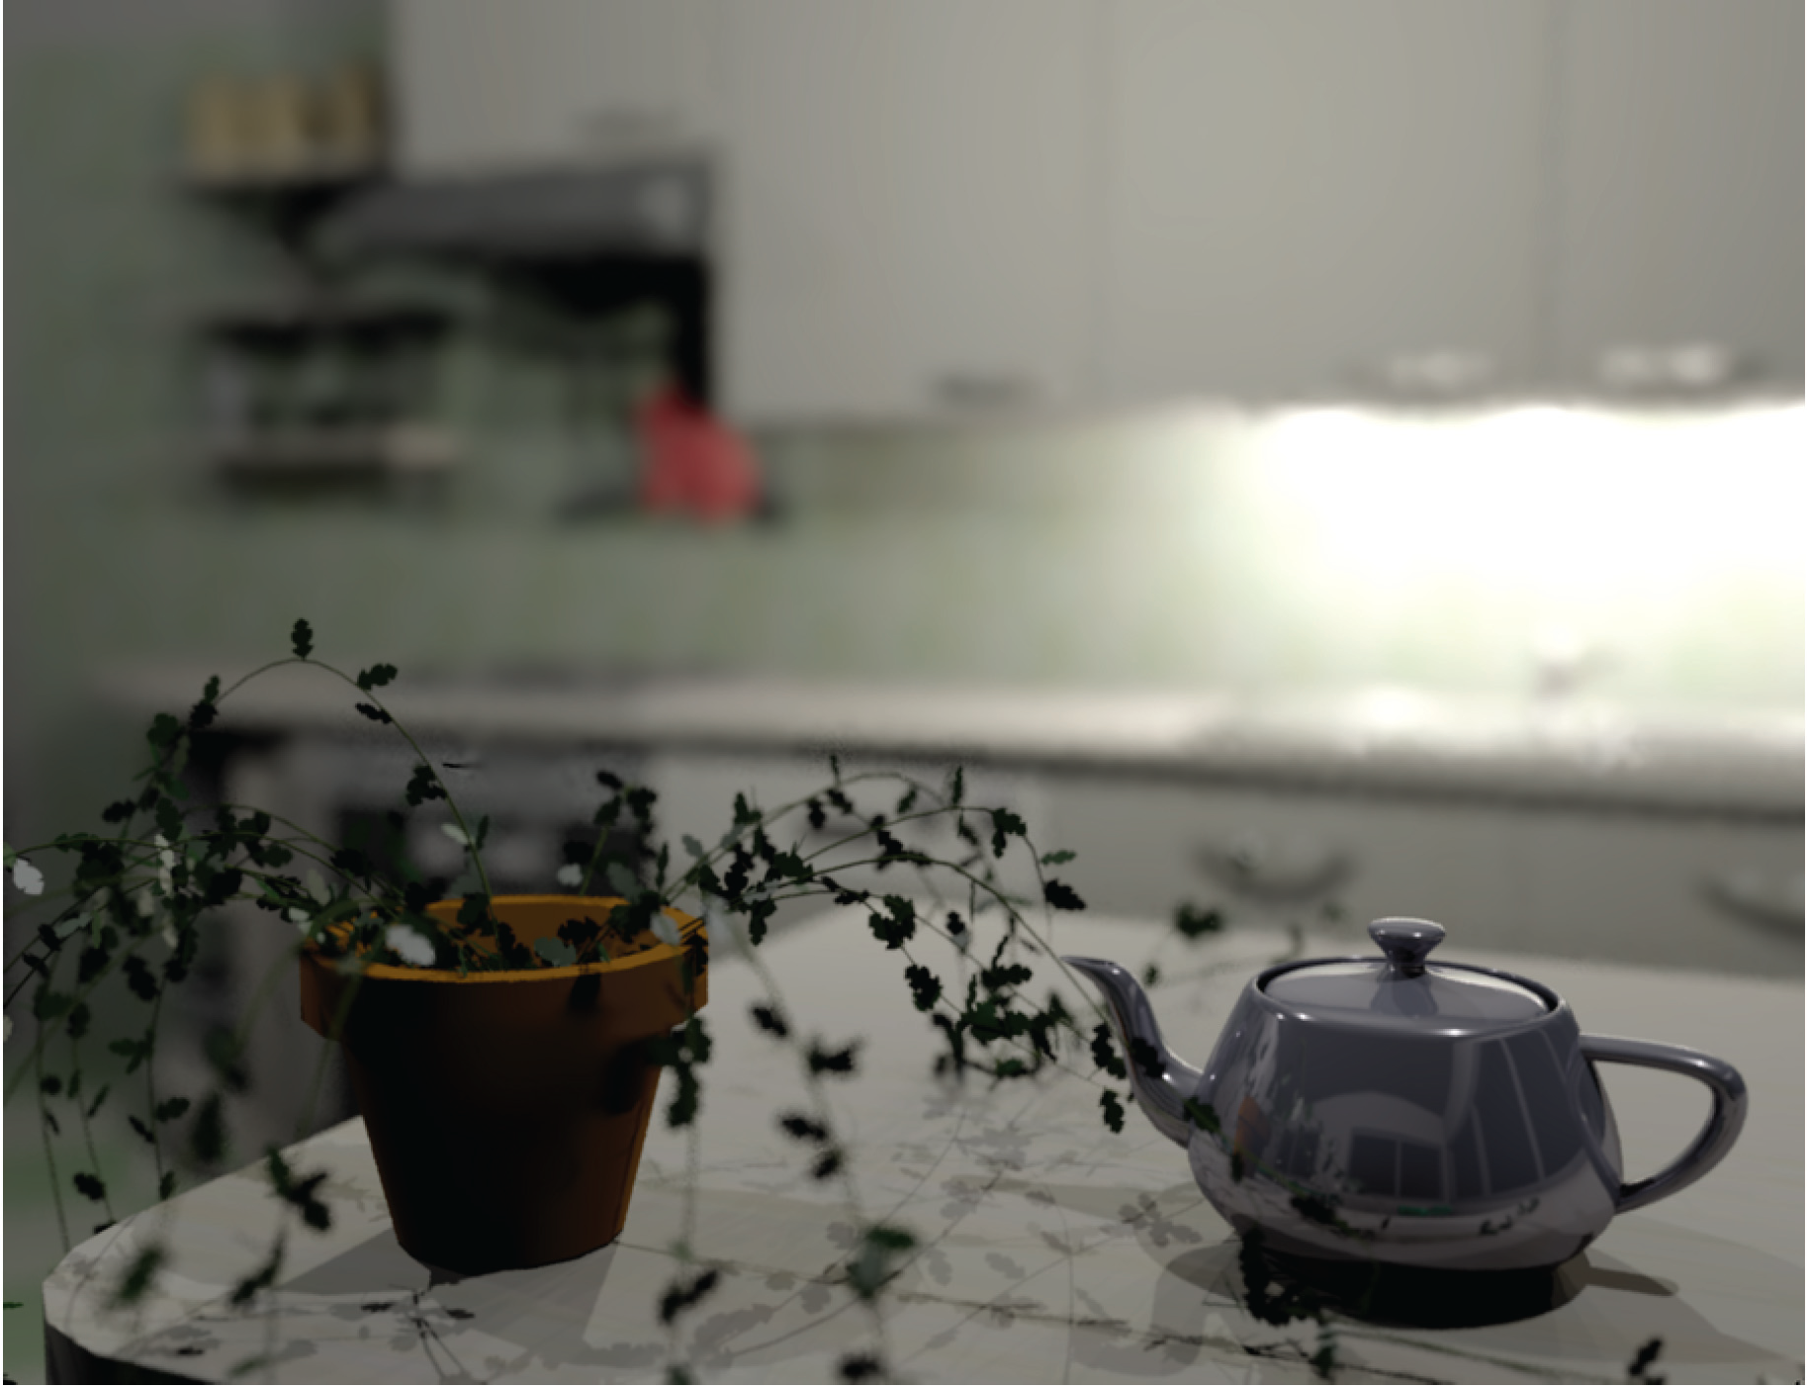
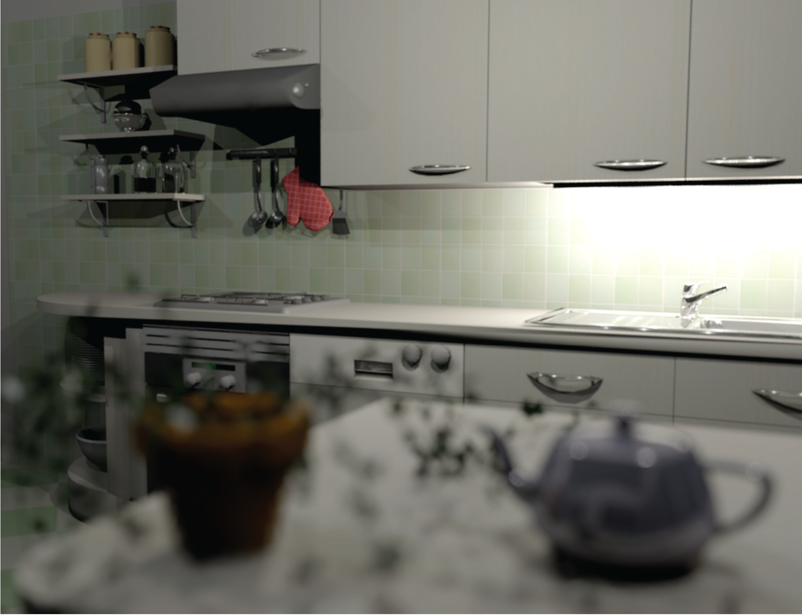
Depth of Field
Soler et al., Fourier Depth of Field, ACM TOG v28n2, April 2009

Slide 30
Pinhole Lens

Slide 31
Lens Model

Slide 32
Real Lens
Focal Plane

Slide 33
Lens Model
Focal Plane

Slide 34
Ray Traced DOF
Move image plane out to focal plane
Jitter start position within lens aperture
  Smaller aperture = closer to pinhole
  Larger aperture = more DOF blur

Slide 35
Rasterized DOF
Blend images from jittered viewponts
  Need lots to avoid artifacts
Render, blur, merge
  Use depth to decide how much blur
  Doesn’t get occlusion quite right

