Slide 1
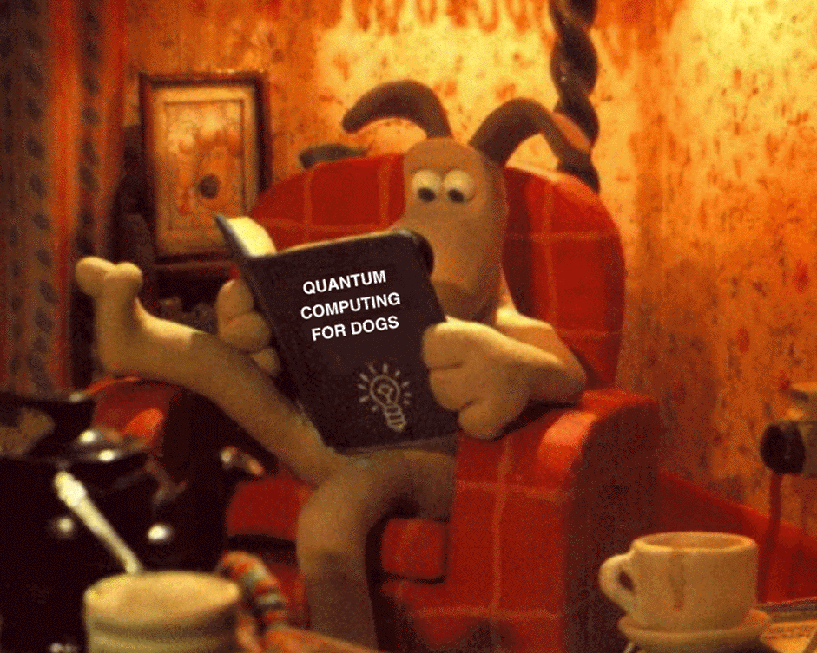
???

Slide 2
Quantum Computing:
Lecture 3
Samuel J. Lomonaco, Jr.
Dept. of Computer Science & Electrical Engineering
University of Maryland Baltimore County
Baltimore, MD 21250
Email: Lomonaco@UMBC.EDU WebPage: http://www.csee.umbc.edu/~lomonaco
Transcribed into PowerPoint by Mark Laczin

Slide 3
Lecture 3: Part 1
Visualizing Qubits:
The Bloch Sphere

Slide 4
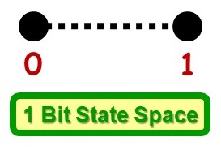
Visualizing Qubits
It’s easy to visualize the state space $\left\{0, 1\right\}$of a Shannon bit, i.e.,
But how do we visualize the state of a qubit?
So far, we’ve thought of a single qubit as a vector in a $2$-D complex Hilbert space. But this is actually not fully correct!

Slide 5
Visualizing Qubits
Let $\left|ψ\right\rangle ∈𝓗$.
Actually, for all $λ∈ℂ−\left\{0\right\},\left|ψ\right\rangle and λ\left|ψ\right\rangle$ represent the same physical state, because a global phase $λ$ is not physically detectable. Hence, $λ\left|ψ\right\rangle$and $\left|ψ\right\rangle$represent the same state, i.e., $λ\left|ψ\right\rangle ≅\left|ψ\right\rangle .$
More precisely, the complex line through the origin of $𝓗$is actually the state, i.e.,
$$\left\{λ\left|ψ\right\rangle │λ∈ℂ \right\}$$
is the state.

Slide 6
Visualizing Qubits
The space of all complex lines through the origin is called the complex projective space and is denoted $ℂP^{1}.$
We now show how to visualize the qubit state space $ℂP^{1}$as the surface of a ball, i.e., a $2$-sphere.

Slide 7
Visualizing Qubits
Consider an arbitrarily chosen state of a qubit:
$$\left|ψ\right\rangle =a\left|0\right\rangle +b\left|1\right\rangle =\left(\begin{aligned}a \\ b\end{aligned}\right)$$
For the time being, assume that the amplitude $a≠0.$ Then the state is equivalent to
$$\frac{1}{a}\left|ψ\right\rangle =\left|0\right\rangle +\frac{b}{a}\left|1\right\rangle ,$$
where $\frac{b}{a}=s+it$is a complex number.

Slide 8
Visualizing Qubits
In this way, the states of a quantum system correspond to the complex numbers $ℂ$:
$$\left\{λ\left|ψ\right\rangle \right\}⟷\frac{b}{a}∈ℂ.$$
If $a=0$, we say that the state corresponds to a point at infinity $∞$ .
So, the state space of a qubit can be identified with the complex numbers $ℂ$plus infinity $∞$, i.e., $ℂ∪∞.$

Slide 9
Visualizing Qubits: The Complex Plane
$\left|0\right\rangle ⟷0/1=0$
$$\left|1\right\rangle ⟷1/0=∞$$
$$\left|+\right\rangle =\frac{\left(\left|0\right\rangle +\left|1\right\rangle \right)}{\sqrt{2}}⟷+1$$
$$\left|−\right\rangle =\frac{\left(\left|0\right\rangle −\left|1\right\rangle \right)}{\sqrt{2}}⟷−1$$
$$\left|i\right\rangle =\frac{\left(\left|0\right\rangle +i\left|1\right\rangle \right)}{\sqrt{2}}⟷i$$
$$\left|−i\right\rangle =\frac{\left(\left|0\right\rangle −i\left|1\right\rangle \right)}{\sqrt{2}}⟷−i$$
$$\left|ψ\right\rangle =a\left|0\right\rangle +b\left|1\right\rangle ⟶b/a=s+it$$

Slide 10
Visualizing Qubits: The Complex Plane
$$∞$$
$$\frac{b}{a}=s+it$$
$$|1>$$
$$+i$$
$$|+i>$$
$$|−>$$
$$|+>$$
$$−1$$
$$0$$
$$|0>$$
$$\left|ψ\right\rangle$$
$$1$$
$$−i$$
$$|−i>$$

Slide 11
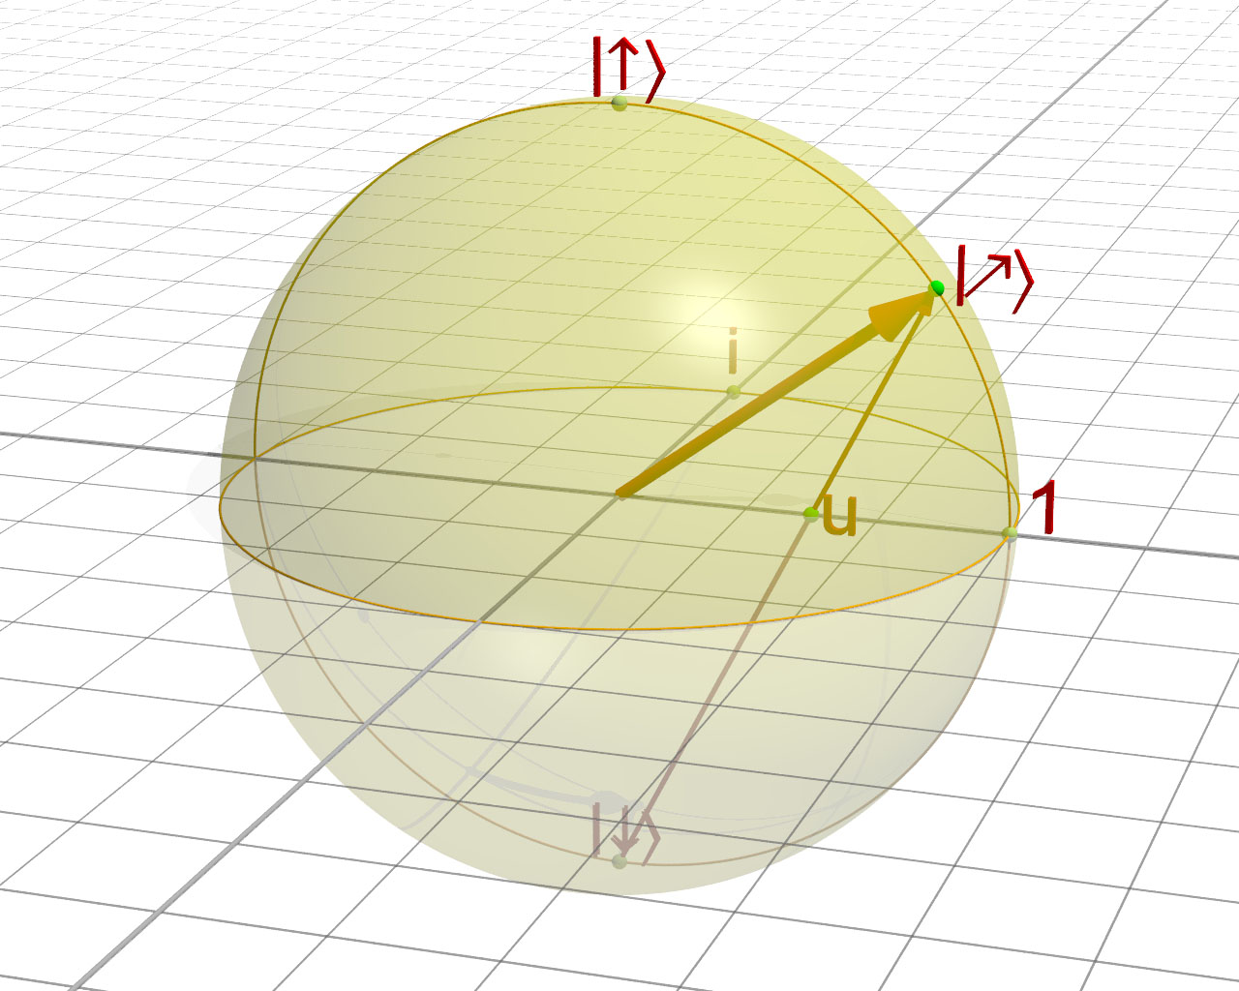
Visualizing Qubits: The Bloch Sphere
$$|1>$$
$$∞$$
We now use the reverse stereographic projection to identify $ℂ∪∞$with the surface of a ball, i.e., the $2$-sphere.
$$|i>$$
$$|ψ>$$
$$a/b$$
$$i$$
$$|−>$$
$$−1$$
$$0$$
$$−i$$
$$|+>$$
$$|−i>$$
$$|0>$$

Slide 12
Visualizing Qubits: The Bloch Sphere
Thus, the state space of a qubit is a sphere, called the Bloch sphere.

Slide 13
Lecture 3: Part 2
Multipartite Systems:
Beyond a Single Qubit

Slide 14
Definitions
A multipartite quantum system $𝓠$consists of $n$qubits
$$𝓠_{0},𝓠_{1},…,𝓠_{n−1},$$
with respective Hilbert spaces
$$𝓗_{0},𝓗_{1},…, 𝓗_{n−1},$$
and has as its state space the Hilbert space
$𝓗=⊗_{j=0}^{n−1}𝓗_{j}$.

Slide 15
Definitions
If $\left\{\left|0\right\rangle ,\left|1\right\rangle \right\}$is designated as the standard orthonormal basis of $𝓗_{j}$, then these bases induce a standard orthonormal basis
$$\left|0\right\rangle ,\left|1\right\rangle ,…, \left|2^{n−1}\right\rangle$$
of the $n$qubit state space $𝓗, where$ the above integer labels denote the corresponding n bit binary strings.

Slide 16
The State of $\left|ψ\right\rangle$
Thus, the state $\left|ψ\right\rangle$of $n$qubits is of the form
$$\left|ψ\right\rangle =\sum_{j=0}^{2^{n}−1}{z_{j}\left|j\right\rangle }=z_{0}\left|0\right\rangle +z_{1}\left|1\right\rangle +⋯+z_{2^{n}−1}\left|2^{n}−1\right\rangle$$

Slide 17
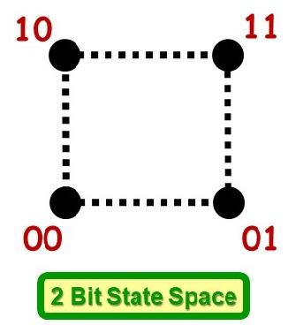
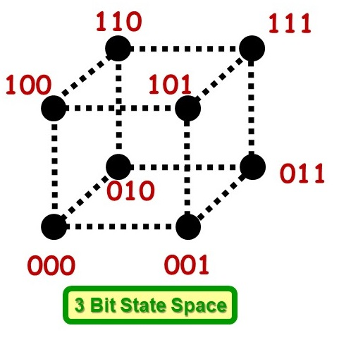
Shannon Bits
Note that it is easy to visualize the state space of $n$Shannon bits.
This is because the state space of Shannon bits,
${\left\{0,1\right\}}^{n}=\left\{0,1\right\}×\left\{0,1\right\}×⋯×\left\{0,1\right\}$,
is simply the set of all binary $n$bit strings.

Slide 18
Bits versus Qubits
For classical bits, please note that the number of states of an $n$bit multipartite system is $O\left(2^{n}\right),$ but each state can be easily designated by an $O\left(n\right)$-bit string.
For qubits, the state space $𝓗$of a multipartite quantum system is much more complex, and more difficult to visualize.

Slide 19
Question: How to visualize an $n$-qubit state?
Let $\left|ψ\right\rangle =\sum_{j=0}^{2^{n}−1}{z_{j}\left|j\right\rangle }$be a state of $n$qubits.
Case 1: if $z_{0}≠0,$then this is the same physical state as
$$\left|ψ\right\rangle =\left|0\right\rangle +\sum_{j=1}^{2^{n}−1}{\frac{z_{j} }{z_{0}}\left|j\right\rangle ⟷\left(\frac{z_{1}}{z_{0}},\frac{z_{2}}{z_{0}},…,\frac{z_{2^{n}−1}}{z_{0}}\right)}∈ℂ^{2^{n}−1}$$
Case 2: iI $z_{0}=0$and $z_{1}≠0,$ then
$$\left|ψ\right\rangle =\left|1\right\rangle +\sum_{j=2}^{2^{n}−1}{\frac{z_{j} }{z_{1}}\left|j\right\rangle ⟷\left(\frac{z_{2}}{z_{1}},\frac{z_{3}}{z_{1}},…,\frac{z_{2^{n}−1}}{z_{1}}\right)}∈ℂ^{2^{n}−2}$$
Case 3: etc…

Slide 20
Question continued…
It follows that the state space of $n$qubits can be identified with
$ℂ^{2^{n}−1}⊔ℂ^{2^{n}−2}⊔⋯⊔ℂ$,
which is a $\left(2^{n}−1\right)$-dimensional complex space, which in turn is a $2\left(2^{n}−1\right)$-dimensional Real space. This space is the complex projective space $ℂP^{2^{n}−1}$.

Slide 21
Lecture 3: Part 3
Measurement:
Classical and Quantum

Slide 22
Measurement: W.r.t the $\left\{\left|0\right\rangle ,\left|1\right\rangle \right\}$basis
Recall that if a qubit in the state $\left|ψ\right\rangle =α\left|0\right\rangle +β\left|1\right\rangle$is measured with respect to the standard basis $\left\{\left|0\right\rangle ,\left|1\right\rangle \right\},$ then
$\left|ψ\right\rangle →$ $→\left\{\begin{aligned}\left|0\right\rangle , 𝓹_{0}={\left|α\right|}^{2} \\ &\left|1\right\rangle , 𝓹_{1}={\left|β\right|}^{2}\end{aligned}\right.$
where we have assumed that $\left|ψ\right\rangle$is of unit length, i.e.,
$\left\langle ψ | ψ\right\rangle ={\left|α\right|}^{2}+{\left|β\right|}^{2}=1$.
Measurement
w.r.t. $\left\{\left|0\right\rangle ,\left|1\right\rangle \right\}$

Slide 23
Measurement: W.r.t. other bases, e.g., $\left\{\left|+\right\rangle ,\left|−\right\rangle \right\}$
Now we also note that measurement may be made with respect to any orthonormal basis.
For example, let us consider the orthnormal basis
$$\left|+\right\rangle =\frac{\left|0\right\rangle +\left|1\right\rangle }{\sqrt{2}} \left|−\right\rangle =\frac{\left|0\right\rangle −\left|1\right\rangle }{\sqrt{2}}$$
If we re-express $\left|ψ\right\rangle$in this basis, we have
$$\left|ψ\right\rangle =\frac{\left(α+β\right)}{2}\left|+\right\rangle +\frac{\left(α−β\right)}{2}\left|−\right\rangle$$
Then,
$\left|ψ\right\rangle →$ $→\left\{\begin{aligned}\left|+\right\rangle , 𝓹_{+}={\left|\frac{\left(α+β\right)}{2}\right|}^{2} \\ &\left|−\right\rangle , 𝓹_{−}={\left|\frac{\left(α−β\right)}{2}\right|}^{2}\end{aligned}\right.$
Measurement
w.r.t. $\left\{\left|+\right\rangle ,\left|−\right\rangle \right\}$

Slide 24
Measurement: W.r.t. the $\left\{\left|i\right\rangle ,\left|−i\right\rangle \right\}$ basis
In like manner, consider the orthnormal basis
$$\left|i\right\rangle =\frac{\left|0\right\rangle +i\left|1\right\rangle }{\sqrt{2}} \left|−i\right\rangle =\frac{\left|0\right\rangle −i\left|1\right\rangle }{\sqrt{2}}$$
If we re-express $\left|ψ\right\rangle$in this basis, we have
$$\left|ψ\right\rangle =\frac{\left(α−iβ\right)}{2}\left|i\right\rangle +\frac{\left(α+iβ\right)}{2}\left|−i\right\rangle$$
Then,
$\left|ψ\right\rangle →$ $→\left\{\begin{aligned}\left|i\right\rangle , 𝓹_{i}={\left|\frac{\left(α−iβ\right)}{2}\right|}^{2} \\ &\left|−i\right\rangle , 𝓹_{−i}={\left|\frac{\left(α+iβ\right)}{2}\right|}^{2}\end{aligned}\right.$
Measurement
w.r.t. $\left\{\left|i\right\rangle ,\left|−i\right\rangle \right\}$

Slide 25
Classical versus Quantum Measurement: As coin flips
The previous three examples of measurements w.r.t. a basis demonstrate very emphatically how a qubit differs from a Shannon bit.
We can see this with an example. Consider a classical coin, which when flipped (thus observed) produces a heads H or a tails T with probability
$$\left\{\begin{aligned}H, 𝓹_{H} \\ T, 𝓹_{T}\end{aligned}\right.$$
where $𝓹_{h}+𝓹_{T}=1.$

Slide 26
Measurement: Qubits
Let us now compare the classical coin flip with the measurement of a qubit in the state $\left|ψ\right\rangle =α\left|0\right\rangle +β\left|1\right\rangle ,$ where ${\left|α\right|}^{2}+{\left|β\right|}^{2}=1.$
Then, unlike a classical coin, the qubit behaves as $3$different coins, depending on which of the three bases
$$\left\{\left|0\right\rangle ,\left|1\right\rangle \right\}, \left\{\left|+\right\rangle ,\left|−\right\rangle \right\}, \left\{\left|i\right\rangle ,\left|−i\right\rangle \right\}$$
is chosen, as shown in the following figure:

Slide 27
Measurement of a qubits
$$\left\{\begin{aligned}\left|i\right\rangle , 𝓹_{i}={\left|\left(α−iβ\right)/2\right|}^{2} \\ &\left|−i\right\rangle , 𝓹_{−i}={\left|\left(α+iβ\right)/2\right|}^{2}\end{aligned}\right.$$
Qubitt
$$\left\{\begin{aligned}\left|+\right\rangle , 𝓹_{+}={\left|\left(α+β\right)/2\right|}^{2} \\ &\left|−\right\rangle , 𝓹_{−}={\left|\left(α−β\right)/2\right|}^{2}\end{aligned}\right.$$
Measure
$$\left|i\right\rangle ,\left|−i\right\rangle$$
Measure
$$\left|+\right\rangle ,\left|−\right\rangle$$
$$\left|ψ\right\rangle$$
Measure
$$\left|0\right\rangle ,\left|1\right\rangle$$
$$\left\{\begin{aligned}\left|0\right\rangle , 𝓹_{0}={\left|α\right|}^{2} \\ &\left|1\right\rangle , 𝓹_{1}={\left|β\right|}^{2}\end{aligned}\right.$$

Slide 28
Measurement: more qubits
In other words, a qubit behaves like many different coins, depending on how it is observed.
If, in the same vein, we were to continue to pursue this for $2$qubits, we would encounter some amazing non-classical behavior, e.g., the Bell inequalities.

Slide 29
There is much more to Q Measurement
Step 1. Measurement of a qubit with respect to orthonormal basis
Step 2. Measurement of n qubits with respect to orthonormal basis
Step 3. Measurement of with respect to eigen basis of a Hermitian operator (a.k.a., an observable

Slide 30
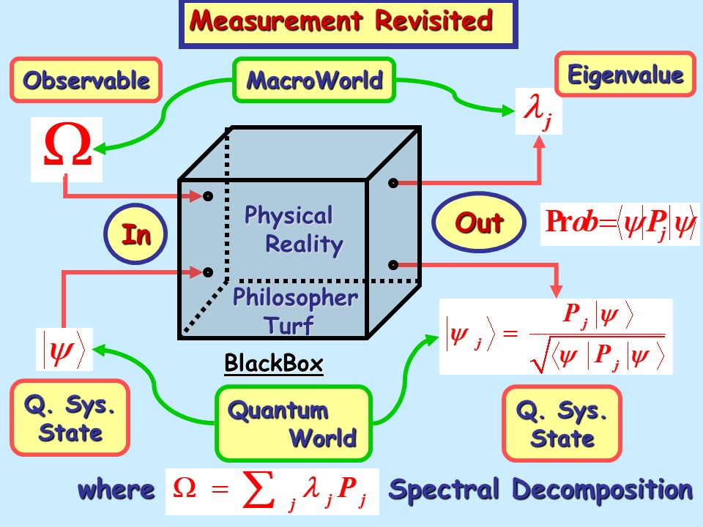

Slide 31
Lecture 3: Part 4
Wiring Diagrams:
Drawing Quantum Circuits

Slide 32
Wiring Diagrams: Recall
As previously mentioned, there are two types of quantum computer instruction:
Unitary transformations $U,$ where $U^{†}=U^{−1}.$
Measurements, which are given by Hermitian matrices $Ω,$where $Ω^{†}=Ω.$
However, we now encounter a problem…

Slide 33
A Problem
As the number $n$of qubits grows, the size of the matrices $U$and $Ω$grow as $2^{n}×2^{n},$i.e., exponentially!
Question: How do we program a quantum computer when the size of the instructions grows as $O\left(2^{n}\right)$?
The answer is to represent quantum computer programs as wiring diagrams which grow linearly $O\left(n\right)$with $n.$
In a sense, the language of wiring diagrams is analogous to today’s classical computer languages, e.g., C/C++, Python, etc.

Slide 34
What is a wiring diagram?
A wiring diagram consists of lines and gates.
A solid line corresponds to a qubit, and a double line corresponds to a classical Shannon bit.
A solid line labeled with a slash denotes $n$ qubits.
Gates correspond to quantum computer instructions, i.e., to unitary transformations and measurements.
$$n$$

Slide 35
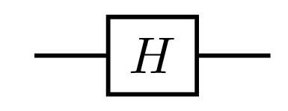
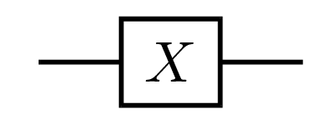
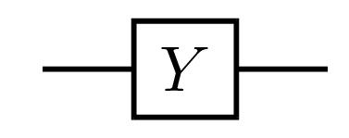
Some single qubit gates
Hadamard: $=\left(\frac{1}{\sqrt{2}}\right)\left(\begin{matrix}1 & 1 \\ 1 & −1\end{matrix}\right)$
Pauli-X: $=\left(\begin{matrix}0 & 1 \\ 1 & 0\end{matrix}\right)$
Pauli-Y: $=\left(\begin{matrix}0 & −i \\ i & 0\end{matrix}\right)$

Slide 36
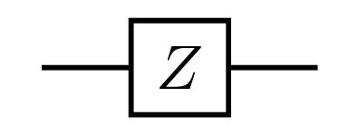
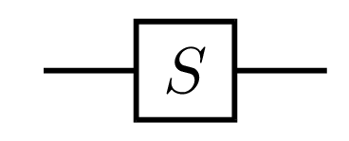
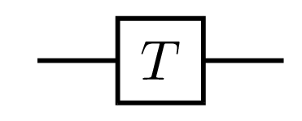
Some single qubit gates
Pauli-Z: $=\left(\begin{matrix}1 & 0 \\ 0 & −1\end{matrix}\right)$
Phase: $=\left(\begin{matrix}1 & 0 \\ 0 & i\end{matrix}\right)$
$\frac{π}{8}:$ $=\left(\begin{matrix}1 & 0 \\ 0 & e^{iπ/4}\end{matrix}\right)$

Slide 37
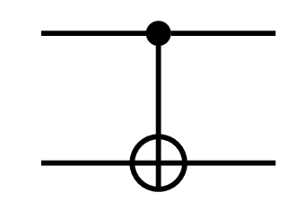
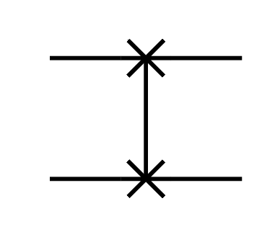
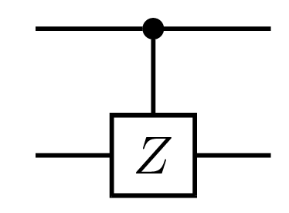
Some multi-qubit gates pt. 1
Controlled-NOT: $= \left(\begin{matrix}1 & 0 & 0 & 0 \\ 0 & 1 & 0 & 0 \\ 0 & 0 & 0 & 1 \\ 0 & 0 & 1 & 0\end{matrix}\right)$
SWAP: $= \left(\begin{matrix}1 & 0 & 0 & 0 \\ 0 & 0 & 1 & 0 \\ 0 & 1 & 0 & 0 \\ 0 & 0 & 0 & 1\end{matrix}\right)$
Controlled-Z: $= \left(\begin{matrix}1 & 0 & 0 & 0 \\ 0 & 1 & 0 & 0 \\ 0 & 0 & 1 & 0 \\ 0 & 0 & 0 & −1\end{matrix}\right)$

Slide 38
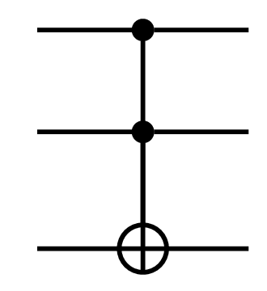
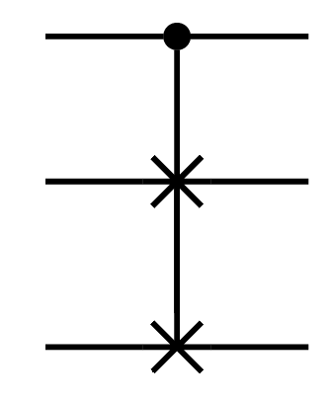
Some multi-qubit gates
Toffoli:
Fredkin:

Slide 39
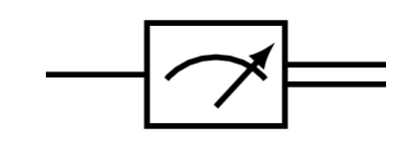
Measurement gate
Measurement is represented by a small meter:

Slide 40
Composition
In general, a wiring diagram of the form
And represents the unitary transformation
$$A_{n−1}A_{n−2}⋯A_{1}A_{0}.$$
Note the corresponding order reversal of the product!

Slide 41
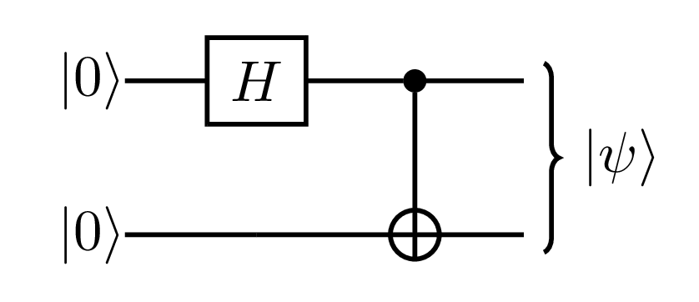
Example 1
Consider the following wiring diagram:
This is equivalent to
$$\left(CNOT\right)\left(H⊗I\right)\left(\left|0\right\rangle ⊗\left|0\right\rangle \right)$$
That is,
$\left|ψ\right\rangle =\left(\begin{matrix}1 & 0 & 0 & 0 \\ 0 & 1 & 0 & 0 \\ 0 & 0 & 0 & 1 \\ 0 & 0 & 1 & 0\end{matrix}\right)\left[\left(\frac{1}{\sqrt{2}}\right)\left(\begin{matrix}1 & 0 \\ 0 & −1\end{matrix}\right)⊗\left(\begin{matrix}1 & 0 \\ 0 & 1\end{matrix}\right)\right]\left(\begin{aligned}1 \\ 0 \\ 0 \\ 0\end{aligned}\right)$

Slide 42
Example 1 cont.
Performing the arithmetic,
$$\left|ψ\right\rangle =\left(\begin{matrix}1 & 0 & 0 & 0 \\ 0 & 1 & 0 & 0 \\ 0 & 0 & 0 & 1 \\ 0 & 0 & 1 & 0\end{matrix}\right)\left(\begin{matrix}1 & 0 & 1 & 0 \\ 0 & 1 & 0 & 1 \\ 1 & 0 & −1 & 0 \\ 0 & 1 & 0 & −1\end{matrix}\right)\left(\begin{aligned}1 \\ 0 \\ 0 \\ 0\end{aligned}\right)$$
$$=\left(\frac{1}{\sqrt{2}}\right)\left(\begin{aligned}1 \\ 0 \\ 0 \\ 0\end{aligned}\right)+\left(\frac{1}{\sqrt{2}}\right)\left(\begin{aligned}0 \\ 0 \\ 0 \\ 1\end{aligned}\right)=\frac{\left|00\right\rangle +\left|11\right\rangle }{\sqrt{2}}$$
which is known as a Bell state.

Slide 43
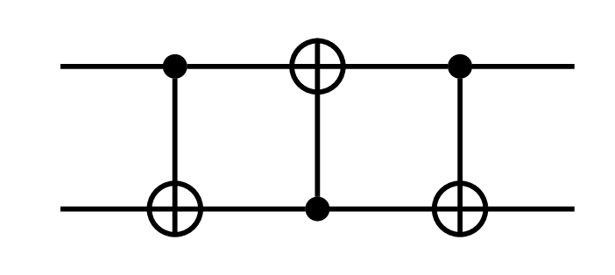
Exercise 1
Show that
=

Slide 44
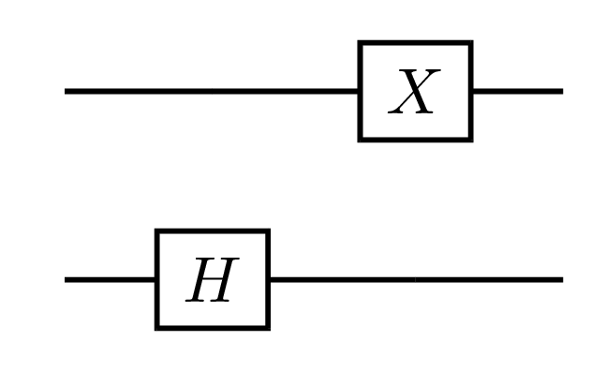
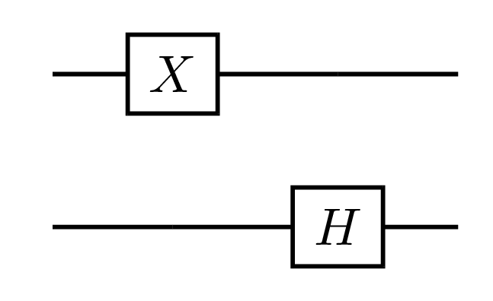
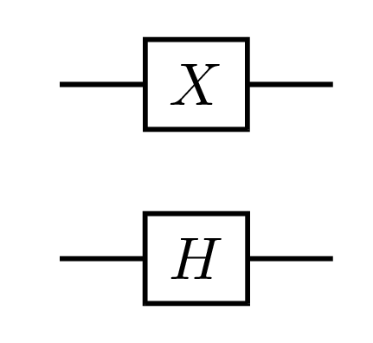
Exercise 2
Show that
= =
Note that in general,
$$\left(A⊗I\right)\left(I⊗B\right)=\left(I⊗B\right)\left(A⊗I\right)=\left(A⊗B\right)$$

Slide 45
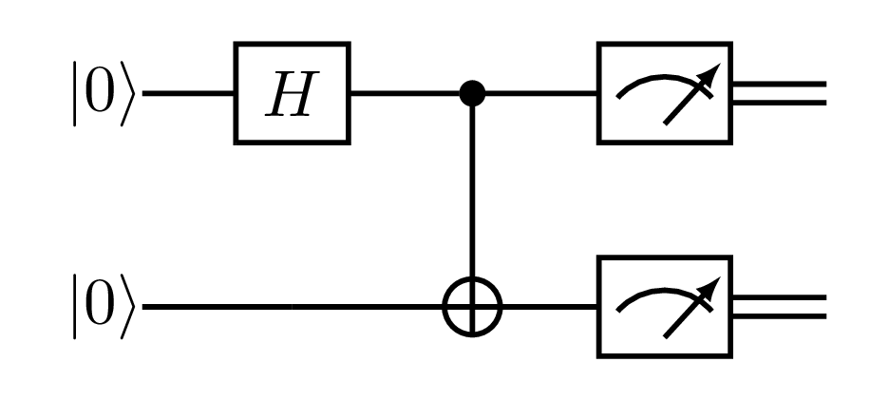
Now consider…
$=\left\{\begin{aligned}\left|00\right\rangle , 𝓹_{00}=1/2 \\ \left|01\right\rangle , 𝓹_{01}=0 \\ \left|10\right\rangle , 𝓹_{10}=0 \\ \left|11\right\rangle , 𝓹_{11}=1/2\end{aligned}\right.$

Slide 46
The Bell Orthonormal Basis
Consider the Bell orthnormal basis of a $2$-qubit state space:
$\left|β_{00}\right\rangle =\left(I⊗I\right)\left|β_{00}\right\rangle =\frac{\left(\left|00\right\rangle +\left|11\right\rangle \right)}{\sqrt{2}}$
$\left|β_{01}\right\rangle =\left(X⊗I\right)\left|β_{00}\right\rangle =\frac{\left(\left|10\right\rangle +\left|01\right\rangle \right)}{\sqrt{2}}$
$\left|β_{10}\right\rangle =\left(Z⊗I\right)\left|β_{00}\right\rangle =\frac{\left(\left|00\right\rangle −\left|11\right\rangle \right)}{\sqrt{2}}$
$\left|β_{11}\right\rangle =\left(ZX⊗I\right)\left|β_{00}\right\rangle =\frac{\left(\left|01\right\rangle −\left|10\right\rangle \right)}{\sqrt{2}}$
Thus, $\left|β_{ab}\right\rangle =\left(Z^{a}X^{b}⊗I\right)\left|β_{00}\right\rangle$where $a,b∈\left\{0,1\right\}.$

Slide 47
Note
We can move from one Bell basis to any other by applying a local unitary transformation to only the left qubit.
Later on, this will be useful in quantum communication protocols.
Exercise 3: Verify the formulas relating the Bell basis elements.

Slide 48
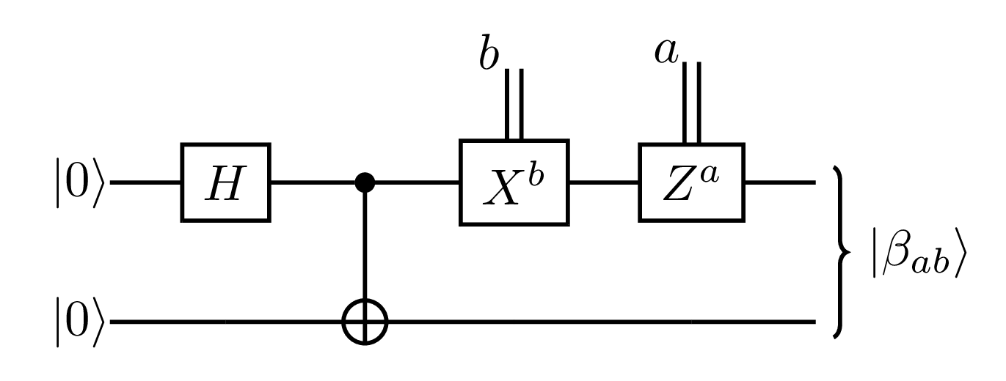
Transforming the Bell Basis
We can translate the equation $\left|β_{ab}\right\rangle =\left(Z^{a}X^{b}⊗I\right)\left|β_{00}\right\rangle$
Into a wiring diagram as follows:
where gates $X^{b}$and $Z^{a}$ are gates controlled by external classical bits $a,b$. In other words,
$X^{b}=\left\{\begin{aligned}I, if b=0 \\ X, if b=1 \end{aligned}\right.$ and $Z^{a}=\left\{\begin{aligned}I, if a=0 \\ Z, if a=1 \end{aligned}\right.$
Please note that the first two gates from the left produce the Bell state $\left|β_{00}\right\rangle$ .

Slide 49
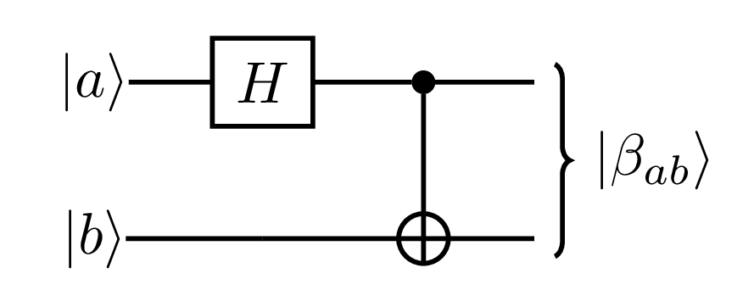
Exercise 4
Verify that
Thus, the above unitary operations change the standard basis into the Bell basis.
$$\left|β_{00}\right\rangle$$

Slide 50
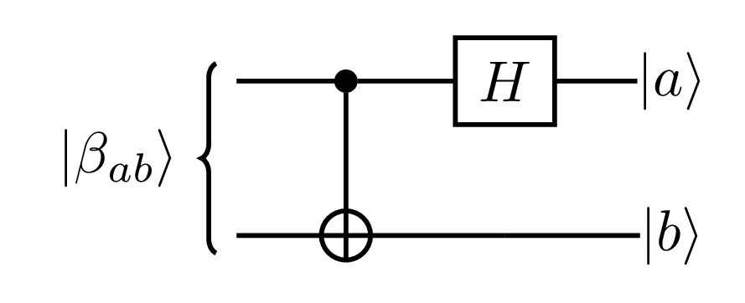
Exercise 5
Prove that
Thus, the above unitary operation transforms the Bell basis into the standard basis.

Slide 51
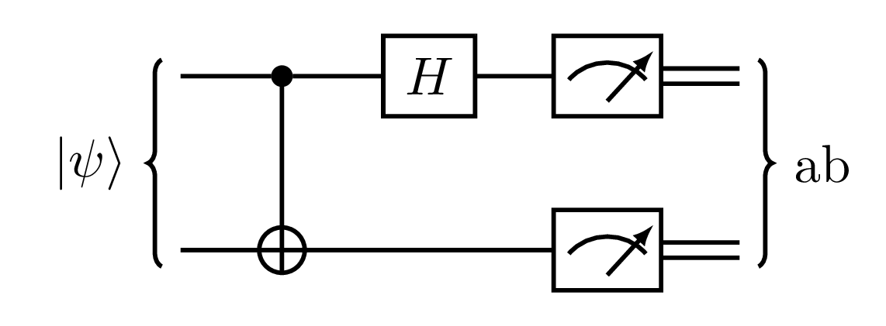
Bell Basis Measurement
This circuit makes a Bell basis measurement, i.e., a measurement with respect to the Bell basis:
if $𝓹_{ab}={\left|\left\langle β_{ab} | ψ\right\rangle \right|}^{2}$, where it can be shown that
$$\left|ψ\right\rangle =\sum_{a,b=0}^{1}{\left\langle β_{ab} | ψ\right\rangle \left|β_{ab}\right\rangle }$$

Slide 52
Lecture 3: Part 5
Quirk: A useful wiring diagram simulator.
https://algassert.com/quirk

Slide 53
???

