Slide 1
Principles of Computer Security
Instructor: Haibin Zhang
hbzhang@umbc.edu

Slide 2
How to Achieve CIA altogether?

Slide 3
What’s an Ideal Security Service?
Ideal security systems
A fundamental question every security and system researcher should ask
5

Slide 4
Three “Most” Important Security Goals
Ideal security systems
Liveness (availability)
  A service operates without interruption.
Safety (integrity)
  A service correctly processes clients’ requests.
Confidentiality
  [Crypto]: Adversary learns nothing (neither on the client request (i.e., x) nor server reply (i.e., f(x))).
6

Slide 5
State Machine Replication (SMR)
State Machine Replication
Total order
$100
$100
$100
11

Slide 6
State Machine Replication (SMR)
State Machine Replication
Total order
$100
$100
$100
12

Slide 7
State Machine Replication (SMR)
State Machine Replication
Total order
Client 1:
“Deposit $100”
$100
$200
Client 1:
“Deposit $100”
$100
$200
$100
13

Slide 8
State Machine Replication (SMR)
State Machine Replication
Total order
Client 1:
“Deposit $100”
Chase:
“Charge 10%”
$100
$200
$180
Client 1:
“Deposit $100”
Chase:
“Charge 10%”
$100
$200
$180
$100
14

Slide 9
State Machine Replication (SMR)
State Machine Replication
✓
Total order
Client 1:
“Deposit $100”
Chase:
“Charge 10%”
$100
$200
$180
Client 1:
“Deposit $100”
Chase:
“Charge 10%”
$100
$200
$180
$100
15

Slide 10
State Machine Replication (SMR)
State Machine Replication
✓
Total order
Chase:
“Charge 10%”
Client 1:
“Deposit $100”
$100
$90
$190
Chase:
“Charge 10%”
Client 1:
“Deposit $100”
$100
$90
$190
$100
16

Slide 11
State Machine Replication (SMR)
State Machine Replication
✘
Total order
Chase:
“Charge 10%”
Client 1:
“Deposit $100”
$100
$90
$190
Client 1:
“Deposit $100”
Chase:
“Charge 10%”
$100
$200
$180
$100
17

Slide 12
Total Order Using Sequence Number
State Machine Replication
Chase:
“Charge 10%”
Client 1:
“Deposit $100”
$100
$90
$190
Chase:
“Charge 10%”
Client 1:
“Deposit $100”
$100
$90
$190
$100
18

Slide 13
Total Order Using Sequence Number
State Machine Replication
Sequence number =1
Sequence number =2
Chase:
“Charge 10%”
Client 1:
“Deposit $100”
$100
$90
$190
Chase:
“Charge 10%”
Client 1:
“Deposit $100”
$100
$90
$190
$100
19

Slide 14
This Talk
  A system satisfying safety, liveness, and secure outsourcing
  Confidential BFT
A system satisfying safety, liveness, and causality
  Secure causal BFT
[Duan and Zhang, 2016]
[Duan, Reiter, and Zhang, 2017]
34

Slide 15
Part I: Confidential BFT
Confidential BFT
Scenario
  A fraction of servers can be malicious.
  Clients can be malicious.
  Servers can process arbitrary functions.
  Yet adversary learns nothing.
Two possible directions
  From single-server confidentiality solutions to replicated state machines?
  From BFT to BFT with confidentiality?
35

Slide 16
Single-Server Solutions Cannot Be Extended
Confidential BFT
36

Slide 17
The Other Direction
Confidential BFT
Replicas first agree (A) on a total order of all requests and then execute (E) these requests.
37

Slide 18
The Other Direction
Confidential BFT
Replicas first agree (A) on a total order of all requests and then execute (E) these requests.
38

Slide 19
Hard to Achieve Confidentiality in BFT
Confidential BFT
Replicas first agree (A) on a total order of all requests and then execute (E) these requests.
  Each replica sees the client requests!
  This makes secure outsourcing an impossibility
39

Slide 20
The Idea of YMYAD
Confidential BFT
Separating agreement from execution
[Yin, Martin, Venkataramani, Alvisi, and Dahlin, SOSP 03]
40

Slide 21
The Idea of YMYAD
Confidential BFT
Separating agreement from execution
[Yin, Martin, Venkataramani, Alvisi, and Dahlin, SOSP 03]
41

Slide 22
Separating AC from EC
Confidential BFT
AC (agreement cluster, 3f+1)
  Assigns sequence numbers to client requests
EC (execution cluster, 2g+1)
  Executes requests
EC state information is leaked
  if two replicas in EC and AC collude!
42

Slide 23
Further Introducing Distributed Firewall
Confidential BFT
[Yin, Martin, Venkataramani, Alvisi, and Dahlin, SOSP 03]
43

Slide 24
Attacking and Improving YMVAD
Confidential BFT
Lacking formal definitions
Safety attack
Multicast encryption with soundness
Confidentiality attack
Encryption from Randomized BFT
Privacy firewall using
threshold signature
Novel non-cryptographic privacy firewall
Symmetric Cryptography
44

Slide 25
Evaluation
Confidential BFT
Several orders of magnitude faster than YMVAD
45

Slide 26
Part II: Secure Causal BFT
Secure Causal BFT
The “strongest” consensus protocol in distributed systems literature
Hard problem
  No practical solution for more than 30 years
[Reiter and Birman, TOPLAS 94]
46

Slide 27
Secure Causal BFT Overview
Secure Causal BFT
Definition
Examples (DNS, Transaction, Cloud)
CP0 (The existing protocols)
CP1 (Byzantine clients + Byzantine servers)
CP2 + CP3 (Semi-honest clients + Byzantine servers)
Evaluation (Latency, throughput, scalability, and performance under failures)
47

Slide 28
Reliable Broadcast
Secure Causal BFT
Reliable broadcast: either all correct processes received the message or none of them received the message.
  no ordering requirement
Byzantine reliable broadcast
  Byzantine General’s Problem
  Broadcast channel (in cryptography)
[Lamport, Shostak, and Pease, TOPLAS 1982]
48

Slide 29
(Recall) Total Order
Secure Causal BFT
✓
Total order
Chase:
“Charge 10%”
Client 1:
“Deposit $100”
$100
$90
$190
Chase:
“Charge 10%”
Client 1:
“Deposit $100”
$100
$90
$190
$100
49

Slide 30
(Recall) Total Order
Secure Causal BFT
✘
Total order
Chase:
“Charge 10%”
Client 1:
“Deposit $100”
$100
$90
$190
Client 1:
“Deposit $100”
Chase:
“Charge 10%”
$100
$200
$180
$100
50

Slide 31
Atomic Broadcast
Secure Causal BFT
Atomic broadcast = reliable broadcast + total order
  State machine replication
  BFT
51

Slide 32
Causal Order
Secure Causal BFT
[Lamport, Comm. ACM 1978]
[Lamport, Distrib. Comput. 1986]
Causal order
  If the broadcast of message m₁ "happens before" or "causally precedes" the broadcast of message m₂, then no correct process delivers m₂ before it delivers m₁.
m₂ “That is outrageous!”
m₁ “Chase charges 10%!”
52

Slide 33
Causal Order
State Machine Replication
✓
Causal order
Chase:
“Charge 10%”
Outrageous!
$100
$90
Chase:
“Charge 10%”
Outrageous!
$100
$90
$100
53

Slide 34
Causal Order
State Machine Replication
✘
Causal order
Chase:
“Charge 10%”
Outrageous!
$100
$100
$90
Chase:
“Charge 10%”
Outrageous!
$100
$90
$90
$100
54

Slide 35
Causal Order Total Order
State Machine Replication
⇏
✓
✘
Causal order Total order
Chase:
“Charge 10%”
Client 1:
“Deposit $100”
Outrageous!
$100
$90
$190
Client 1:
“Deposit $100”
Chase:
“Charge 10%”
Outrageous!
$100
$200
$180
$100
55

Slide 36
Total Order Causal Order
State Machine Replication
⇏
✓
✘
Total order Causal order
Chase:
“Charge 10%”
Outrageous!
$100
$100
$90
Chase:
“Charge 10%”
Outrageous!
$100
$100
$90
$100
56

Slide 37
Total Order + Causal Order
State Machine Replication
✓
✓
Total order Causal Order
Chase:
“Charge 10%”
Client 1:
“Deposit $100”
Outrageous!
$100
$90
$190
Chase:
“Charge 10%”
Client 1:
“Deposit $100”
Outrageous!
$100
$90
$190
$100
57

Slide 38
Crash Failure Model
Secure Causal BFT
ZooKeeper
58

Slide 39
Byzantine Failure Model
Secure Causal BFT
[Lamport, Shostak, and Pease, TOPLAS 82]
a.k.a. BFT protocols
[Not formally studied]
[Reiter and Birman, TOPLAS 94]
Basically satisfying everything; strongest
59

Slide 40
Name Registration
Secure Causal BFT
60

Slide 41
Name Registration
Secure Causal BFT
61

Slide 42
Name Registration
Secure Causal BFT
62

Slide 43
Name Registration
Secure Causal BFT
63

Slide 44
Name Registration
Secure Causal BFT
64

Slide 45
Name Registration
Secure Causal BFT
65

Slide 46
Name Registration
Secure Causal BFT
66

Slide 47

Name Registration
Secure Causal BFT
67

Slide 48

Name Registration
Secure Causal BFT
68

Slide 49
Another Example—Trading Service
Secure Causal BFT
Consider a trading service that trades stocks
  A client issues a request to purchase stock shares.
  A corrupt replica could collude with a corrupt client to issue a request for the same stock.
  If the new request is processed earlier than the original request, this may adjust the demand for the stock.
69

Slide 50
Secure Causal BFT
Secure Causal BFT
Existing Constructions
  Use threshold encryption.
  Schedule the ciphertext before revealing decryption shares.
[Reiter and Birman, TOPLAS 94]
[Cachin, Kursawe, Petzold, and Shoup, CRYPTO 2001]
[Cachin and Portiz, DSN 2002]
70

Slide 51
CP0—Using Threshold Encryption
Secure Causal BFT
A public key is associated with the system and a decryption key is shared among all the servers.
71

Slide 52
CP0—Using Threshold Encryption
Secure Causal BFT
72

Slide 53
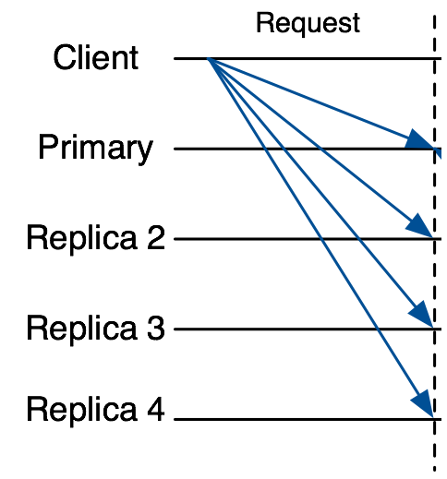
CP0—Using Threshold Encryption
Secure Causal BFT
M
M
M
Any BFT protocol
R
M
Assign a sequence number N to M
R
R
R
C
C = ThresEnc(pk, M)
C
C
Any BFT protocol
C
Assign a sequence number N to C
73

Slide 54
CP0—Using Threshold Encryption
Secure Causal BFT
Use tagged threshold encryption
  To distinguish instances of the protocol.
Drawbacks
  Threshold encryption is really expensive
  Only from a handful of number-theoretical assumptions
  Trusted setup (or expensive interactive setup)
74

Slide 55
A New Look
Secure Causal BFT
Key observation
  Unnecessarily coupled with threshold encryption
A novel framework
  Non-malleable commitment with associated-data
  Fair BFT
Benefits
  General constructions
  Efficient instantiations
75

Slide 56
Our Protocol Uses Commitment Scheme
Secure Causal BFT
Hiding: M is hidden given C.
Binding: C can be only opened to M.
Commit
Phase
C =
M
Sender
M
Receiver
Reveal
Phase
Sender
M
Receiver
76

Slide 57
Non-malleable commitment with associated-data (NM-CAD)
Secure Causal BFT
Syntax
  Associated-data as an additional input
Security
  Additionally ask for non-malleability w.r.t. opening and associated-data (NM-OAD)
M
tag
2M
tag
M
tag
M
tag’
77

Slide 58
Non-malleable commitment with associated-data (NM-CAD)
Secure Causal BFT
Generality
  Any (adaptive) one-way function
Efficiency
  (tag, C) =(tag, H(tag, r, M)), where M is the message, C is the commitment, r is a random coin.
78

Slide 59
Our First Protocol CP1
Secure Causal BFT
  First schedule the commitment
  Then schedule the opening M
Phase 1
M
tag
Phase 2
79

Slide 60
Our First Protocol CP1
Secure Causal BFT
Phase 1
80

Slide 61
Our First Protocol CP1
Secure Causal BFT
Phase 1
M
81

Slide 62
Our First Protocol CP1
Secure Causal BFT
Phase 1
M
M = client request, e.g., “Register UConn”
Tag = a unique identifier of the message
82

Slide 63
Our First Protocol CP1
Secure Causal BFT
Phase 1
Agree on a sequence number to
M
83

Slide 64
Our First Protocol CP1
Secure Causal BFT
Phase 1
M
84

Slide 65
Our First Protocol CP1
Secure Causal BFT
Phase 2
M
85

Slide 66
Our First Protocol CP1
Secure Causal BFT
Phase 2
Assign the same sequence number to the opening
86

Slide 67
Our First Protocol CP1
Secure Causal BFT
Phase 2
87

Slide 68
Our First Protocol CP1
Secure Causal BFT
Above, Gracious Execution!
  Without failures and attacks
88

Slide 69
What Could Go Wrong Under Attacks?
Secure Causal BFT
Malicious clients
  May fail to send opening to replicas.
Malicious replicas
  May delay/drop opening.
89

Slide 70
1) Malicious clients
Secure Causal BFT
Malicious clients fail to send opening?
90

Slide 71
☛ Cleaning Committed but Unopened Requests
Secure Causal BFT
Agree on which requests should be cleaned
91

Slide 72
2) Malicious Replicas
Secure Causal BFT
Drop/Delay openings from correct clients
  s.t. the requests from correct clients from being incorrectly cleaned.
92

Slide 73
☛ Fair BFT
Secure Causal BFT
Fair BFT
  prevents the BFT service from unfairly delaying or dropping some clients’ requests but not others.
[Clement, Wong, Alvisi, Dahlin, and Marchetti, NSDI 2009]
[Duan, Levitt, Meling, Sean, and Zhang, SRDS 2014]
93

Slide 74
CP1 Security (Just Some Intuition)
Secure Causal BFT
Non-malleable commitment wrt opening and associated-data
  Why hiding?
  Why binding?
  Why non-malleable wrt opening?
  Why non-malleable wrt associated-data?
Cleaning and fairness
Causality
Integrity
Causality
Instances
Causality and liveness
94

Slide 75
Another Framework
Secure Causal BFT
Handling the case of semi-honest clients and Byzantine replicas (as in many BFT protocols)
Novel asynchronous robust secret sharing (ARSS)
Two instantiations
  Any commitment scheme and secret sharing (CP2)
  Information secure (CP3)
95

Slide 76
Implementation and Evaluation
Secure Causal BFT
Using 15 virtual nodes (5 of which are client nodes)
LAN: 100 MB bandwidth, 0.1 ms latency
WAN: 1 MB bandwidth, 120 ms latency
96

Slide 77
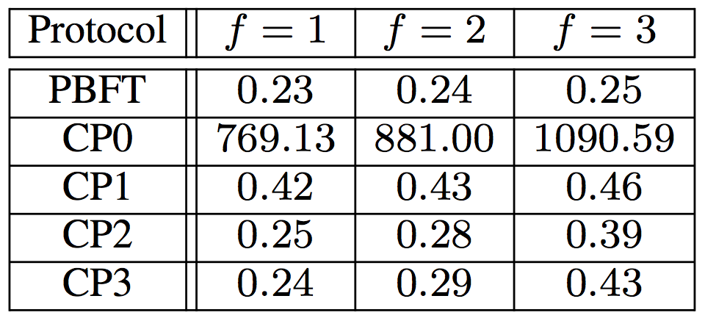
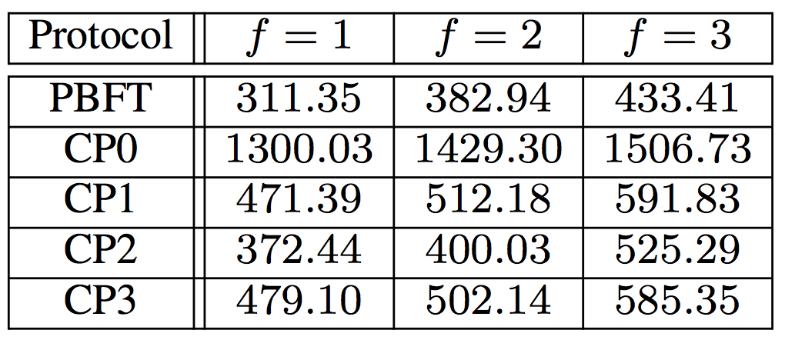
Evaluation
Secure Causal BFT
Latency in LAN (in ms)
Latency in WAN (in ms)
97

Slide 78
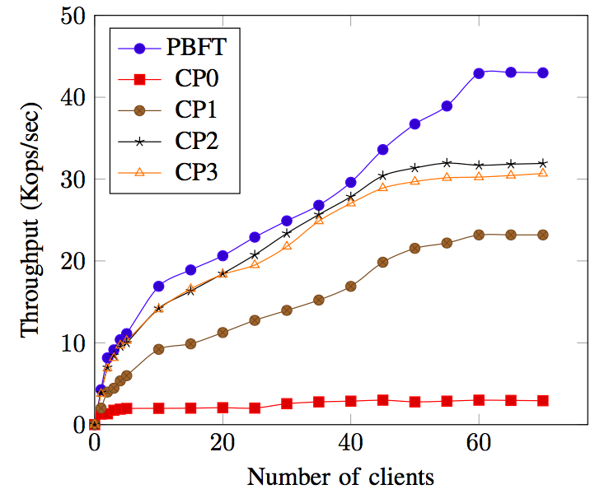
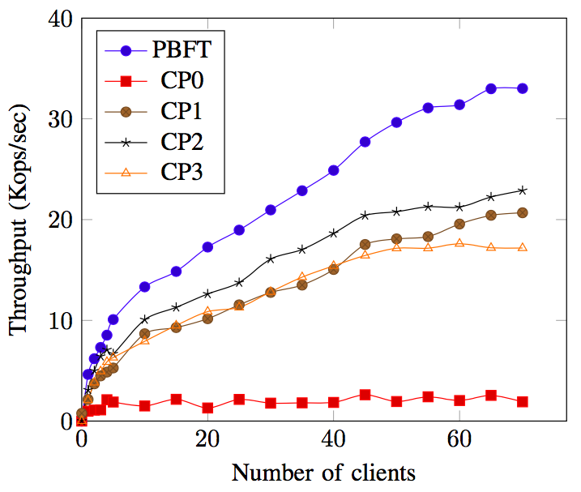
Evaluation
Secure Causal BFT
Throughput
LAN
WAN
98

Slide 79
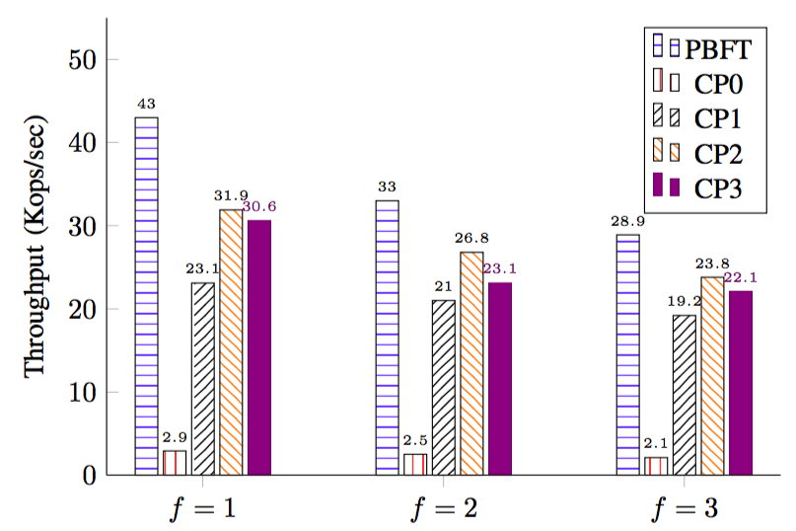
Evaluation
Secure Causal BFT
Scalability (in LAN)
99

Slide 80
Improving Failures Scenarios
Secure Causal BFT
Free amplification
Ordering tentative requests
100

Slide 81
Improving Failures Scenarios
Secure Causal BFT
Free amplification
Ordering tentative requests
101

Slide 82
Improving Failures Scenarios
Secure Causal BFT
Free amplification
Ordering tentative requests
102

Slide 83
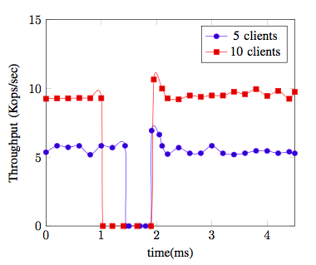
Improving Failures Scenarios
Secure Causal BFT
Free amplification
Ordering tentative requests
103

