Slide 1
Blockchains
Lecture 2

Slide 2
Review of Lecture 1

Slide 3
Client-Server Architecture
One server is a single point of failure or compromise
Request
Response
Client
Server

Slide 4
Blockchains (State Machine Replication)
Blockchains tolerate Byzantine (arbitrary) failures
Integrity/safety: the code to be executed correctly
Availability/liveness: the service is always available
(Typically, not confidentiality)
Replicas
Client

Slide 5
Blockchain Consensus (What is it? Why hard?)
Correct servers maintain the same consistent state, even
1) under highly concurrent client requests
2) when a fraction of servers are compromised
3) under network asynchrony

Slide 6
Roughly, Consensus: All About Achieving “Total Order”
[Lamport, ACM TOPLAS 1984]
Blockchains (modeled as state machine replication)
$100
$100
$100

Slide 7
The “Total Order” Requirement
Client 1:
“Deposit $100”
$100
$200
Client 1:
“Deposit $100”
$100
$200
$100

Slide 8
The “Total Order” Requirement
Client 1:
“Deposit $100”
Chase:
“Charge 10%”
$100
$200
$180
Client 1:
“Deposit $100”
Chase:
“Charge 10%”
$100
$200
$180
$100

Slide 9
The “Total Order” Requirement
Client 1:
“Deposit $100”
Chase:
“Charge 10%”
$100
$200
$180
Client 1:
“Deposit $100”
Chase:
“Charge 10%”
$100
$200
$180
$100

Slide 10
The “Total Order” Requirement
Chase:
“Charge 10%”
Client 1:
“Deposit $100”
$100
$90
$190
Chase:
“Charge 10%”
Client 1:
“Deposit $100”
$100
$90
$190
$100

Slide 11
The “Total Order” Requirement
Chase:
“Charge 10%”
Client 1:
“Deposit $100”
$100
$90
$190
Client 1:
“Deposit $100”
Chase:
“Charge 10%”
$100
$200
$180
$100

Slide 12
Review of Lecture 1
The above are blockchains goals!
Not how we implemented or realized blockchains.
However, use them in a black-box manner.

Slide 13
Characterizing Blockchains
Permissionless: explicitly/implicitly rely on cryptocurrency
Permissioned: traditional Byzantine fault-tolerant distributed system (consortium blockchains, private blockchains)
 | Membership | Consensus Approach | Examples
Permissionless | Dynamic | PoX (Proof of “X”) | Bitcoin, Ethereum
Permissioned | Fixed; know IDs of each other | BFT (Byzantine fault tolerance) | Fabric, Iroha, Chios, BEAT

Slide 14
Characterizing Blockchains
Permissionless: explicitly/implicitly rely on cryptocurrency
Permissioned: traditional Byzantine fault-tolerant distributed system (consortium blockchains, private blockchains)
Hybrid: use BFT to improve permissionless blockchains
 | Membership | Consensus Approach | Examples
Permissionless | Dynamic | PoX (Proof of “X”) + Some mechanism | Bitcoin, Ethereum
Permissioned | Fixed; know IDs of each other | BFT (Byzantine fault tolerance) | Fabric, Iroha, Chios, BEAT
Hybrid (permissonless) | Dynamic | Sybil resistant PoX+ BFT | Elastico, OmniLedger, Ethereum Casper

Slide 15
Systems and Distributed Systems Basics
Reading material:
Cachin book, chapter 2 (Basic abstractions)
https://library.umbc.edu/
Search “Introduction to Reliable and Secure Distributed Programming”
Select “online access”

Slide 16
Safety and liveness (Generalized Notations)
Safety: a safety property is a property of a distributed algorithm that can be violated at some time t and never be satisfied again after that time.
You algorithm should not do anything wrong.
Liveness: for any time t, there is some hope that the property can be satisfied at some time t’>t.
Something good eventually happens.
They can be rather specific when the setting is fixed.

Slide 17
One Example
Ordered data stream (e.g., TV show, NBA live)
Messages are 1 ) neither lost 2) nor duplicated, and 3) are received in the order where they were sent.

Slide 18
What about Blockchains?
Blockchains tolerate Byzantine (arbitrary) failures
Integrity/safety: the code to be executed correctly
Availability/liveness: the service is always available
Replicas
Client

Slide 19
In order to Describe a Distributed System
Participants: Processes
Links connecting processes

Slide 20
Processes via Failures Types
A process never fails?
Crash failures
Arbitrary failures (Byzantine failures)
Processing a request incorrectly
Corrupting local state
Sending incorrect or inconsistent messages
Not function as designated (this is the definition)
https://lwn.net/Articles/540368/

Slide 21
Failures
Failure happens all the time
When you design, you design for failure

Slide 22
Links
How can two correct processes communicate with each other?
If you trust each other, good!
easy
If you think the link is not trustworthy, still easy!
use crypto

Slide 23
Cryptography
Message authentication codes (MACs)
Digital signatures
Both of them allow you to establish authenticated channels

Slide 24
Links
Crash failure model
Fair-loss links
Stubborn delivery
Perfect links (e.g., TCP)
Byzantine failure model
Authenticated perfect links

Slide 25
Fair-Loss Links
Fair-loss: if a correct process p infinitely sends a message m to q, then q delivers m an infinite number of times
Finite duplication: ….finite times, …finite …
No creation: If q delivers m with send p, the m was sent to q by p.

Slide 26
Stubborn Links
Stubborn delivery: if a correct process p sends a message m to q once, then q delivers m an infinite number of times
No creation
Built from fair-loss links?

Slide 27
Perfect Links
Reliable delivery: if a correct p sends a message to a correct q, q eventually delivers m.
No dup: q only receives m once
No creation

Slide 28
Authenticated Perfect Links
Reliable delivery: if a correct p sends a message to a correct q, q eventually deliver m.
No dup
No creation → authenticity

Slide 29
Timing Assumptions
Synchronous environments
Asynchronous environments
Partially asynchronous environments

Slide 30
Synchronous environment
Failure detection
MSG
ACK
Server 1
Server 2

Slide 31
Asynchronous environment
Replicas
Client

Slide 32
System model
Failure types
Links
Environments
What is the hardest model?
What is the most appropriate model?

Slide 33
Common Communication Pattern
The remaining lecture will focus on communcation

Slide 34
Communication Mechanisms
Many protocols are available
Sockets
Remote Procedure Call (RPC)
Distributed shared memory (later in the class)
MPI
…

Slide 35
Socket Communication
TCP (Transmission Control Protocol; realizing perfect links)
Protocol built upon the IP networking protocol, which supports sequenced, reliable, two-way transmission over a connection (or session, stream) between two sockets
More reliable
More expensive
UDP (User Datagram Protocol)
Also protocol built on top of IP. Supports best-effort, transmission of single datagrams
It’s ok to lose, re-order, or duplicate messages
Low latency

Slide 36
Other communication models
Can be based on perfect links
Broadcast
Multicast

Slide 37
RPC
Remote Procedure Call
A type of client/server communication
Programming (just a bit easier)
Hide complexity
Standardize some low-level data packaging protocols

Slide 38
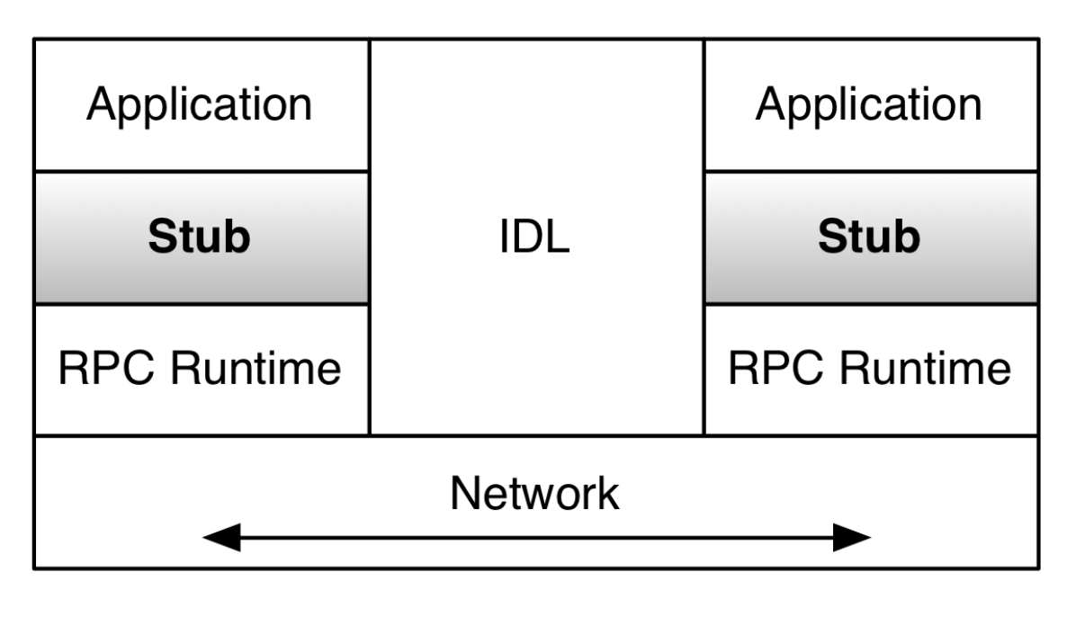
RPC
The application calls the remote procedure locally at the stub
The stub intercepts calls that are for remote servers
Marshalling: pack the parameters into a message
Make a system call to send the message
Stubs are generated automatically by RPC frameworks (libraries), which also provide the RPC Runtime
Programmers only write definitions for their data structures and protocols in an IDL

Slide 39
RPC
The RPC Runtime handles message sending
The interface definition language (IDL) handles message translation
RPC hides heterogeneity among the computers and handles the communication across network

Slide 40
RPC technologies
XML/RPC
Over HTTP, huge XML parsing overheads
SOAP
Designed for web services via HTTP, huge XML overhead
CORBA
Relatively comprehensive, but quite complex and heavy
Protocol buffers
Lightweight, developed by Google
Thrift
Lightweight, supports services, developed by Facebook

Slide 41
Projects
If you code, I recommend you maintain the code in github or bitbucket. It is easier for you and me to track the progress and understand the code complexity.

Slide 42
Sample Projects
improving some open source projects (Hyperledger Fabric, Tendermint); threshold cryptography library; an interesting DApp; MPC with a real-world use case; devise a new blockchain system and prove it is better; cryptographic engineering projects; multi-cloud deployment of blockchains; implementation and comparison of existing blockchains (with some interesting findings); attacks on existing blockchains (with ethics and procedures discussed in class). Out-of-box ideas are highly encouraged!

Slide 43
Exercises

