Slide 1
Algorithmic Problem Solving CMSC 201 Adapted from slides by Marie desJardins
(Spring 2015 Prof Chang version)

Slide 2
Algorithms
An algorithm is an ordered set of unambiguous steps that describes a process
Examples from real life:
Recipes (not really)
Project directions - chemistry lab, writing prompt (hopefully)
Assembly instruction (Legos, IKEA)

Slide 3
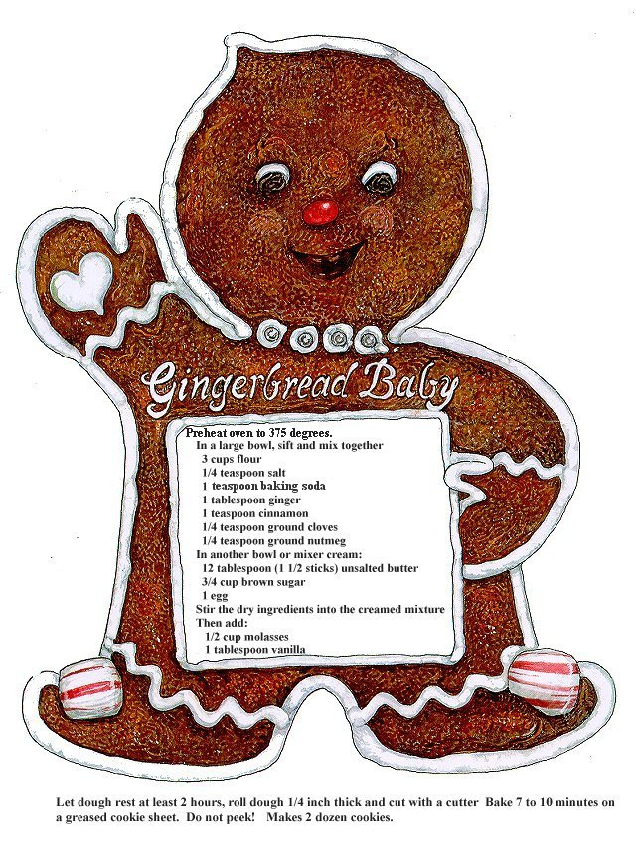

Slide 4
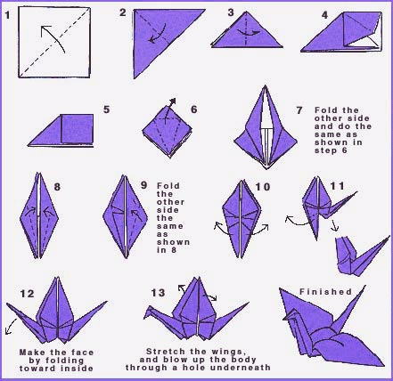

Slide 5
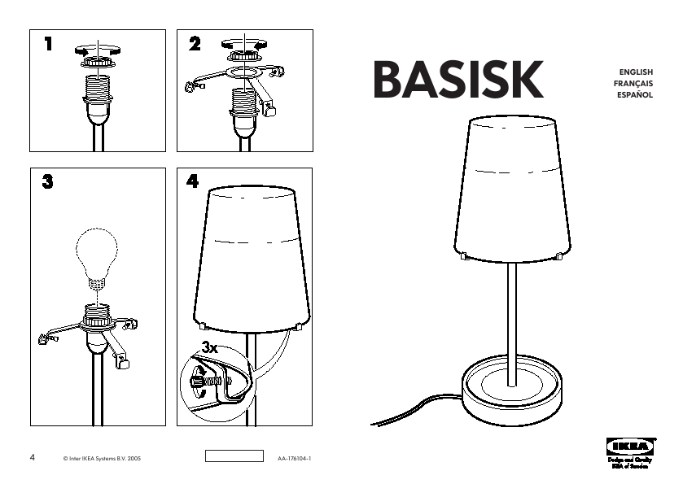

Slide 6
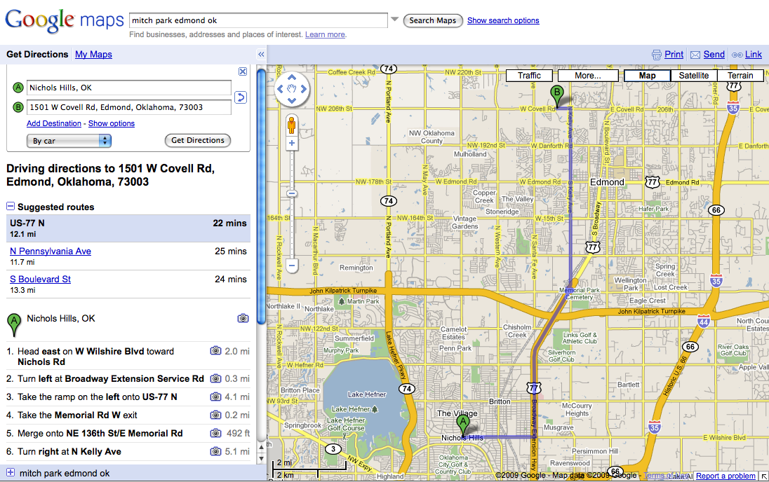

Slide 7
Algorithms Express Solutions to Computational Problems
Algorithms are expressed and implemented using languages
Possibilities: natural language, pseudocode, visual and textual programming languages
Some languages more suitable for some problems
The choice of language can affect clarity or readability, but not whether a solution exists

Slide 8
Algorithms Express Solutions to Computational Problems
Algorithms can solve many, but not all, problems
Many problems can be solved in reasonable time
We use heuristic approaches to find approximate solutions for some problems in reasonable time
We know some problems cannot be solved by any algorithm. (We can prove this!)
For some problems, we do not know if efficient algorithms exist, but we cannot prove they do not exist. (E.g., cracking encryption schemes.)

Slide 9
Algorithms Express Solutions to Computational Problems
There can be many algorithmic solutions to the same problem.
Which one is better? (The one I thought of ?)
Algorithms are evaluated analytically and empirically
Analytically = analyze mathematically
Empirically = run implementation on statistically significant sample data
Many criteria for evaluation: speed, space usage, correctness (??), usability,

Slide 10
Algorithms: Syntax and Semantics
Need a language for algorithms.
(A programming language!)
Basic components of every algorithmic language:
Primitive actions
Conditionals: if <condition> then <actions>
Loops: repeat <actions> until <condition>
Variables: places to store information
Input and output:
Functions: grouping

Slide 11
Three main control constructs for algorithm development
Control structures:
Sequence (i.e. one line after the other)
Decision making (e.g. using if/else constructs)
Looping (e.g. using while loops)

Slide 12
Example – Sequential
Calculate an hourly employee’s weekly pay
Step 1 : Understand the problem
Input : pay rate and number of hours
Process: pay = rate * hours
Output: pay

Slide 13
Algorithm – Calculate pay
Plain English:
Ask for the pay rate and the number of hours worked. Then, multiply the pay rate by the number of hours. The result is the pay.

Slide 14
Algorithm – Calculate pay
.
Pseudocode - looks like code, but not a real language
1. Variables: hours, rate, pay
2. Display “Number of hours worked: ”
3. Get hours
4. Display “Amount paid per hour: ”
5. Get rate
6. pay = hours * rate
7. Display “The pay is $” , pay
Notice the importance of order and lack of ambiguity

Slide 15
Example – Flow Chart
Start
Display “Amount paid per hour: ”
Display “Number of hours worked: ”
Get rate
Get hours
pay = hours * rate
Display “The pay is $”, pay
End

Slide 16
Example – Decision Making
.
Figure out if a number is positive
Step 1 : Understand the problem
Input : The number
Process: Is it greater than zero?
Output: A message that says whether the number is positive or non-positive

Slide 17
Algorithm
.
Plain English
Ask for the number. Check if it is greater than zero. If it is, it is a positive number. If not (i.e. else), it is not positive

Slide 18
Algorithm
.
Pseudocode
1. Variable: num
2. Display “Enter the number: ”
3. Get num
if num > 0
Display “It is positive”
else
7. Display “It is not positive”

Slide 19
Flowcharts-Decision Making
If num > 0 display “Positive”
Else (that means 0 or negative) display “Not Positive”
num >0?
True
False
Display “positive”
Display “Not positive”

Slide 20
Looping
Add the numbers from 1 to 10.
That is 1 + 2 + 3 + …+ 10 = 55
Step 1 : Understand the problem
Input : None needed
Process: Add 0 to 1 to get a new sum. Add 2 to the old sum to get a new sum. Add 3 to the old sum to get a new sum ... Add 10 to the old sum to get the final sum
Output: The new sum after 10 iterations

Slide 21
Algorithm
.
Plain English
Start count at 1.
Add the count to the sum (originally zero) to get a new sum.
Increment the count.
Repeat the last two steps 10 times.

Slide 22
Algorithm
.
Pseudocode
While_Example
Numeric Variables: counter = 1, sum = 0
While counter <= 10:
sum = sum + counter
counter = counter + 1
EndWhile
Display “The sum is”, sum

Slide 23
Averaging Algorithm
An algorithm to average a list of numbers
For each number in the list, add that number to a sum (initially zero). Once this is done, divide the sum by the number of items in the list.

Slide 24
Variables
Not the same as variables in algebra.
A place to store stuff:
stuff = values (e.g., numbers, "objects")
place = location (e.g., in memory)
places can have names (e.g. sum, counter)
can change the value stored in a place
Python: names are name tags and can be moved

Slide 25
Averaging Algorithm
A more programmatic version of the algorithm:
Average(listOfNumbers, length)
Create a variable called sum starting at zero
For each number in listOfNumbers:
Add that number to sum
Set result to (sum / length)
Return result

Slide 26
Averaging Algorithm
In Python:
def average(listOfNumbers, length):
sum = 0
for currentNumber in listOfNumbers:
sum = sum + currentNumber
result = counter / length
return result

