Slide 1



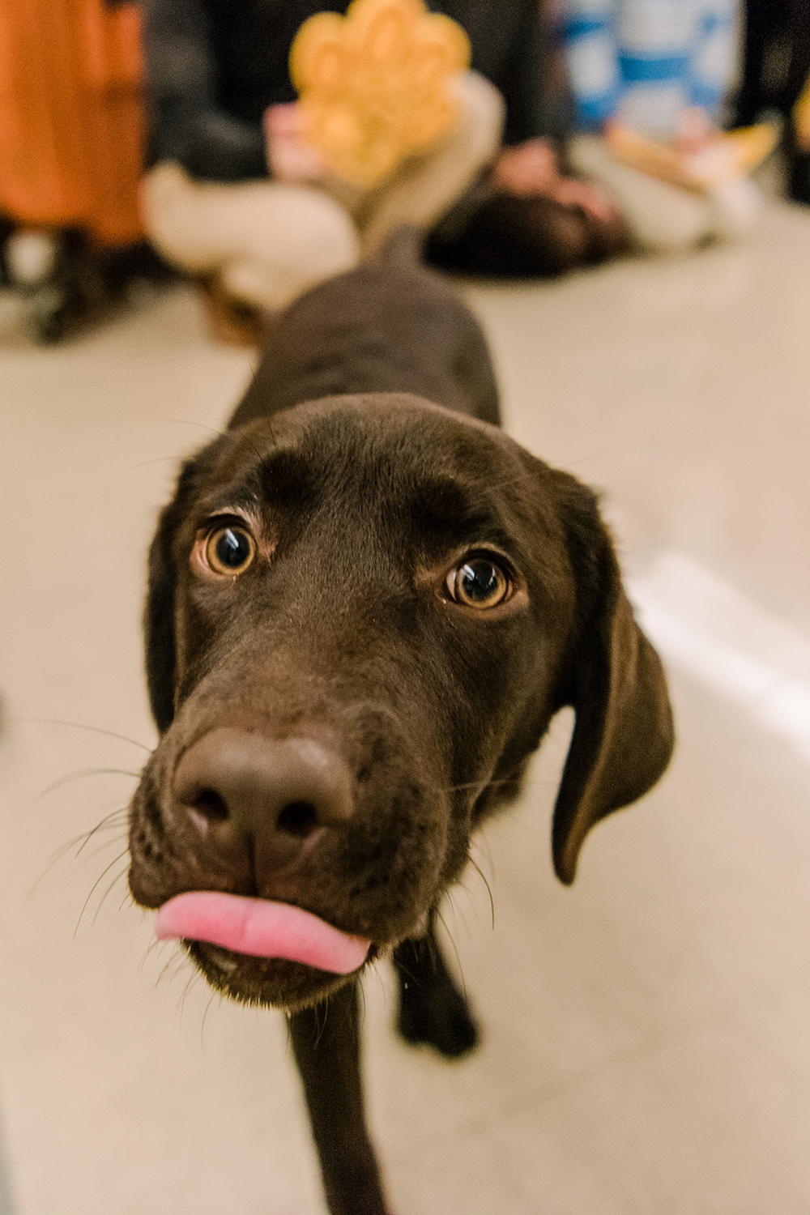
Graduate
Student
Association
Greetings,
Grad Students!
2026-2027

Slide 2

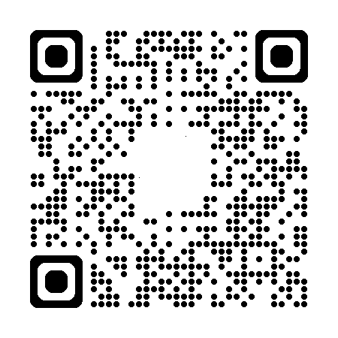
Graduate Student Association
Our Mission
To support, promote, and represent all graduate students at UMBC
To provide a forum for matters involving graduate students and their welfare at UMBC
To provide opportunities for intellectual, professional, and social development
WHAT WE’RE ABOUT

Slide 3
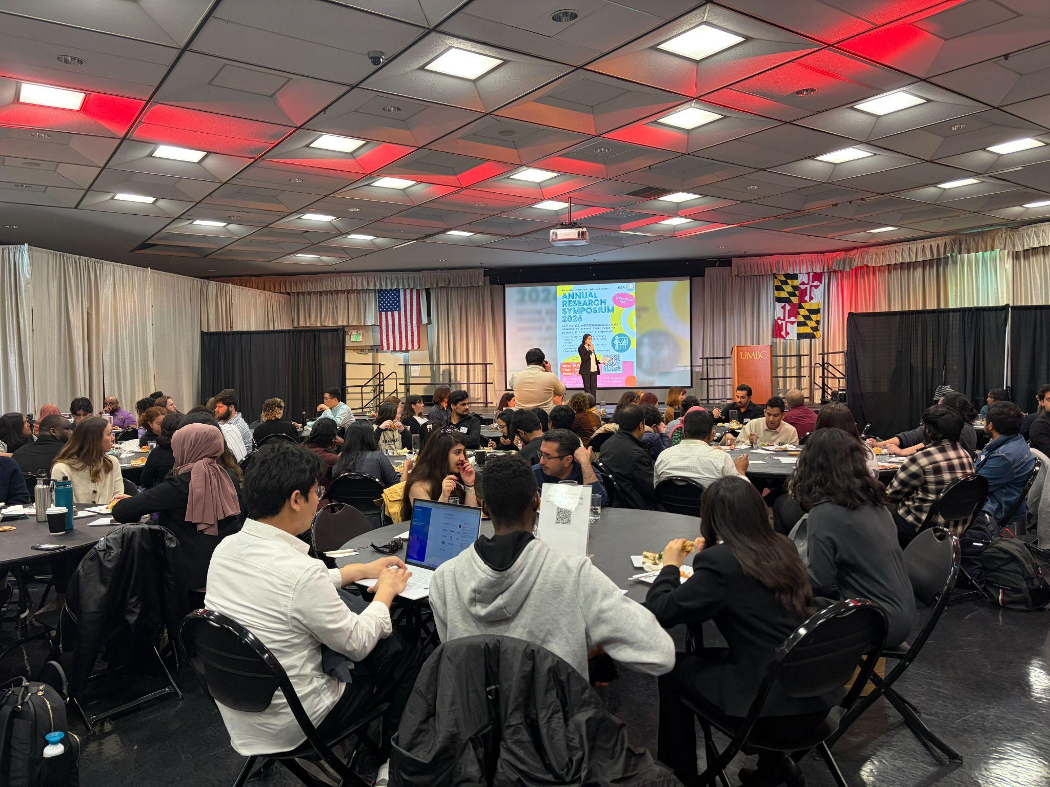
General Opportunities
GEARS Research Symposium
Research development
Professional development
Writing Advising
Leadership
Socialization across disciplines
Networking

Slide 4
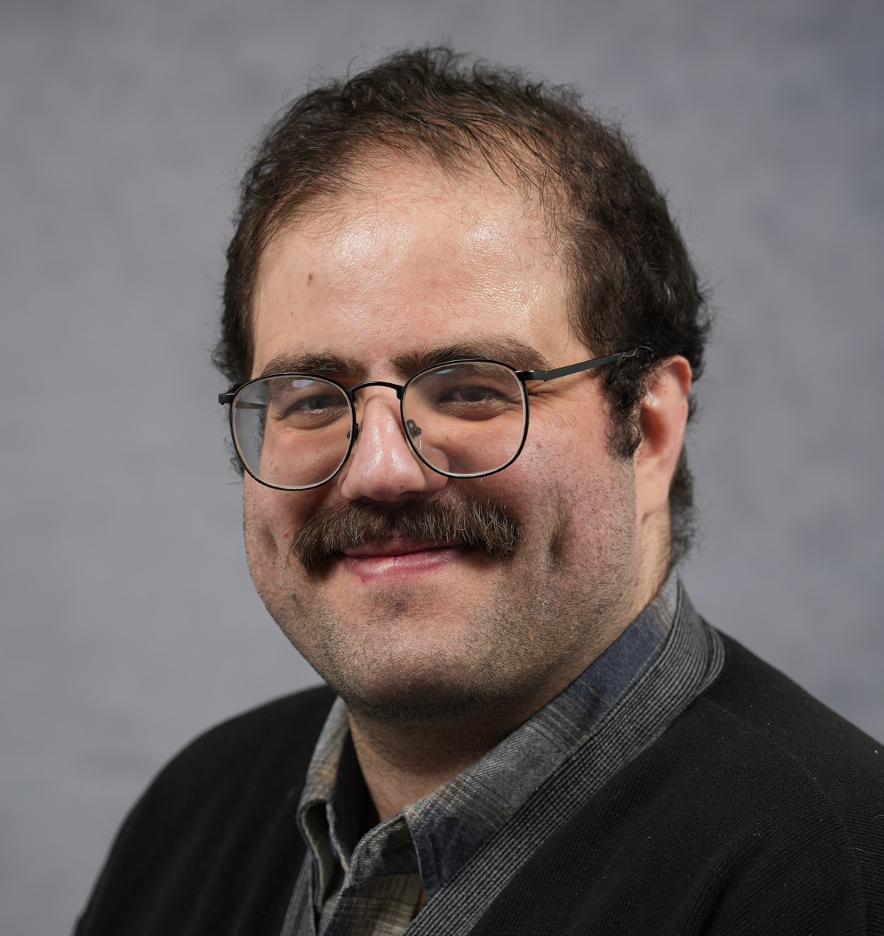
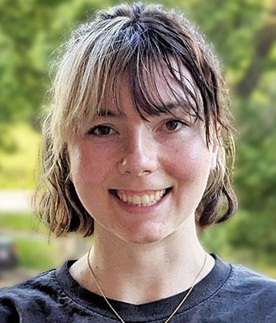
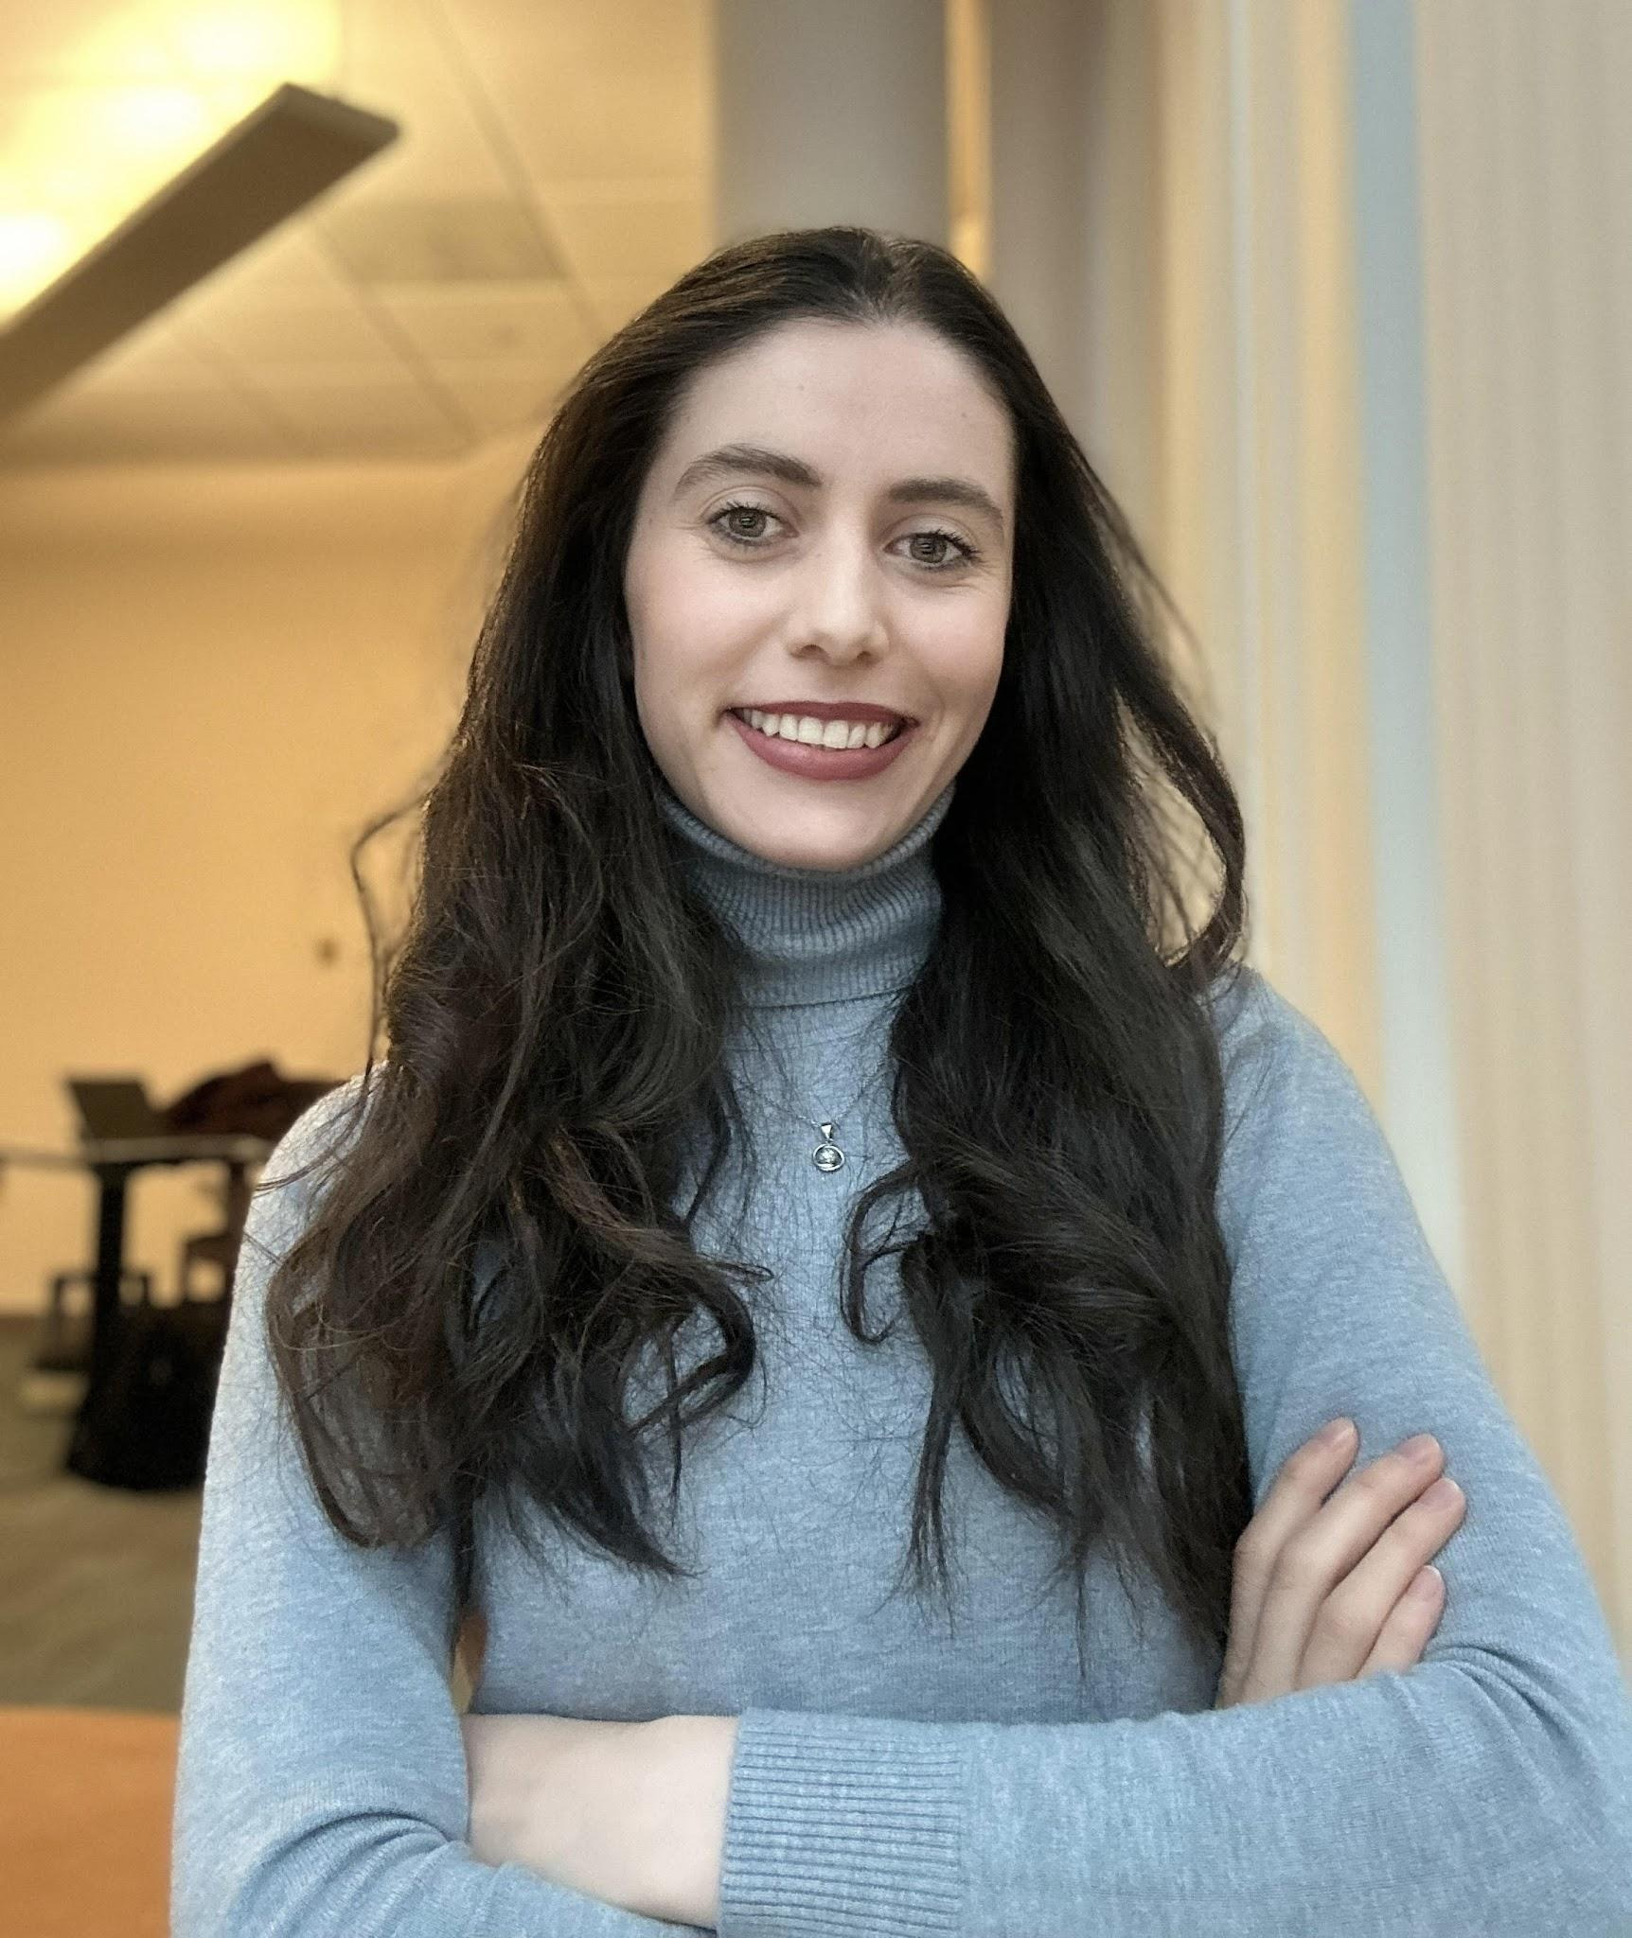
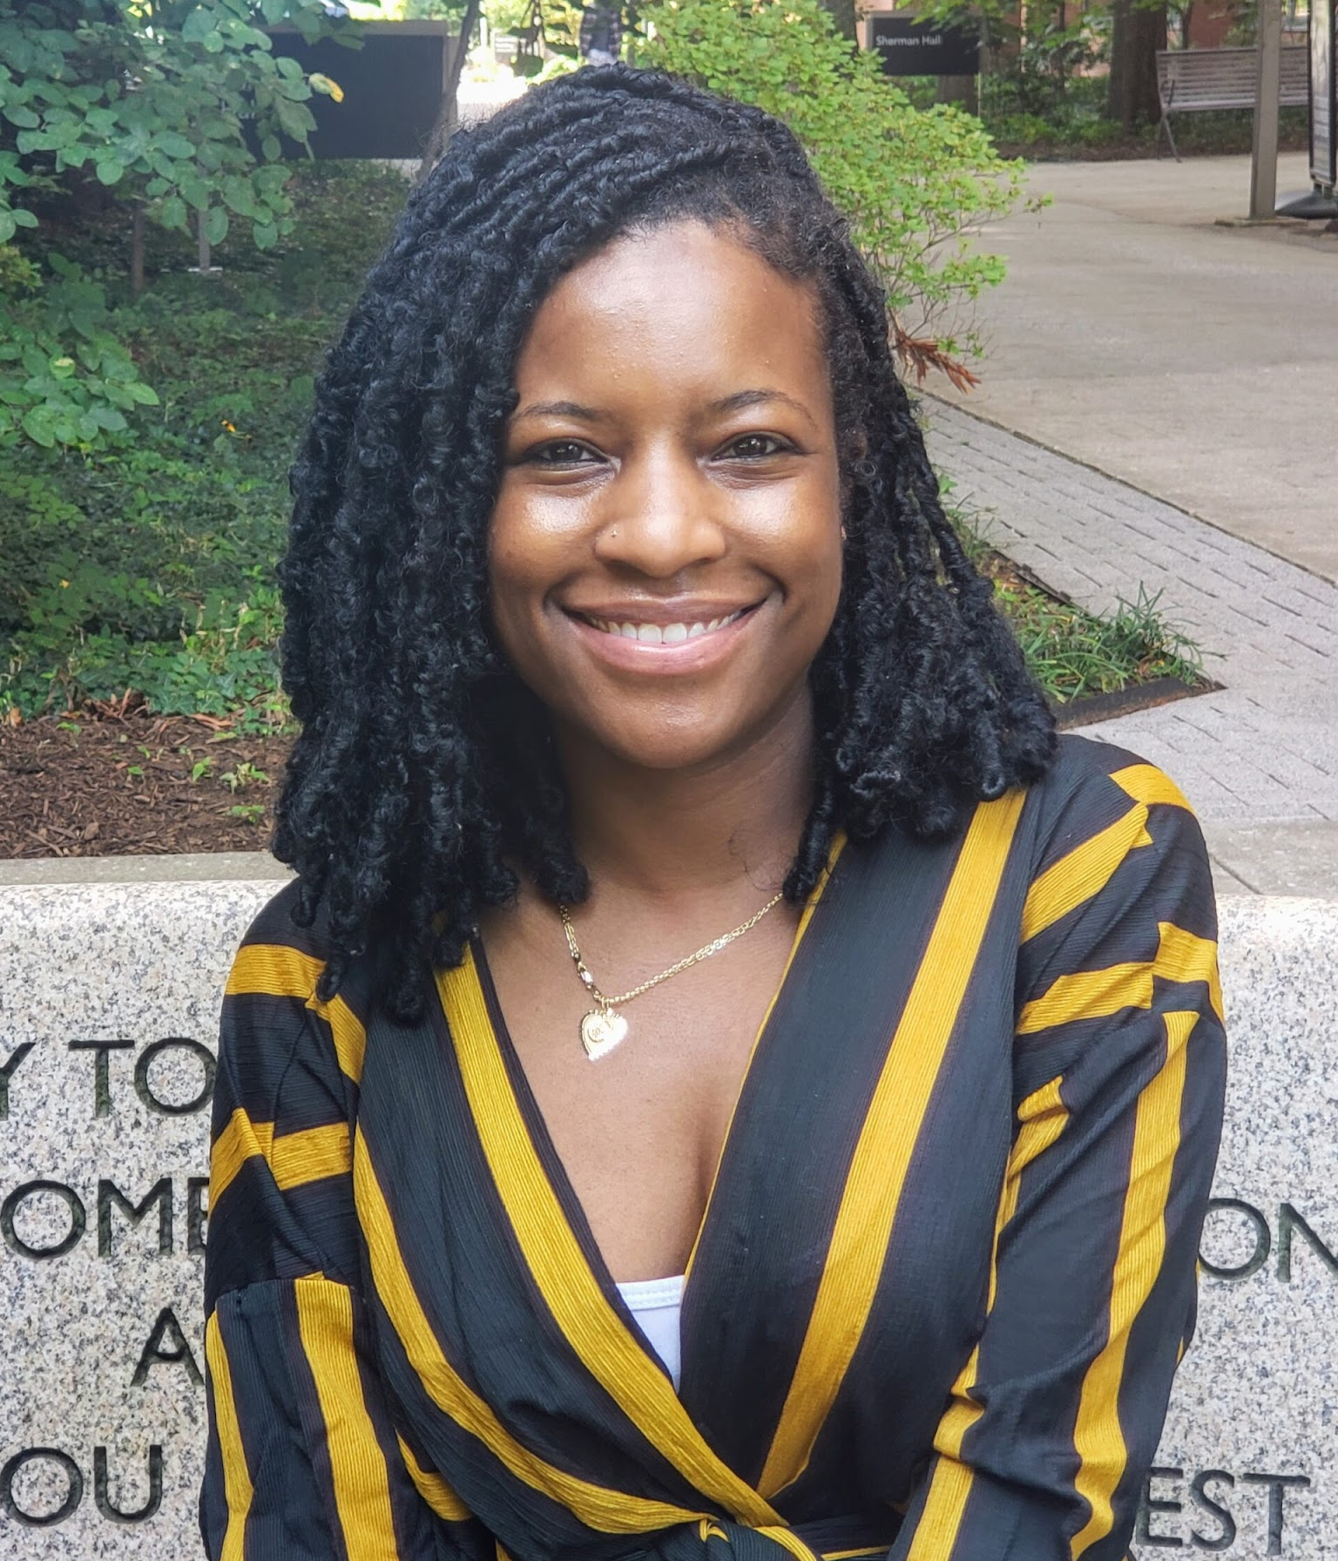
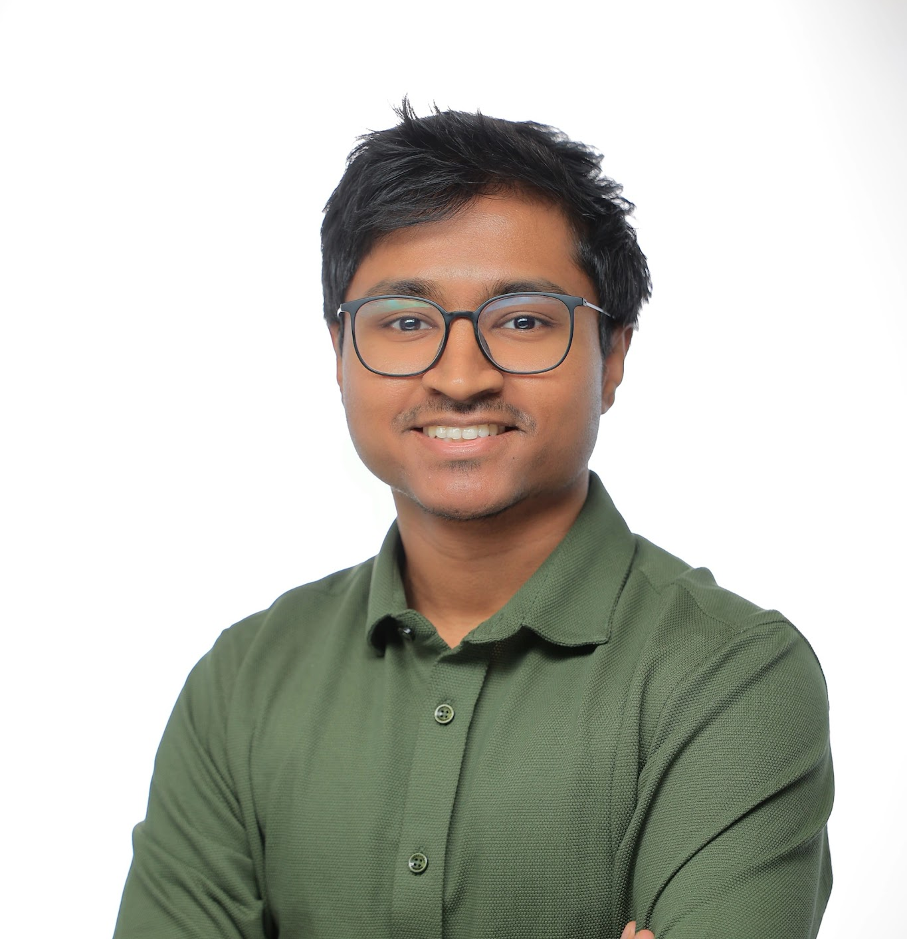
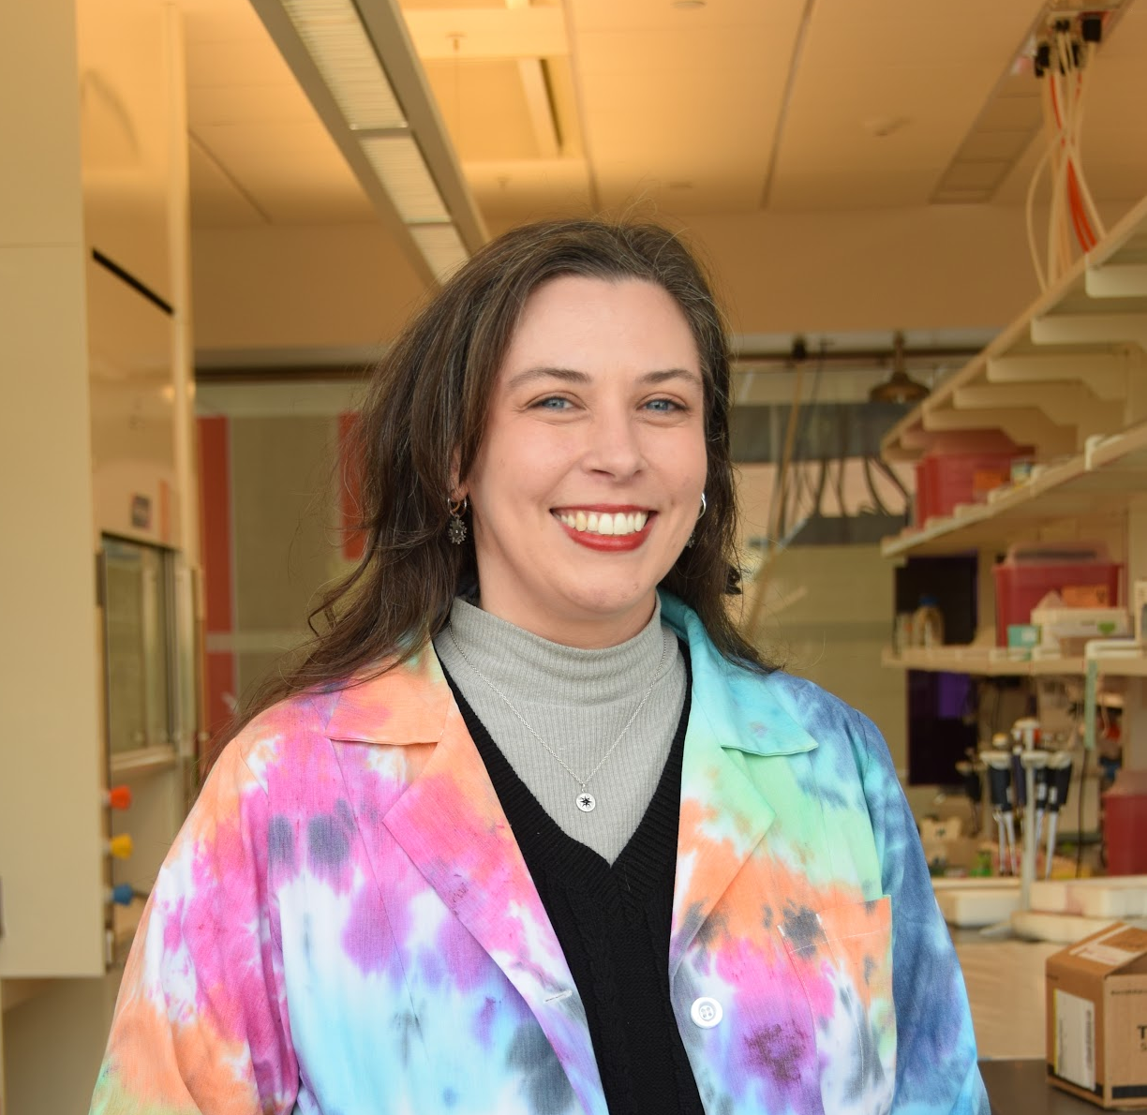
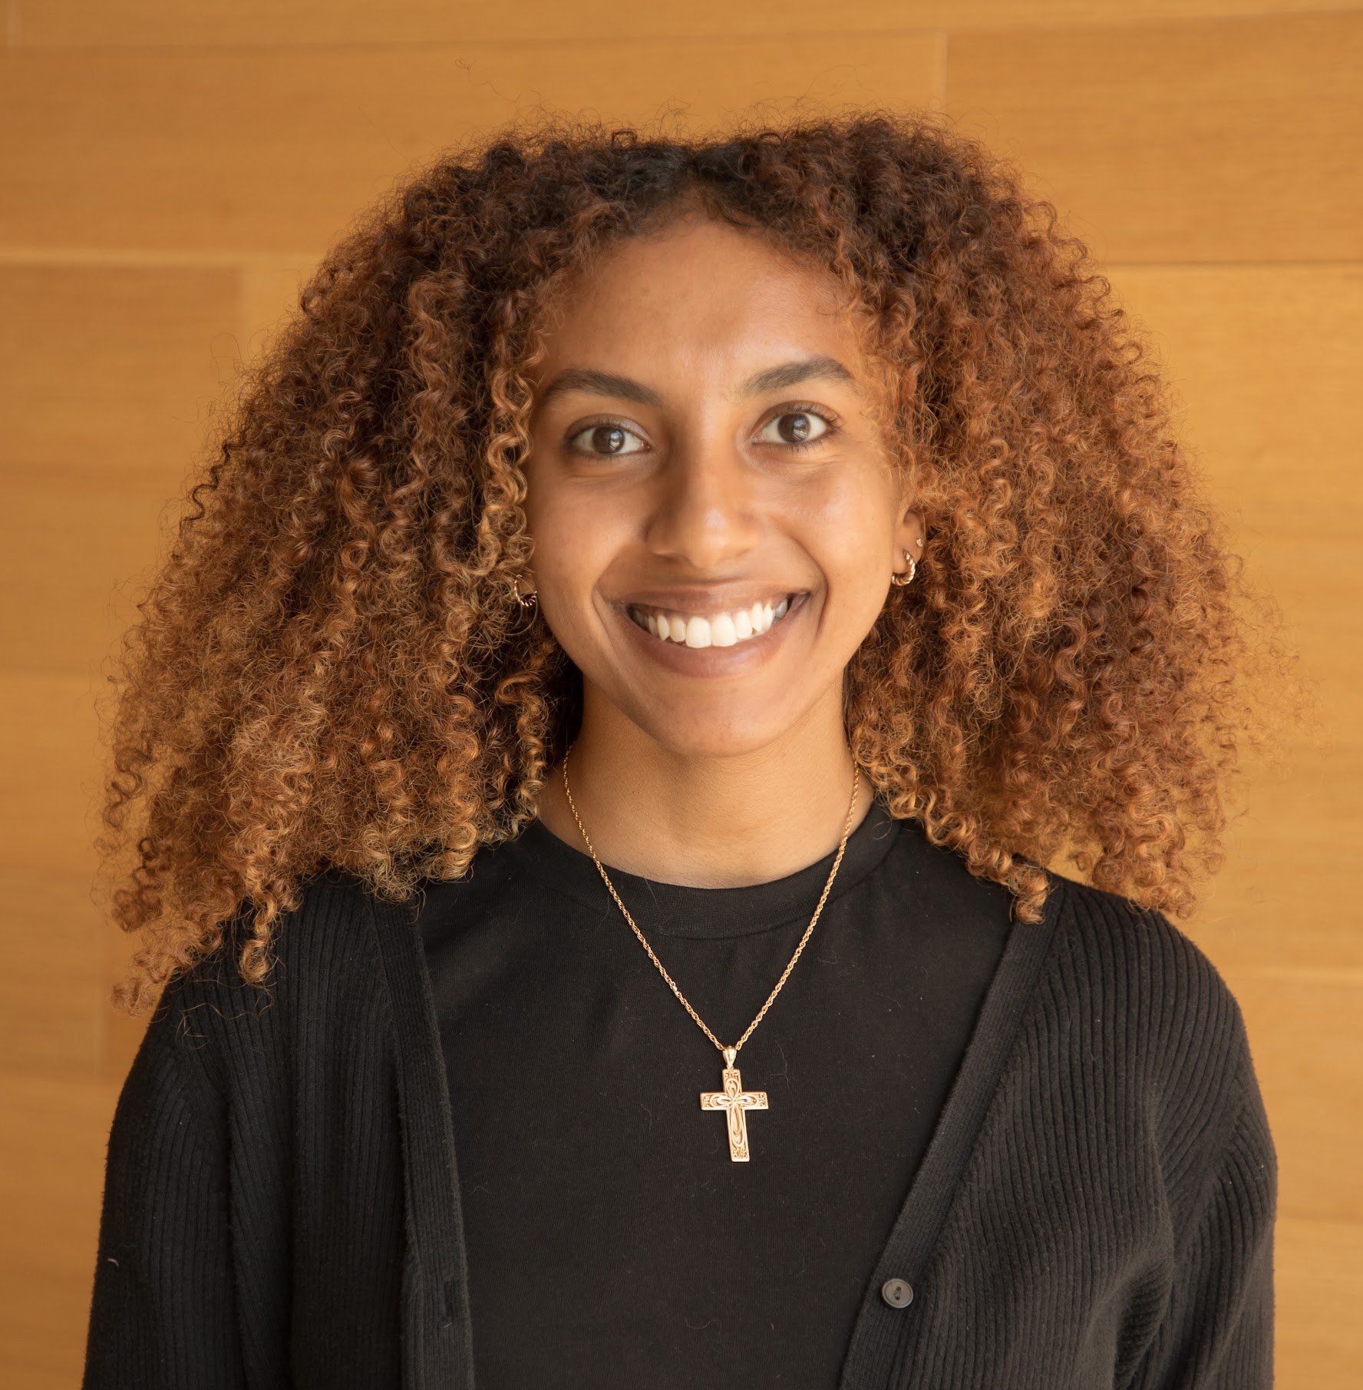
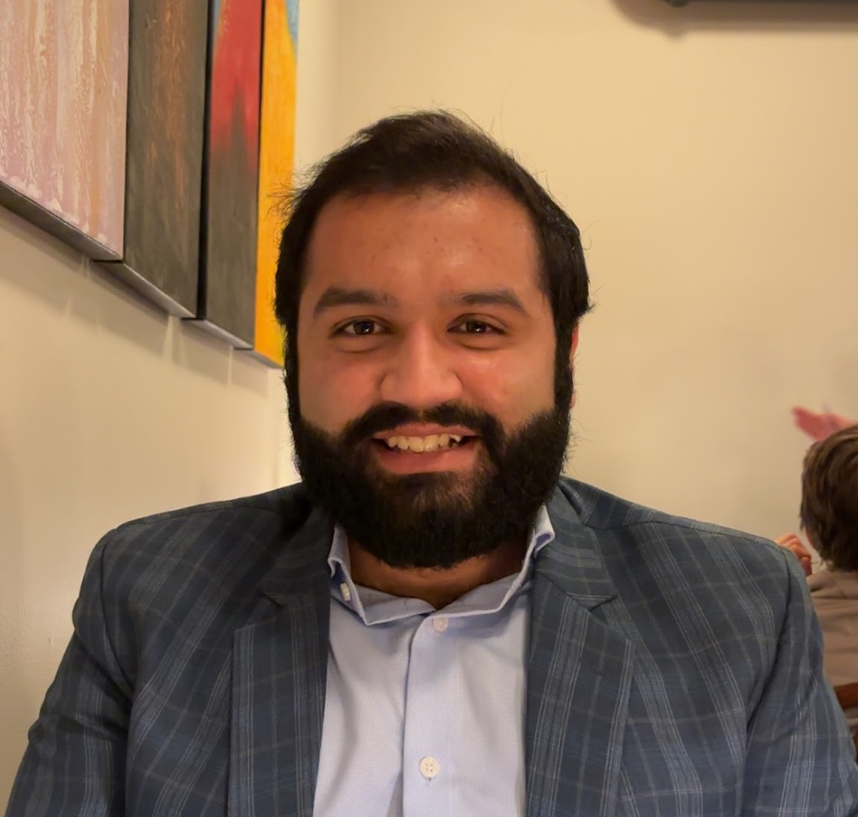
Hi! We're Your
Executive Council & Coordinators
Ahmet Kaan Aydin
President
Kennedy Davis
Vice President
Xixellonje Nebihu
Chief of Staff
Diane Placide
Senate Speaker
Milind Ramesh Rampure
Treasurer
Bethel G Beyene
Events Coordinator
Saad Khan
Marketing & Communications Coordinator
Tori LaChapelle-Sproat
Secretary

Slide 5
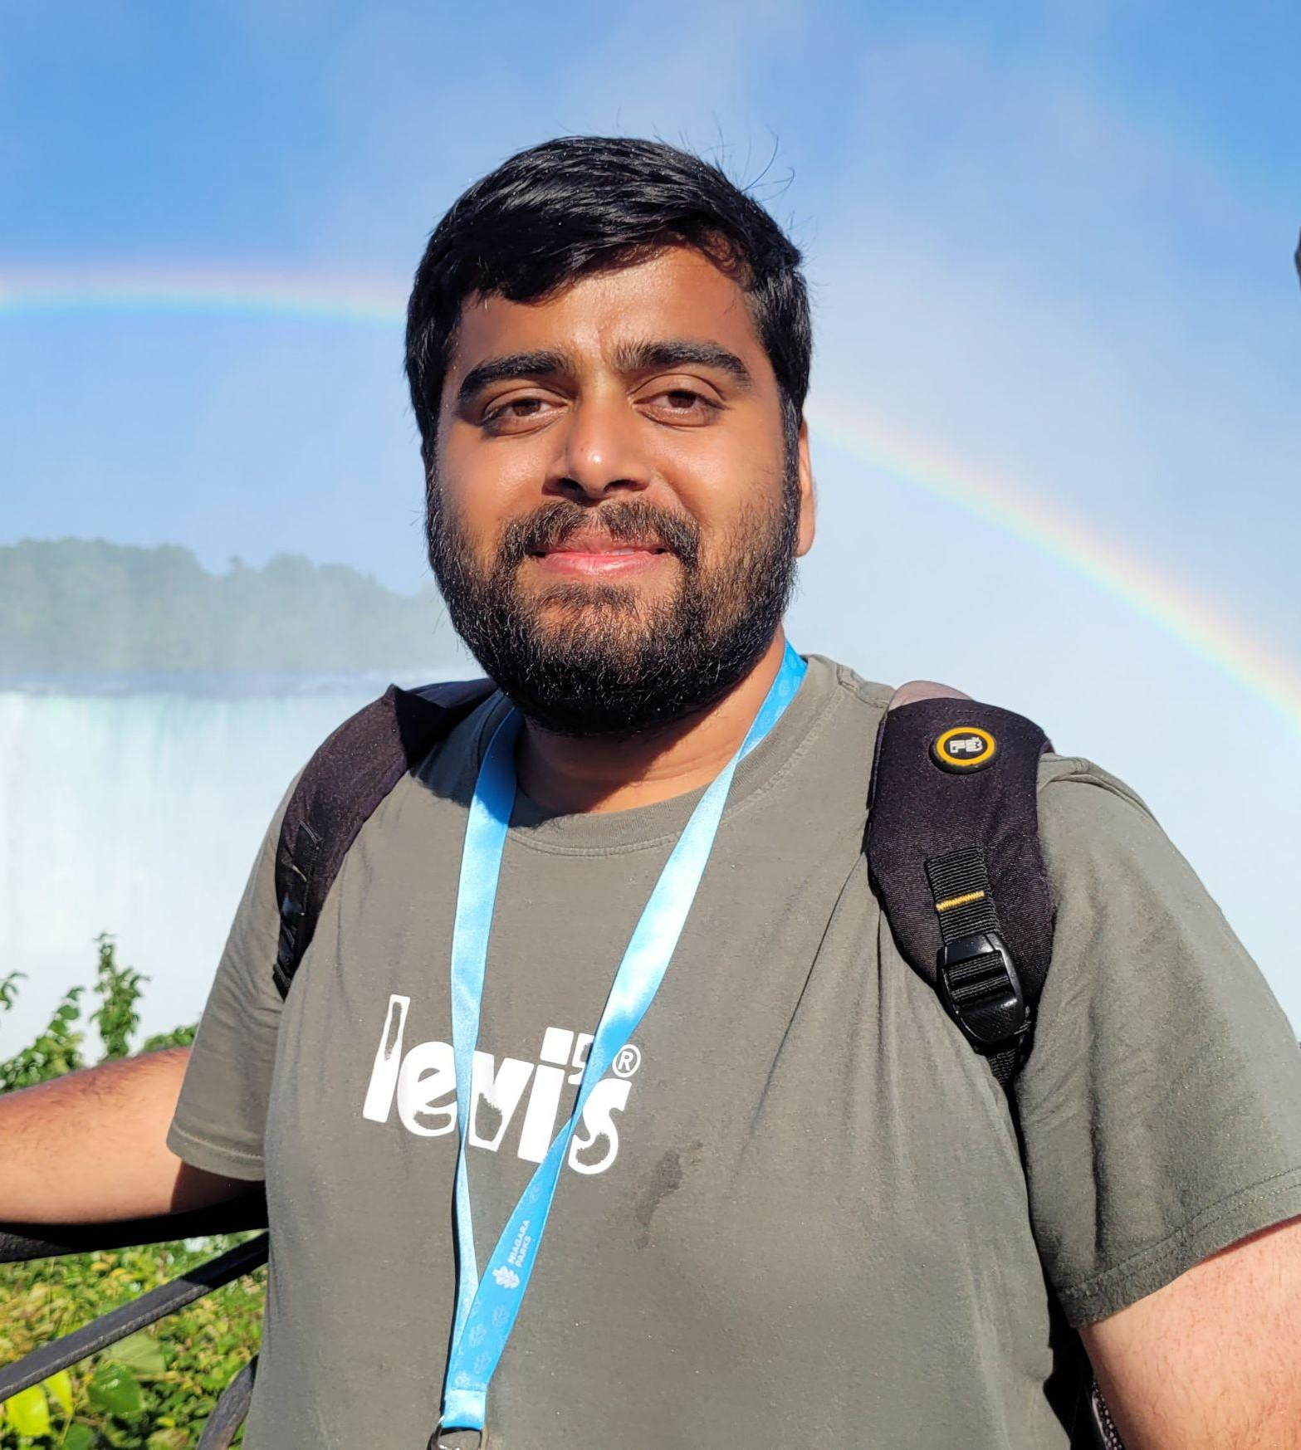

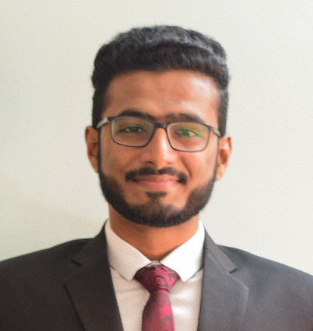
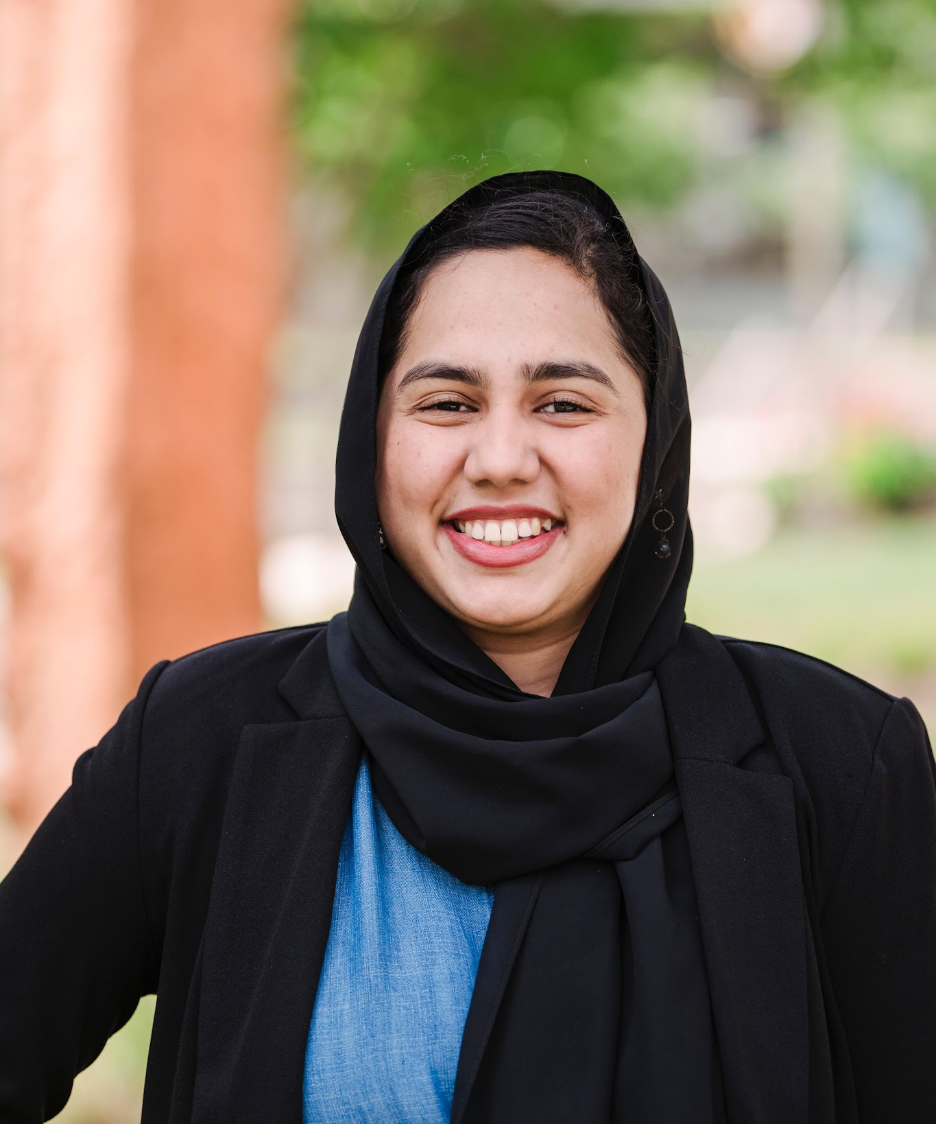
Hi! We're Your
Committee Chairs
Graduate Experiences, Achievements, and Research Successes (GEARS)
Gaurav Shinde
gsagears@umbc.edu
Graduate Assistant Advisory Committee (GAAC)
Risha Gupta
gsagaac@umbc.edu
Grant Review Panel (GRPC)
Aminah Amjad
gsagrants@umbc.edu
Equity of Funds (EoF)
Pavan Raj Ravi
gsaeof@umbc.edu

Slide 6
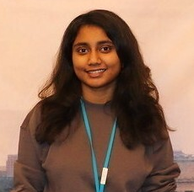
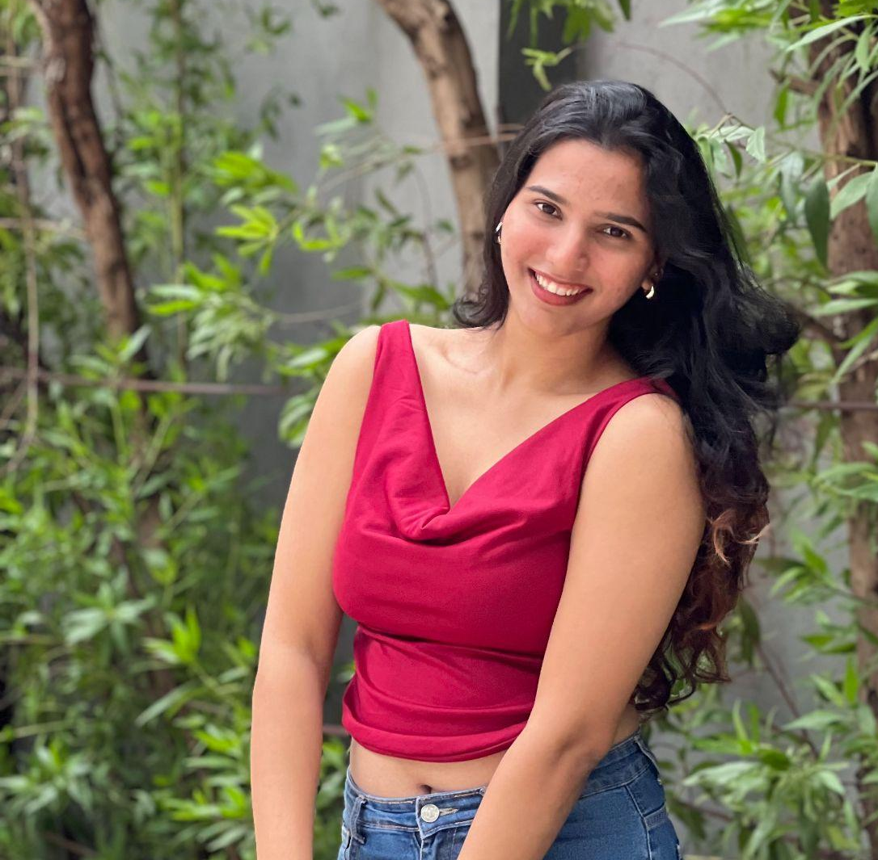
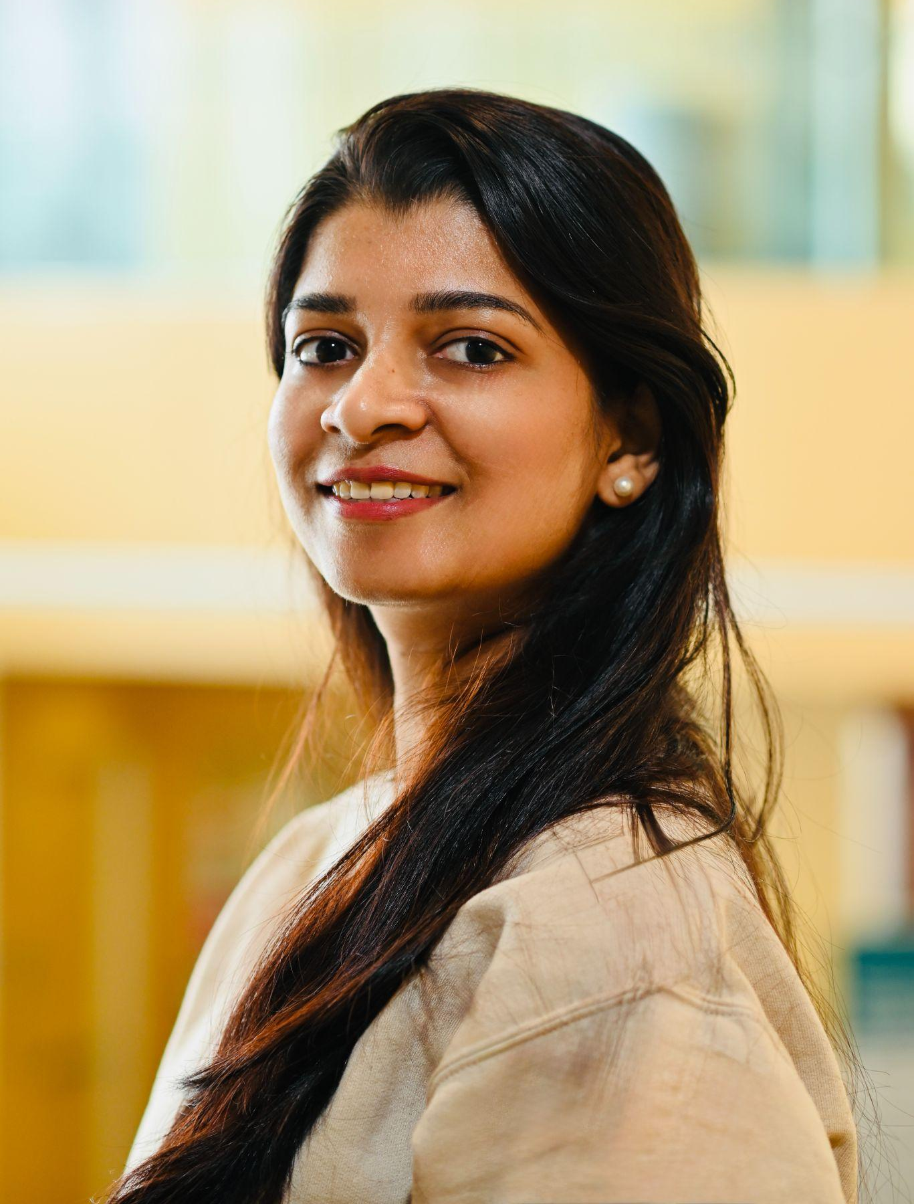
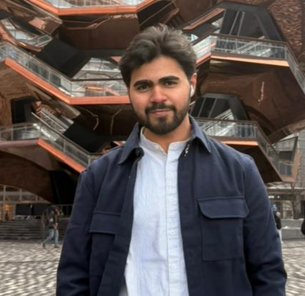
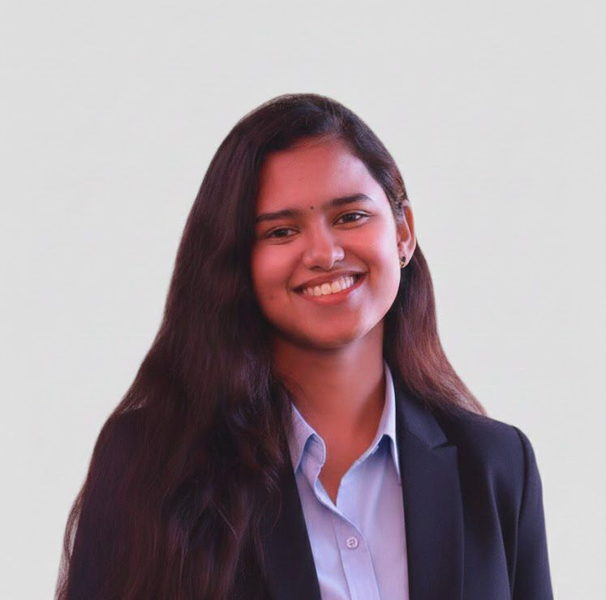
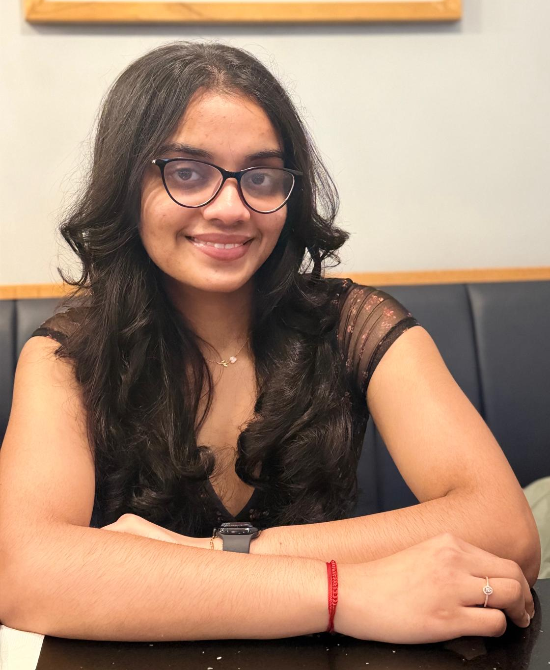
Hi! We're Your
GSA Senators
Student Affairs
Senators
Insert
Photo
Insert
Photo
Insert
Photo
Dharani Nadendla
Senator
Diane Placide
Senator
Aaryaa R. Gaikwad
Senator
COEIT
Senators
Photo
Insert
Photo
Insert
Photo
Sreeja Lakkakula
Senator
Krish Mehta
Senator
Suma Ronanki
Senator
Monika Battula
Senator

Slide 7

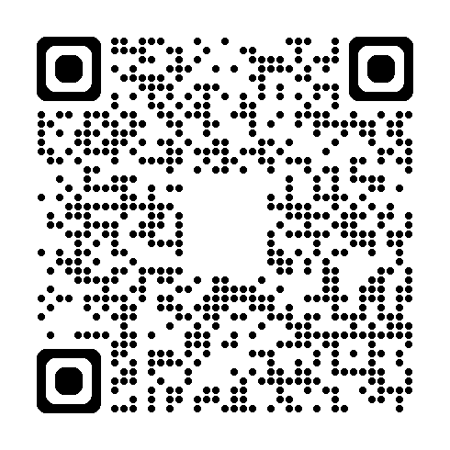
Become a GSA Senator!
APPLY HERE!
Open Senator Positions
We are looking for:
Student Affairs
CNMS
CHASS
senators.

Slide 8
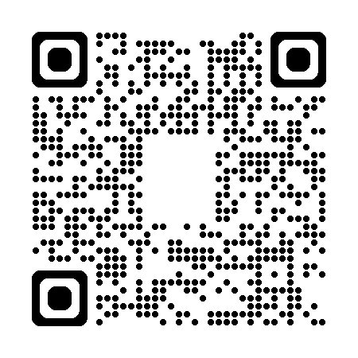
Apply for a GSA Grant!
Program info HERE!
Professional Development
Up to $900
attending/presenting at the conference or workshop
Research
Up to $1000
Anything related to thesis/dissertation work

Slide 9

Discover Your Community
Graduate Student Organizations (GSO)
Why Join?
Find like-minded peers
Share mutual interests
Expand network
Enrich your journey
Develop leadership
Explore GSOs
• American Statistical Association (ASA)
• Assoc. of Neuropsychology (ANST)
• Bangladesh Student Association (BSA)
• Bhakti Yoga and Meditation Club
• Biology Outreach Group (BOG)
• Black Graduate Student Org (BGSO)
• CBEE GSO
• Chemistry Graduate Student Assoc.
• Chinese Student & Scholar (CSSA)
• Cybernetics GSO
• EKTA-Indian Graduate Student Assoc.
• Graduate Assoc. of Biol. Sci. (GABS)
• Graduate Christian Fellowship
• Graduate Women in Physics +
• Int'l Students Connect (ISC-GCO)
• Iranian Graduate Student Assoc. (IGSA)
• Latinx Hispanic Graduate Student Assoc.
• Nigerian Graduate Student Association
• Pakistani Graduate Student Org.
• Physics Graduate Student Association
• Social Hub
• SPIE
• TESOL Club
Create Your Own!
Looking for something else? Create yourself!
Design your mission
Gather 5+ grad peers
Receive GSA funding
Build your legacy

Slide 10
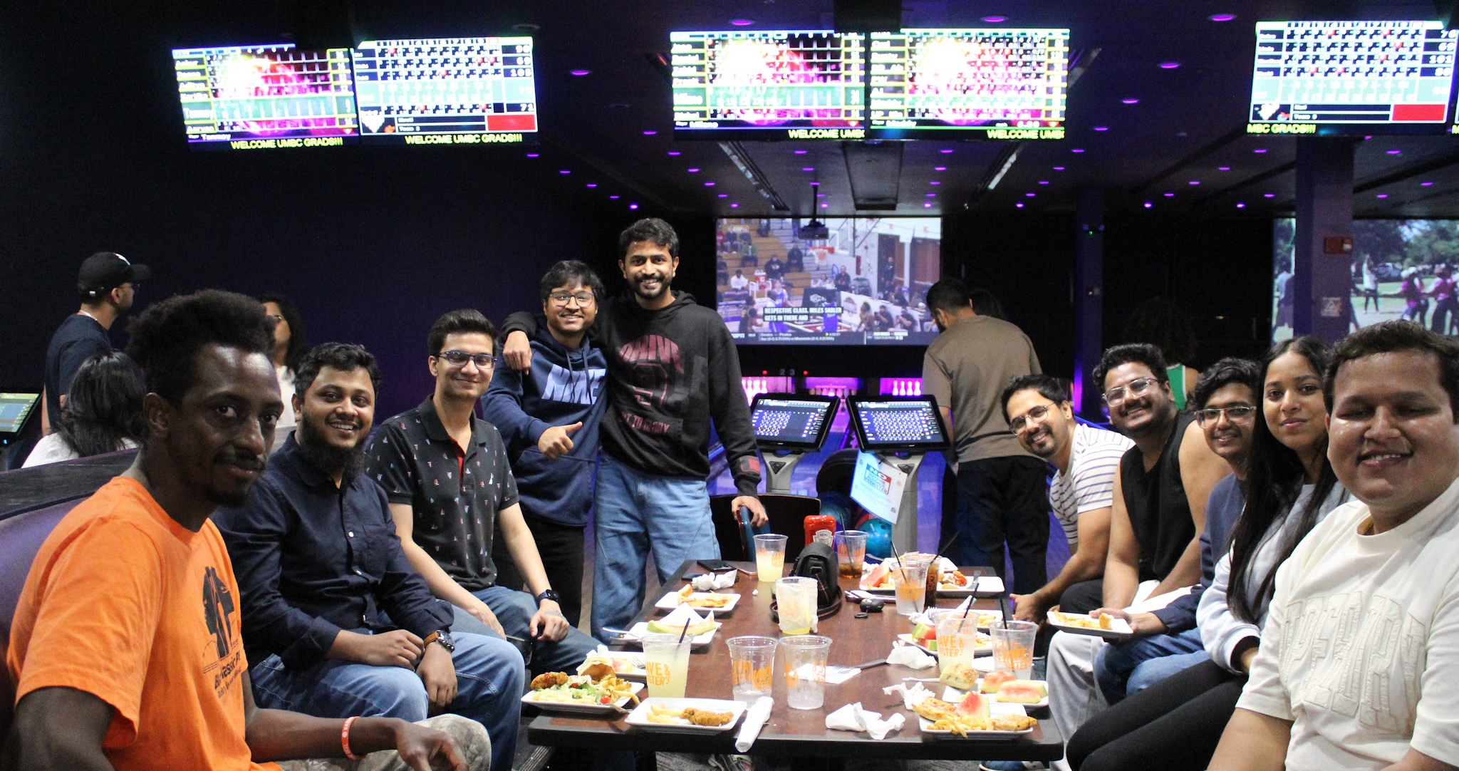
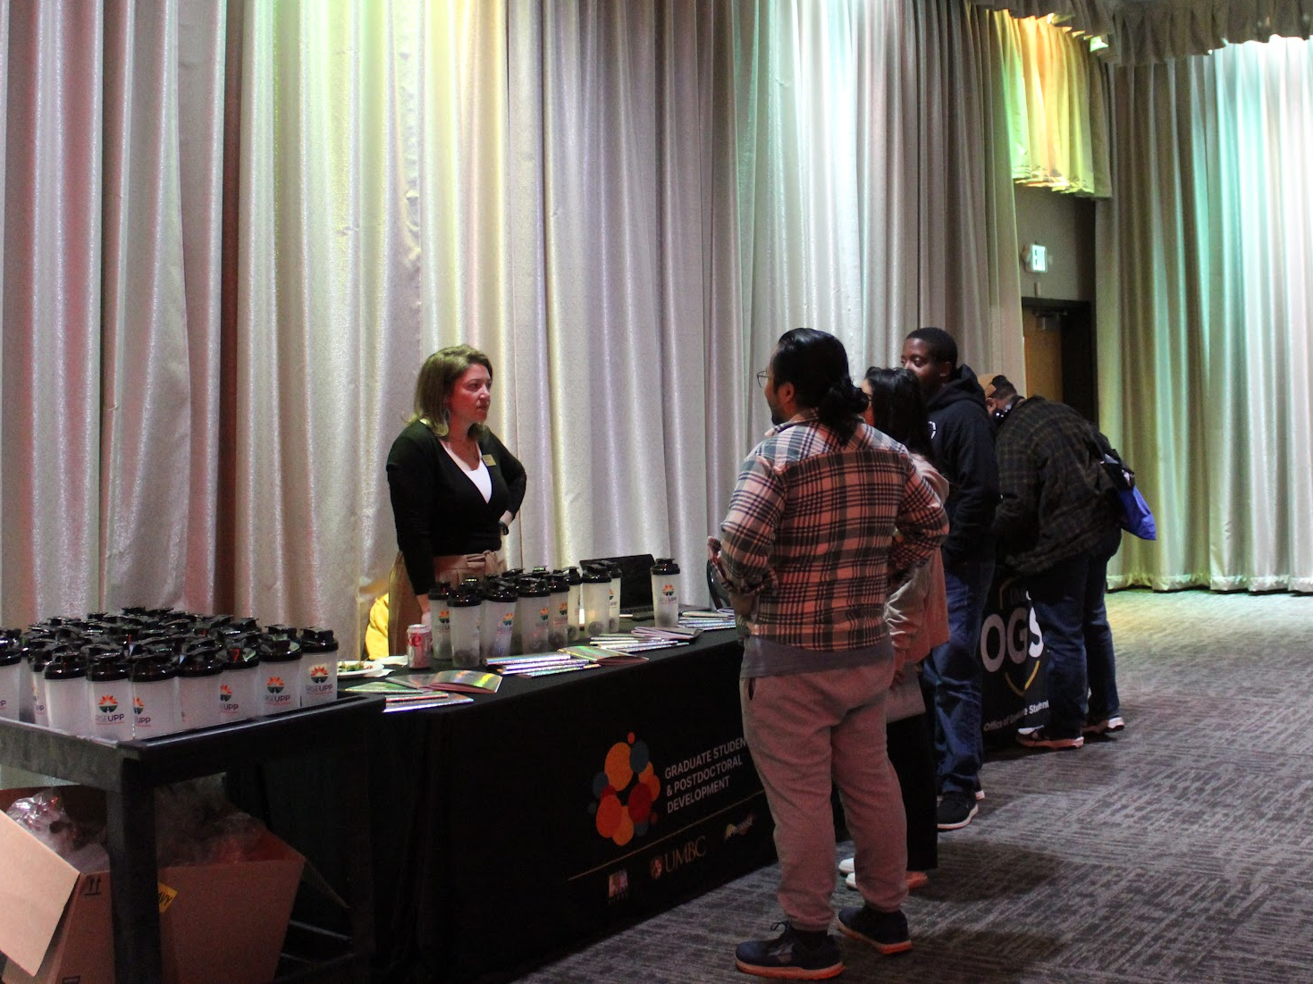
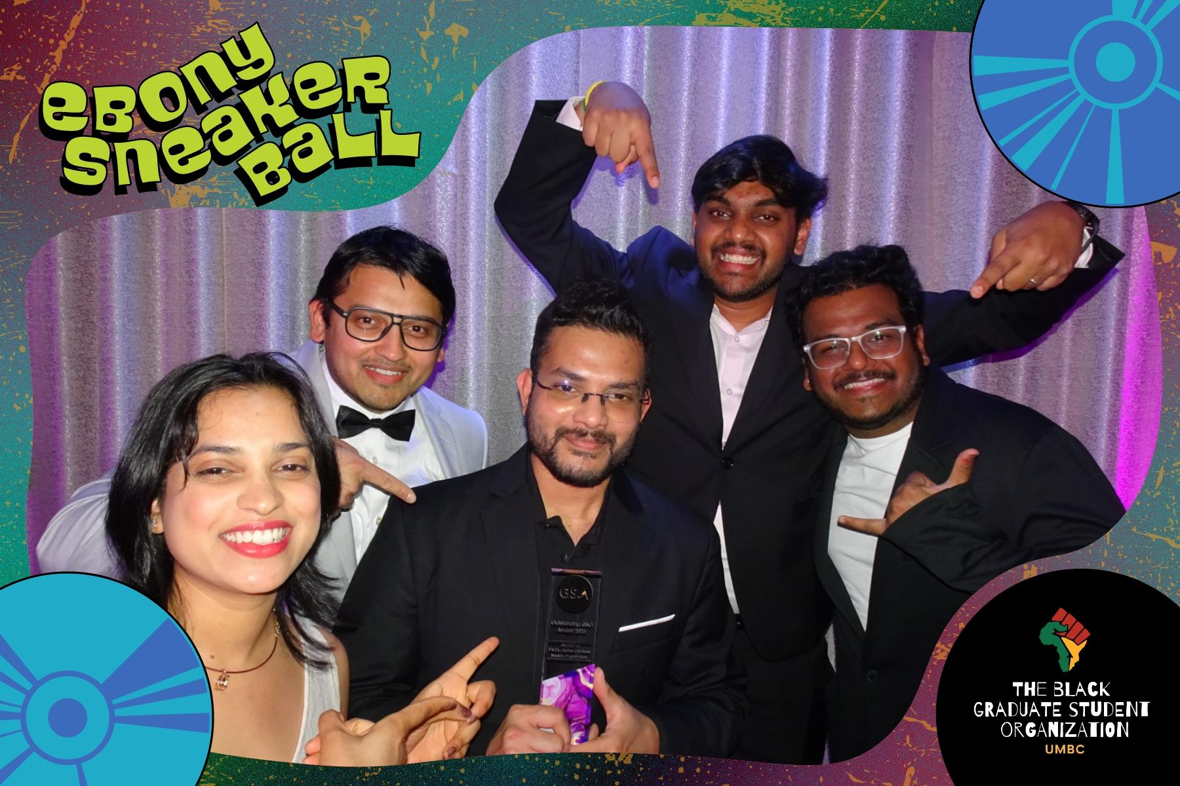
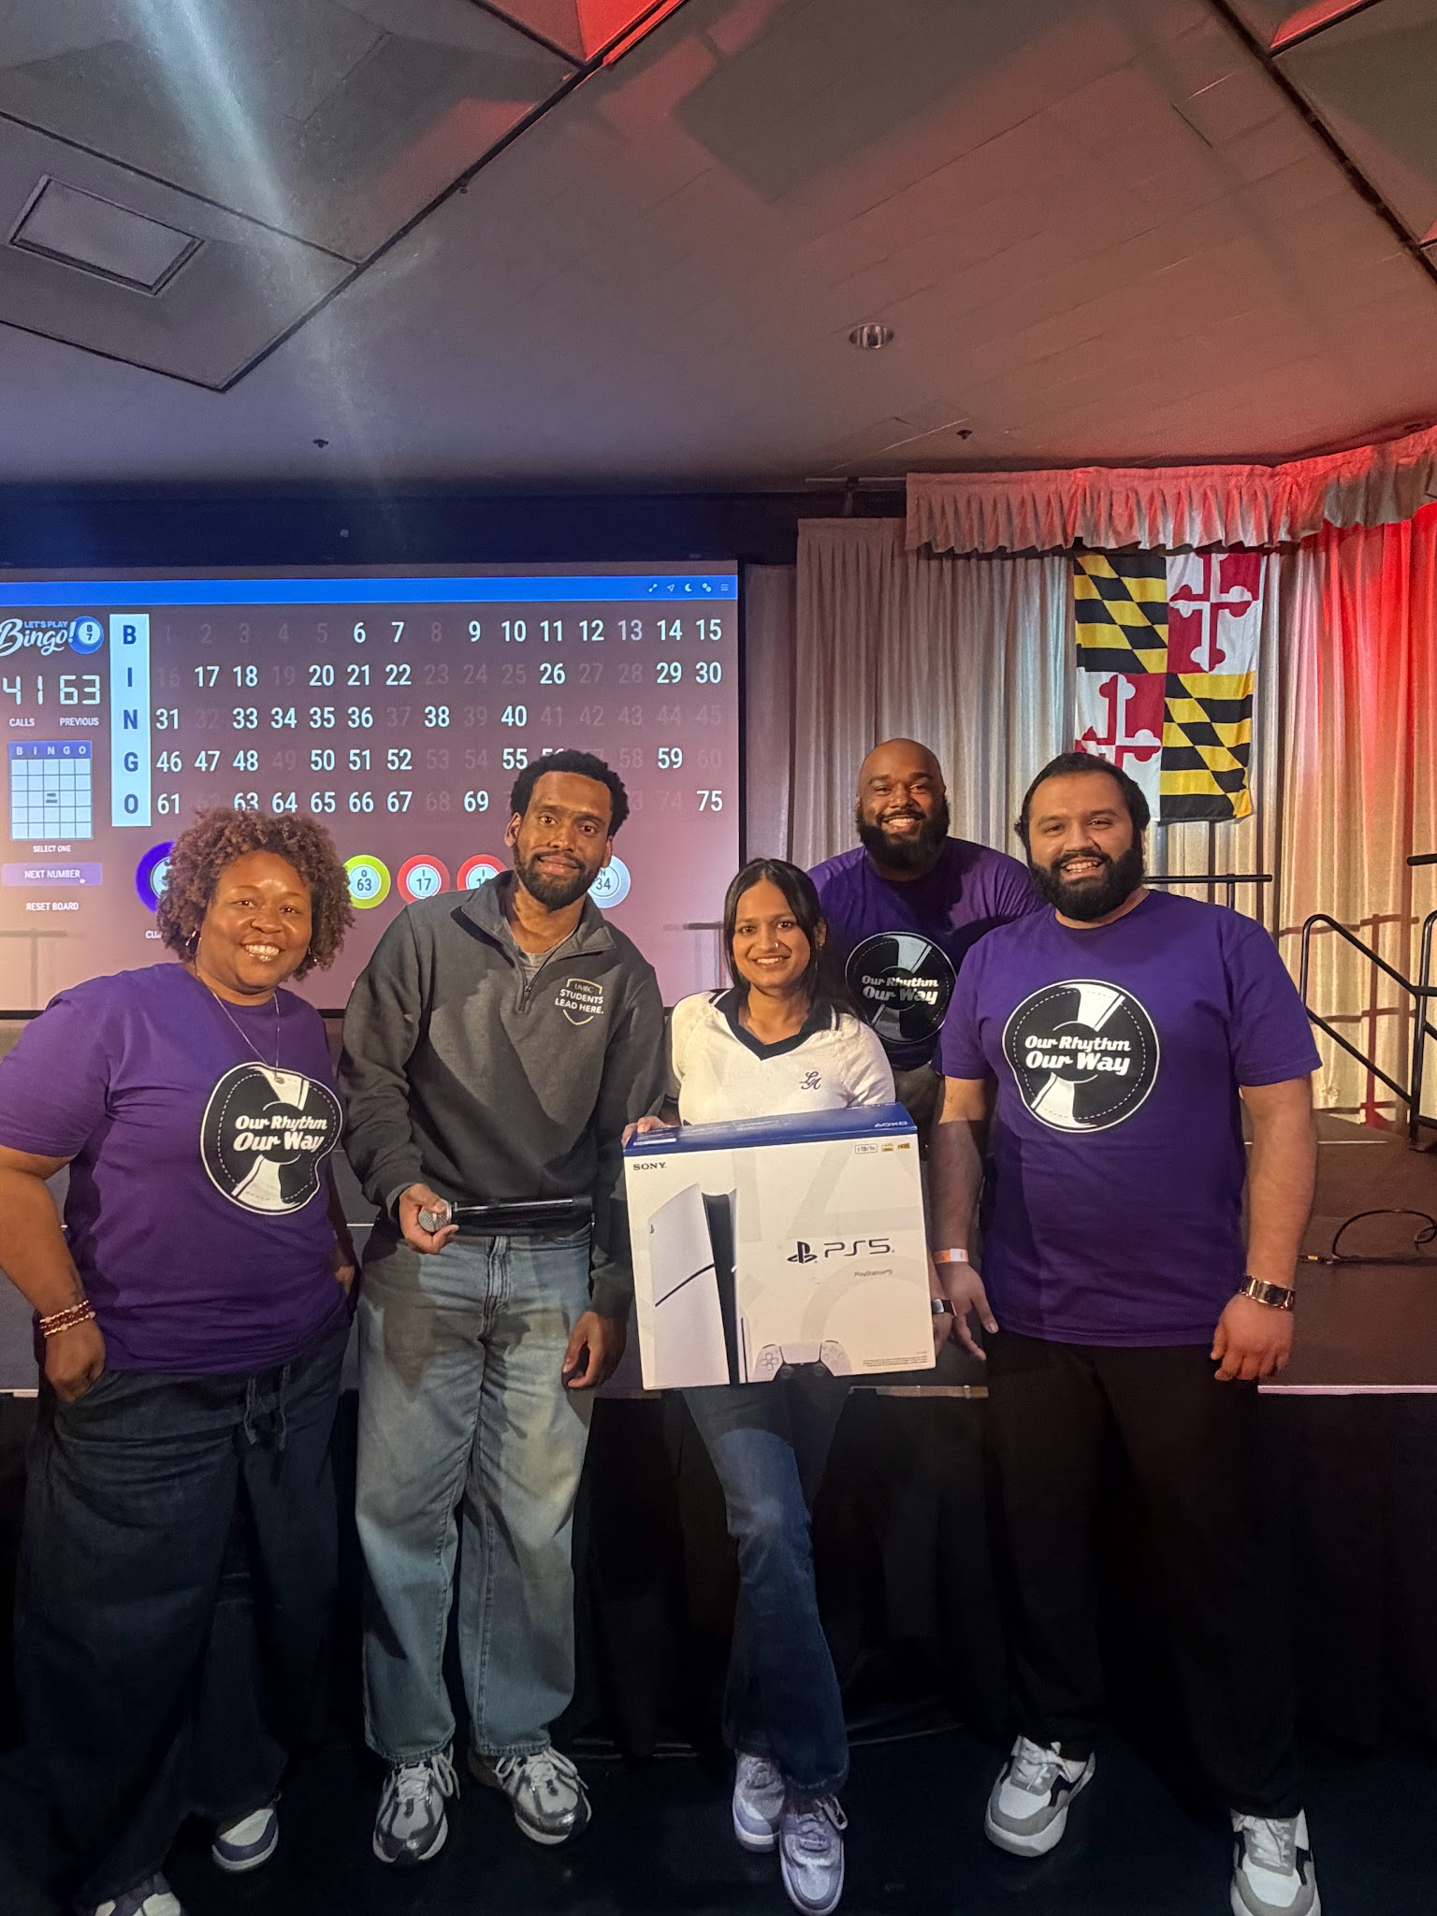
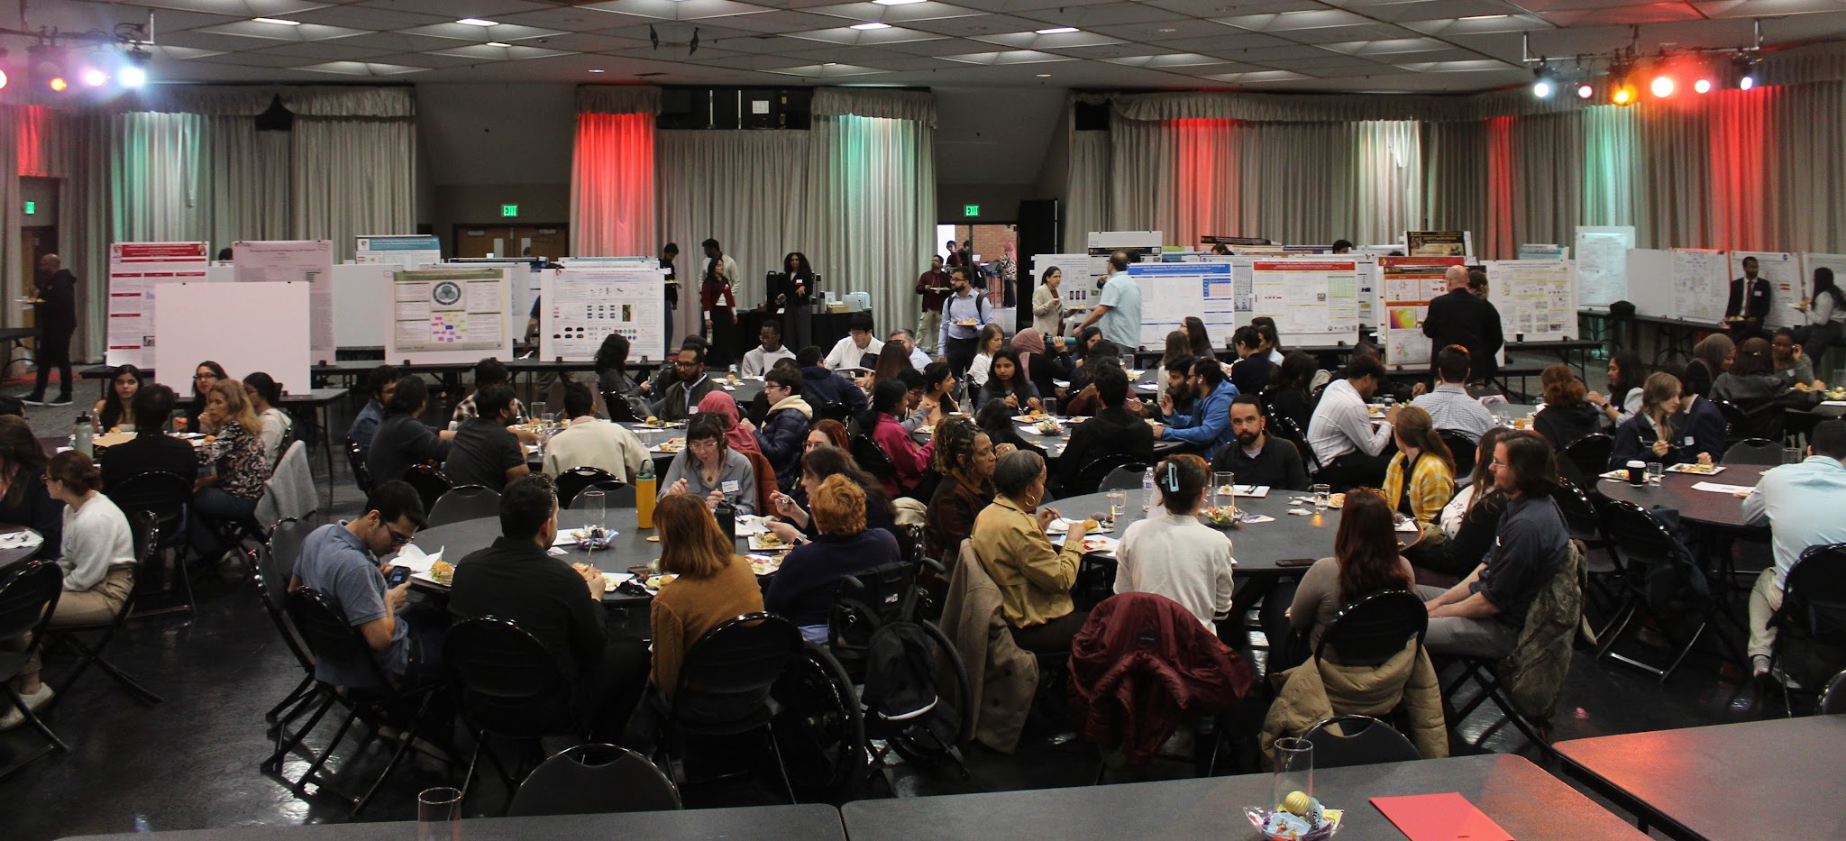
Culture Day
Dave & Buster Trip
Bingo Night
GEARS Research Symposium

Slide 11
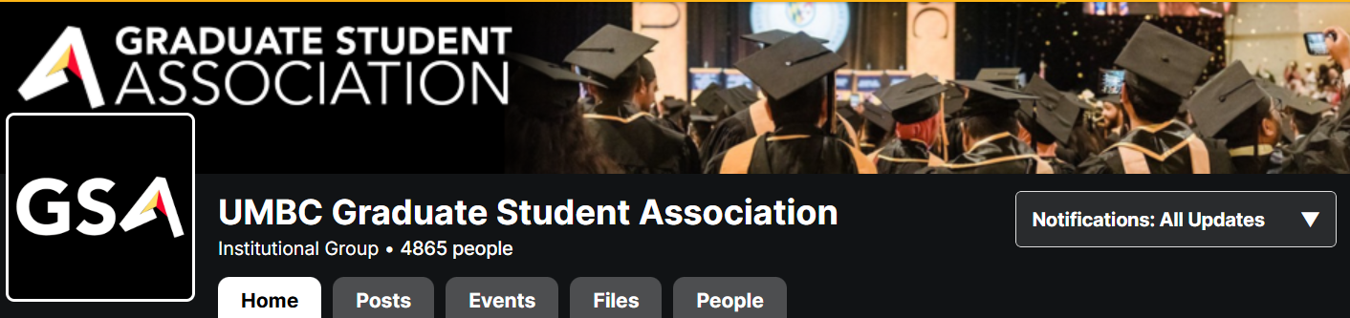
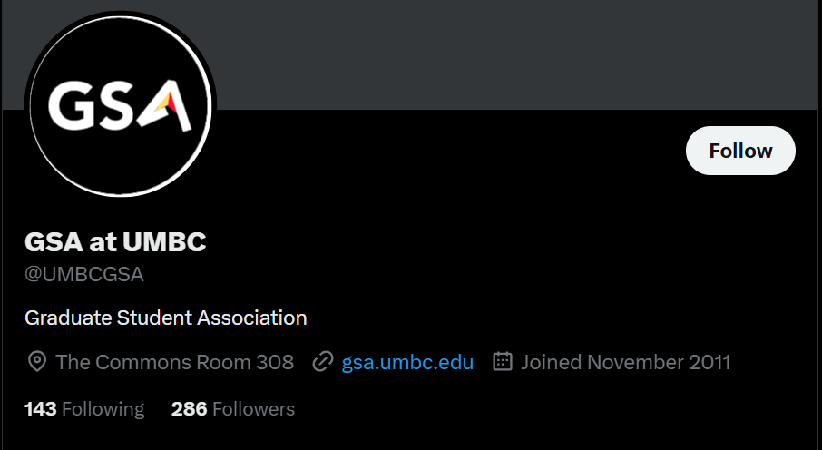


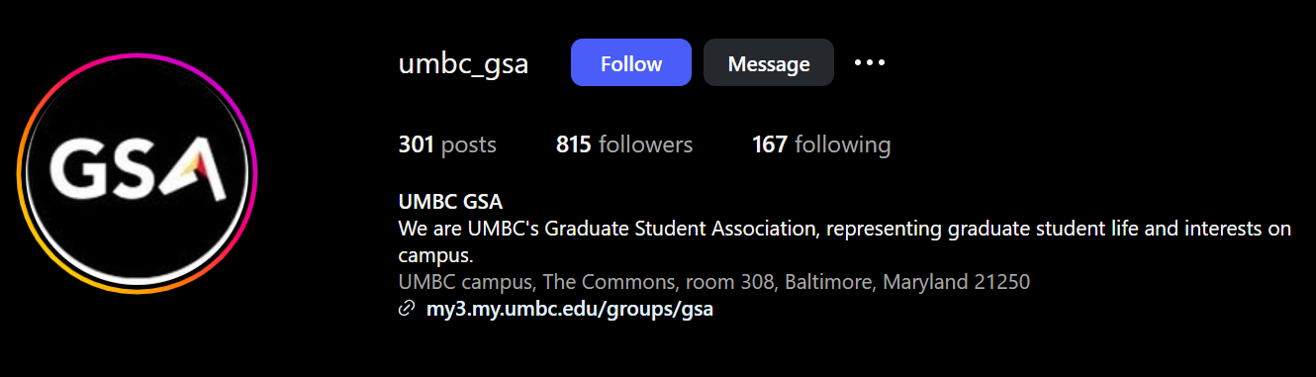
Contact Us
email
Email Us
gsa@umbc.edu

