Slide 1
Reinventing the Classroom: Creating a New Course and a Space to Teach It
Harry Lewis
Gordon McKay Professor
of Computer Science

Slide 2
Step 1 in Creating Anything:
Understand what problem
you are trying to solve!

Slide 4
hits movie theaters

Slide 5
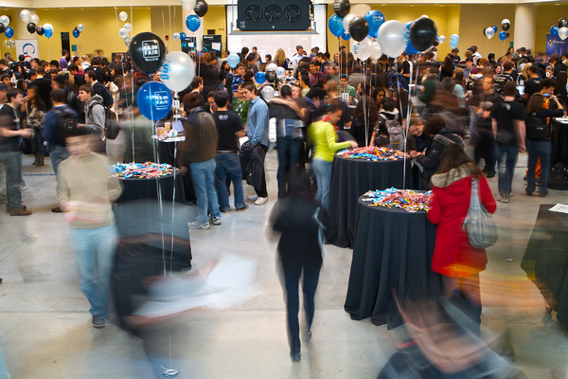
CS50 2012

Slide 6
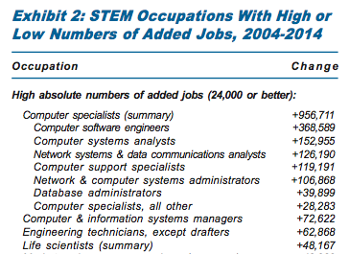
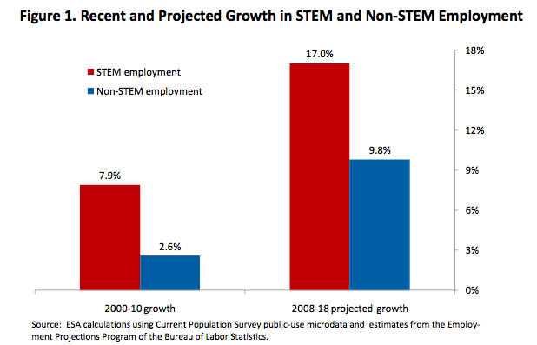

Slide 7
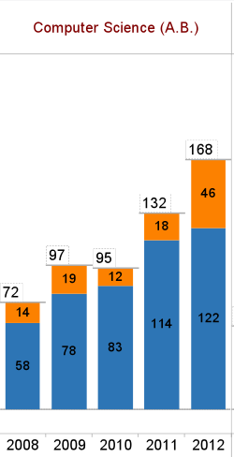
Concentrators 2008-2012
< 40% of those who major in CS came to Harvard expecting to major in CS
2.3x

Slide 8
Need a Pre-Theory Course
For students who haven’t done formal mathematics
Regular calculus course not formal enough
Not for students doing “honors” calculus

Slide 9
CS 20 Syllabus
Logic
Proofs
Graph theory
Probability
Counting
How many poker hands have 2 pairs?

Slide 10
Bad News and Good About the Syllabus
The Bad News: No Grand Narrative
The Good News: Plenty of Stories!
E.g. for graph theory …

Slide 11
Six Degrees to Harry Lewis
On Friday, January 23, 2004, at 05:09 AM, Mark Elliot Zuckerberg wrote:
[MEZ] Professor, I've been interested in graph theory and its applications to social networks for a while now so I did some research … linking people through articles they appear in from the Crimson.
I've set up a preliminary site that allows people to find the connection (through people and articles) from any person to the most frequently mentioned person in the time frame I looked at.

Slide 12
Six Degrees to Harry Lewis
[MEZ] This person is you.

Slide 13
Six Degrees to Harry Lewis
[HRL] Can I see it before I say yes? It's all public information, but there is somehow a point at which aggregation of public information feels like an invasion of privacy …

Slide 14
Six Degrees to Harry Lewis
[HRL] Sure, what the hell, seems harmless …

Slide 15
Problem 1 Students Don’t Attend Lectures

Slide 16
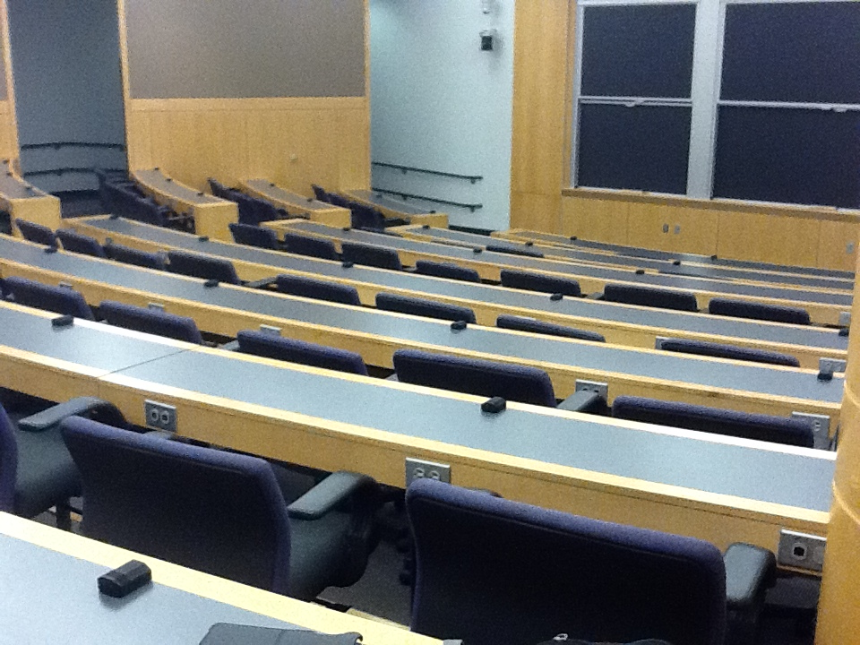
Typical CS 121 Lecture Slide
Typical CS 121 Lecture Attendance

Slide 17
Problem 1 Students Don’t Attend Lectures
They are all videorecorded for a distance audience
Possible Responses
Required attendance
Unannounced quizzes
Restrain distribution of videos
All hostile, adversarial, anti-libertarian
Universities should be about disseminating information not bottling it up

Slide 18
These Solutions Do Not Respond To the Underlying Problem
In the information era we do not need the classroom as a venue for information transfer
“College is a place where a professor’s lecture notes go straight to the students’ lecture notes, without passing through the brains of either.”

Slide 19
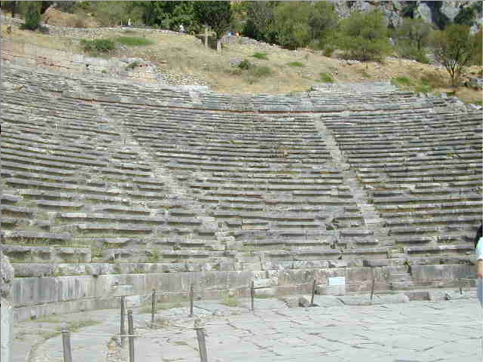

Slide 20
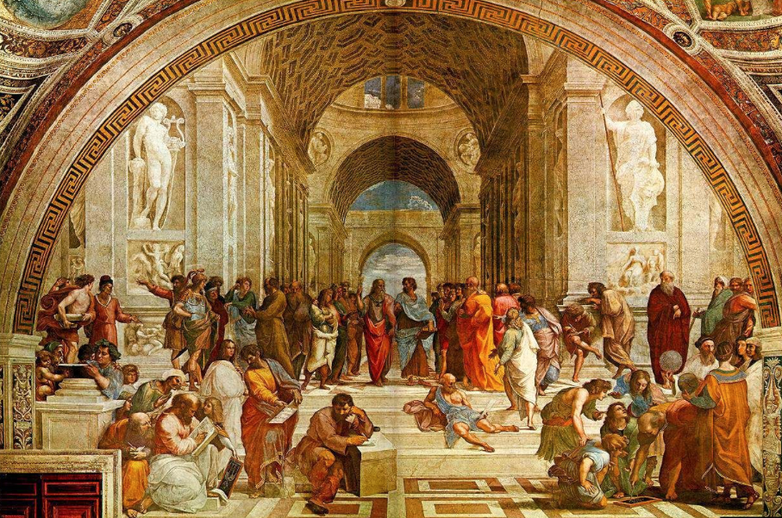

Slide 21
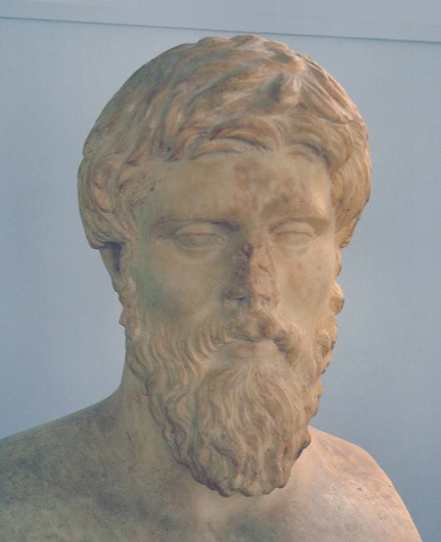
Plutarch (AD 46-122) on education
The mind is not a vessel to be filled but a fire to be kindled.

Slide 22
Solution: Flip the Classroom!
Listen to lectures at home
Do homework in class

Slide 23
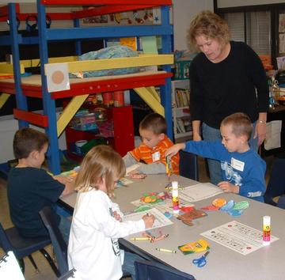

Slide 24
Problem 2 No Place to Teach!

Slide 25
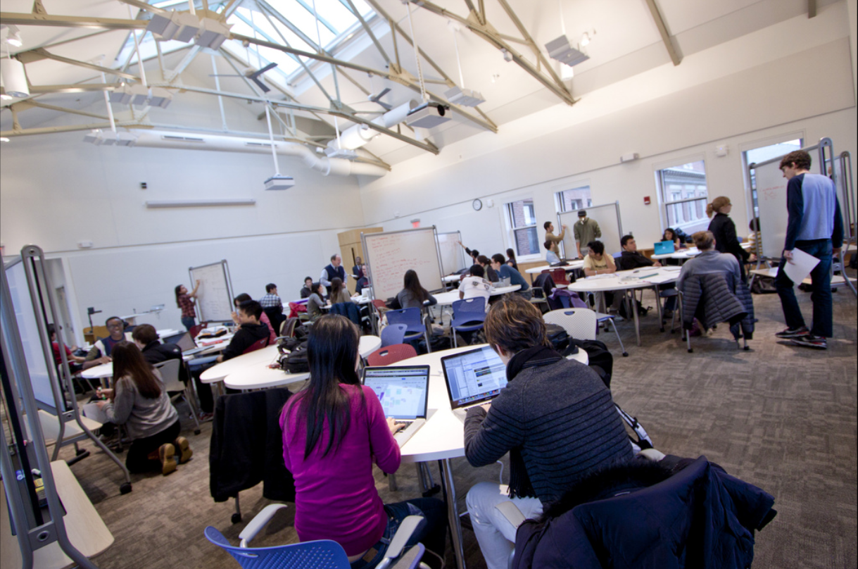
Bright, Low-Tech Classroom!
Reconfigurable paisley-shaped tables
False floor to bring power to each table
Whiteboards with daily marker check
Projection at both ends of room
Controllable shades on windows and skylight
Ignore these two volunteers: We don’t use computers

Slide 26
In-Class Structure
42 Students
Students in tables of 4
Students solve problems, write on whiteboard
TFs coach and coax
TF checks off solution, group goes on to next problem

Slide 27
Typical Class
http://flickr.com/gp/grinnell/s5F5y8/

Slide 28
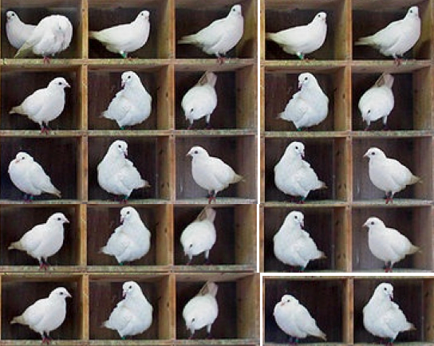
First Class: The Pigeonhole Principle
If n pigeons are in fewer than n pigeonholes, some pigeonhole must contain at least two pigeons
http://www.blog.republicofmath.com/archives/3115

Slide 29
Now solve the problem!
If 10 points are chosen from the area of a 1x1 square, then some two points are no more than √2/3 apart (< 0.48)
Use the Pigeonhole Principle!
1
√2/3
1

Slide 30
Course Structure
New bright flat floor classroom – Pierce 301
Required attendance
Daily homework
(collaboration OK with acknowledgment)
Homework box removed at beginning of class
Exams

Slide 31
Grading
Each HW problem graded 0-2
Homework 35% Midterms (2) 30% Final exam 25% Check-in questions 10%
P/F allowed

Slide 32
Typical Topic Structure
Before class:
Reading
Watch 20 minute pre-recorded mini-lecture
Check-in problems
In class:
HRL does one warm-up problem
TFs return graded problem sets from previous topic
Distribute in-class problems
After class:
Homework problems
Goal: 10 hours/week outside class, 3 hours in class

Slide 33
More Problems!
For each of 33 topics (3 per week) need
Readings
Video
Check-in problems
In-class problems
Homework problems
Huge management problem!
Typical text costs $220
Use free materials instead
Producing notes for next year with one of the TFs

Slide 34
Non-Competitive
We take attendance but we do not give points for solving in-class problems
3 wildcard absences permitted
No wildcard needed for:
Medical problems/personal emergencies
Religious observances
Official Harvard business
5/42 students are varsity athletes

Slide 35
Forming Tables
Open until study cards submitted (1 week)
HRL made up the tables
Avoid gender clusters
Avoid class-year clusters
Avoid ethnic clusters
Unpredictable variables
Ability
Sociability
Next-time, re-mix

Slide 36
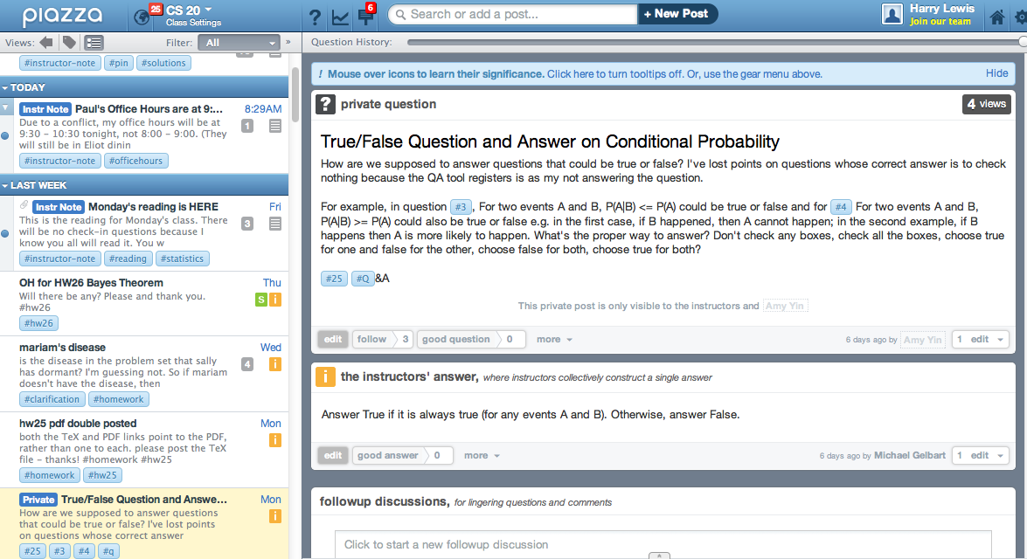
Piazza Discussion Tool

Slide 37
Piazza Discussion Tool
☺ Excellent tool for question answering
☺ TeX support
☺ Quick way to post corrections
☺ Post materials that should not be made public
☺ TFs and I monitor constantly and provide quick answers
☺ Allow anonymous questions and comments
☹ Probably a BAD idea to have BOTH anonymity AND quick responses!

Slide 38
Keys to Success
Get the level of the problems right
Students will put up with a lot if they trust you
High quality TFs and plenty of them
Head TF was Biophysics PhD student
CAs were 3 math majors + 1 CS major
Each is responsible for 2 or 3 tables of 3 or 4

Slide 39
Learning Tensions
Ideally TFs force the table to come up with answer and then call on a student at random to explain table’s answer
But we don’t want them to waste time aimlessly
We want discourse
But we encourage students to bring computers so they can refer to course materials in class
In practice one hour is just too short
50 mins minus warm-up ≈ 35-40 mins
I’d rather have 3 x 75 minute classes
I no longer answer questions during warm-up
Wastes time of students who understand
TFs can answer the question at the table
Counter-cultural!

Slide 40
Rigidity and Flexibility
The gears really have to click for this style of teaching to be successful
And yet you can’t seem to be taking yourself too seriously or you will only make the students anxious
Keep your sense of humor

Slide 41
A Distance Ed Version!
20 students, from California to UK
Students in “rooms” of 4
Use tablets to write on virtual whiteboard
Also chat to collaborate
TFs wander among rooms to check in and coax
One very experienced Extension TF, one freshman

Slide 42
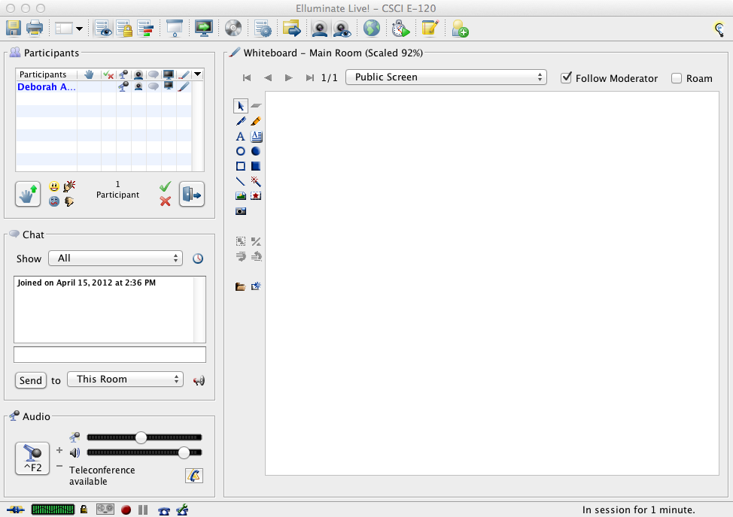

Slide 43
Sum-Up on Goals
CS 20 aims to teach ways of thinking
CS 20 aims to teach vocabulary and methodology
CS 20 should give the student little to memorize and a lot to remember
“Wait! I remember there is some general way to solve that kind of problem.”

Slide 44
CS20 is “Inefficient”
Not as much material “covered” as in lectures
But if you factor in what students actually learn …
3 hour per week class structure is an anachronism of the lecture era
Scalability?

Slide 45
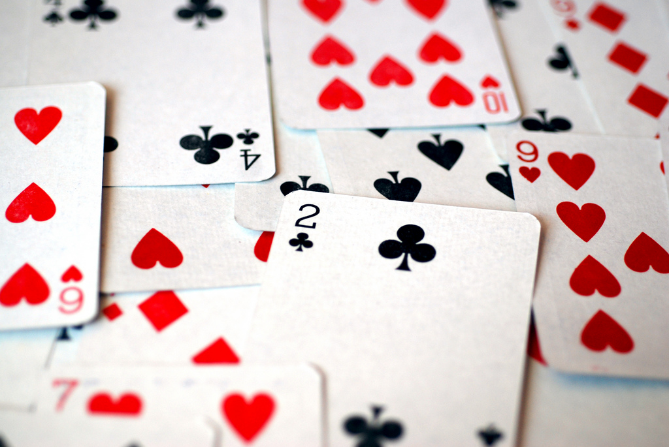
Next Time, No Card Problems!

Slide 46
Student Comments
“I've found this to be the most helpful teaching method at Harvard.”
“In-class problem solving is the best. More courses should be taught this way.”
“Oh my goodness, the in-class problem solving is beautiful! We need more of it.”

Slide 47
Even the Negative Comments are Positive!
“The TFs are great. Professor Lewis' teaching is not good. … I find it more useful to … talk to the TFs than listening to his lectures.”

Slide 48
“You might say the class is a kind of start-up, and that its niche is the ‘class as context for active, engaging, useful, and fun problem solving’ (as opposed to ‘class as context for sitting, listening, and being bored’). No other class here at Harvard is doing quite what CS 20 is doing with the idea of ‘class.’ … I would love to see other classes here taught in a manner similar to this one - if it succeeds, CS 20 can lead other classes in that direction.”

Slide 49
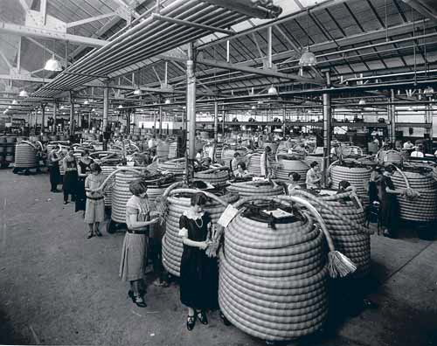
Nice, but a Hawthorne Effect??

Slide 50
FINIS Thank you!

