Slide 1
History of Computing
CMSC 304, February 14, 2013 – Prof. Marie desJardins

Slide 2
Movie Day
Computer History in 90 Seconds
https://www.youtube.com/watch?v=wfU___GMMJw
Pre-Computing and Today: Abacus Action
https://www.youtube.com/watch?v=wIiDomlEjJw
World War I: Breaking the Code clip
http://www.youtube.com/watch?v=gV67Sj2jkVg
World War II: ENIAC / “Top Secret Rosies”
http://vimeo.com/24993772
Making History Today: Self-Driving Car
http://www.slate.com/blogs/future_tense/2012/03/29/google_s_self_driving_car_takes_a_blind_man_to_taco_bell_video_.html

Slide 3
Discussion Questions
Is the advent of the smartphone in the ’10s the same kind of revolution as the PC in the ’80s? What are the similarities and differences?
Quiz: In 85 years, how many Women of the Year do you suppose there have been?
(Don’t even get me started about how nobody would ever buy a computer for Susie!!!!!!!! This article was written when I was in college, for criminy’s sake! It wasn’t exactly the dark ages, though you would think so from that stupid comment...)
“The most visible aspect of the computer revolution, the video game, is its least significant.” True?
Notes:
Started in 1927. Four Women of the Year (Wallis Simpson, Madame Chiang Kai-Shek (with Chiang Kai-Shek), Queen Elizabeth II, and Corazon Aquino) before 1999, when it was changed to “Person of the Year.” Since then, four: three in a group (Cynthia Cooper, Coleen Rowley, and Sherron Watkins) and one individual (Melinda Gates). Plus “American Women” in 1975. Mostly women who are famous for being married to famous men. Even the 15 “American Scientists” in 1960 managed to all be men.

Slide 4
Discussion Questions cont.
In 1982, there were 1450 databases in the US. How many do you think there are now?
“’You cannot rely on being able to find what you want [on the Internet],” says Atari’s Kay. ‘It’s really more useful to go to a library.’”
Enter Google, stage left..
How many typos did you find in the Time article?
Will MOOCs make the traditional classroom obsolete in the not-too-distant future?
What’s your prediction for the next big technology revolution?

Slide 5
And now, for something completely different...

Slide 6
Paper Enigma Machine
German rotor-based encoding/decoding machine
Alan Turing and others developed techniques to break the Enigma code
You get to be a codebreaker today...
http://mckoss.com/Crypto/Paper%20Enigma.pdf

Slide 7
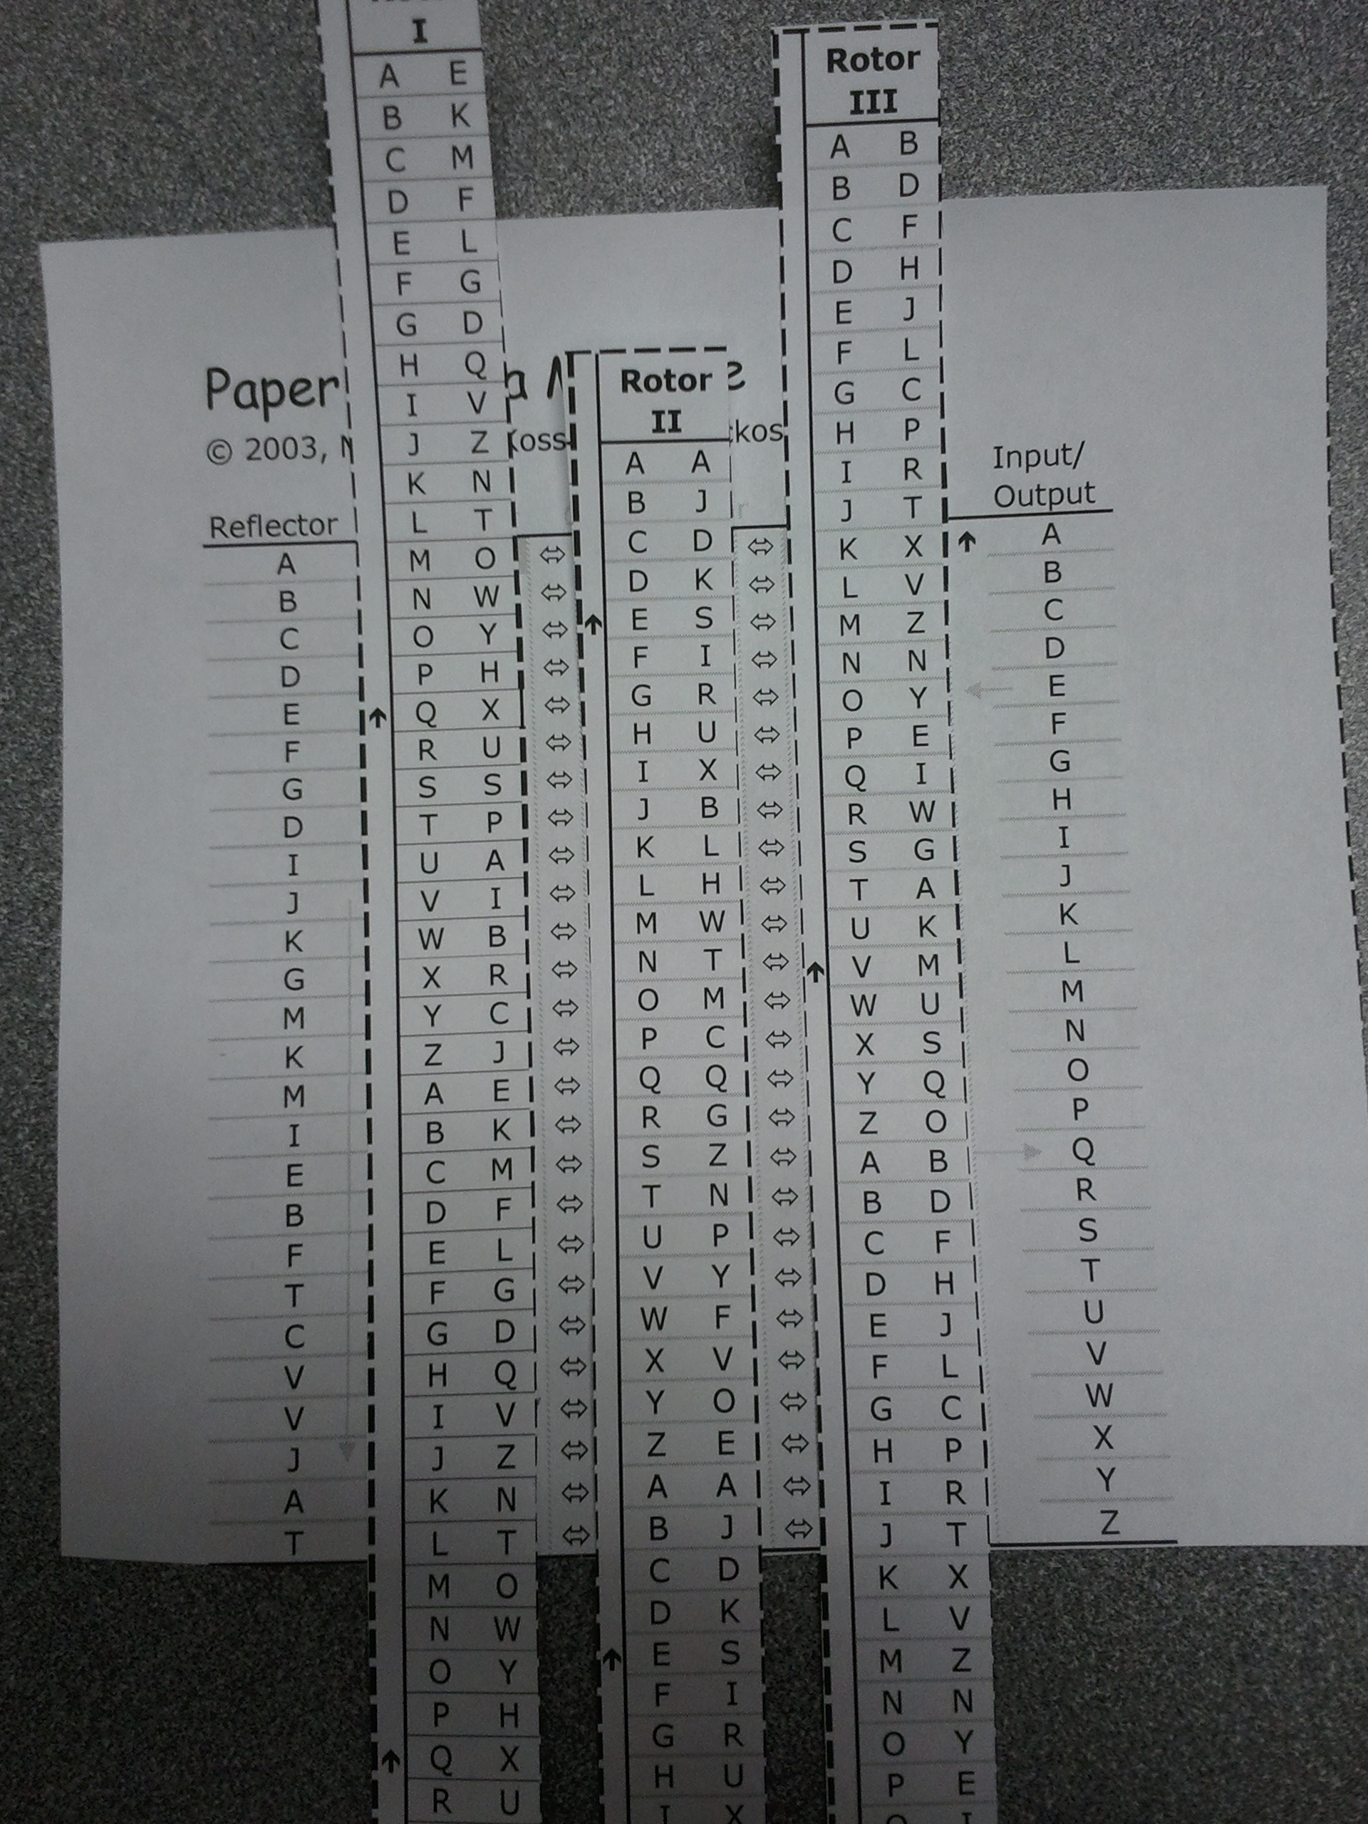
Order the rotors as specified from left to right.
Position the rotors vertically so that the three letters in the initial code position align with the As in the left and right columns (“Row A”).
Repeat:
Slide up each rotor that has an arrow in Row A on either side. (The right rotor always slides up, since there is an arrow to its right.)
Find the next letter to be encoded/decoded in the right row.
Map through the rotors leftwards to the Reflector column then right again to the Input/Output column

Slide 8
Initial setting: I-II-III, MCK
Message to decode:
QMJIDO MZWZJFJR

Slide 9
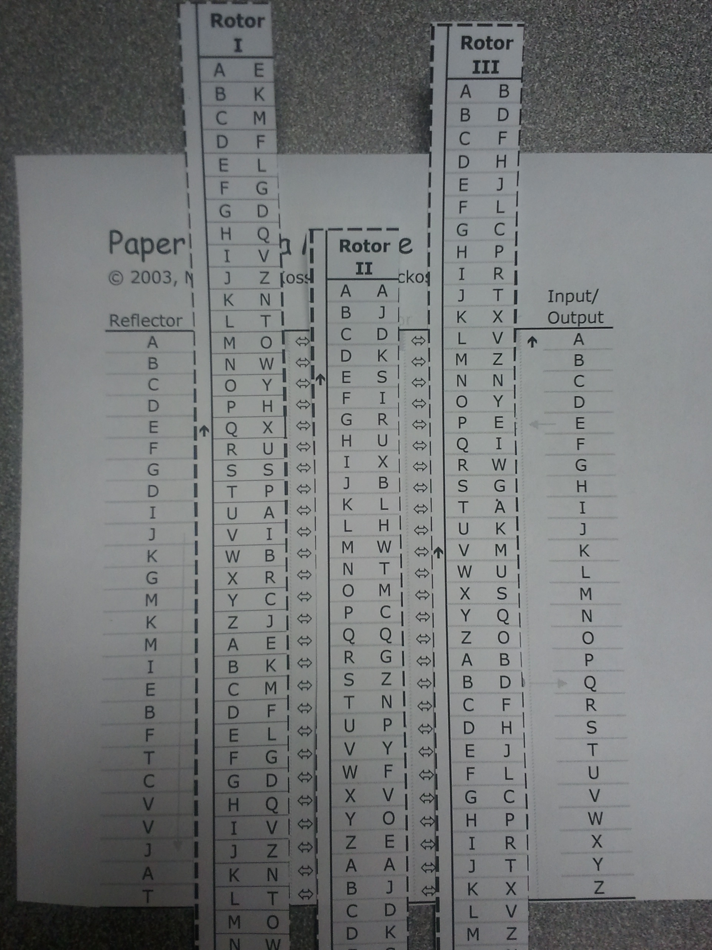
Initial setting: I-II-III, MCK Message to decode:
QMJIDO MZWZJFJR
Slide right rotor up (MCL)

Slide 10
Initial setting: I-II-III, MCK
Slide right rotor up (MCL)
Map:
Q (Input/Output)
D (Rotor III right)
P (Rotor II right)
J (Rotor I right)
J (Reflector)
V (Rotor I left)
Y (Rotor II left)
E (Rotor III left)
E (Input/Output
So Q decodes to E
Slide right rotor up (MCM) and continue...

Slide 11
Decoding the Example
Initial setting: I-II-III, MCK
Q ➔ E (MCL)
M ➔ N (MCM)
J ➔ I (MCN)
I ➔ G (MCO)
D ➔ M (MCP)
O ➔ A (MCQ)
M ➔ R (MCR)
Z ➔ E (MCS)
W ➔ V (MCT)
Z ➔ E (MCU)
J ➔ A (MC⬆V)
F ➔ L (MDW)
J ➔ E (MDX)
R ➔ D (MDY)

Slide 12
Your Turn...
Initial settings: III-II-I, MDJ
Message: KFI NIL DRTBP

