Slide 1
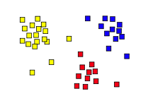
14.6
Unsupervised Learning: Clustering
Introduction and Simple K-means
Some material adapted from slides by Andrew Moore, CMU

Slide 2
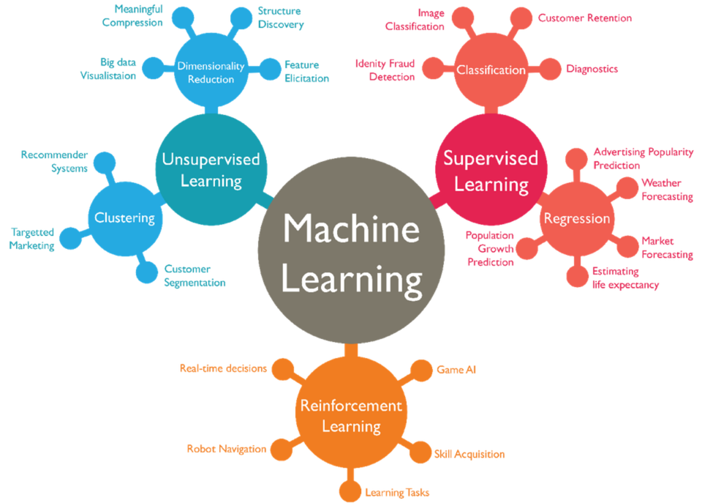

Slide 3
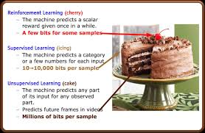
Yann LeCun on Unsupervised Learning
“Most of human and animal learning is unsupervised learning. If
intelligence was a cake, unsupervised learning would be the cake,
supervised learning would be the icing on the cake, and reinforcement learning would be the cherry on the cake. … We know how to make the icing and the cherry, but we don't know how to make the cake. We need to solve the unsupervised learning problem before we can even think of getting to true AI.”*
--
* Yann LeCun (Head of Facebook AI, NYU CS Prof.) on AlphaGo’s success and AI, 2016

Slide 4
Unsupervised Learning
Supervised learning used labeled data pairs (x, y) to learn a function f : X→y
What if we don’t have labels?
No labels = unsupervised learning
Only some points are labeled = semi-supervised learning
  Getting labels is expensive, so we only get a few
Clustering is the unsupervised grouping of data points based on similarity
It can be used for knowledge discovery

Slide 5
Clustering algorithms
Many clustering algorithms
Clustering typically done using a distance measure defined between instances or points
Distance defined by instance feature space, so it works with numeric features
  Requires encoding of categorial values; may benefit from normalization
We’ll look at three popular approaches
  Centroid-based clustering (e.g., Kmeans)
  Hierarchical clustering
  DBSCAN

Slide 6
Clustering Data
Given a collection of points (x,y), group them into one or more clusters based on their distance from one another
How many clusters are there?
How can we find them

Slide 7
(1) K-Means Clustering
Randomly choose k cluster center locations, aka centroids
Loop until convergence
  assign a point to cluster of closest centroid
  re-position cluster centroids based on its data assigned
Convergence: no point is re-assigned to a different cluster
k = 5

Slide 8
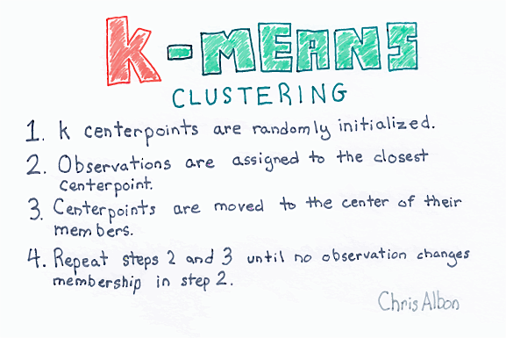

Slide 9
distance, centroids
Distance between points (X₀,Y₀,Z₀) and (X₁,Y₁,Z₁) is just sqrt((X₀- X₁)² + (Y₀- Y₁)² + (Z₀- Z₁)²)
In numpy
  >>> import numpy as np
  >>> p1 = np.array([0,-2,0,1]) ; p2 = np.array([0,1,2,1]))
  >>> np.linalg.norm(p1 - p2)
  3.605551275463989
Computing centroid of set of points easy
  >>> points = np.array([[1,2,3], [2,1,1], [3,1,0]]) # 3D points
  >>> centroid = np.mean(points, axis=0) # mean across columns
  >>> centroid
  array([2.0, 1.33, 1.33])

Slide 10
(1) K-Means Clustering
Randomly choose k cluster center locations, aka centroids
Loop until convergence
  assign a point to cluster of the closest centroid
  re-estimate cluster centroids based on its data assigned
Convergence: no point is assigned to a different cluster
k = 5

Slide 11
K-Means Clustering
K-Means (k, data )
Randomly choose k cluster center locations (centroids)
Loop until convergence
  Assign each point to the cluster of closest centroid
  Re-estimate cluster centroids based on data assigned to each
Convergence: no point is assigned to a different cluster
veroni diagram: add lines for regions of points closest to each centroid

Slide 12
K-Means Clustering
K-Means (k, data )
Randomly choose k cluster center locations (centroids)
Loop until convergence
  Assign each point to the cluster of closest centroid
  Re-estimate cluster centroids based on data assigned to each
Convergence: no point is assigned to a different cluster

Slide 13
K-Means Clustering
K-Means (k, data )
Randomly choose k cluster center locations (centroids)
Loop until convergence
  Assign each point to the cluster of closest centroid
  Re-estimate cluster centroids based on data assigned to each
Convergence: no point is assigned to a different cluster

Slide 14
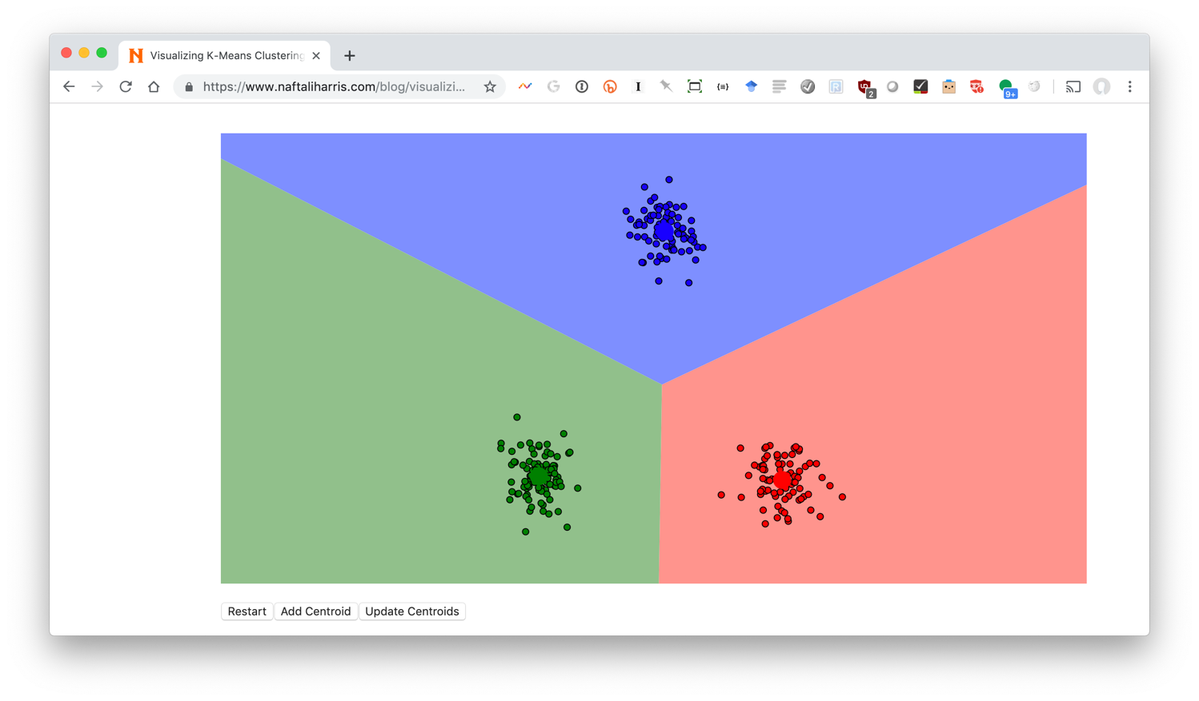
Visualizing k-means: http://bit.ly/471kmean

Slide 15
Clustering the Iris Data
Let’s try using unsupervised clustering on the Iris Data

Slide 16
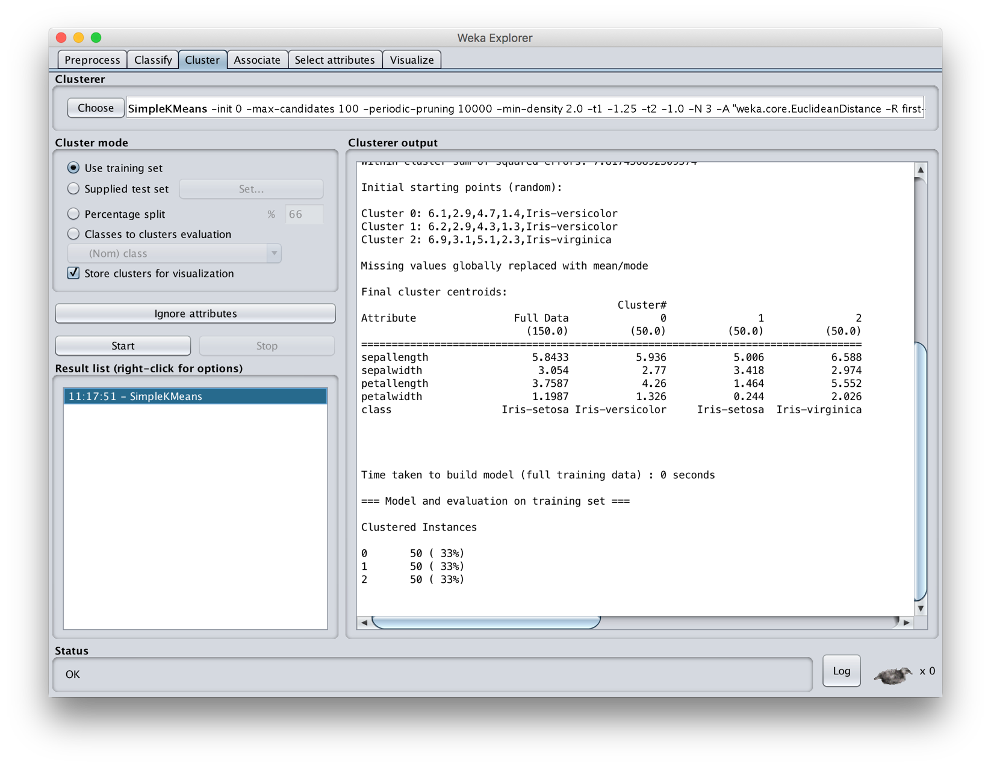
Notes:
We get perfect results, but we forgot to remove the ground truth nominal attribute! Select “Classes to cluster evaluation” to identify that class.

Slide 17
Getting results that are too good is usually a red flag
Perfect results, but we forgot to remove ground truth nominal attribute! Select “Classes to cluster evaluation” to identify that class.
Notes:
We get perfect results, but we forgot to remove the ground truth nominal attribute! Select “Classes to cluster evaluation” to identify that class.

Slide 18
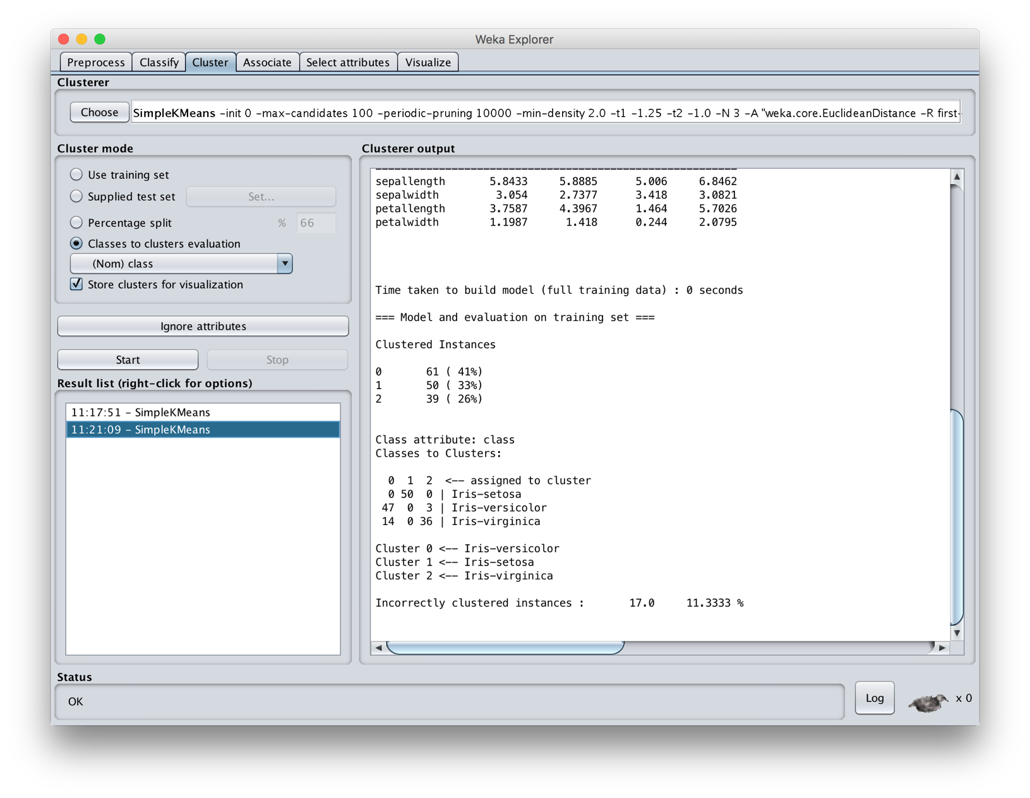

Slide 19
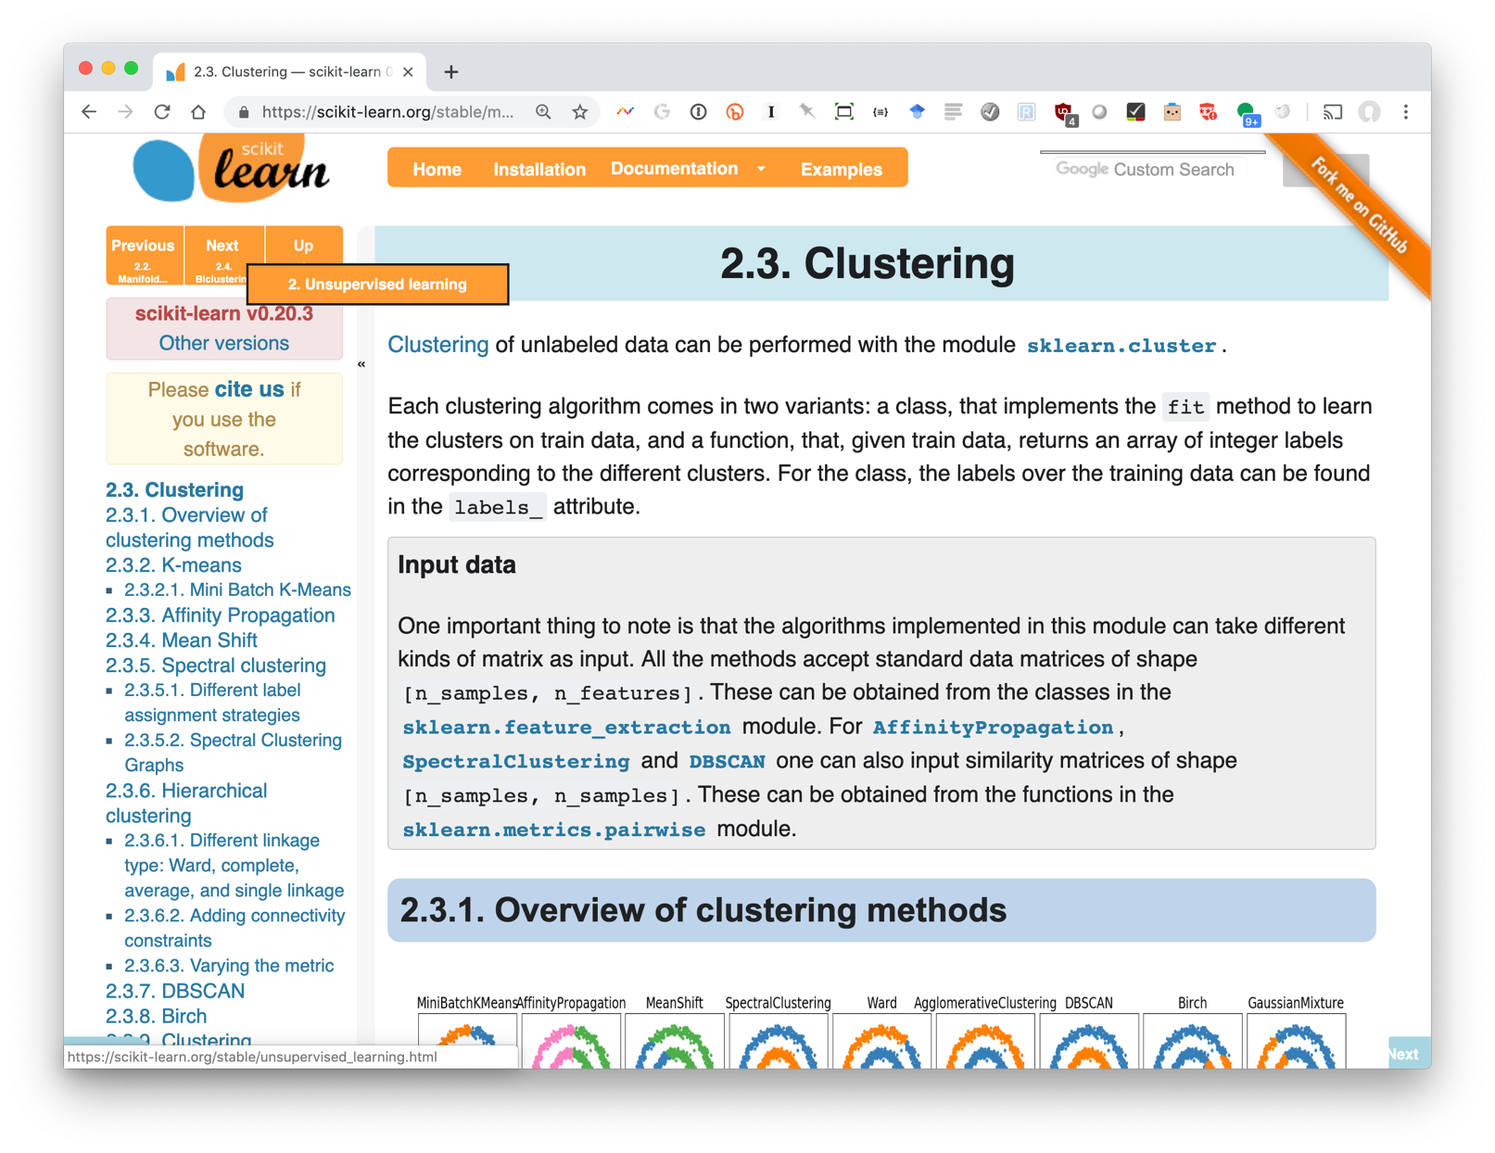
Scikit-learn clustering

Slide 20
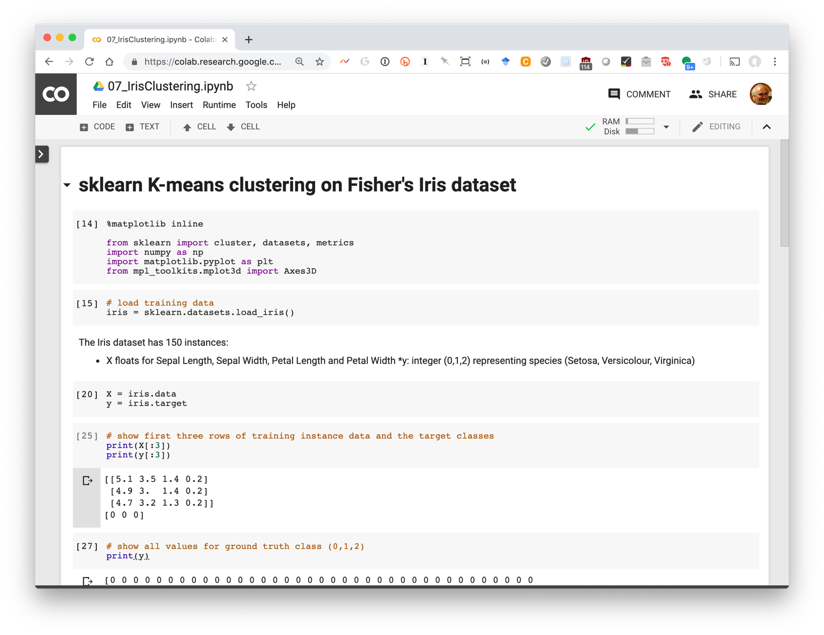

Slide 21
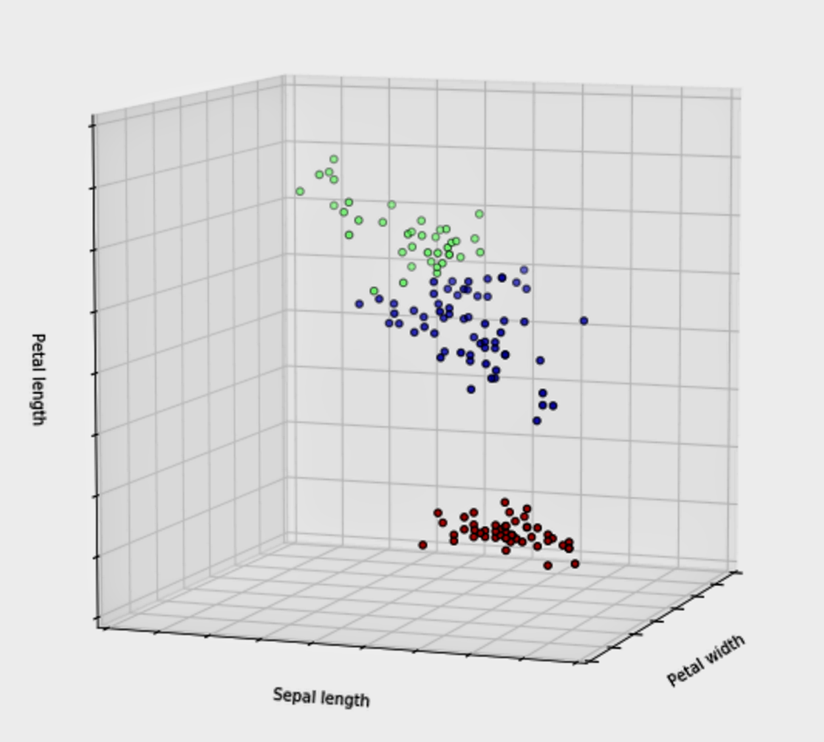

Slide 22
Problems with K-Means
Only works for numeric data (typically reals)
Very sensitive to the initial points
  fix: Do many runs, each with different initial centroids
  fix: Seed centroids with non-random method, e.g., farthest-first sampling
Sensitive to outliers
  fix: identify and remove outliers
Must manually choose k
  E.g.: find three
  Learn optimal k using some performance measure

Slide 23
Problems with K-Means
How do you tell it which clustering you want?
Constrained clustering technique provides hints
Same-cluster constraint
(must-link)
Different-cluster constraint
(cannot-link)

Slide 24
K-means Clustering Summary
Clustering useful & effective for many tasks
K-means clustering one of simplest & fastest techniques, but
  Requires knowing how many clusters is right
  Doesn’t handle outliers well
There are many other clustering options

