Slide 1
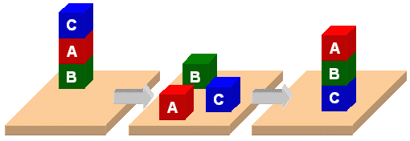
PDDL

Slide 2
PDDL
Planning Domain Description Language
Based on STRIPS with various extensions
Originally defined by Drew McDermott (Yale) and others
Used in biennial International Planning Competition (IPC) series (1998-2018)
Many planners use it as a standard input

Slide 3
PDDL Representation
A task specified via two files: domain file and problem file
Problem file: gives objects, initial state and goal state
Domain file gives predicates & operators and may be re-used for different problem files
Domain file corresponds to the transition system; problem files constitute instances in that system

Slide 4
Blocks Word Domain File
(define (domain hw5)
(:requirements :strips)
(:constants red green blue yellow)
(:predicates (on ?x ?y) (on-table ?x) (block ?x) … (clean ?x))
(:action pick-up
:parameters (?obj1)
:precondition (and (clear ?obj1) (on-table ?obj1) (arm-empty))
:effect (and (not (on-table ?obj1))
(not (clear ?obj1))
(not (arm-empty))
(holding ?obj1)))
… more actions ...)

Slide 5
Blocks Word Problem File
(define (problem 00)
(:domain hw5)
(:objects A B C)
(:init (arm-empty)
(block A)
(color A red)
(on-table A)
(block B)
(on B A)
(block C)
(on C B)
(clear C))
(:goal (and (on A B) (on B C))))
C
A
B
B
A
C

Slide 6
Blocks Word Problem File
(define (problem 00)
(:domain hw5)
(:objects A B C)
(:init (arm-empty)
(block A)
(color A red)
(on-table A)
(block B)
(on B A)
(block C)
(on C B)
(clear C))
(:goal (and (on A B) (on B C))))
C
A
B
B
A
C
Begin plan
1 (unstack c b)
2 (put-down c)
3 (unstack b a)
4 (stack b c)
5 (pick-up a)
6 (stack a b)
End plan

Slide 7
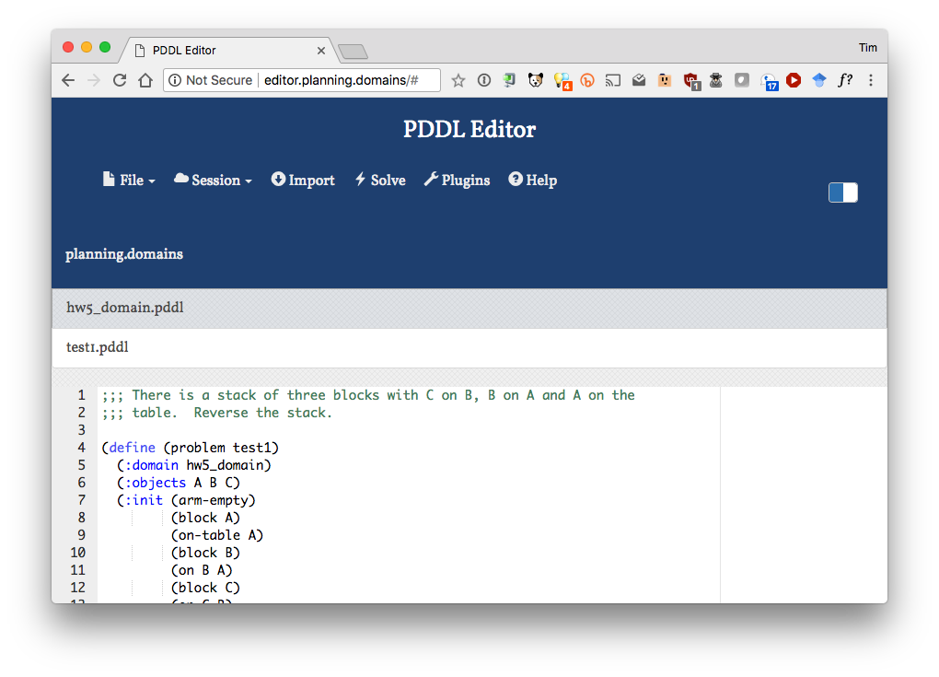
http://planning.domains/

Slide 8
Planning.domains
Open source environment for providing planning services using PDDL
Default planner is ff
very successful forward-chaining heuristic search planner producing sequential plans
Can be configured to work with other planners
Use interactively or call via web-based API
Use for HW5 to extend blocks world domain

