Slide 1
Knowledge-Based Agents
Chapter 7.1-7.3
Some material adopted from notes by Andreas Geyer-Schulz and Chuck Dyer

Slide 2
Big Idea
Drawing reasonable conclusions from a set of data (observations, beliefs, etc.) seems key to intelligence
Logic is a powerful and well developed approach and highly regarded by people
Logic is also a strong formal system that computers can use (cf. John McCarthy)
We can solve some AI problems by represent-ing them in logic and applying standard proof techniques to generate solutions

Slide 3
Inference in People
People can do logical inference, but are not always very good at it
Reasoning with negation and disjunction seems particularly difficult
But, people seem to employ many kinds of reasoning strategies, most of which are neither complete nor sound

Slide 4
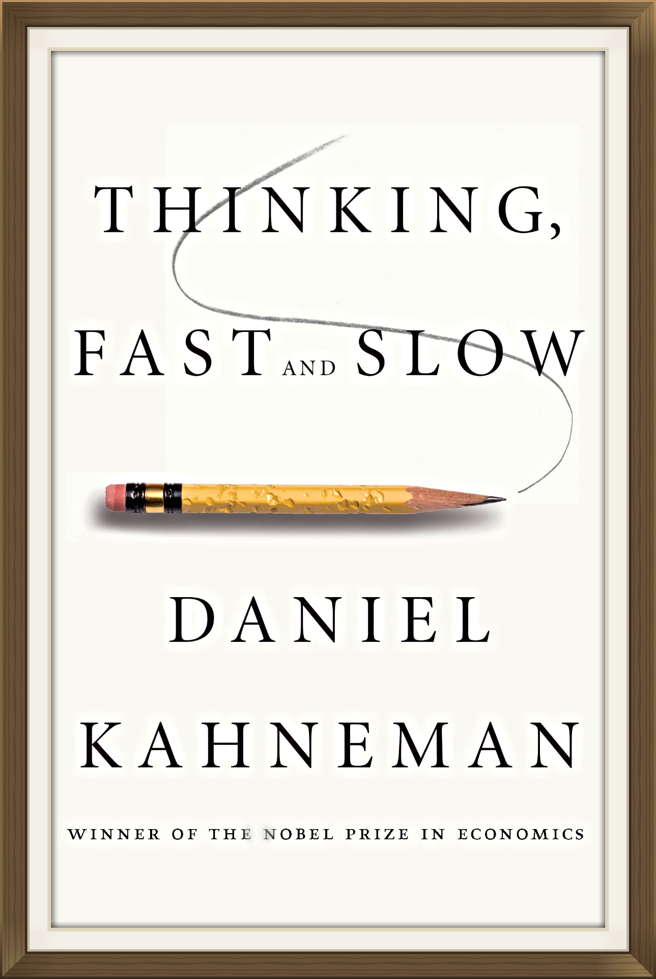
Thinking Fast and Slow
Popular 2011 book by Nobel prize winning cognitive psychologist
His model is we have two types of reasoning facilities
System 1 operates automatically and quickly, with little or no effort and no sense of voluntary control
System 2 allocates attention to the effortful mental activities that demand it, including complex computations

Slide 5
Question #1
Here is a simple puzzle
Don’t try to solve it -- listen to your intuition

Slide 6
Question #1
Here is a simple puzzle
Don’t try to solve it -- listen to your intuition
A bat and ball cost $1.10
The bat costs one dollar more than the ball
How much does the ball cost?

Slide 7
Question #1
Here is a simple puzzle
Don’t try to solve it -- listen to your intuition
A bat and ball cost $1.10
The bat costs one dollar more than the ball
How much does the ball cost?
The ball costs $0.05

Slide 8
Question #2
Determine, as quickly as you can, if the argument is logically valid, i.e. does the conclusion follow the premises?

Slide 9
Question #2
Try to determine, as quickly as you can, if the argument is logically valid. Does the conclusion follow the premises?
All roses are flowers
Some flowers fade quickly
∴ Therefore some roses fade quickly

Slide 10
Question #2
Try to determine, as quickly as you can, if the argument is logically valid. Does the conclusion follow the premises?
All roses are flowers
Some flowers fade quickly
Therefore some roses fade quickly
It is possible that there are no roses among the flowers that fade quickly

Slide 11
Question #3
It takes 5 machines 5 minutes to make 5 widgets
How long would it take 100 machines to make 100 widgets?

Slide 12
Question #3
It takes 5 machines 5 minutes to make 5 widgets
How long would it take 100 machines to make 100 widgets?
100 minutes or 5 minutes?

Slide 13
Question #3
It takes 5 machines 5 minutes to make 5 widgets
How long would it take 100 machines to make 100 widgets?
100 minutes or 5 minutes?
5 minutes

Slide 14
Wason Selection Task
I have a pack of cards; each has a letter on one side and a number on the other
I claim the following rule is true:
If a card has a vowel on one side, then it has an even number on the other
Given these cards, which should you turn over to decide whether the rule is true or false?
E
4
T
7
Wikipedia
Notes:
Turn over e and 7

Slide 15
Wason Selection Task
Wason (1966) showed people are bad at this task
To disprove rule P=>Q, find a situation in which P is true but Q is false, i.e., show P^~Q
To disprove vowel => even, find a card with a vowel and an odd number
Thus, turn over the cards showing vowels and turn over cards showing odd numbers
E
4
T
7

Slide 16
Wason Selection Task
This version is easier for people, as shown by Griggs & Cox, 1982
You are the bouncer in a bar; which of these people do you card given the rule: You must be 21 or older to drink beer.
beer
coke
22
20
Perhaps easier because it’s more familiar or because people have special strategies to reason about certain situations, such as cheating in a social situation

Slide 17
Negation in Natural Language
We often model the meaning of natural language sentences as a logic statements
Logic maps these into equivalent statements
All elephants are gray
No elephant are not gray
Double negation is common in informal language: that won’t do you no good
But what does this mean: we cannot underestimate the importance of logic
Notes:
There is no regard for logic that is too low
We consider logic to be of zero importance

Slide 18
Misnegation
we cannot underestimate the importance of logic
Does it mean:
Logic is very important
Logic is not very important
Language Log has many posts withexamples of the phenomenon

Slide 19
Logic as a Methodology
Even if people don’t use formal logical reason-ing for solving a problem, logic might be a good approach for AI for a number of reasons
Airplanes don’t need to flap their wings
Logic may be a good implementation strategy
Solution by a formal system can offer other benefits, e.g., letting us prove properties of the approach (e.g., complexity)
See neats vs. scruffies

Slide 20
Knowledge-based agents
Knowledge-based agents have a knowledge base (KB) and an inference system
KB: a set of representations of facts believed true
Each individual representation is called a sentence
Sentences are expressed in a knowledge represent-ation language
The agent operates as follows:
1. It TELLs the KB facts it perceives
2. It ASKs the KB what action it should perform
3. It performs the chosen action

Slide 21
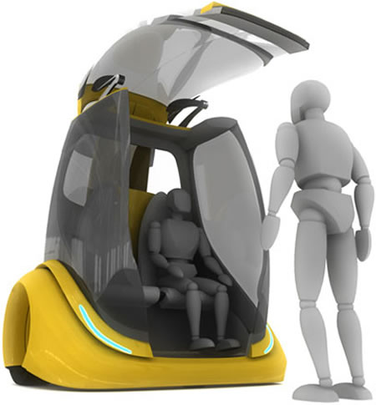
Architecture of a KB agent
Knowledge Level
Most abstract: describe agent by what it knows
Ex: Autonomous vehicle knows Golden Gate Bridge connects San Francisco with the Marin County
Logical Level
Level where knowledge is encoded into sentences
Ex: links(GoldenGateBridge, SanFran, MarinCounty)
Implementation Level
Software representation of sentences, e.g. (links goldengatebridge sanfran marincounty)

Slide 22
Wumpus World environment
Cf. 1972 Hunt the Wumpus computer game
Agent explores cave of rooms connected by passageways
Lurking in a room is the Wumpus, a beast that eats any agent that enters its room
Some rooms have bottomless pits that trap any agent that wanders into the room
Somewhere is a heap of gold in a room
Goal: collect gold & exit w/o being eaten

Slide 23
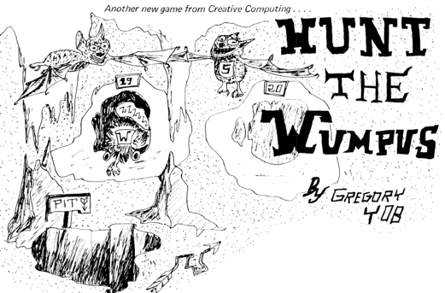
Wumpus History
See Hunt_the_Wumpus
Early (c. 1972) text-based game written in BASIC by Gregory Yob, a student at UMASS, Dartmouth
Defined a genre of games including zork, adventure and nethack
Eventually commercialized (c. 1980) for early personal computers
Hunt the Wumpus basic code is available in a 1976 article in Creative Computing

Slide 24
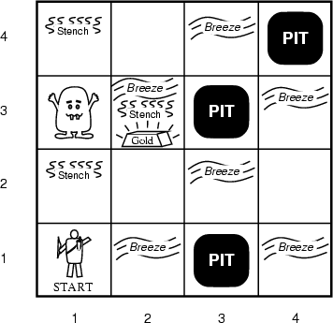
AIMA’s Wumpus World
The agent always starts in [1,1]
Agent’s task: find the gold, return to [1,1], and exit cave

Slide 25
Agent in a Wumpus world: Percepts
The agent perceives
stench in square containing Wumpus and adjacent squares (not diagonally)
breeze in squares adjacent to a pit
glitter in the square where the gold is
bump, if it walks into a wall
Woeful scream everywhere if Wumpus killed
Percepts given as five-tuple, e.g., if stench and breeze, but no glitter, bump or scream:
(Stench, Breeze, None, None, None)
Agent cannot perceive its location, e.g., (2,2)

Slide 26
Wumpus World Actions
go forward
turn right 90 degrees
turn left 90 degrees
grab: Pick up object in same square as agent
shoot: Fire arrow in direction agent faces. It continues until it hits & kills Wumpus or hits outer wall. Agent has one arrow, so only first shoot action has effect
Climb: leave cave, only effective in start square
die: automatically and irretrievably happens if agent enters square with pit or living Wumpus

Slide 27
Wumpus World Goal
Agent’s goal: find the gold and bring it back to the start square as quickly as possible, without getting killed
Reward function:
+1,000 points for exiting cave with gold
-1 point for every action taken
-10,000 points for getting killed

Slide 28
Wumpus world characterization
Recall environment characteristics from ch. 2
Fully Observable?
Deterministic?
Episodic?
Static?
Discrete?
Single-agent?

Slide 29
Wumpus world characterization
Fully Observable No, only local perception
Deterministic Yes, outcomes exactly specified
Episodic No, sequential at level of actions
Static Yes, Wumpus and Pits do not move
Discrete Yes
Single-agent? Yes, Wumpus essentially a natural feature

Slide 30
AIMA’s Wumpus World
The agent always starts in [1,1]
Agent’s task: find gold, return [1,1], and climb out of the cave

Slide 31
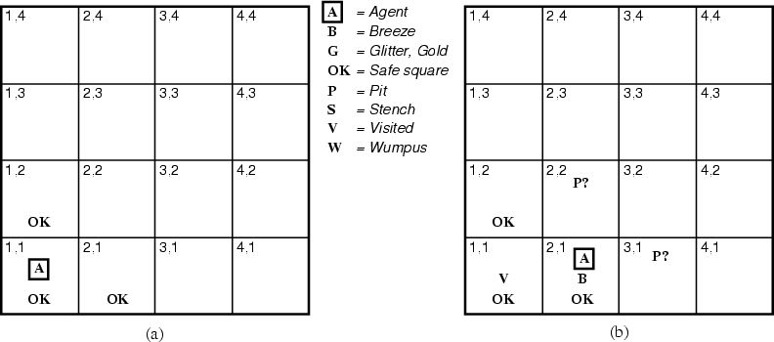
The Hunter’s first step
¬W
¬W
Since agent is alive and perceives neither breeze nor stench at [1,1], it knows [1,1] and its neighbors are OK
Moving to [2,1] is a safe move that reveals a breeze but no stench, implying that Wumpus isn’t adjacent but one or more pits are

Slide 32
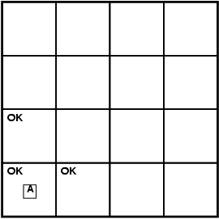
Exploring a wumpus world
A agent
B breeze
G glitter
OK safe cell
P pit
S stench
W wumpus

Slide 33
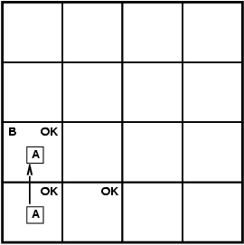
Exploring a wumpus world
A agent
B breeze
G glitter
OK safe cell
P pit
S stench
W wumpus

Slide 34
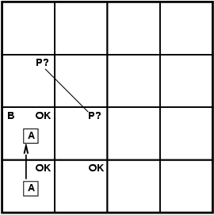
Exploring a wumpus world
A agent
B breeze
G glitter
OK safe cell
P pit
S stench
W wumpus

Slide 35
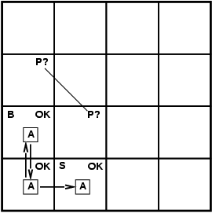
Exploring a wumpus world
A agent
B breeze
G glitter
OK safe cell
P pit
S stench
W wumpus

Slide 36
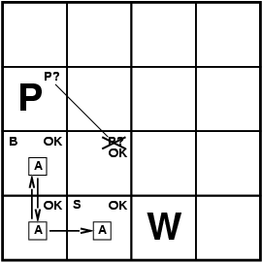
Exploring a wumpus world
A agent
B breeze
G glitter
OK safe cell
P pit
S stench
W wumpus

Slide 37
Exploring a wumpus world
A agent
B breeze
G glitter
OK safe cell
P pit
S stench
W wumpus

Slide 38
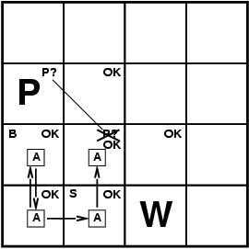
Exploring a wumpus world
A agent
B breeze
G glitter
OK safe cell
P pit
S stench
W wumpus

Slide 39
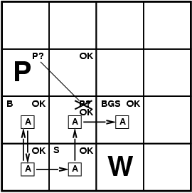
Exploring a wumpus world
A agent
B breeze
G glitter
OK safe cell
P pit
S stench
W wumpus

Slide 40
Exploring a wumpus world
A agent
B breeze
G glitter
OK safe cell
P pit
S stench
W wumpus
P?
P?

Slide 41
Logic in general
Logics are formal languages for representing information so that conclusions can be drawn
Syntax defines the sentences in the language
Semantics define the "meaning" of sentences
i.e., define truth of a sentence in a world
E.g., the language of arithmetic
x+2 ≥ y is a sentence; x2+y > {} is not a sentence
x+2 ≥ y is true iff the number x+2 is no less than the number y
x+2 ≥ y is true in a world where x = 7, y = 1
x+2 ≥ y is false in a world where x = 0, y = 6
x+1> x is true for all numbers x

Slide 42
Entailment
Entailment: one thing follows from another
KB ╞ α
Knowledge base KB entails sentence α iff α is true in all possible worlds where KB is true
E.g., the KB containing “UMBC won” and “JHU won” entails “Either UMBC won or JHU won”
E.g., x+y = 4 entails 4 = x+y
Entailment is a relationship between (sets of) sentences (i.e., syntax) that is based on semantics

Slide 43
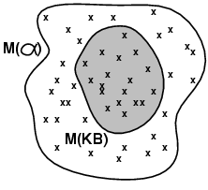
Models
Logicians talk of models: formally structured worlds w.r.t which truth can be evaluated
m is a model of sentence α if α is true in m
Lots of other things might or might not be true or might be unknown in m
M(α) is the set of all models of α
Then KB ╞ α iff M(KB) ⊆ M(α)
KB = UMBC and JHU won
α = UMBC won
Then KB ╞ α

Slide 44
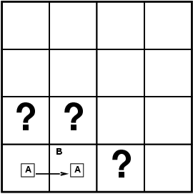
Entailment in the Wumpus World
Situation after detecting nothing in [1,1], moving right, breeze in [1,2]
Possible models for KB assuming only pits and restricting cells to {(1,3)(2,1)(2,2)}
Two observations: ~B11, B12
Three propositional variables variables: P13, P21, P22
⇒ 8 possible models
B11: breeze in (1,1)
P13: pit in (1,3)

Slide 45
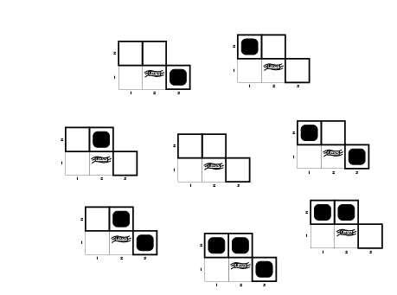
Wumpus models
P13 | P21 | P22
F | F | F
F | F | T
F | T | F
F | T | T
T | F | F
T | F | T
T | T | F
T | T | T
Each row is a possible world

Slide 46
Wumpus World Rules (1)
If a cell has a pit, then a breeze is observable in every adjacent cell
In propositional calculus we can not have rules with variables (e.g., forall X…)
P11 => B21
P11 => B12
P21 => B11
P21 => B22 …
these also follow
~B21 => ~P11
~B12 => ~P11
~B11 => ~P21
~B22 => ~P21
…
If a pit in (1,1) then a breeze in (2,1), …

Slide 47
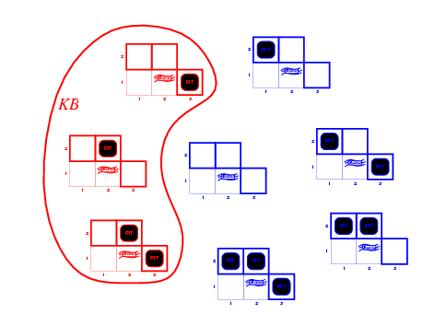
Wumpus models
Only three of the possible models are consistent with what we know
KB = wumpus-world rules + observations

Slide 48
Wumpus World Rules (2)
Cell safe if it has neither a pit nor wumpus
OK11 => ~P11 ∧ ~W11
OK12 => ~P12 ∧ ~W12 …
From which we can derive
P11 ∨ W11 => ~OK11
P11 => ~OK11
W11 => ~OK11 …
OK11: (1,1) is safe
W11: Wumpus in (1,1)

Slide 49
Wumpus models
KB = wumpus-world rules + observations

Slide 50
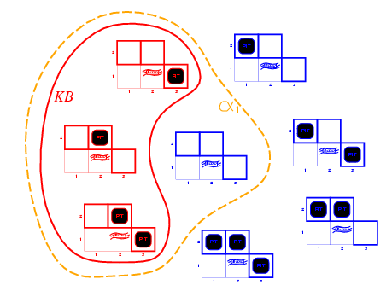
Wumpus models
KB = wumpus-world rules + observations
α₁ = “[1,2] is safe”
Since all models include α₁
KB ╞ α₁, proved by model checking

Slide 51
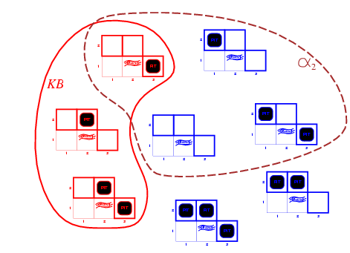
Is (2,2) Safe?
KB = wumpus-world rules + observations
α₂ = "[2,2] is safe"
Since some models don’t include α_{2,} KB ╞ α₂
We cannot prove OK22; it might be true or false

Slide 52
Inference, Soundness, Completeness
KB ├_{i} α = sentence α can be derived from KB by procedure i
Soundness: i is sound if whenever KB ├_{i} α, it is also true that KB╞ α
Completeness: i is complete if whenever KB╞ α, it is also true that KB ├_{i} α
Preview: first-order logic is expressive enough to say almost anything of interest and has a sound and complete inference procedure

Slide 53
Representation, reasoning, and logic
Object of knowledge representation (KR): express knowledge in a computer-tractable form, so that agents can perform well
A KR language is defined by:
Syntax: defines all possible sequences of symbols that constitute sentences of the language
Ex: Sentences in a book, bit patterns in computer memory
Semantics: determines facts in the world to which the sentences refer
Each sentence makes a claim about the world.
An agent is said to believe a sentence about the world.

Slide 54
The connection between sentences and facts
Semantics maps sentences in logic to facts in the world.
The property of one fact following from another is mirrored
by the property of one sentence being entailed by another.

Slide 55
Soundness and completeness
A sound inference method derives only entailed sentences
Analogous to the property of completeness in search, a complete inference method can derive any sentence that is entailed

Slide 56
Logic as a KR language
Multi-valued
Logic
Modal
Temporal
Non-monotonic
Logic
Higher Order
Probabilistic
Logic
First Order
Propositional Logic
Fuzzy
Logic

Slide 57
Ontology and epistemology
Ontology is the study of what there is—an inventory of what exists. An ontological commitment is a commitment to an existence claim.
Epistemology is a major branch of philosophy that concerns the forms, nature, and preconditions of knowledge.

Slide 58
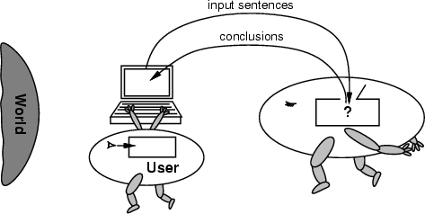
No independent access to the world
Reasoning agents often gets knowledge about facts of the world as a sequence of logical sentences and must draw conclusions only from them w/o independent access to world
Thus, it is very important that the agents’ reasoning is sound!

Slide 59
Summary
Intelligent agents need knowledge about world for good decisions
Agent’s knowledge stored in a knowledge base (KB) as sentences in a knowledge representation (KR) language
Knowledge-based agents needs a KB & inference mechanism. They store sentences in KB, infer new sentences & use them to deduce which actions to take
A representation language defined by its syntax & semantics, which specify structure of sentences & how they relate to facts of the world
Interpretation of a sentence is fact to which it refers. If fact is part of the actual world, then the sentence is true

