Slide 1
A Glimpse of
Game Theory
Notes:
1

Slide 2
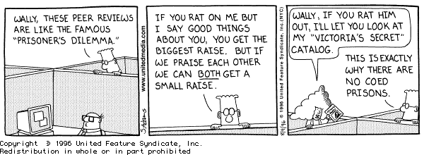

Slide 3
Games and Game Theory
Much effort to develop computer programs for artificial games like chess or poker commonly played for entertainment
Larger issue: account for, model and predict how agents (human or artificial) interact with other agents
Game theory accounts for mixture of cooperative and competitive behavior
Applies to zero-sum and non-zero-sum games

Slide 4
Basic Ideas of Game Theory
Game theory studies how strategic interactions among rational players produce outcomes with respect to the players’ preferences (or utilities)
  Outcomes might not have been intended
It offers a general theory of strategic behavior
Generally depicted in mathematical form
Plays important role in economics, decision theory and multi-agent systems
Notes:
2

Slide 5
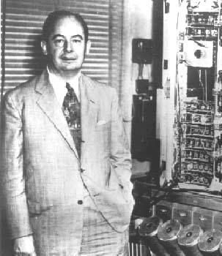
Game Theory
Defined by von Neumann & Morgenstern
  von Neumann, J., and Morgenstern, O., (1947).
  The Theory of Games and Economic Behavior.
Covers a wide range of situations for both cooperative and non-cooperative situations
Developed and used in economics and is being used to model/specify behavior of artificial agents
Provides powerful model and practical tools to think about interactions among a set of autonomous agents
Used to model strategic policies (e.g., arms race)

Slide 6

Zero Sum Games
Zero-sum: participant's gain/loss exactly
balanced by losses/gains of the other participants
Total gains of participants minus total losses = 0
  Poker is zero sum game: money won = money lost
Commercial trade is not a zero sum game
  If a country with an excess of bananas trades with another for their excess of apples, both may benefit
Non-zero sum games more complex to analyze
More non-zero sum games as world becomes more complex, specialized and interdependent

Slide 7
Rules, Strategies, Payoffs & Equilibrium
Situations are treated as games:
Rules of game: who can do what, and when they can do it
Player's strategy: plan for actions in each possible situation in the game
Player's payoff: amount that player wins or loses in particular situation in a game
Player has a dominant strategy if her best strategy doesn’t depend on what others do
Notes:
3

Slide 8

Nash Equilibrium
Occurs when each player's strategy is optimal,
given strategies of the other players
Strategy profile where no player benefits by
unilaterally changing her strategy, while others stay fixed
Every finite game has at least one Nash equilibrium in either pure or mixed strategies (proved by John Nash)
  J. F. Nash. 1950. Equilibrium Points in n-person Games. Proc. National Academy of Science, 36
  Nash won 1994 Nobel Prize in economics for this work
  Read A Beautiful Mind by Sylvia Nasar (1998) and/or see the 2001 film
Notes:
5

Slide 9

Prisoner's Dilemma
Famous example of game
theory
Strategies must be undertaken
without the full knowledge of what other players will do
Players adopt dominant strategies, but they don't necessarily lead to the best outcome
Rational behavior leads to a situation where everyone is worse off
Will the two prisoners cooperate to minimize total loss of liberty or will one of them, trusting the other to cooperate, betray him so as to go free?
Notes:
6

Slide 10

Bonnie and Clyde
Bonnie and Clyde are arrested and charged
with crimes. They’re questioned separately,
unable to communicate. They know how it
works:
  If both proclaim mutual innocence (cooperating), they will be found guilty anyway and get a three year sentences for robbery
  If one confesses (defecting) and the other doesn’t (cooperating), the confessor is rewarded with a light, one-year sentence and the other gets a severe 8-year sentence
  If both confess (defecting), then the judge sentences both to a moderate 4 years in prison
What should Bonnie do? What should Clyde do?

Slide 11
The payoff matrix

Slide 12
Bonnie’s Decision Tree
There are two cases to consider
If Clyde Confesses
If Clyde Does Not Confess
Bonnie
Bonnie
Confess
Not Confess
Confess
Not Confess
4 Years in
8 Years in
1 Year in
3 Years in
Prison
Prison
Prison
Prison
Best
Strategy
Best
Strategy
The dominant strategy for Bonnie is to confess (defect) because no matter what Clyde does she is better off confessing.
Notes:
8

Slide 13
So what?
It seems we should always defect and never cooperate
No wonder Economics is called the dismal science

Slide 14
Some PD examples
There are lots of examples of the Prisoner’s Dilemma situations in the real world
It makes it difficult for “players” to avoid the bad outcome of both defecting
  Cheating on a cartel
  Trade wars between countries
  Arms races
  Advertising
  Communal coffee pot
  Class team project
Notes:
9

Slide 15
Cheating on a Cartel
  Cartel: association of manufacturers or suppliers with purpose of maintaining prices at a high level and restricting competition
  Cartel members' possible strategies range from abiding by their agreement to cheating
  Cartel members can charge the monopoly price or a lower price
  Cheating firms can increase profits
  The best strategy is charging the low price
Notes:
10

Slide 16
Trade Wars Between Countries
Free trade benefits both trading countries
Tariffs can benefit one trading country
Imposing tariffs can be a dominant strategy and establish a Nash equilibrium even though it may be inefficient
Notes:
10

Slide 17
Advertising
Advertising is expensive
All firms advertising tends to equalize the effects
Everyone would gain if no one advertised
But firms increase their advertising to gain advantage
Which makes their competition do the same
It’s an arms race
Notes:
10

Slide 18

Games Without Dominant Strategies
In many games players have no dominant strategy
Player's strategy depends on others’ strategies
If player's best strategy depends on another’s strategy, she has no dominant strategy
Notes:
19

Slide 19
Ma’s Decision Tree
If Pa Confesses
If Pa Does Not Confess
Ma
Ma
Confess
Not Confess
Not Confess
Confess
6 Years in
4 Years in
Prison
Prison
8 Years in
5 Years in
Best
Prison
Prison
Strategy
Best
Strategy
Ma has no explicit dominant strategy, but there is an implicit one since Pa does have a dominant strategy. (What is it?)
Notes:
21
Pa confesses

Slide 20
Pa’s Decision Tree
If Ma Confesses
If Ma Does Not Confess
Pa
Pa
Confess
Not Confess
Not Confess
Confess
1 Years in
2 Years in
Prison
Prison
3 Years in
0 Years in
Best
Prison
Prison
Strategy
Best
Strategy
Pa does have a dominant strategy: confess
Notes:
21
Pa confesses

Slide 21
Some games have no simple solution
In the following payoff matrix, neither player has a dominant strategy. There is no non-cooperative solution
Player B
1
2
1, -1
-1, 1
1
Player A
-1, 1
1, -1
2

Slide 22
Repeated Games
A repeated game is a game that the same players play more than once
Repeated games differ form one-shot games because a player’s current actions can depend on the past behavior of other players
Cooperation is encouraged
Notes:
41

Slide 23
Payoff matrix for the generic two person dilemma game
(A’s payoff,
B’s payoff)
Player B
cooperate
defect
(CC,CC)
reward for
mutual
cooperation
(CD,DC)
sucker’s payoff
and temptation
to defect
cooperate
Player A
(DC,CD)
temptation
to defect and
sucker’s payoff
(DD,DD)
punishment for
mutual
defection
defect

Slide 24

Payoffs
Four payoffs are involved
  CC: Both players cooperate
  CD: You cooperate, other defects (sucker’s payoff)
  DC: You defect, other cooperates (temptation to defect)
  DD: Both players defect
Assigning values induces an ordering, with 24 possibilities (4!); three lead to “dilemma” games
  Prisoner’s dilemma: DC > CC > DD > CD
  Chicken: DC > CC > CD > DD
  Stag Hunt: CC > DC > DD > CD

Slide 25

Chicken
DC > CC > CD > DD
Rebel without a cause scenario
Two cars race toward one another
Drivers choose to serve or not
  Cooperation: swerving
  Defecting: not swerving
Optimal move: do exactly the opposite of other player

Slide 26

Stag Hunt
CC > DC > DD > CD
Two players on a stag hunt
Hard task requiring coordina-tion but with big shared payoff
Hare seen, do you defect and chase it?
  Cooperate: keep after the stag
  Defect: switch to chasing hare
Optimal play: do exactly what the other player(s) do

Slide 27

Prisoner’s dilemma
DC > CC > DD > CD
Optimal play: always defect
Two rational players will always defect.
Thus, (naïve) individual rationality subverts their common good

Slide 28
More examples of the PD in real life
Communal coffeepot
  Cooperate by making new pot of coffee if you take last cup
  Defect by taking last cup and not making new pot, depending on the next coffee seeker to do it
  DC > CC > DD > CD
Class team project
  Cooperate by doing your part well and on time
  Defect by slacking, hoping other team members will come through and sharing benefits of good grade
  (Arguable) DC > CC > DD > CD

Slide 29
Iterated Prisoner’s Dilemma
Game theory shows that rational players should always defect when engaged in a PD situation
In real situations, people don’t always do this
Why not? Possible explanations:
  People aren’t rational
  Morality
  Social pressure
  Fear of consequences
  Evolution of species-favoring genes
Which make sense? How can we formalize?

Slide 30
Iterated Prisoner’s Dilemma
Key idea: We often play more than one “game” with a given player
Players have complete knowledge of past games, including their choices and other players’ choices
Your choice when playing against player can be based on whether she’s been cooperative in past
Simulation was first done by Robert Axelrod (Michigan) where programs played in a round-robin tournament (DC=5,CC=3,DD=1,CD=0)
The simplest program won!

Slide 31
Some possible strategies
Always defect
Always cooperate
Randomly choose
Pavlovian (win-stay, lose-switch)
  Start always cooperating, switch to always defecting when punished by other’s defection, switch back & forth at every such punishment
Tit-for-tat (TFT)
  “Be nice, but punish any defections”. Starts cooperating and, after that always does what the other player did on previous round
Joss
  Sneaky TFT that defects 10% of the time
In an idealized (noise free) environment, TFT is both a very simple and very good strategy

Slide 32
Characteristics of Robust Strategies
Axelrod analyzed entries and identified characteristics
Nice: never defects first
Provocable: responds to defection by promptly defecting. Prompt response is important; being slow to anger isn’t good strategy; some programs tried even harder to take advantage
Forgiving: programs responding to single defections by defecting forever thereafter weren’t successful. Better to respond to TIT with 0.9 TAT; might dampen echoes and prevent feuds
Clear: Clarity an important feature. With TFT you know what to expect and what will/won’t work. With too much randomness or bizarre strategies in program, competing programs cannot analyze and began to always defect.

Slide 33
Implications of Robust Strategies
Succeed not by "beating" others, but by allowing both to do well. TFT never "wins" a single turn! It can't. It can never do better than tie (all C).
You do well by motivating cooperative behavior from others - the provocability part
Envy is counterproductive. Doesn’t pay to get upset if someone does a few points better than you in a single encounter. To do well, others must also do well, e.g., business & its suppliers.

Slide 34
Implications of Robust Strategies
You need not be smart to do well. You don't even have to be conscious! TFT models cooperative relations with bacteria and hosts.
Cosmic threats and promises aren’t necessary, though they may be helpful
Central authority unnecessary, though it may be helpful
Optimum strategy depends on environment. TFT is not necessarily best program in all cases. It may be too unforgiving of JOSS & too lenient with RANDOM

Slide 35

Emergence
Process where larger entities, patterns, and regularities arise through interactions among smaller or simpler entities that themselves don’t exhibit such properties
E.g.: Shape and behavior of a flock of birds or school of fish
Might cooperation be an emergent property?

Slide 36
Required for emergent cooperation
A non-zero sum situation
Players with equal power and no discrimination or status differences
Repeated encounters with another player you can recognize
  Garages depending on repeat business versus those on busy highways. Gypsies. Being unlikely to ever see someone again => a non-iterated dilemma.
A temptation payoff that isn't too great
  If defecting makes you a millionaire, you're likely to do it. "Every man has his price."

Slide 37
Ecological model
Assume an ecological system can support N players
Players accumulate or loose points on each round
After each round, poorest players die and richest multiply
Noise in the environment can model likelihood that an agent makes errors in following a strategy misinterpret another’s choice
A simple way of modeling this is described inThe Computational Beauty of Nature

Slide 38
Evolutionary stable strategies
Strategies do better or worse against other strategies
Successful strategies should be able to work well in a variety of environments
  E.g., ALL-C works well in an mono-culture of ALL-C’s but not in a mixed environment
Successful strategies should be able to “fight off mutations”
  E.g., an ALL-D mono-culture is very resistant to invasions by any cooperating strategies
  E.g., TFT can be “invaded” by ALL-C

Slide 39
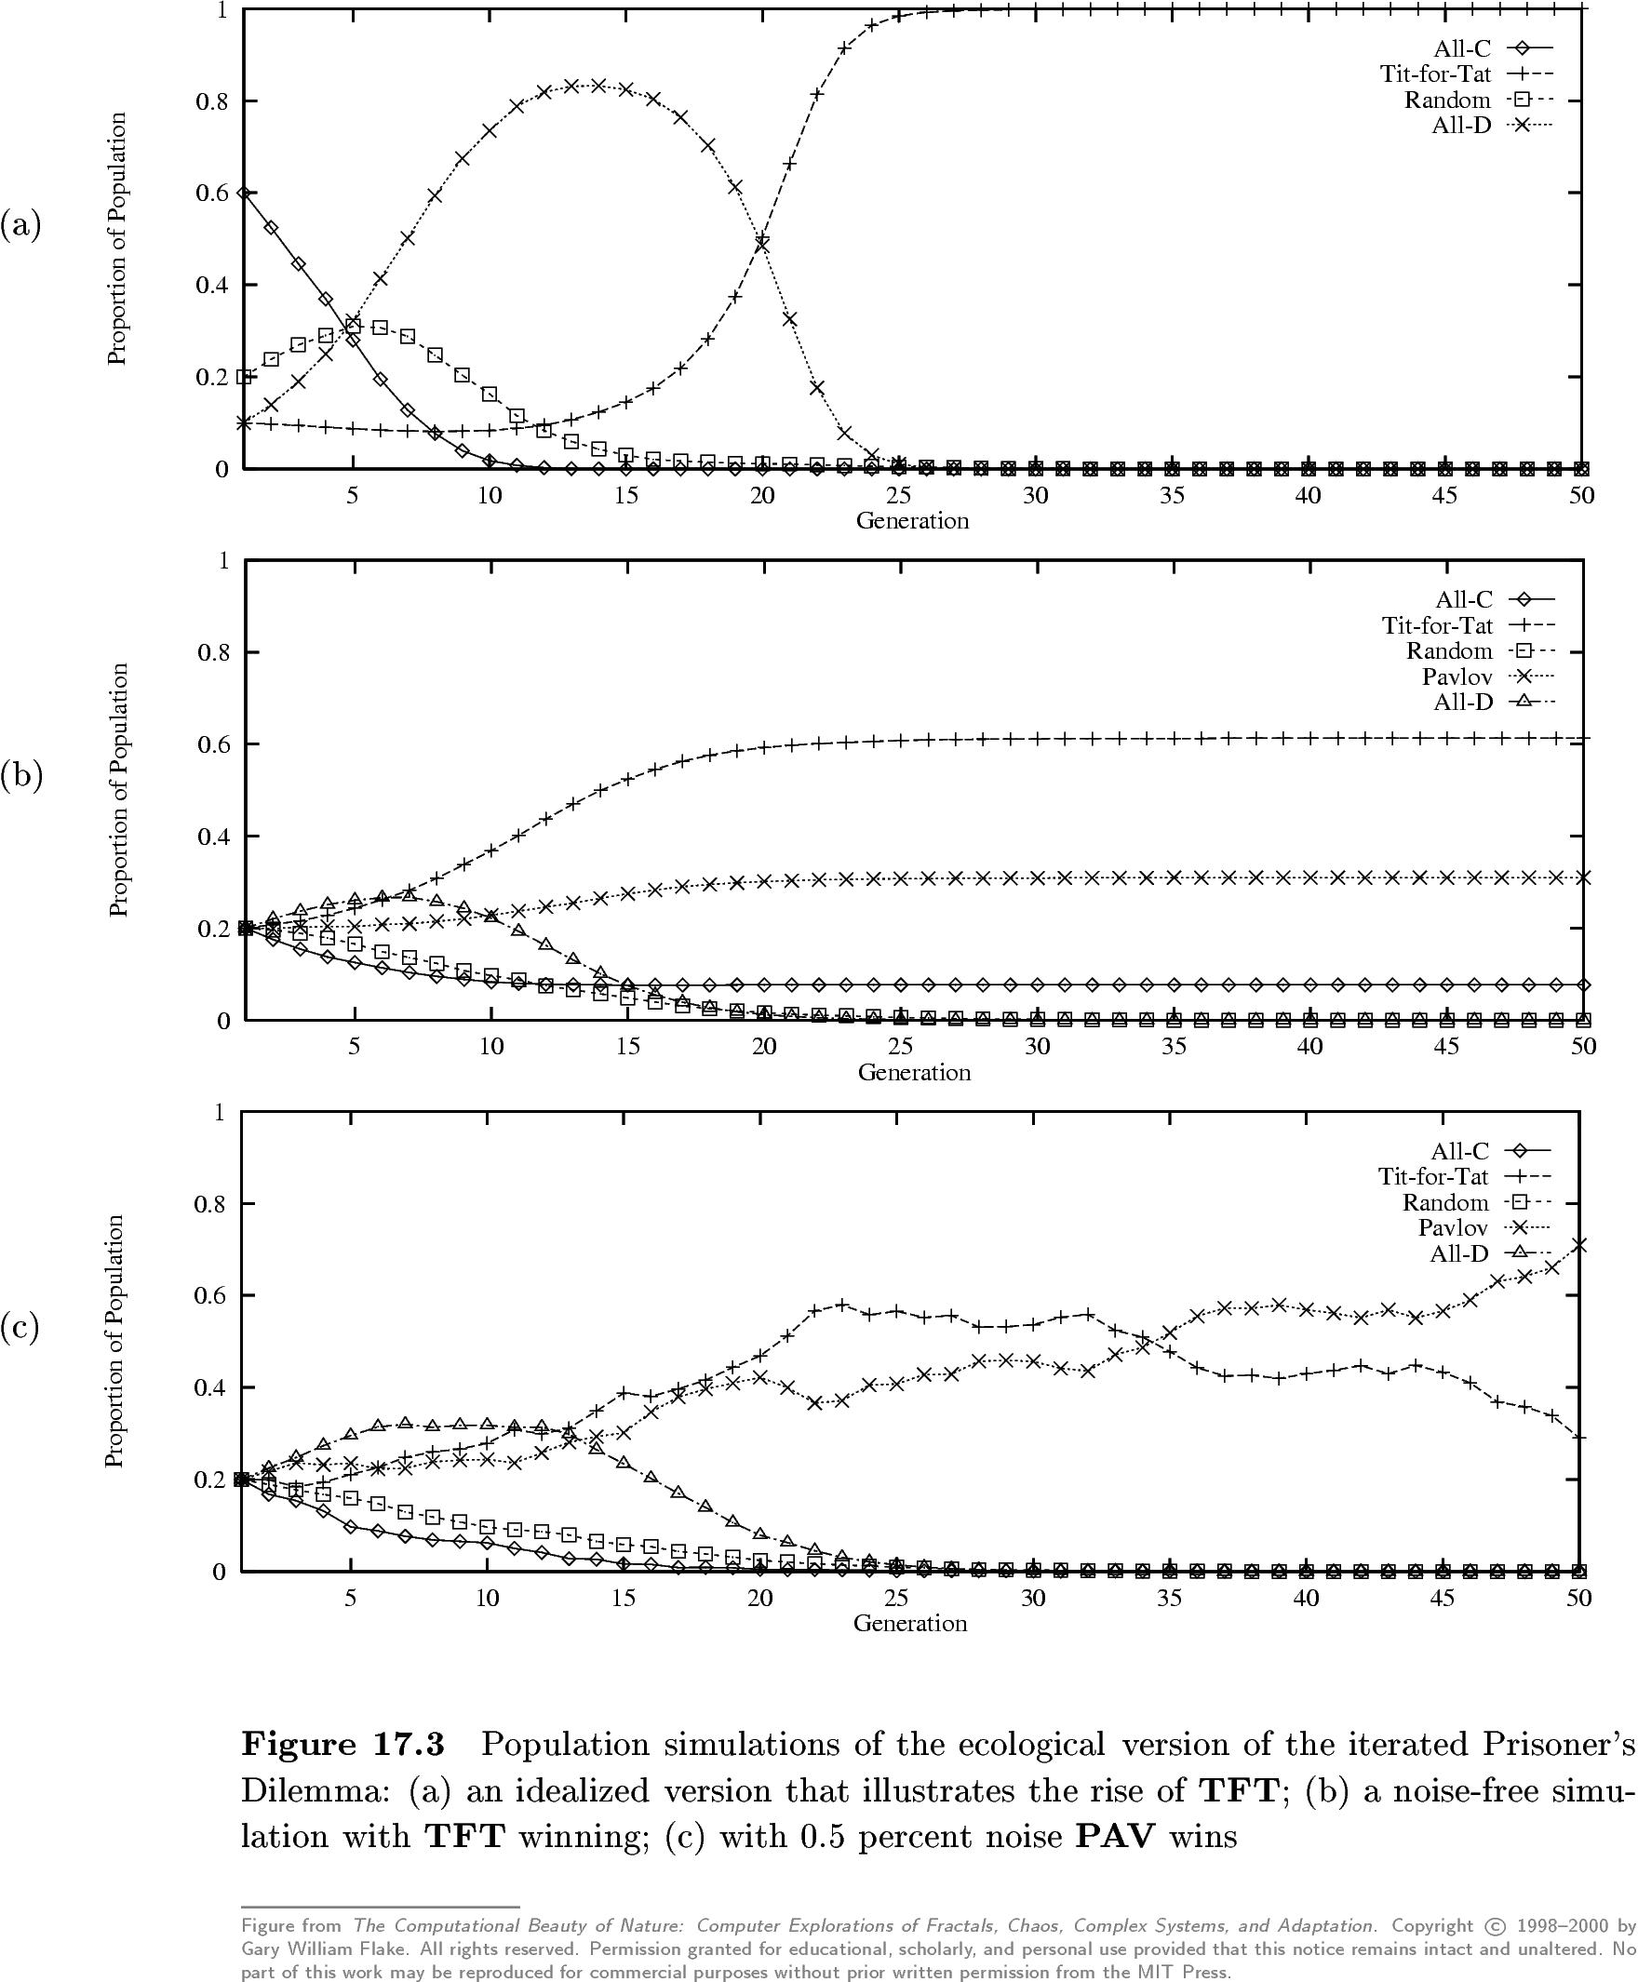
Population simulation
TFT wins
A noise free version with TFT winning
0.5% noise lets Pavlov win

Slide 40
20th anniversary IPD competition (2004)
New Tack Wins Prisoner's Dilemma
Coordinating Team Players within a Noisy Iterated Prisoner’s Dilemma Tournament
U. Southhampton bot team won using a covert channel to let “fellow travelers” recognize each other
The 60 bots
  Executed series of moves that signaled their ‘tribe’
  Defect if other is known to be outside tribe, coordinate if in tribe
  Coordination was not just cooperation, but master/slave : defect/cooperate

Slide 41
For more information
Prisoner's Dilemma: John von Neumann, Game Theory, and the Puzzle of the Bomb, William Poundstone, Anchor Books, Doubleday, 1993.
The Origins of Virtue: Human Instincts and the Evolution of Cooperation, Matt Ridley, Penguin, 1998.
Games of Life : Explorations in Ecology, Evolution and Behaviour, Karl Sigmund, 1995.
Nowak, M.A., R.M. May and K. Sigmund (1995). The Arithmetic of Mutual Help. Scientific American, 272(6).
Robert Axelrod, The Evolution of Cooperation, Basic Books, 1984.
The Computational Beauty of Nature: Computer Explorations of Fractals, Chaos, Complex Systems, and Adaptation, Gary William Flake, MIT Press, 2000.
New Tack Wins Prisoner's Dilemma, By Wendy M. Grossman, Wired News, October 2004.

Slide 42
Hawk and Dove

