Slide 1
Informed Search Chapter 4 (b)
Some material adopted from notes by Charles R. Dyer, University of Wisconsin-Madison

Slide 2
Today’s class: local search
Iterative improvement methods (aka local search) move from potential solution to potential solution until a goal is reached
Examples
Hill climbing
Simulated annealing
Local beam search
Genetic algorithms
Online search

Slide 3
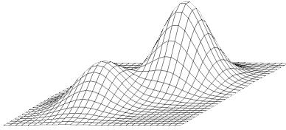
Hill Climbing
Extended current path with successor that’s closer to solution than end of current path
If goal is to get to the top of a hill, then always take a step that leads you up
Simple hill climbing: take any upward step
Steepest ascent hill climbing: consider all possible steps, take one that goes up most
No memory required

Slide 4
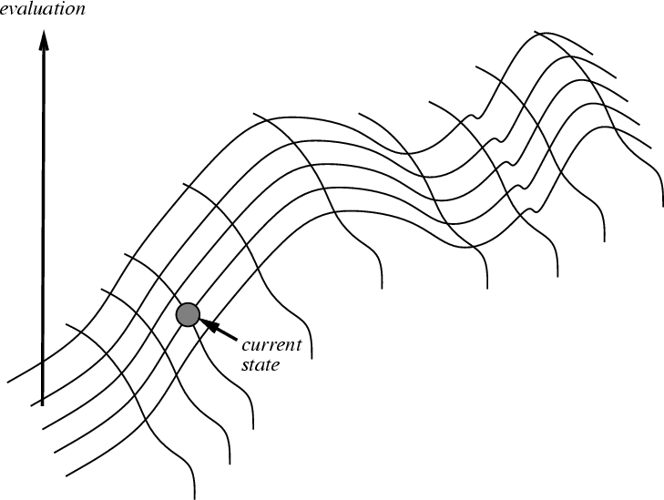
Hill climbing on a surface of states
Height Defined by Evaluation Function

Slide 5
Hill-climbing search
If there’s successor s for current state n such that
h(s) < h(n) and h(s) <= h(t) for all successors t
then move from n to s; otherwise, halt at n
i.e.: Look one step ahead to decide if a successor is better than current state; if so, move to best successor
Like greedy search, but doesn’t allow backtracking or jumping to alternative path since it has no memory
Like beam search with a beam width of 1 (i.e., maximum size of the nodes list is 1)
Not complete since search terminates at a local minima, plateau or ridge

Slide 6
Hill climbing example
2
8
3
1
2
3
start
1
6
4
h = -4
goal
8
4
h = 0
7
5
7
6
5
-5
-5
-2
2
8
3
1
2
3
1
4
h = -3
8
4
h = -1
7
6
5
7
6
5
-3
-4
2
3
2
3
1
8
4
1
8
4
h = -2
7
6
5
7
6
5
h = -3
-4
f(n) = -(number of tiles out of place)

Slide 7
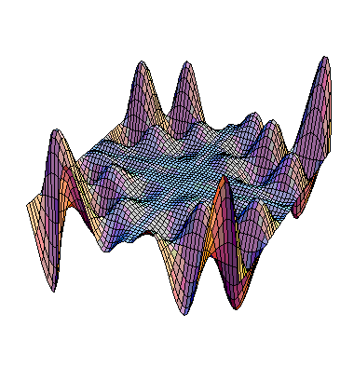
Exploring the Landscape
local maximum
Local Maxima: peaks no highest point in space
Plateaus: broad flat region that gives search algorithm no direction (use random walk)
Ridges: flat like plateau, but with drop-offs to sides; steps to North, East, South and West may go down, but step to NW may go up
plateau
ridge
Image from: http://classes.yale.edu/fractals/CA/GA/Fitness/Fitness.html

Slide 8
Drawbacks of hill climbing
Problems: local maxima, plateaus, ridges
Remedies:
Random restart: keep restarting search from random locations until a goal is found
Problem reformulation: reformulate search space to eliminate these problematic features
Some problem spaces are great for hill climbing and others are terrible

Slide 9
Example of a local optimum
2
5
-4
1
7
4
start
8
6
3
goal
1
2
5
1
2
5
1
2
3
7
4
7
4
-4
8
4
0
8
6
3
8
6
3
7
6
5
-3
1
2
5
8
7
4
-4
6
3

Slide 10
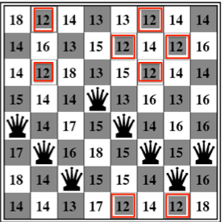
Hill Climbing and 8 Queens
The 8 Queens problem often setup as follows:
Randomly put one queen in each column
Goal state: no two queens attack one another
An action is moving any queen to a different row
Each state thus has 65 successors
Heuristic h: # of pairs attacking one another
Current state: h= 17
h=0 => solution

Slide 11
Hill Climbing and 8 Queens

Slide 12
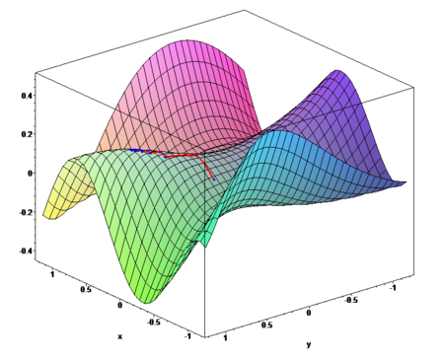
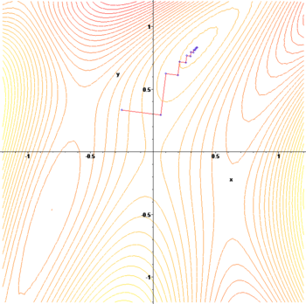
Gradient ascent / descent
Images from http://en.wikipedia.org/wiki/Gradient_descent
Gradient descent procedure for finding the arg_{x} min f(x)
choose initial x₀ randomly
repeat
x_{i+1} ← x_{i} – η f '(x_{i})
until the sequence x₀, x₁, …, x_{i}, x_{i+1} converges
Step size η (eta) is small (perhaps 0.1 or 0.05)
Often used in machine learning algorithms

Slide 13
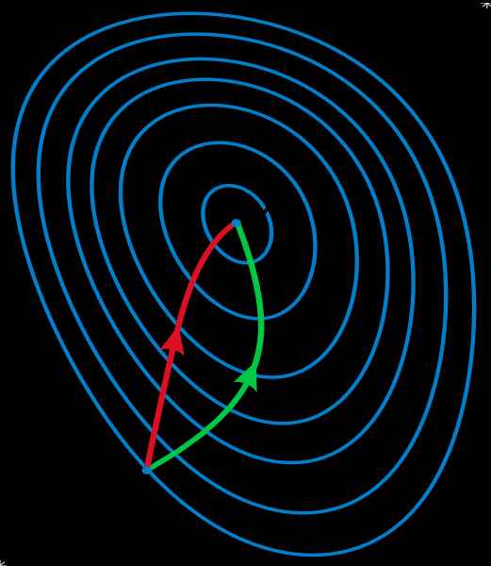
Gradient methods vs. Newtons method
A reminder of Newton’s method from Calculus:
x_{i+1} ← x_{i} – η f '(x_{i}) / f ''(x_{i})
Newton’s method uses 2nd order information (second derivative, or, curvature) to take a more direct route to the minimum.
The second-order information is more expensive to compute, but converges quicker.
Contour lines of a function
Gradient descent (green)
Newton’s method (red)
Image from http://en.wikipedia.org/wiki/Newton's_method_in_optimization

Slide 14
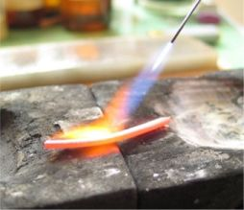
Annealing
In metallurgy, annealing is a technique involving heating & controlled cooling of a material to increase size of its crystals & reduce defects
Heat causes atoms to become unstuck from initial positions (local minima of internal energy) and wander randomly through states of higher energy
Slow cooling gives them more chances of finding configurations with lower internal energy than initial one

Slide 15
Simulated annealing (SA)
SA exploits analogy between how metal cools and freezes into a minimum-energy crystalline structure & search for a minimum/maximum in a general system
SA can avoid becoming trapped at local minima
SA uses a random search that accepts changes increasing objective function f and some that decrease it
SA uses a control parameter T, which by analogy with the original application is known as the system temperature
T starts out high and gradually decreases toward 0

Slide 16
SA intuitions
Combines hill climbing (efficiency) with random walk (completeness)
Analogy: getting a ping-pong ball into the deepest depression in a bumpy surface
Shake the surface to get the ball out of local minima
Don’t shake too hard to dislodge it from global minimum
Simulated annealing:
Start shaking hard (high temperature) and gradually reduce shaking intensity (lower temperature)
Escape local minima by allowing some “bad” moves
But gradually reduce their size and frequency

Slide 17
Simulated annealing
A “bad” move from A to B is accepted with a probability
-(f(B)-f(A)/T)
e
The higher the temperature, the more likely it is that a bad move can be made
As T tends to zero, probability tends to zero, and SA becomes more like hill climbing
If T lowered slowly enough, SA is complete and admissible

Slide 18
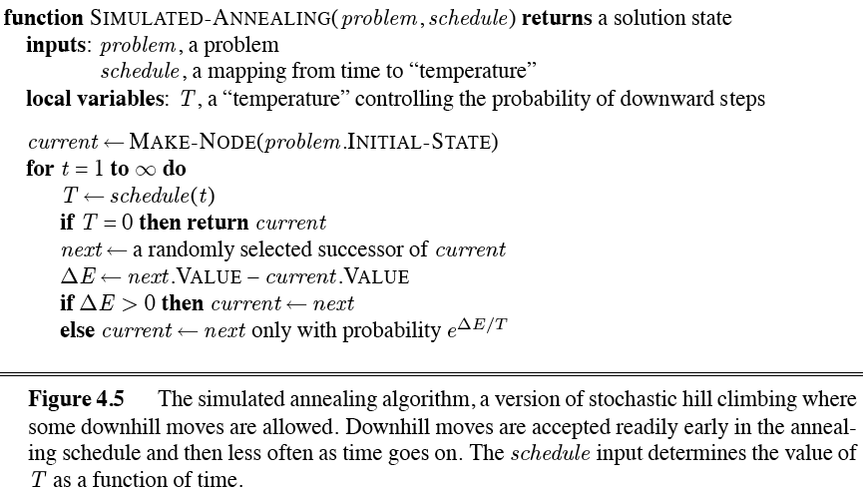
Simulated annealing algorithm

Slide 19
Local beam search
Basic idea
Begin with k random states
Generate all successors of these states
Keep the k best states generated by them
Provides a simple, efficient way to share some knowledge across a set of searches
Stochastic beam search is a variation:
Probability of keeping a state is a function of its heuristic value

Slide 20
Genetic algorithms (GA)
Search technique inspired by evolution
Similar to stochastic beam search
Start with initial population of k random states
New states generated by mutating a single state or reproducing (combining) two parent states, selected according to their fitness
Encoding used for genome of an individual strongly affects the behavior of search

Slide 21
Ma and Pa solutions

Slide 22
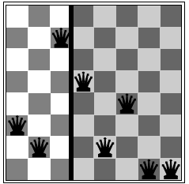
8 Queens problem
Represent state by a string of 8 digits in {1..8}
S = ‘32752411’
Fitness function = # of non-attacking pairs
F(S_{solution}) = 8*7/2 = 28
F(S₁) = 24

Slide 23
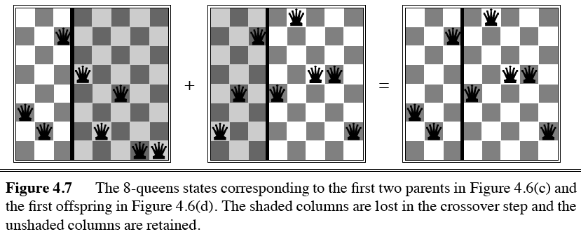
Genetic algorithms
Ma
Pa
Offspring

Slide 24
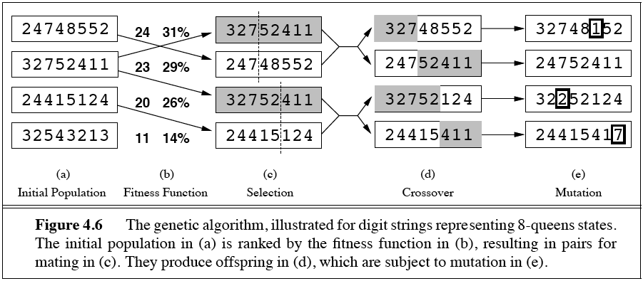
Genetic algorithms
Fitness function: number of non-attacking pairs of queens (min = 0, max = (8 × 7)/2 = 28)
24/(24+23+20+11) = 31%
23/(24+23+20+11) = 29% etc

Slide 25
GA pseudo-code

Slide 26
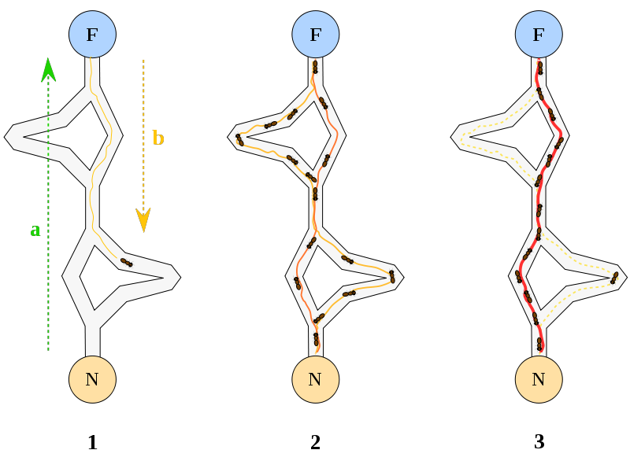
Ant Colony Optimization
A probabilistic search technique for problems reducible to finding good paths through graphs
Inspiration
Ants leave nest
Discover food
Return to nest, pre-ferring shorter paths
Leave pheromone trail
Shortest path is reinforced
An example of agents communicating through their environment

Slide 27
Tabu search
Problem: Hill climbing can get stuck on local maxima
Solution: Maintain a list of k previously visited states, and prevent the search from revisiting them
An example of a metaheuristic

Slide 28
CLASS EXERCISE
What would a local search approach to solving a Sudoku problem look like?
 | 3
 |  |  | 1
3
 |  | 2

Slide 29
Online search
Interleave computation & action
search some, act some
Exploration: Can’t infer action outcomes; must perform them to know result
Relatively easy if actions are reversible (ONLINE-DFS-AGENT)
LRTA* (Learning Real-Time A*): Update h(s) (in state table) based on experience
More about these in chapters on Logic and Learning!

Slide 30
Other topics
Search in continuous spaces
Different math
Search with uncertain actions
Must model the probabilities of an actions results
Search with partial observations
Acquiring knowledge as a result of search

Slide 31
Summary: Informed search
Hill-climbing algorithms keep only a single state in memory, but can get stuck on local optima.
Simulated annealing escapes local optima, and is complete and optimal given a “long enough” cooling schedule.
Genetic algorithms can search a large space by modeling biological evolution.
Online search algorithms are useful in state spaces with partial/no information.

