Slide 1
File I/O CMSC 201

Slide 2
Announcements
HW6 due today
HW7 out today, due next Thurs
Questions?

Slide 3
Overview
Today we’ll be going over:
String methods
File I/O

Slide 4
File I/O
To open a file:
fileThing = open(file_name, mode)
File open modes:
“w” -- open for writing; create if necessary
“r” -- open for reading
Returns file handle.

Slide 5
File I/O
To read from a file:
fileThing = open(“myFile.txt”, “r”)
for line in fileThing: #Loops over every line in the file
print(line)
fileThing.close()

Slide 6
Example
To copy one file to another:
fileIn = open(“myInFile.txt”, “r”)
fileOut = open(“myOutFile.txt”, “w”)
while True:
theline = fileIn.readline()
if len(theline) == 0:
break
fileOut.write(theline)
fileIn.close()
fileOut.close()

Slide 7
Example
To copy a binary file to another:
fileIn = open(“myInFile.txt”, “rb”)
fileOut = open(“myOutFile.txt”, “wb”)
while True:
buf = fileIn.read (1024)
if len(buf) == 0:
break
fileOut.write(buf)
fileIn.close()
fileOut.close()

Slide 8
File I/O
To write to a file:
fileThing = open(“myFile.txt”, “w”)
fileThing.write(“Hello!”)
fileThing.close()

Slide 9
Strings
There are tons of useful functions for python strings!
They can be found here:
https://docs.python.org/release/2.5.2/lib/string-methods.html

Slide 10
Strings
Some examples:
capitalize( )
center( width[, fillchar])
count( sub[, start[, end]])
endswith( suffix[, start[, end]])
expandtabs( [tabsize])
find( sub[, start[, end]])
index( sub[, start[, end]])
isalnum( )
isalpha( ) isdigit( )
islower( )
isspace( )
isupper( )
ljust( width[, fillchar])
lower( )
partition( sep)
replace( old, new[, count])
rfind( sub [,start [,end]])
rindex( sub[, start[, end]])
rjust( width[, fillchar])
splitlines( [keepends])
startswith( prefix[, start[, end]])
strip( [chars])
swapcase( )
title( )
upper( )
zfill( width)

Slide 11
Exercise
Write a program that reads a file and only prints out those lines that contain the word “retriever”.

Slide 12
Exercise
Write a program that reads a file and only prints out those lines that contain the word “retriever”.
fileIn = open(“myInFile.txt”, “r”)
while True:
theline = fileIn.readline()
if len(theline) == 0:
break
if theline.find(“retriever”) > 0
print (theline)
fileIn.close()

Slide 13
Characters
Every character is represented by a number, known as its ASCII value.

Slide 14
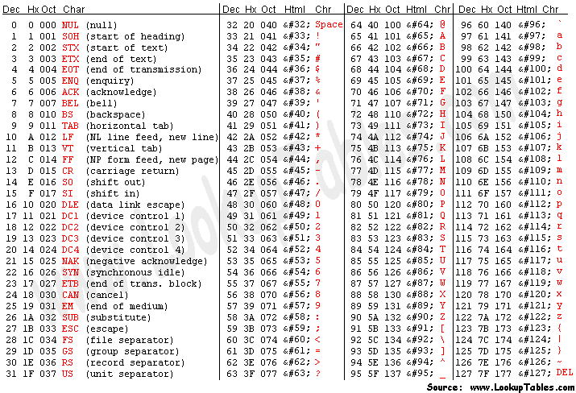
Characters

Slide 15
Characters
To find the ASCII value of a character, use the ord() function.
var = ord(“A”)
print(var)
Prints:
65

Slide 16
Characters
To figure out a character from an ASCII value, use the chr() function.
var = chr(65)
print(var)
Prints:
A

