Slide 1
Graphics and Games IS 101Y/CMSC 101 Computational Thinking and Design Marie desJardins University of Maryland Baltimore County

Slide 2
Games
What things are important for developing compelling/successful computer games?
<Your Thoughts Here>
What background/skills would someone need to work in the field?
<Your Thoughts Here>
Notes:
Who has played a video game?
Who wants to develop video games?

Slide 3
Game Development
Simulation and modeling (physics and effects of players’ actions)
Graphics (simulating the visual appearance of the “game world” visually) is a huge part
Game design (basic concept, levels of play, strategies and skill)
I/O (joystick control, haptic interface, Kinect, pressure sensors...)
Networking and communication (especially in MOOGs)
Game AI (smart opponents/bots)

Slide 4
Computer Graphics
Using computer to generate simulated scenes or worlds
Can require tricking the eye into believing that a 2D collection of pixels is really a continuous 3D world
Coding-intensive applications with strong basis in creativity and human perception
Five key problems to be solved:
What shape is it?
What do you see?
What does it look like?
How does it move?
Why does it have to look like a photograph?

Slide 5
What shape is it?

Slide 6
Modeling Approaches
Modeling problem
Define shape, color, and other visual properties
Modeling solutions
Manual primitive creation
Scans from physical object
Functional descriptions
Grammar-based generation
Biologically inspired simulations

Slide 7
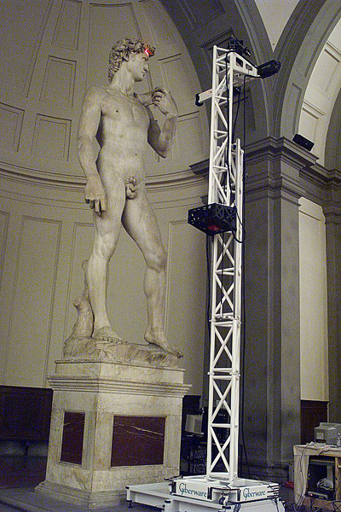
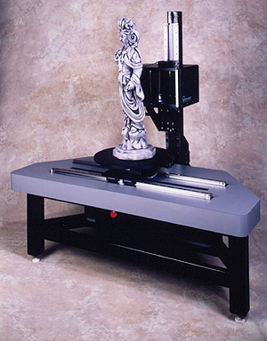
Scanning

Slide 8
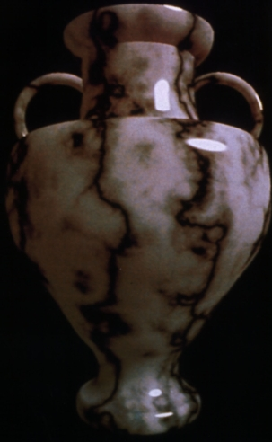
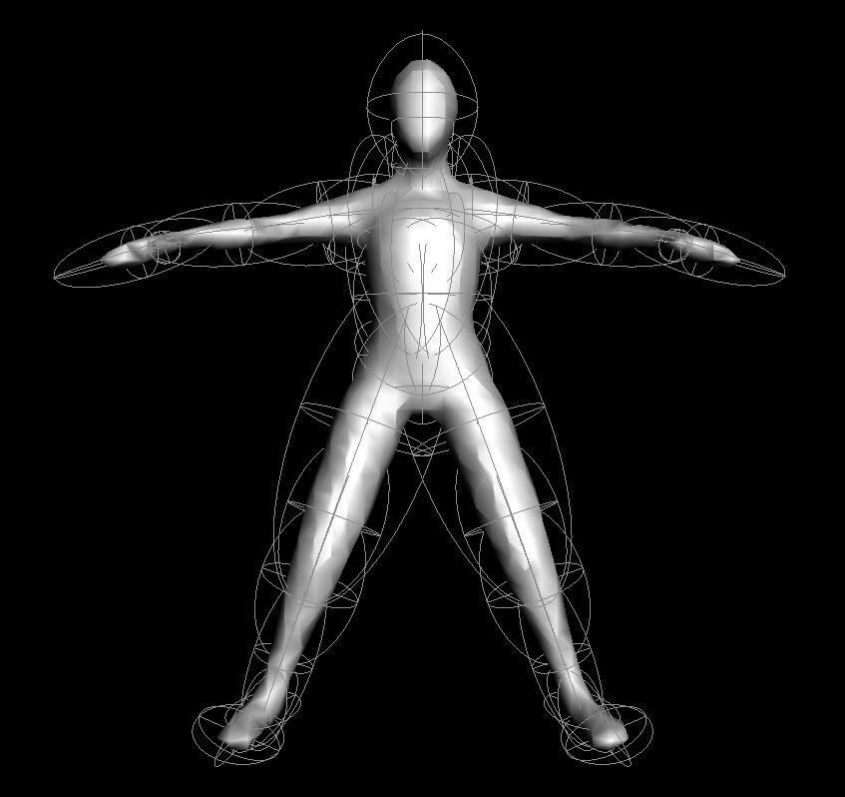
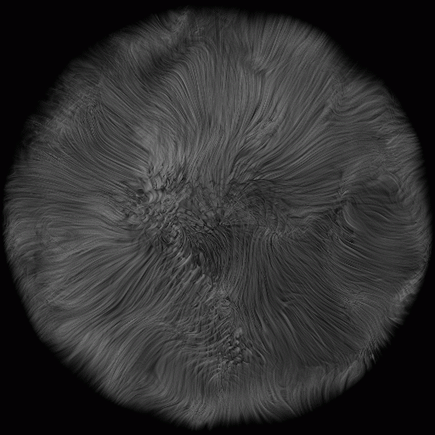
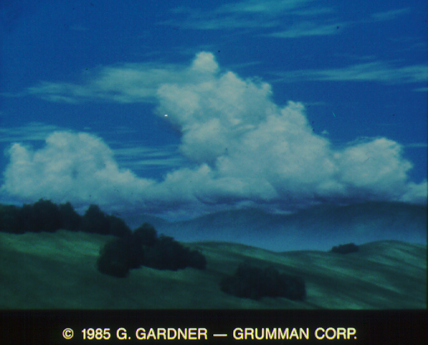
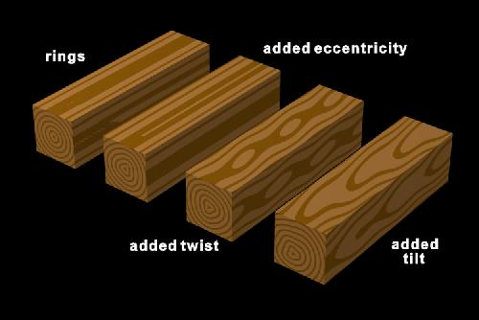
Functional Descriptions
Define visual attributes with function, defined over space
Shape
Density
Color

Slide 9
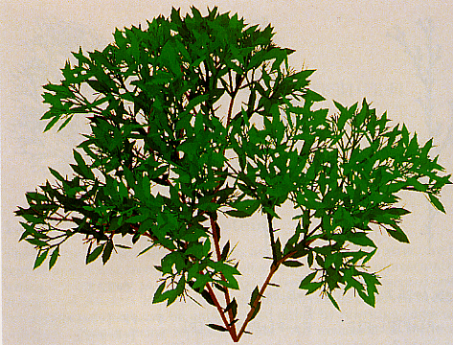
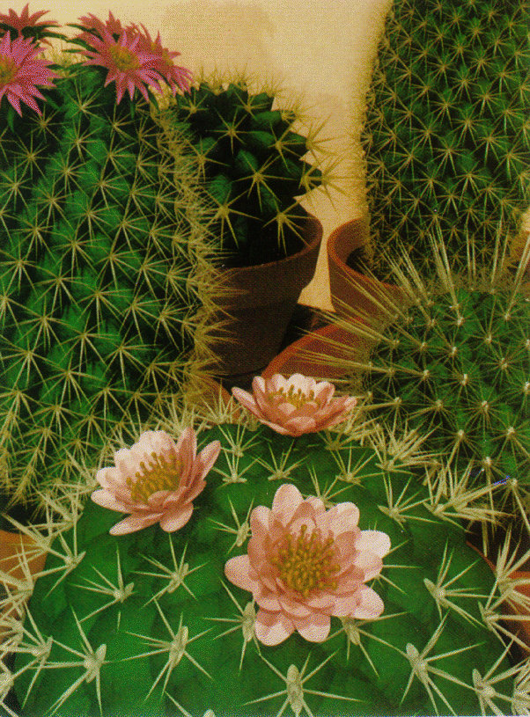
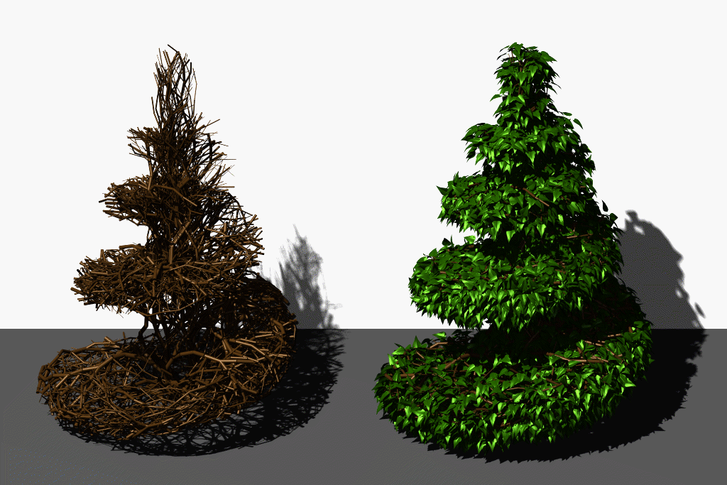
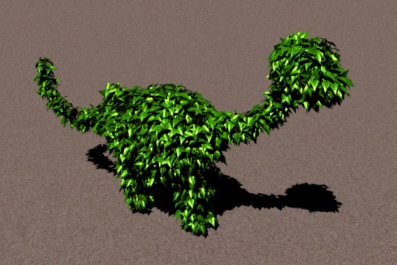
Grammar-based Generation
Use (mostly) context-free grammars (CFG) to specify structural change over generations
A CFG G=(V,T,S,P) with
V is a set of non-terminals
T is a set of terminals
S is the start symbol
P is a set of productions (rules) of the form:
A→x, where A ∈ V, x ∈ (V ∪ T)*

Slide 10
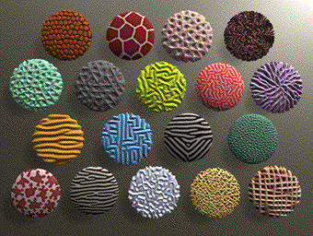
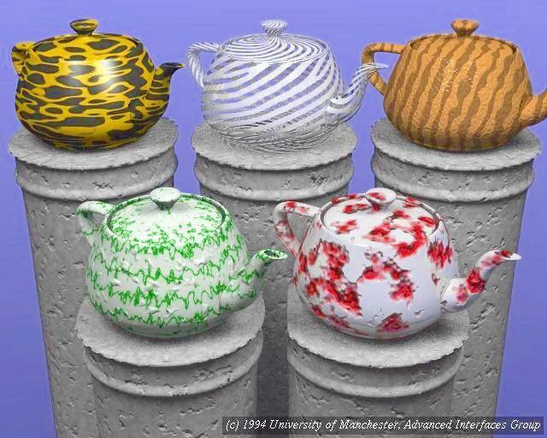
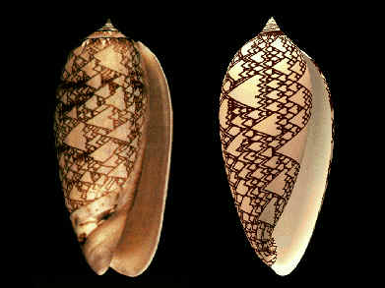
Biological Simulations
Mimic developmental process:
cellular automata
reaction diffusion

Slide 11
What do you see?

Slide 12
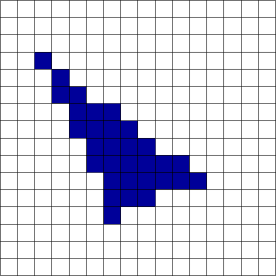
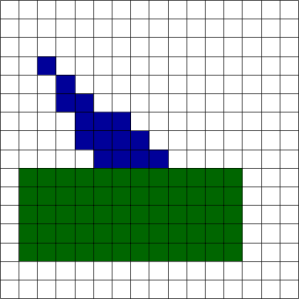
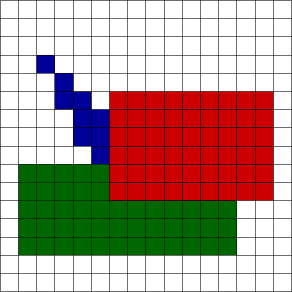
Painter’s Algorithm
Basic approach
Draw polygons, from farthest to closest
Given
List of polygons {P₁, P₂, …. P_{n})
An array of Intensity [x,y]
Begin
Sort polygon list on minimum Z (largest z value comes first in sorted list)
For each polygon P in selected list do
For each pixel (x,y) that intersects P do
Intensity[x,y] = intensity of P at (x,y)
Display Intensity array

Slide 13
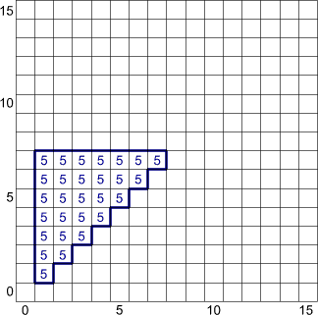
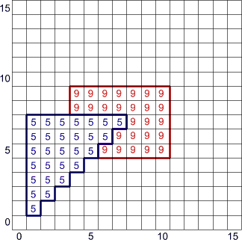
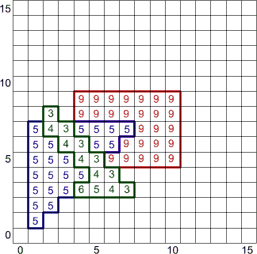
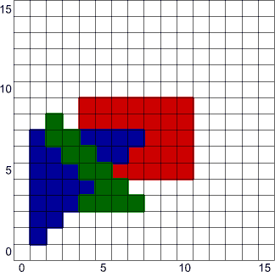
Z-Buffer
Basic approach
Draw polygons, remembering depth of stuff drawn so far
Given
List of polygons {P₁, P₂, …., P_{n}}
An array x-buffer[x,y] initialized to +infinity
An array Intensity[x,y]
Begin
For each polygon P in selected list do
For each pixel (x,y) that intersects P do
Calculate z-depth of P at (x,y)
If z-depth < z-buffer[x,y] then
Intensity[x,y] = intensity of P at (x,y)
Z-buffer[x,y] = z-depth
Display Intensity array

Slide 14
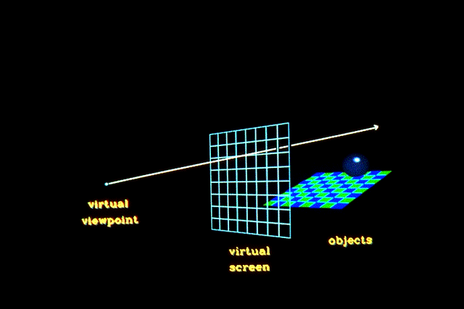
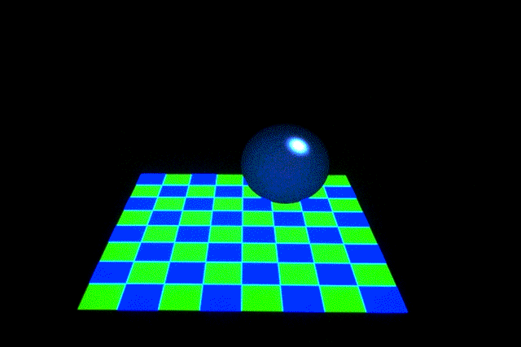
Raytracing
Basic approach
Cast ray from viewpoint through pixels into scene
Given
List of polygons { P₁, P₂, ..., P_{n} }
An array of intensity [ x, y ]
{
For each pixel (x, y) {
form a ray R in object space through the camera position C and the pixel (x, y)
Intensity [ x, y ] = trace ( R )
}
Display array Intensity
}

Slide 15
What does it look like?

Slide 16
Illumination Approaches
Illumination problem
Model how objects interact with light
Modeling solutions
Simple physics/optics
More realistic physics
Surface physics
Surface microstructure
Subsurface scattering
Shadows
Light transport

Slide 17
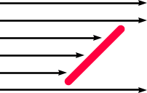
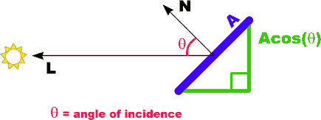
Simple Optics: Diffuse Reflection
Lambert’s Law:
the radiant energy from any small surface area dA in any direction θ relative to the surface normal is proportional to cos θ
I_{diff} = k_{d}I_{l}cos θ
= k_{d}I_{l} (N•L)

Slide 18
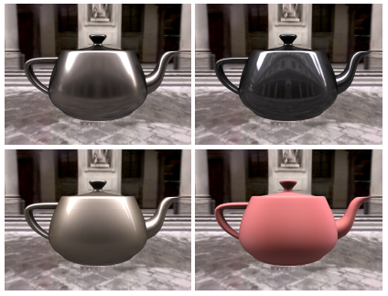
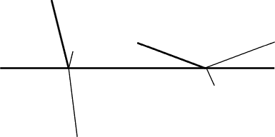
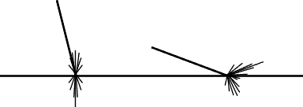
Surface Physics
Conductor (like metal)
Dielectric (like glass)
Composite (like plastic)

Slide 19
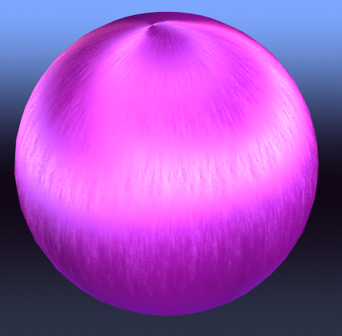
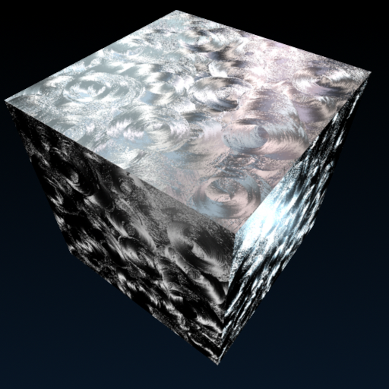
Surface Microstructure
Stam ‘99

Slide 20
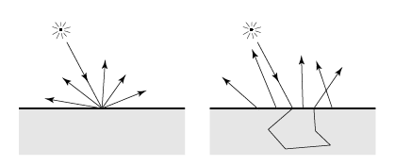
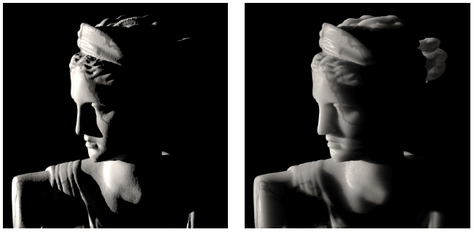
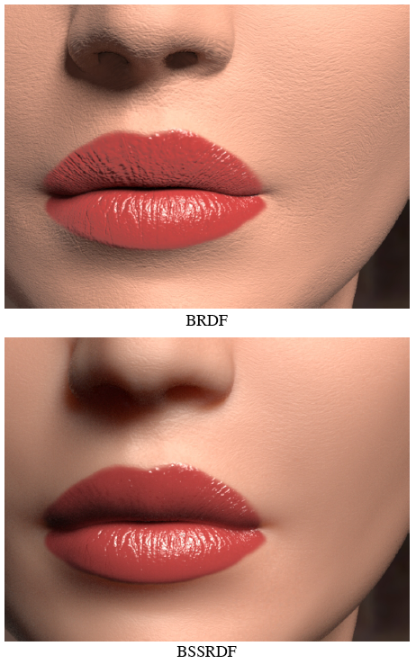
Subsurface Scattering
Jensen et al, ‘01

Slide 21
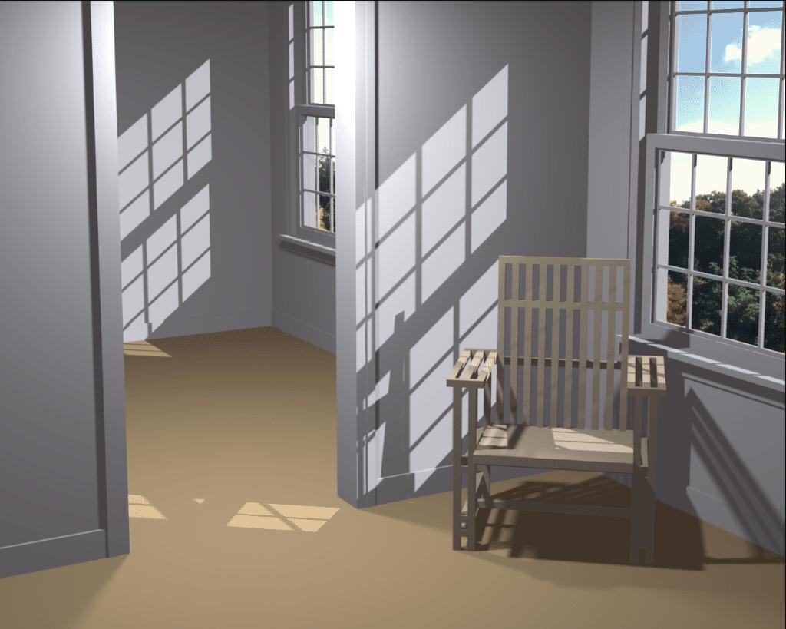
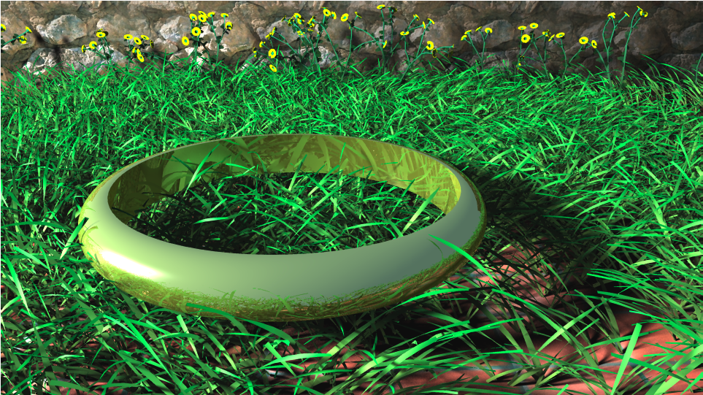
Shadows
Laine et al., SIGGRAPH ‘05

Slide 22
How does it move?

Slide 23
Motion Dynamics Approaches
Motion dynamics problem
Define geometric movements and deformations of objections under motion
Dynamics solutions
Simulate physics of simple objects
Model structure and constraints
Capture motion from reality
Simulate group dynamics
Use your imagination

Slide 24
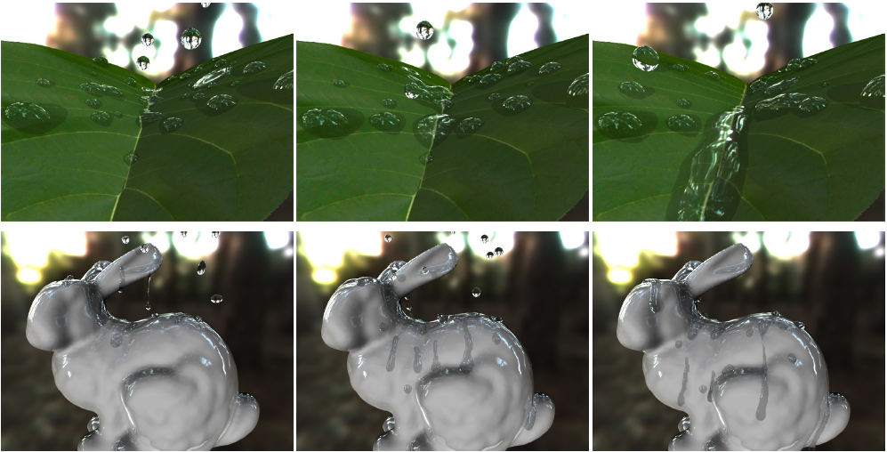
Simulate Physics

Slide 25
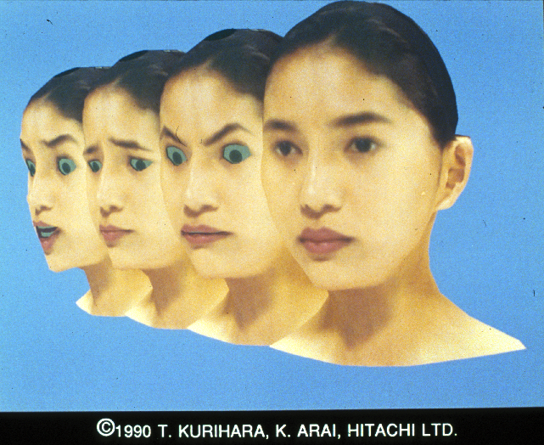
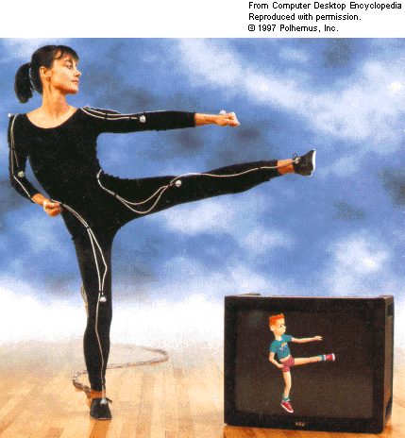
Motion Capture

Slide 26
Why does it have to look like a photograph?
(It doesn’t!)

Slide 27
Artistic Rendering Approaches
Artistic rendering problem (NPR)
Produce images from geometric models that are more expressive or mimic alternative media
Artistic rendering solutions
Mimic characteristics of media
Physically simulate media
Break rules
Learn styles

Slide 28
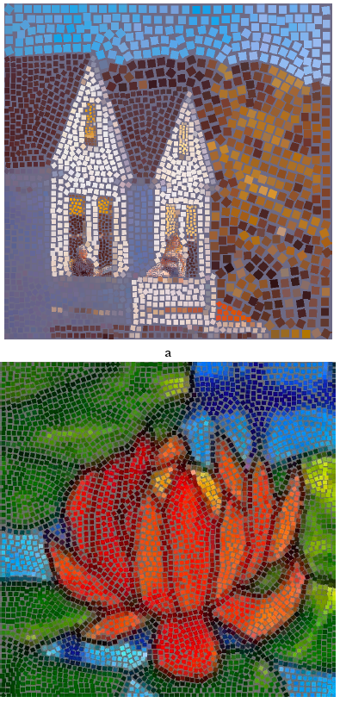
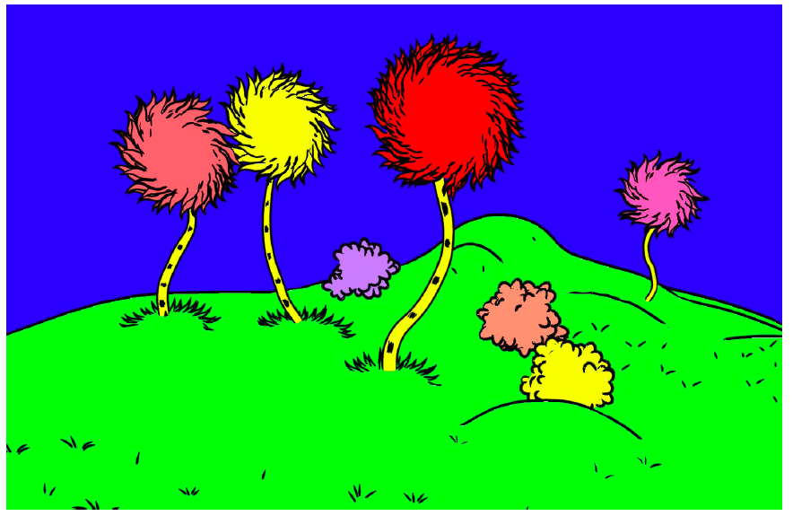
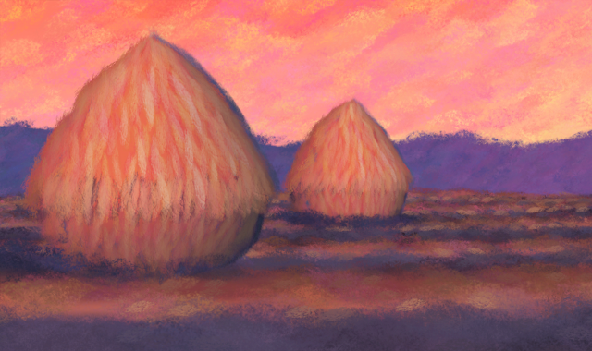
Mimic media

Slide 29
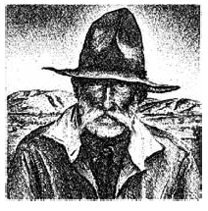
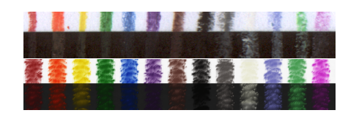
Physical Media Simulation

Slide 30
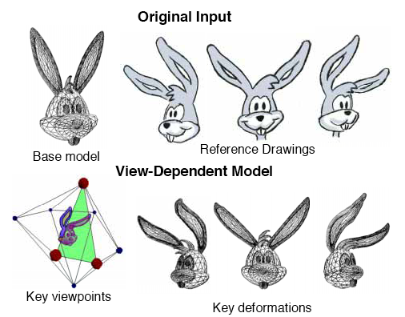
Break the Rules

