Slide 1
Wikibase and Wikidata

Slide 2
Wikibase is…
Wikibase: a structured data repository based on MediaWiki
Complex/expressive data model has triples, provenance, qualifiers, and alternate values
Export to standard formats including JSON, RDF/XML, N3, and Turtle
Access via SPARQL
Local installs via a Docker image
Stored in a RDBMS (e.g., mySQL)

Slide 3
Wikidata is…
Wikidata is “the free knowledge base with 69,192,605 data items that anyone can edit”
Uses the Wikibase data model and associated software and APIs
Its data is available to download
In bulk as JSON or RDF
as individual items in JSON or RDF

Slide 4
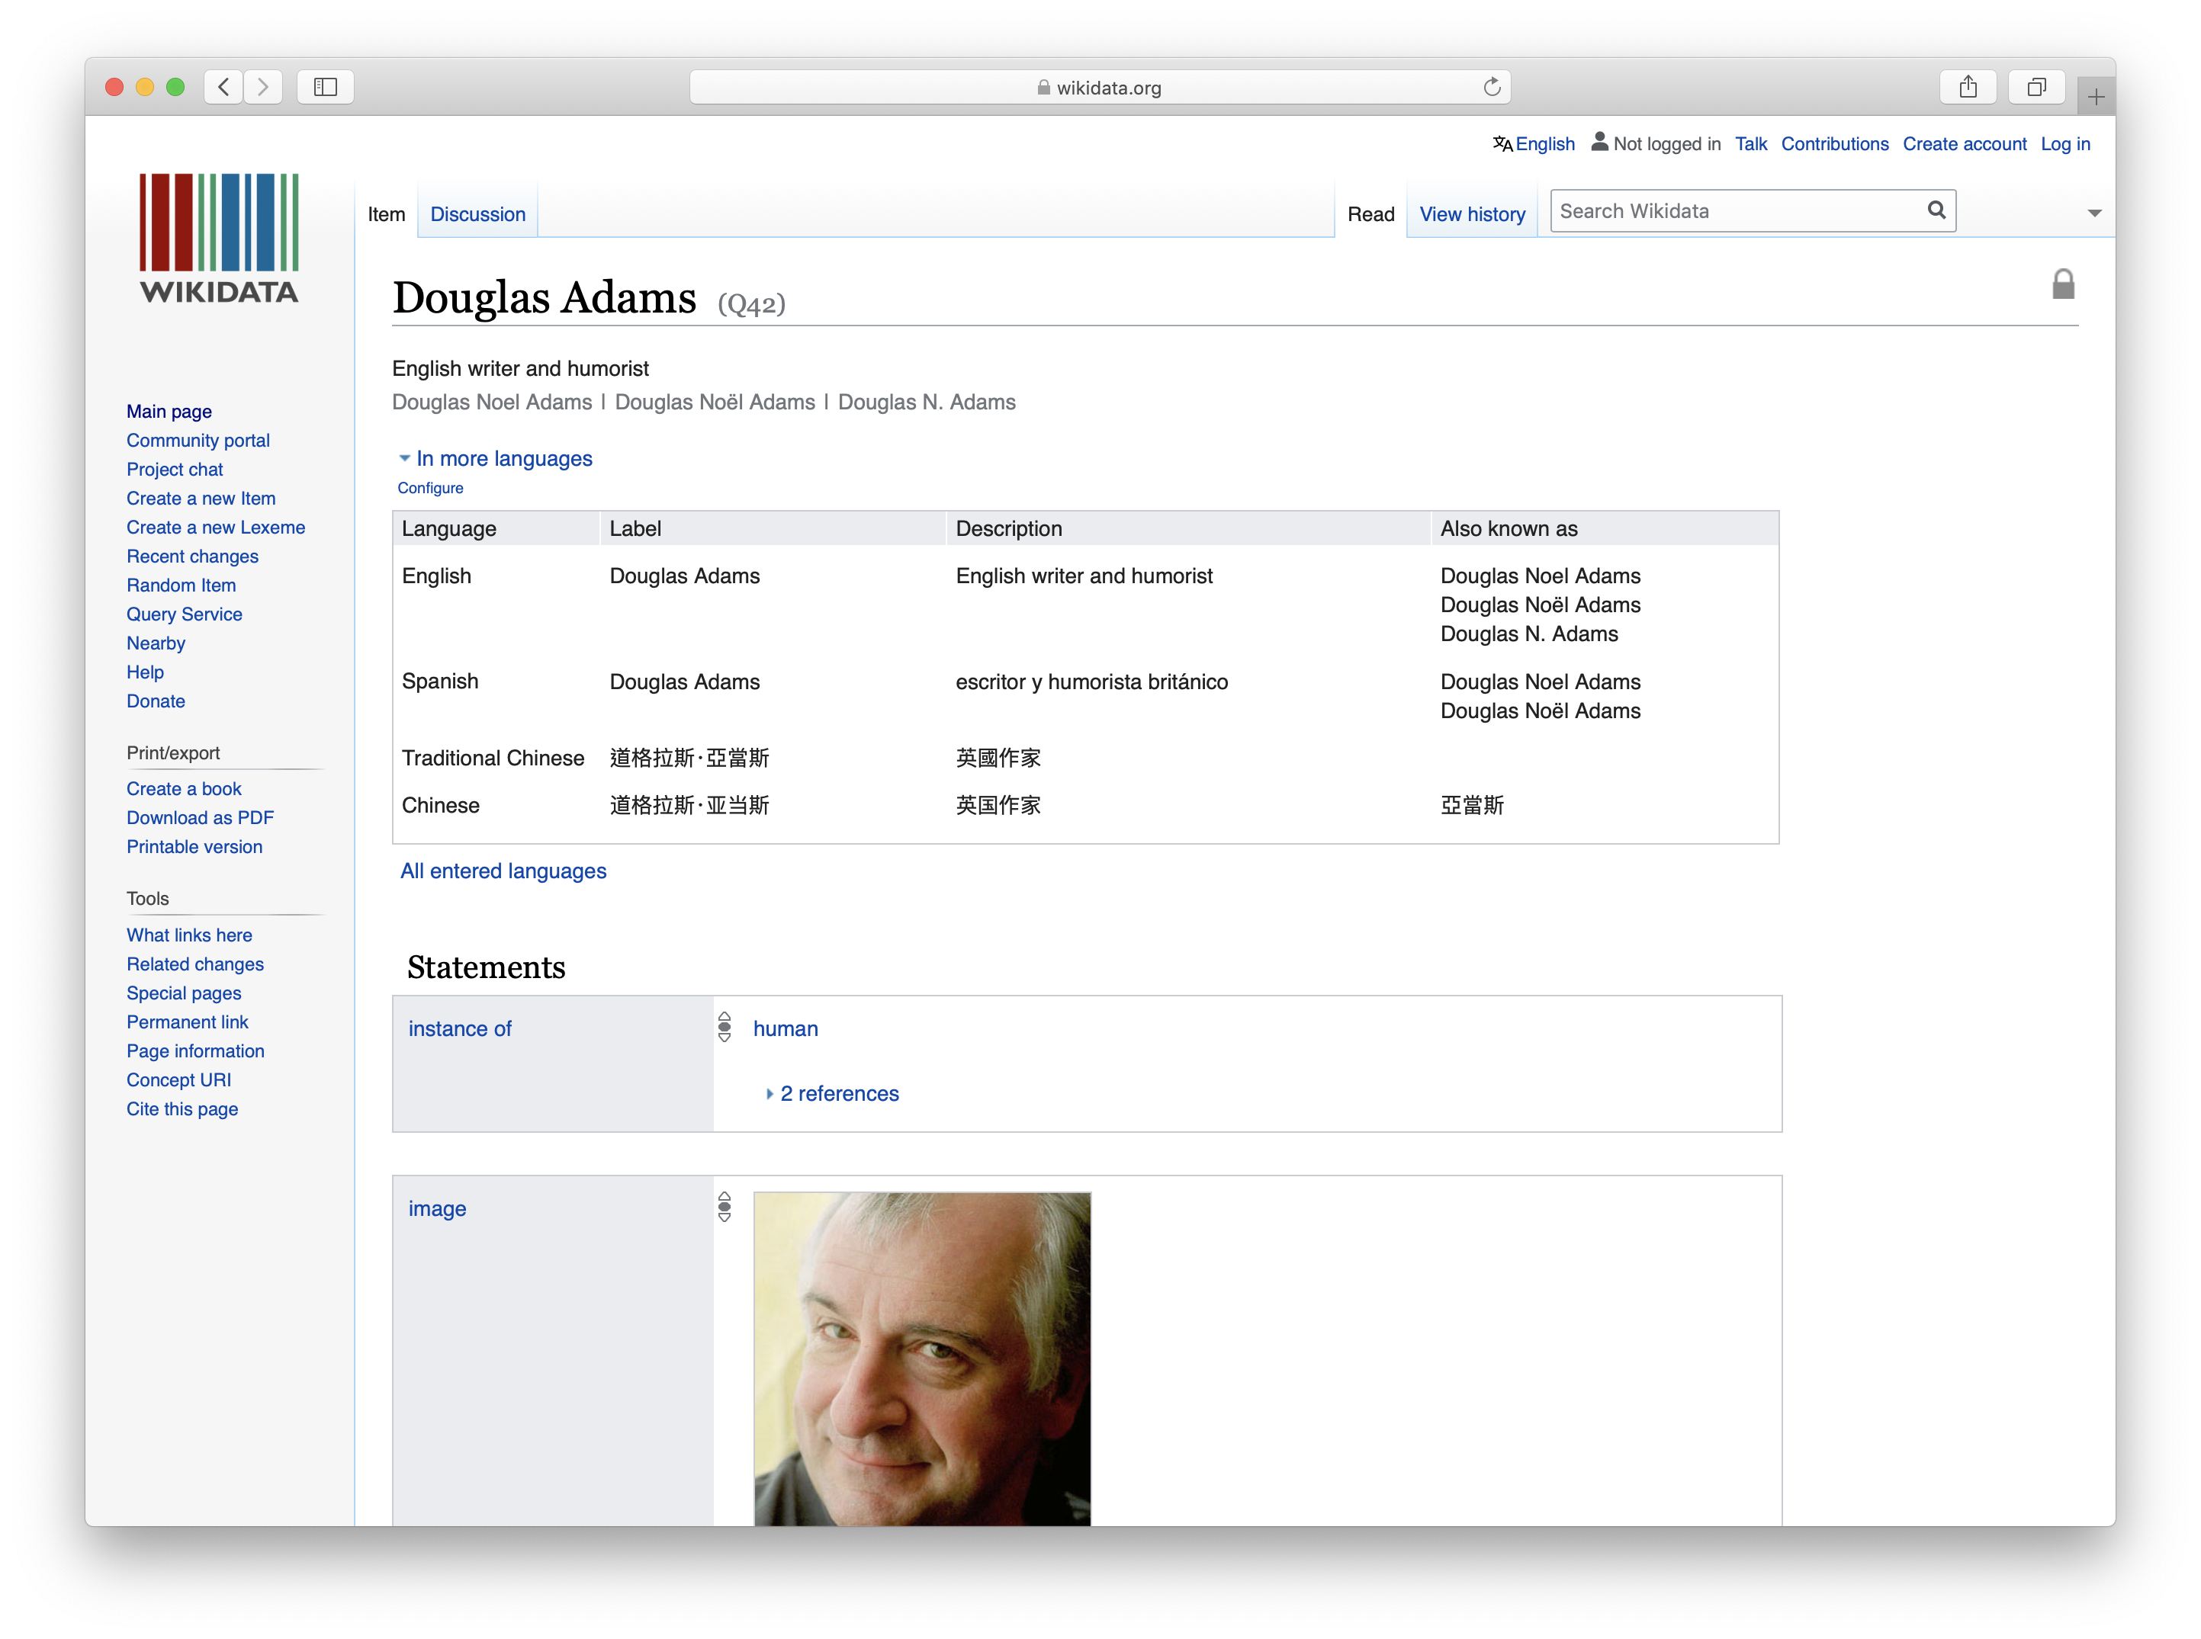
https://www.wikidata.org/wiki/Q5

Slide 5
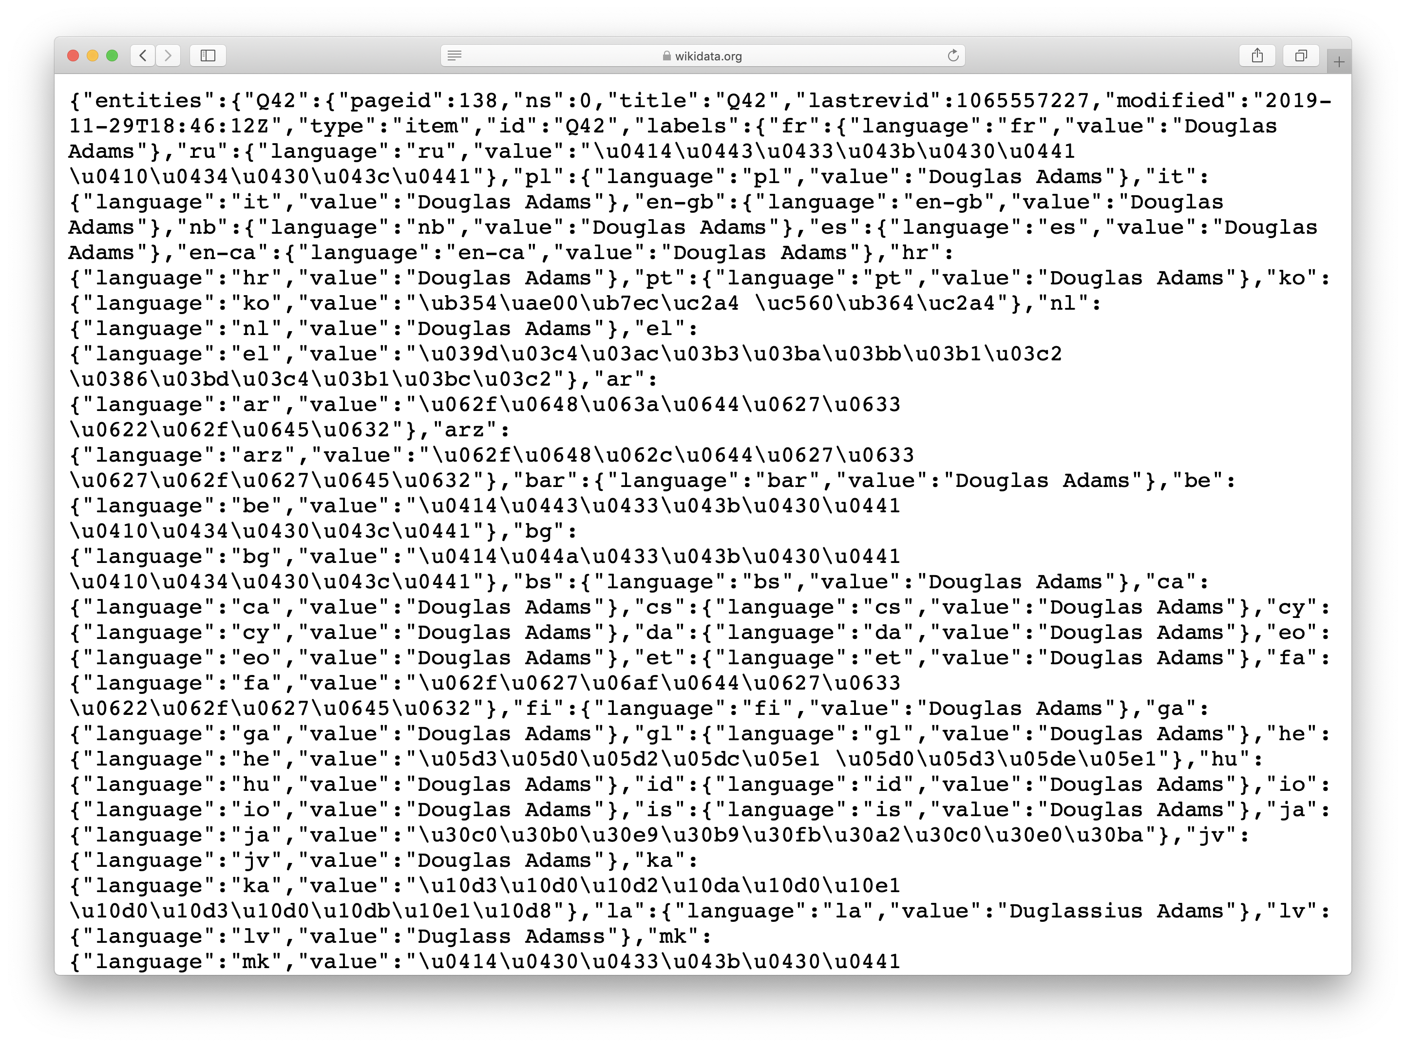
https://wikidata.org/wiki/Special:EntityData/Q42.json

Slide 6
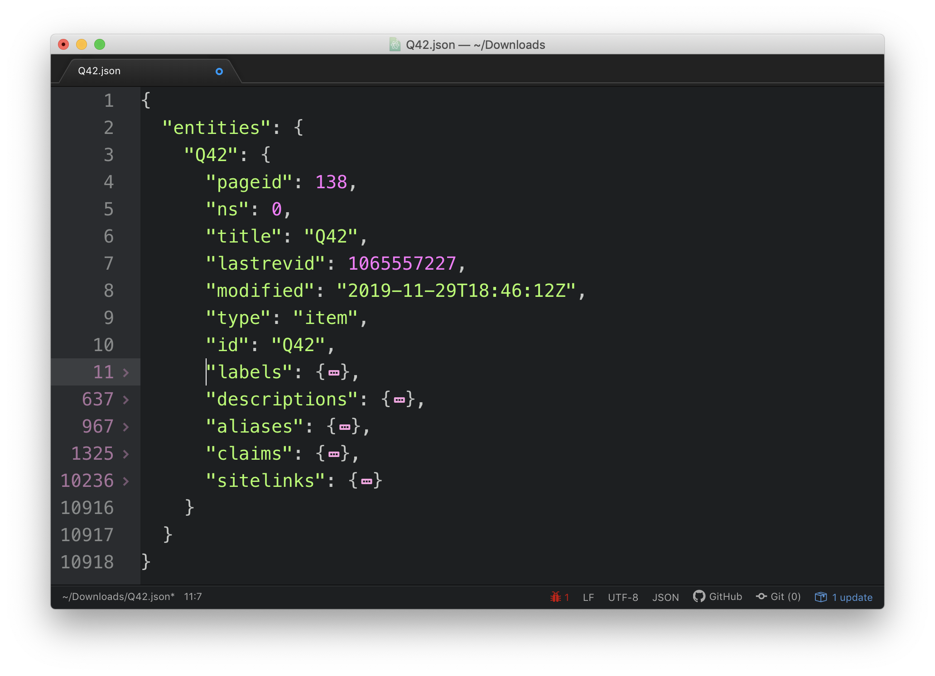
The entity in JSON

Slide 7
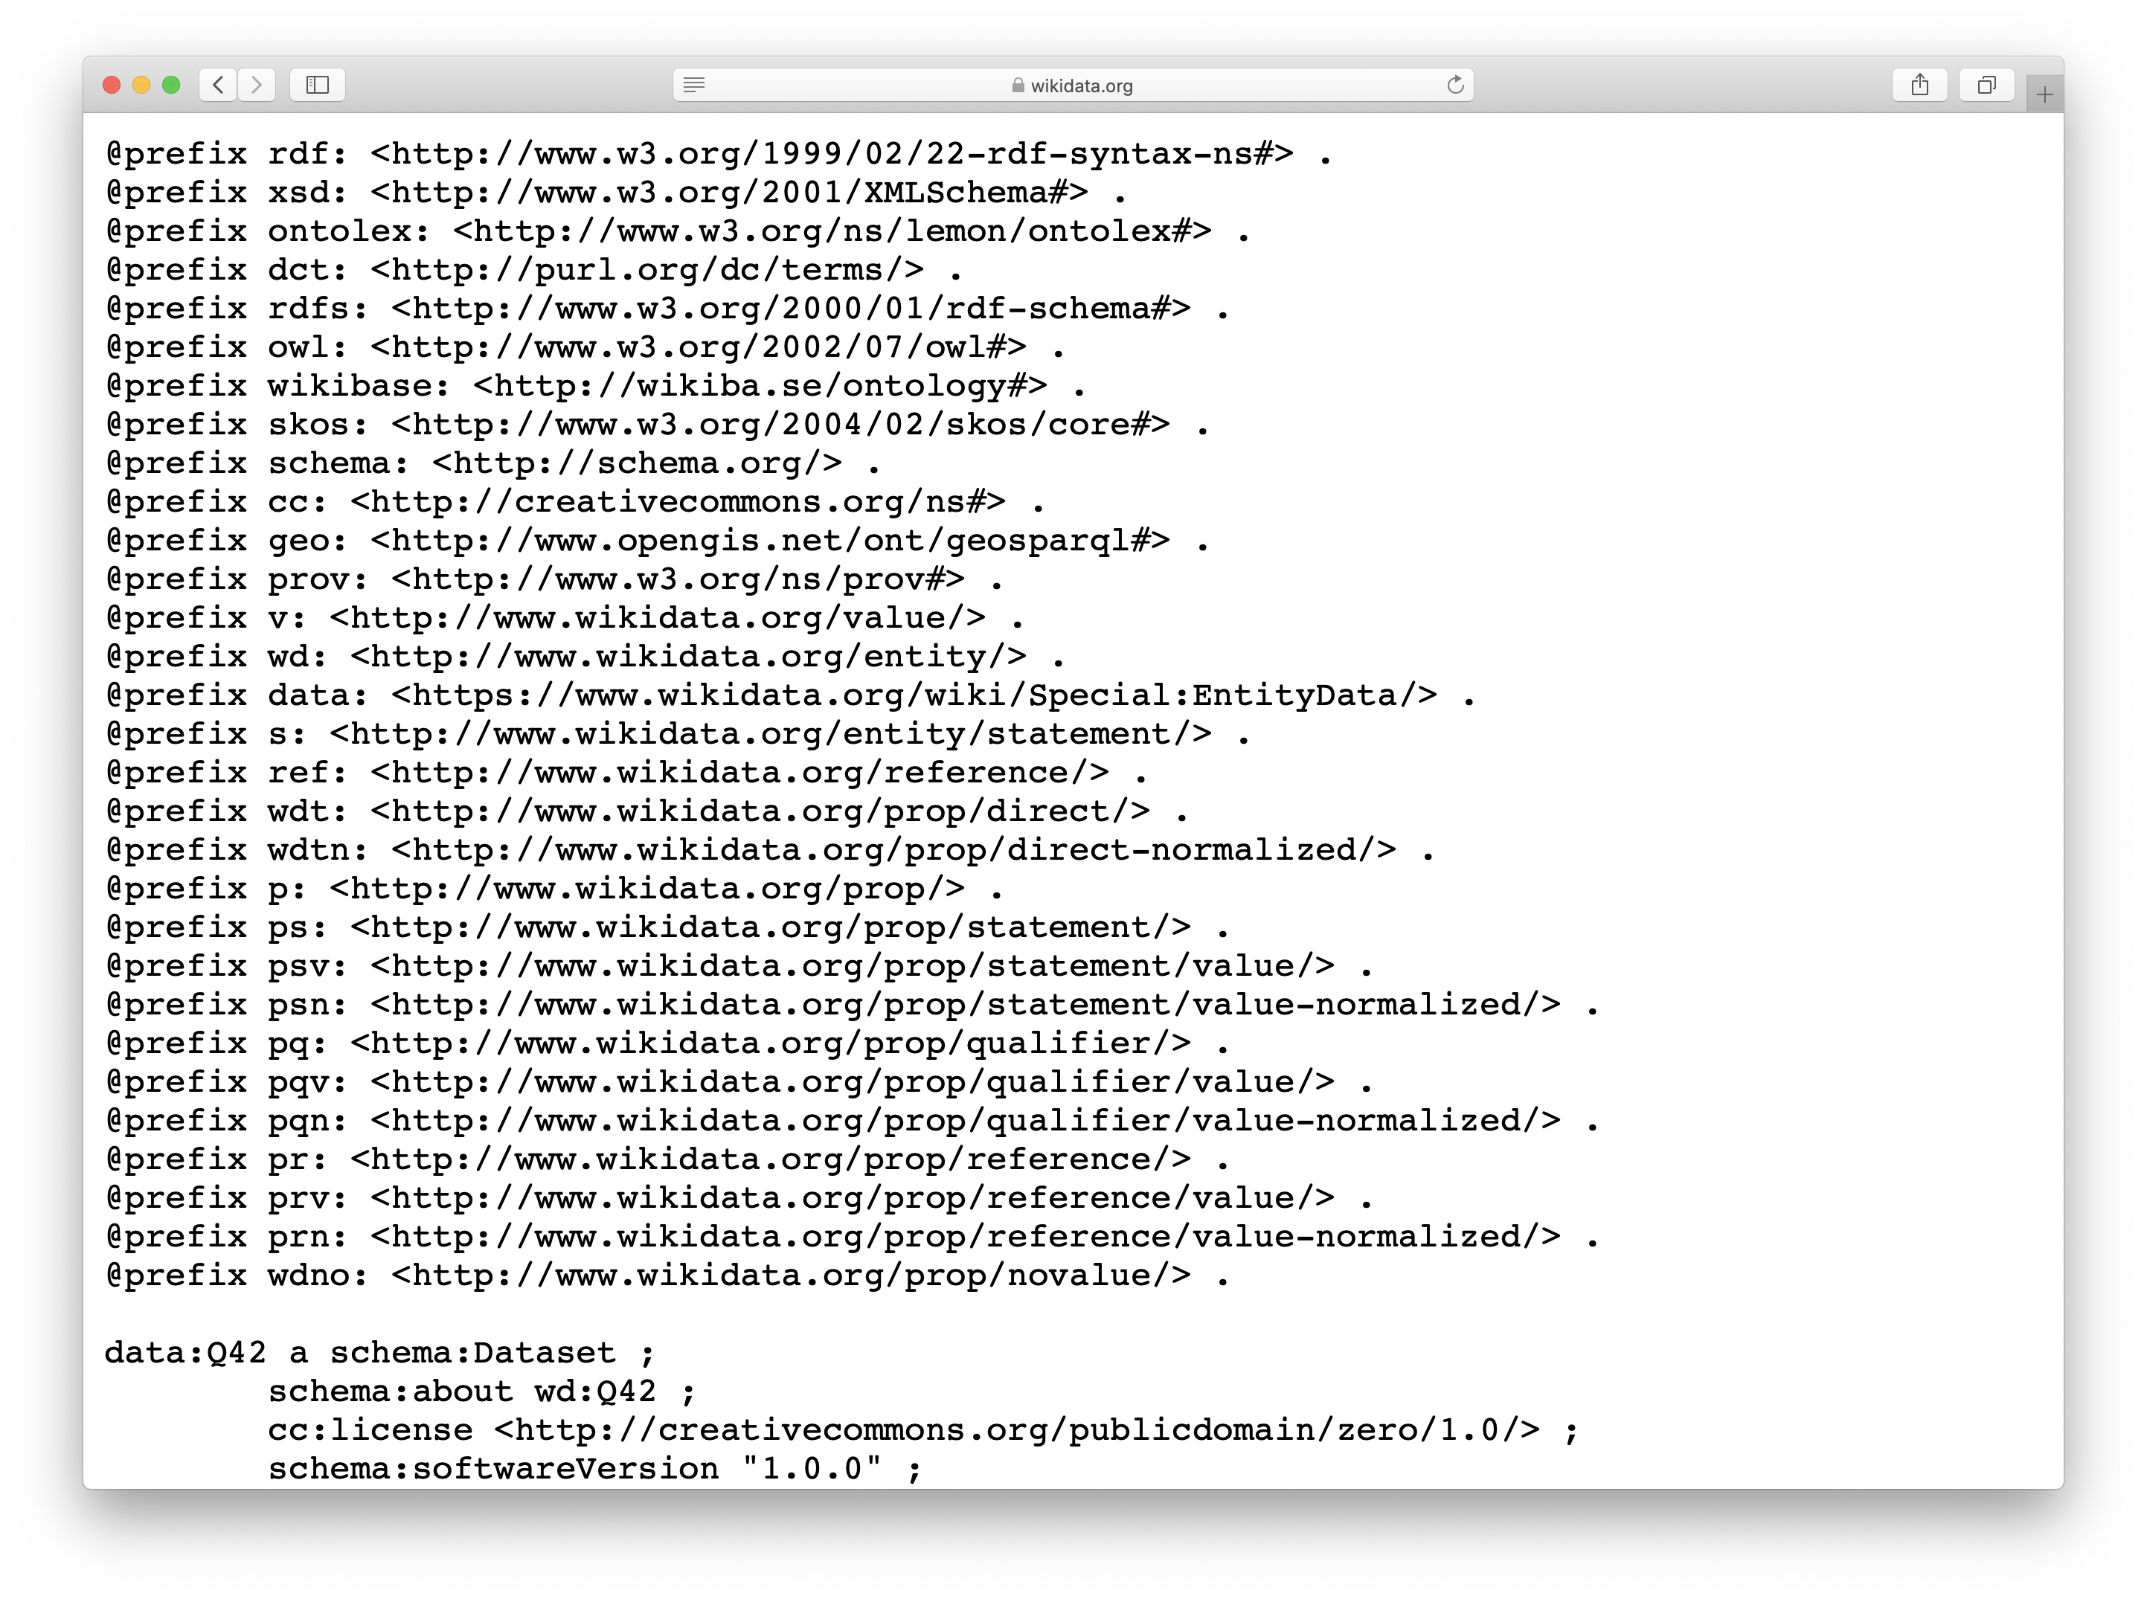
https://wikidata.org/wiki/Special:EntityData/Q42.ttl

Slide 9
Wikibase Data Model
Item = subjects = entities
Property = properties
Value = entities or datatypes (string, number,…)
Snak = basic assertion about item, i.e. a Property-Value pair -- ”small, but more than a byte”
Some are simple claims: population of Berlin is 3,499,879
Others (e.g., type assertions) are structural: type Berlin City
Others include a claim an qualifiers Population of Berlin is 3,499,879, considering only territory of city, as estimated on 30 November 2011

Slide 10
Items have
Item identifier (number prefixed with Q)
Fingerprint, consisting of:
Multilingual label*
Multilingual description*
Multilingual aliases
Statements, each consisting of:
Claim, consisting of:
Property
Value
Qualifiers (additional property-value pairs)
References (each with one or more property-value pairs)
Rank
Site links

Slide 11
Statements…
A statement may have:
one property (in the example, P551 “residence")
one value (Q84 “London”)
optionally one or more qualifiers (e.g, property:P582, “end time” 11 May 2011)
optional reference(s) (e.g., property:P143 “imported from Wikipedia”)
The property, value, and qualifiers together are also called the claim, which together with any source references forms a statement.

Slide 12
Properties have …
Property identifier (number prefixed with P)
Fingerprint, consisting of:
Multilingual label*
Multilingual description*
Multilingual aliases
Statements, each consisting of:
Claim, consisting of:
Property
Value
Qualifiers (additional property-value pairs)
References (each with one or more property-value pairs)
Rank
Datatype

Slide 13
Example of Data Model

Slide 14
Statements…
Requirement: "Wikibase will not be about the truth, but about statements and their references"
Doesn’t model items, but statements about them
Not “Daulgas Adams residence is London”
But “There’s a statement of Douglas Adams having a residence of London prior to 11 May 2011 according to WIkipedia”

Slide 15
Example: Trumps spouses
Who are Donald Trump’s spouses?
We must identify the IDs for
Donald Trump
Spouse relation
And then write and run a simple SPARQL query
Let’s give it a try

Slide 16
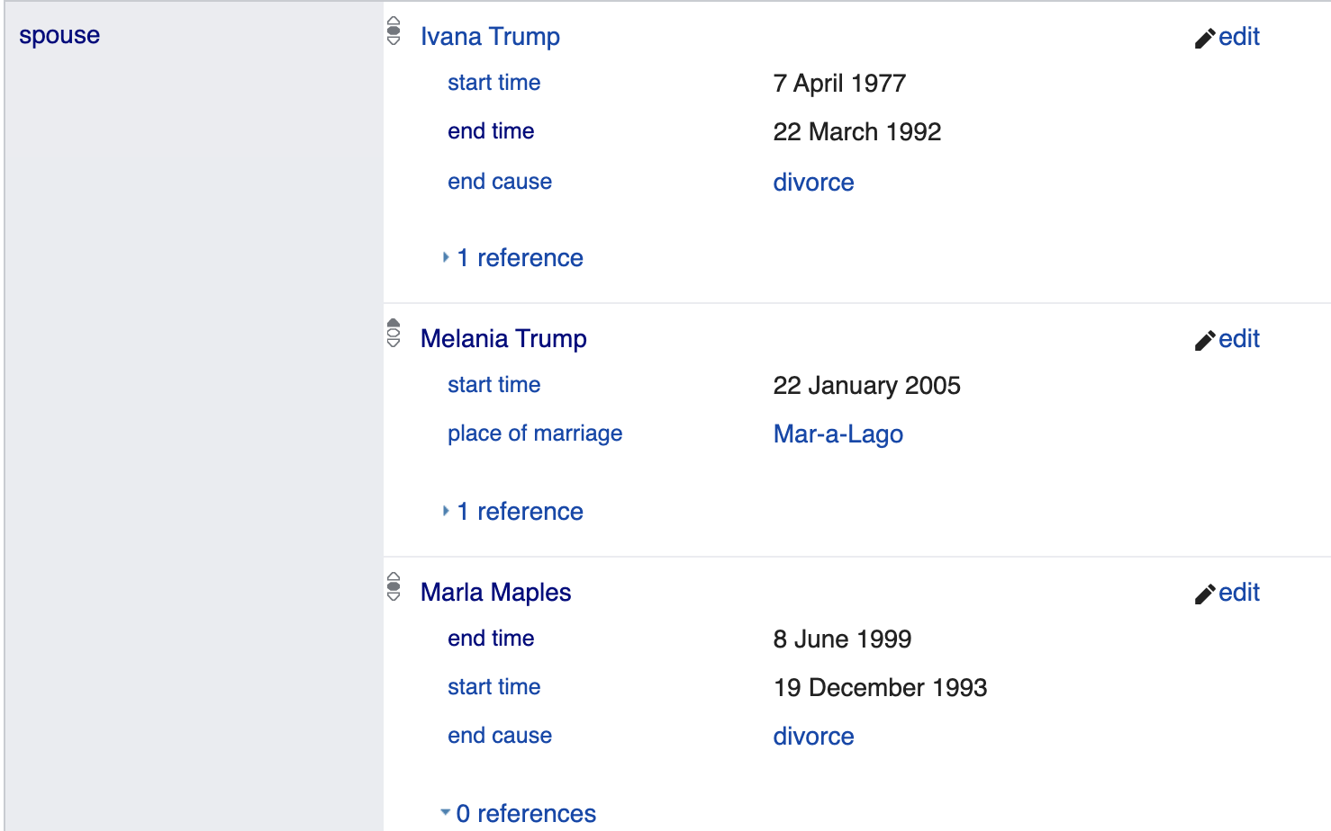
Well….
It only returns one answer: his current spouse
Other values have an end time
Maybe that’s a feature!
Let’s try another query: what schools did Donald Trump attend?

Slide 17
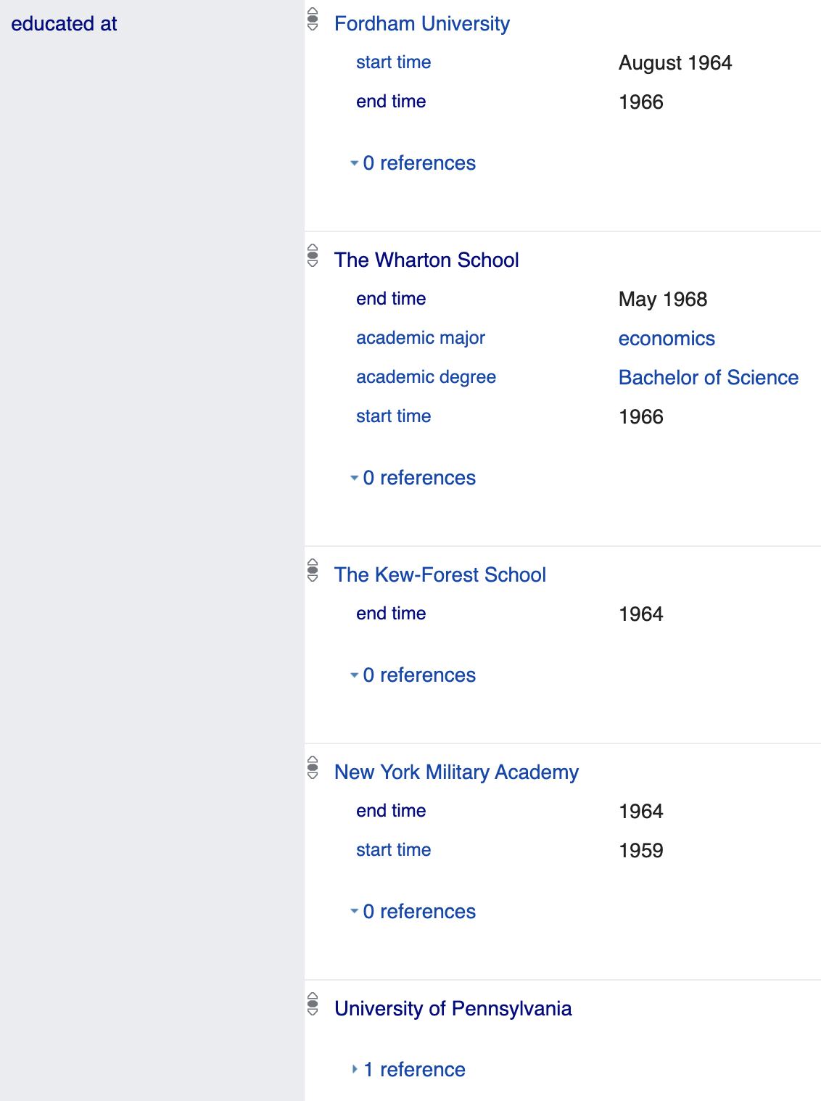
Property Rank
We get four schools, even though all have end dates (we might quibble that Penn and Wharton are the same)
Does Wikidata’s ontology know that spouse (P26) is a temporal quality and educated at (P69) is not?
No, though property has some constraints that might be useful
The mechanism used is to give each value a rank

Slide 18
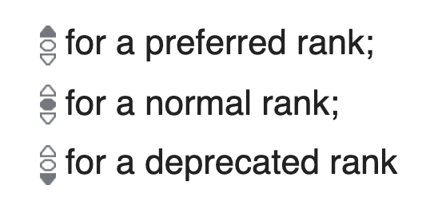
Ranking claims
Preferred: most current or represent consensus
Normal: default; no judgement of a value's accuracy and currency
Deprecated: errors or outdated
For DT’s spouses, Melania has preferred rank and the others normal rank
All of DT’s schools had normal rank.
How are ranks represented in RDF and how does the Wikidata query service use them?

Slide 19
WDQS Procedure
What’s matched for ?s wdt:Pxxx ?o
If there’s at least one ?v with preferred rank, only values preferred values are returned
If there are no preferred values, all values with normal rank are returned
Deprecated values are never returned.
The humans or bots populating the graph must figure out how to assign ranks

Slide 20
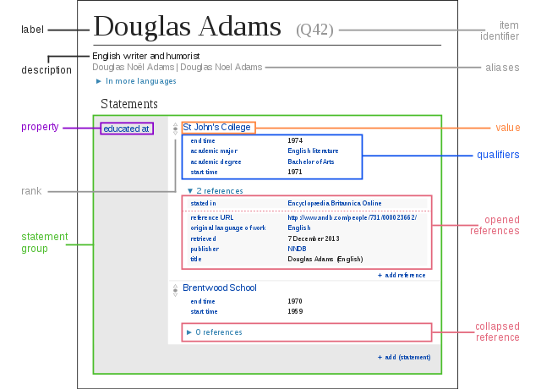
Qualifiers, rank and references
Wikidata uses special namespaces to access a reified node with claim’s qualifiers, rank & references
prefix p: points not to object, but to statement node
It is then subject of other triples
Within a statement node:
ps: gets the object
pq: gets qualifier information
wikibase:rank gets rank information
prov:wasDerivedFrom/pr:P248 gets reference values

Slide 21
Example (1)
SELECT ?education ?educationLabel ?starttime ?endtime WHERE {
wd:Q42 p:P69 ?statement.
?statement ps:P69 ?education.
?statement pq:P580 ?starttime.
?statement pq:P582 ?endtime.
SERVICE wikibase:label { bd:serviceParam wikibase:language "en". } }
ORDER BY ?starttime
Try it

Slide 22
Example (2)
We can simplify this with the [ ] syntax to eliminate the ?statement variable.
SELECT ?education ?educationLabel ?starttime ?endtime WHERE {
wd:Q42 p:P69
[ ps:P69 ?education;
pq:P580 ?starttime;
pq:P582 ?endtime ].
SERVICE wikibase:label { bd:serviceParam wikibase:language "en". } }
ORDER BY ?starttime
Try it

Slide 23
Example (3)
Here’s an example getting rank information
SELECT ?education ?educationLabel ?rank WHERE {
wd:Q42 p:P69
[ps:P69 ?education;
wikibase:rank ?rank; ].
SERVICE wikibase:label { bd:serviceParam wikibase:language "en". } }
Try it

Slide 24
Trumps Spouses
# Get Donald Trump’s spouses, current and former and deprecated
SELECT ?spouse ?spouseLabel ?rank
WHERE {
wd:Q22686 p:P26
[ps:P26 ?spouse;
wikibase:rank ?rank; ].
SERVICE wikibase:label { bd:serviceParam wikibase:language "en". }
}
Try it

Slide 25
Deprecated values
See this page on deprecation
Honoré de Balzac (Q9711) has two values for date of death (P570): 18 and 19 August 1850
The August 19 claim is tagged as deprecated, with the reason incorrect value (Q41755623)

Slide 26
Getting the software and data
Open source software to run an instance
Uses a RDBMS (e.g., mysql) for storage
Provides a SPARQL interface
Data dumps in JSON or RDF
33GB for JSON (compressed)
43GB for TTL (compressed)

