Slide 1
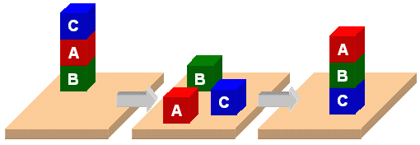
HW: Planning

Slide 2
PDDL
Planning Domain Description Language
Based on STRIPS with various extensions
Originally defined by Drew McDermott (Yale) and others
Used in the biennial International Planning Competition (IPC) series
Many planners use it as a standard input

Slide 3
PDDL Representation
A task specified via two files: domain file and problem file
Problem file gives objects, initial state, and goal state
Domain file gives predicates and operators; these may be re-used for different problem files
Domain file corresponds to the transition system, the problem files constitute instances in that system

Slide 4
Blocks Word Domain File
(define (domain hw5)
(:requirements :strips)
(:constants red green blue yellow)
(:predicates (on ?x ?y) (on-table ?x) (block ?x) … (clean ?x))
(:action pick-up
:parameters (?obj1)
:precondition (and (clear ?obj1) (on-table ?obj1) (arm-empty))
:effect (and (not (on-table ?obj1))
(not (clear ?obj1))
(not (arm-empty))
(holding ?obj1)))
… more actions ...)

Slide 5
Blocks Word Problem File
(define (problem 00)
(:domain hw5)
(:objects A B C)
(:init (arm-empty)
(block A)
(color A red)
(on-table A)
(block B)
(on B A)
(block C)
(on C B)
(clear C))
(:goal (and (on A B) (on B C))))
C
A
B
B
A
C

Slide 6
Blocks Word Problem File
(define (problem 00)
(:domain hw5)
(:objects A B C)
(:init (arm-empty)
(block A)
(color A red)
(on-table A)
(block B)
(on B A)
(block C)
(on C B)
(clear C))
(:goal (and (on A B) (on B C))))
C
A
B
B
A
C
Begin plan
1 (unstack c b)
2 (put-down c)
3 (unstack b a)
4 (stack b c)
5 (pick-up a)
6 (stack a b)
End plan

Slide 7
(1) Extend the domain: new objects
Paint cans: A paint can holds only only color of paint. It can also be open (i.e., no lid) or not open (i.e., it’s lid is on)
Brushes: A brush can either be clean or loaded with paint of a particular color
Water bucket: A water bucket is used to wash brushes

Slide 8
(2) Extend the domain: new actions
painting an object a given color with a brush and can
loading a brush with paint of a given color
washing a brush in a water bucket to make make it clean
Removing the lid of a paint can
Replacing the lid of a paint can

Slide 9
Action preconditions
To paint an object, it must be on the table and clear
To paint something a color with a brush, it must be loaded with paint of that color
To load paint bush with a color, you must be holding brush, it must be clean & there must be a paint can with that color that is clear & open. When a brush is loaded with a color it’s not clean.
To wash brush, making it clean, you must have a water bucket with nothing on it (i.e., is clear) and you must be holding brush
To make paint-can open, it has to be not open and clear and on the table
To make paint-can not open, it has to be open and clear and on the table

Slide 10
Problem p0.ppd
;; There is only one block, A, which is on the table. There is a
;; brush B on the table that is loaded with red paint. Our goal is to
;; have A be red and the arm empty.
(define (problem p0)
(:domain hw5_domain)
(:objects a brush1)
(:init (arm-empty)
(block a) (on-table a) (clear a)
(brush brush1) (on-table brush1) (clear brush1) (loaded brush1 red))
(:goal (and (color a red) (arm-empty))))

Slide 11
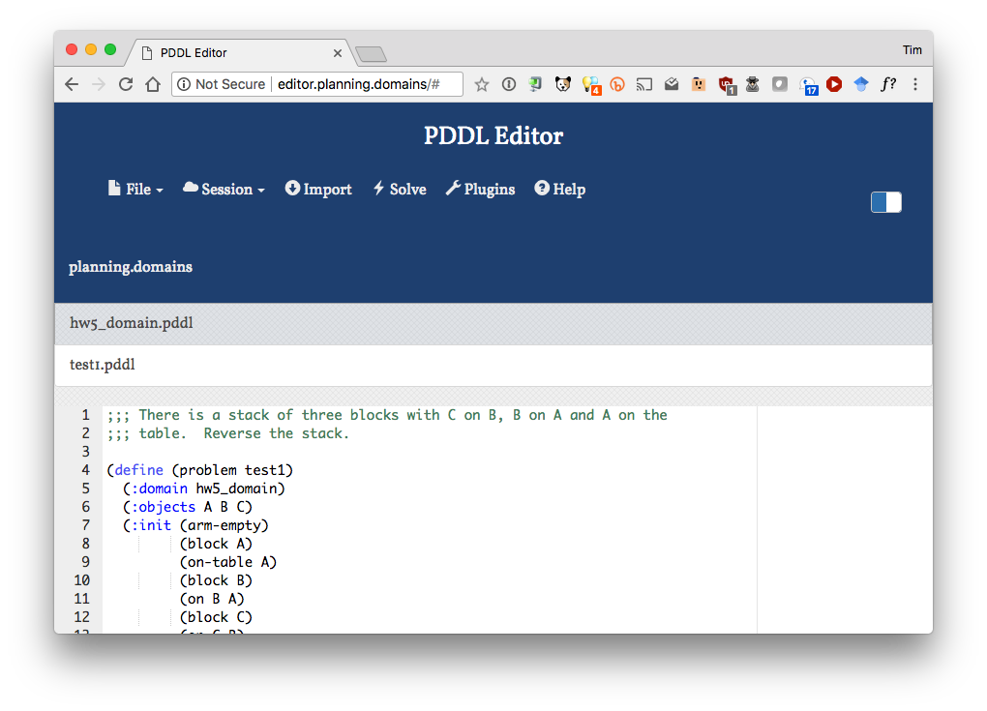
http://planning.domains/

Slide 12
P4
;; Block A is on the table, B is on A and C on B. On the table are a water
;; bucket, cans of red, green and blue paint stacked on each other and a clean
;; brush. The goal is to make A red, B green and C blue and to have A on B, B
;; on C and C on the table, the cans closed and the brush clean and arm empty.
(define (problem p4)
(:domain hw5_domain)
(:objects A B C can1 can2 can3 brush1 wb1)
(:init (arm-empty)
(block a) (on-table a)
(block b) (on b a)
(block c) (on c b) (clear c)
(water-bucket wb1) (on-table wb1)(clear wb1)
(paint-can can1 red) (on-table can1) (not (open can1))
(paint-can can2 green) (on can2 can1) (not (open can2))
(paint-can can3 blue) (on can3 can2) (clear can3) (not (open can3))
(brush brush1)(clean brush1)(on-table brush1)(clear brush1))
(:goal (and (arm-empty)
(on a b) (on b c) (on-table c) (clear a)
(color a red) (color b green) (color c blue)
(not (open can1)) (not (open can2))
(not (open can3)) (clean brush1))))
http://planning.domains/

Slide 13
Fin

