Slide 1
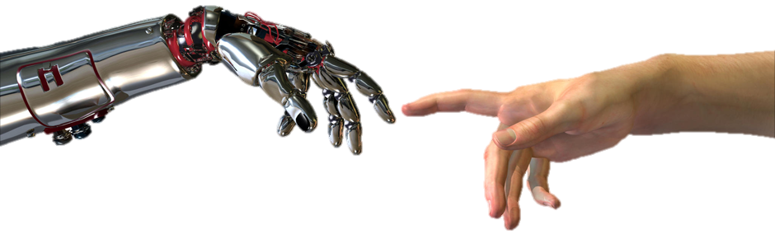
Artificial Intelligence Class 1: Course Overview
Dr Cynthia Matuszek (Dr M)
cmat@umbc.edu – ITE 331

Slide 2
Course Staff
Professor: Dr. M
cmat@umbc.edu
ITE 331
Office hours: M 9-10, T 3-4, or by appointment
TA: Koninika Patil
koni1@umbc.edu
ITE 353H
Office hours: TTh 12-1, or by appointment.

Slide 3
My Research
Robotics
How can we go from industrial robots to useful robots in human environments? (Schools, cars, homes…)
Natural Language Processing
How can computers learn to understand and speak human languages (English)?
Artificial intelligence
How to get computers to behave in ways that we would consider to be “intelligent”
Human-Robot Interaction (HRI)

Slide 4
Today: Intro & Overview
Brief history of AI
What is AI? (and why is it so cool?)
What’s the state of AI now?
Review of syllabus and schedule
Academic honesty
Expectations
Topics we’ll cover
What is ‘intelligence’?
From handout:
http://tiny.cc/ai-schedule
http://tiny.cc/ai-class
http://tiny.cc/ai-piazza

Slide 5
Classroom Policies
Be courteous to classmates and instructors.
No devices in use except when specified.
You don’t learn as much.
People around you don’t learn as much.
http://tiny.cc/devices-in-class
Don’t eat in the classroom.
Distracting to everyone.

Slide 6
Grading
Class participation | 5%
Midterm | 15%
Homework | 30%
Quizzes | 5%
Project | 25%
Final exam | 20%
Quizzes, surveys, … | (up to) 5%

Slide 7
Homework
Homeworks: written and programming
Due at midnight the day before class!
Late policy: 25% / day
Requests for extensions may be given:
With reasonable cause
When made in advance
All inquiries about grading → TA first

Slide 8
Assignment Policies
This class is primarily paperless
Most assignments will be turned in electronically
Blackboard, online forms, or email
10% penalty for failing to follow turn-in instructions
Usually due at 11:59pm the day before class
Late: 25% off per day
Time management
Extensions are sometimes available
Please talk to me!

Slide 9
Academic Integrity
Instructor’s responsibilities:
Be respectful
Be fair
Be available
Tell the students what they need to know and how they will be graded
Students’ responsibilities:
Be respectful
Do not cheat, plagiarize, or lie, or help anyone else do so
Do not interfere with other students’ academic activities

Slide 10
Academic Integrity Policy
“By enrolling in this course, each student assumes the responsibilities of an active participant in UMBC’s scholarly community, in which everyone’s academic work and behavior are held to the highest standards of honesty. Cheating, fabrication, plagiarism, and helping others to commit these acts are all forms of academic dishonesty, and they are wrong. Academic misconduct could result in disciplinary action that may include, but is not limited to, suspension or dismissal.” [Statement adopted by UMBC’s Undergraduate Council and Provost’s Office]

Slide 11
Plagiarism
Representing someone else’s words as your own is plagiarism.
What if the reference is in the bibliography?
If you didn’t explicitly quote the text you used, and cite the source where you used the text, it is plagiarism.
What if I only use some of the words?
Scattering some of your own words and rephrasing isn’t enough; if the ideas are not restated entirely in your own words, it is plagiarism.

Slide 12
Plagiarism
More Examples
The introduction and background material are borrowed; all of the research is original.
If somebody else’s words appear in any document that you claim is written by you, it is plagiarism.
It was a draft or not an official assignment
If you represented somebody else’s words as your own, even in an informal context, it is plagiarism.
“But the professor told me to use that source!”
Unless you are explicitly told to copy a quote from a source, you must write your answers in your own words

Slide 13
Abetting
Helping another student to cheat, falsify, or plagiarize will generally result in your receiving the same penalty
Know what your project partners are doing; if you turn a blind eye to their cheating, you may be hurting yourself
This includes putting someone’s name on something when they didn’t work on it

Slide 14
What To Do
You can always bring it to me
If it’s from you / in your group / etc:
You may talk to them about it
Unless it’s too late (it’s been turned in, the test is over)
Then you are abetting unless you report
Some people may get sneakier instead of improving
You do not have to talk to anyone but me

Slide 15
Penalties
Penalties depend on the offense and whether it recurs
The minimum penalties are:
Receiving a zero on an assignment
Being required to redo the assignment, without credit, in order to pass the class
Additional penalties may include:
Receiving a full grade reduction in the class
Failing the class without possibility of dropping it
Suspension or expulsion from the university

Slide 16
About Groupwork
Study groups are encouraged!
Talking about the homework is completely acceptable
Some homework be done by a group (2-3 students) working together
Programming work must be submitted individually
You may help the other members of your group
Programming assignments must be written by you
Your group members may help you debug
Copying another person’s code is never acceptable

Slide 17
Availability & Communication
Drop in when my door is open
If I’m busy, we’ll make an appointment
We will try to respond to Piazza posts immediately
Email: 24-48 hours
Post general questions (most questions!) to Piazza
Always send email to professor and TA

Slide 18
Schedule
You will check this pretty much every class
Before class
After class

Slide 19
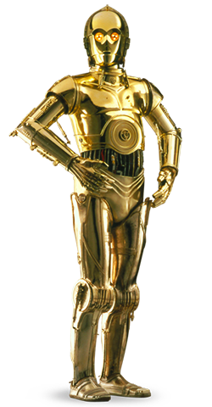
What is AI?

Slide 20
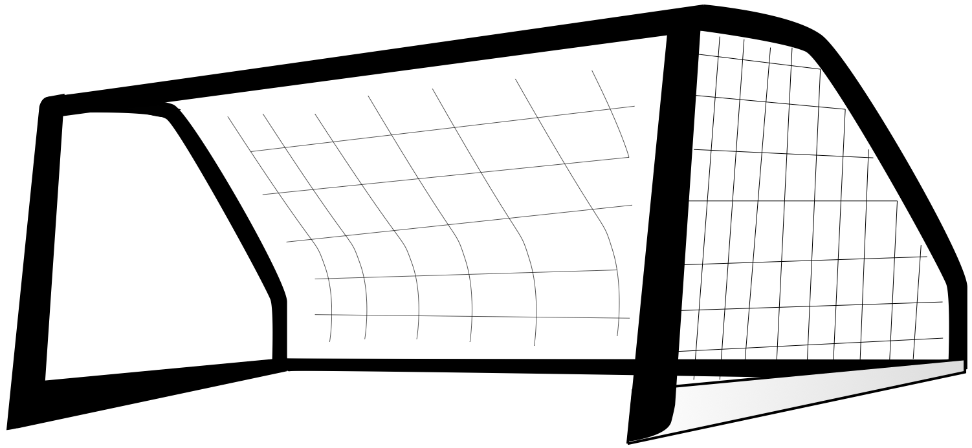
Artificial Intelligence
Key types
Strong AI: mental/thought capabilities equal to (or better than) human
Weak (bounded) AI: intelligent actions or reasoning in some limited situations
These are problematic
How do we measure it?
What’s an ‘intelligent action’?
In practice, ‘previously human only’
Is there something ineffable missing?

Slide 21
AI: A Vision
Could an intelligent agent living on your home computer manage your email, coordinate your work and social activities, help plan your vacations…… even watch your house while you take those vacations?

Slide 22
Main Goals of AI
Represent and store knowledge
Retrieve and reason about knowledge
Behave intelligently in complex environments
Develop interesting and useful applications
Interact with people, agents, and the environment

Slide 23
Why AI?
Engineering
To get machines to do a wider variety of useful things
Understand spoken natural language, recognize individual people in visual scenes, find the best travel plan for your vacation, etc.
Cognitive Science
As a way to understand how natural minds and mental phenomena work
Visual perception, memory, learning, language, etc.
Philosophy
As a way to explore some basic and interesting (and important) philosophical questions

Slide 24
Foundations of AI
Computer
Science &
Engineering
Mathematics
Philosophy
AI
Economics
Biology
Psychology
Linguistics
Cognitive
Science

Slide 25
History
1997: Deep Blue beats Garry Kasparov (world champion)
1998: Founding of Google
2000: Interactive robot pets
2004: First DARPA Grand Challenge robot race
2004: Commercial recommender systems (TIVO, amazon.com)
2007: Checkers is solved!
2011: An AI named Watson beats the top Jeopardy! champions
2010: Google self-driving cars reach their 1000th mile

Slide 26
Eliza
ELIZA: A program that simulated a psychotherapist
Successfully passed the Turing Test!
Coded at MIT during 1964-1966 by Joel Weizenbaum.
First script was DOCTOR.
The script was a simple collection of syntactic patterns
Each pattern had a reply which might include bits of the input
Weizenbaum was shocked at reactions:
Psychiatrists thought it had potential.
People unequivocally anthropomorphized.
Many thought it solved the NL problem.

Slide 27
I am the psychotherapist. Please, describe your problems. Each time you are finished talking, type RET twice.
i'm having a hard time with my students
Why do you say that?
well, they keep asking me for money
Maybe your plans have something to do with this.
what plans?
Is it because of your life that you say what plans?
No, it's because I didn't know what you were talking about
Is it because you didn't know what I was talking about that you came to me?
no, it's because i wanted to see if you could pass the turing test
Does it bother you that you wanted to see if I could really pass the turing test?
…..
How do you reconcile problems at school?
This is a waste of time. Good bye
My secretary will send you a bill.

Slide 28
PARRY
H: Good afternoon. My name is Doctor Jones.
P: Pleased to meet you.
H: How are you?
P: All right I guess.
H: Could you tell me your name?
P: Pat Smith.
H: I though you might have some problems.
P: I've been upset lately.
H: By what?
P: People get on my nerves sometimes.
H: Tell me more.
P: Do you know anything about bookies?
...
Kenneth Colby modeled a paranoid using the same techniques circa 1968.
PARRY has basic emotions. If it gets angry, its replies become more hostile.
In a Turing test, expert psychiatrists were unable to distinguish PARRY’s ramblings from those of real paranoids.

Slide 29
Parry Meets Eliza
P: I don't understand your motives.
E: Why don't you understand my motives?
P: Shouldn't I be?
E: Why do you say that just now?
P: That's just the way it is.
E: Suppose that's the way it were not.
P: So?
E: I am not sure I understand you fully.
P: You harp on the same questions too much.
E: What does that similarity suggest to you?
P: I don't get you.
E: Do you wish that you did get I?

Slide 30
We’ve Come a Long Way (or have we?...)

Slide 31
Big Questions
Can machines think?
If so, how?
If not, why not?
What does this say about human beings?
What does this say about the mind?

Slide 32
What’s Easy and What’s Hard?
It’s easier to mechanize many high-level tasks
Symbolic integration, proving theorems, playing chess, medical diagnosis
It’s hard to mechanize tasks that lots of animals can do
walking around without running into things
catching prey and avoiding predators
interpreting complex sensory information (e.g., visual, aural, …)
modeling the internal states of other animals from their behavior
working as a team (e.g., with pack animals)
Is there a fundamental difference?

Slide 33
Turing Test
Three rooms:
1 person, 1 computer, and 1 interrogator
The interrogator can communicate with the other two
The interrogator tries to decide which is the person
Both try to convince the interrogator they are the person
If the machine succeeds, then we conclude that the machine can think
….Right? (no)

Slide 34
The Loebner Contest
A modern version of the Turing Test, held annually
$100,000 cash prize.
Hugh Loebner was once director of UMBC’s Academic Computing Services (née UCS)
http://www.loebner.net/Prizef/loebner-prize.html
Restricted topic (removed in 1995) and limited time.
Participants: set of humans, set of computers, set of judges.
Scoring
Rank from least human to most human.
Highest median rank wins $2000

Slide 35
What Can AI Systems Do Now?
Computer vision: face recognition from a large set
Natural language processing: machine translation
Expert systems: medical diagnosis in a narrow domain
Spoken language systems: ~1000 word continuous speech
Planning and scheduling: Hubble Telescope experiments
Robotics: autonomous (mostly) automobile
User modeling: Bayesian reasoning in Windows help (the infamous paper clip…)
Games: Grand Master level in chess (world champion), perfect play in checkers, Go
Search: You’ve used Google.
Learning: So much learning.

Slide 36
What Can’t AI Systems Do Yet?
Understand natural language robustly
Read and understand articles in a newspaper)
Surf the web
Interpret an arbitrary visual scene
Learn a natural language
Play Go as well as the best human players
Construct plans in dynamic real-time domains
Refocus attention in complex environments
Perform life-long learning
Exhibit true autonomy
and intelligence?

Slide 37
Who Does AI?
Academic researchers (perhaps the most Ph.D.-generating area of computer science in recent years)
Some of the top AI schools: CMU, Stanford, Berkeley, MIT, UW, UIUC, UMd, U Alberta, UT Austin, ... (and, of course, UMBC!)
Government and private research labs
NASA, NRL, NIST, IBM, AT&T, SRI, ISI, MERL, ...
Lots of companies!
Google/Alphabet, Microsoft, Amazon, Honeywell, Teknowledge, SAIC, MITRE, Fujitsu, Global InfoTek, BodyMedia, ...

Slide 38
Applications

Slide 39
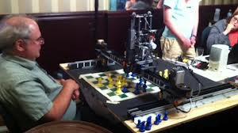
Game Playing

Slide 40
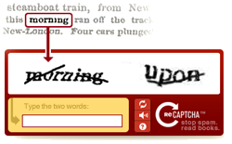
Text/Sketch Recognition

Slide 41
User Modeling & NLP

Slide 42
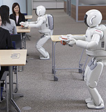
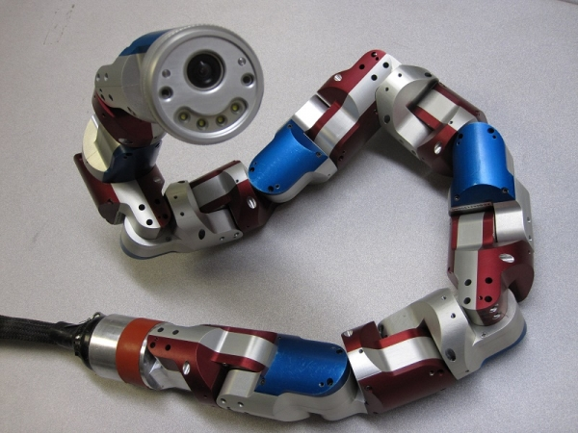
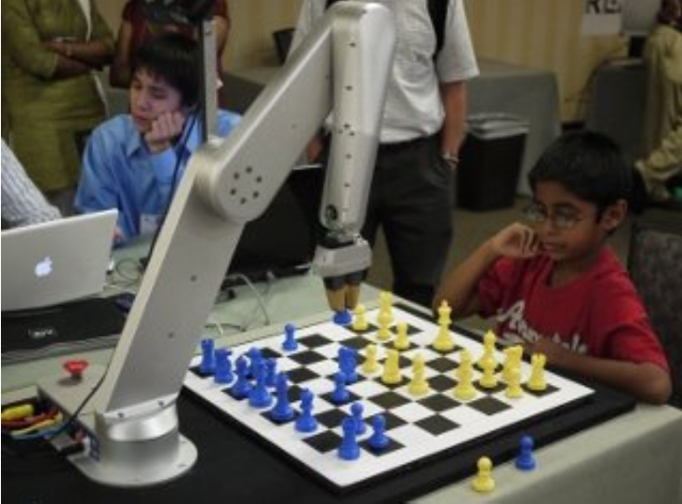
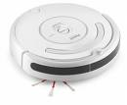
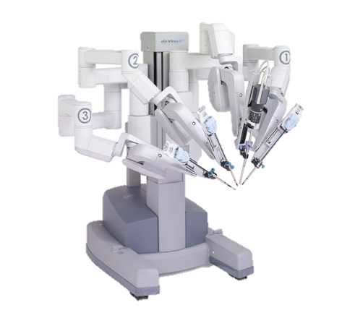
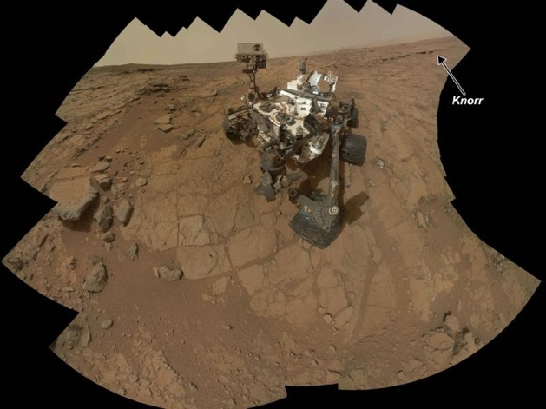
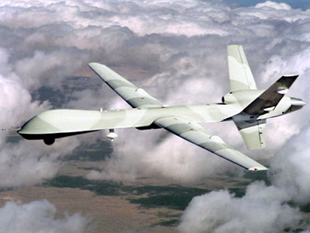
Robotics

Slide 43
Knowledge Representation
Watson
43

Slide 44
Evolutionary Art

Slide 45
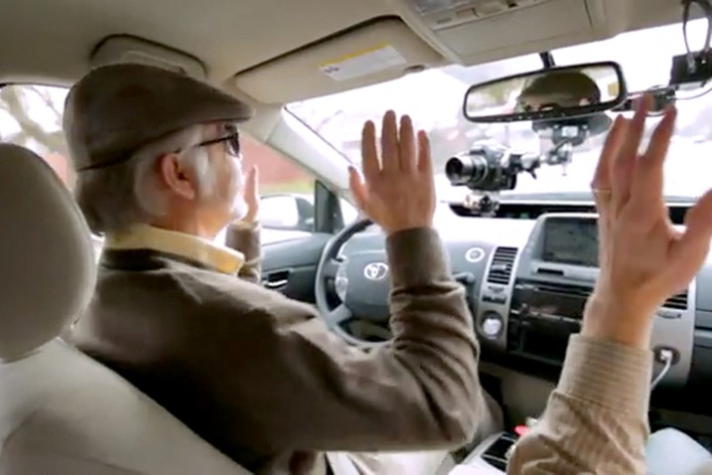
Computer Vision

Slide 46
Possible Approaches
Like humans
Well
Rational
agents
Think
GPS
AI tends to work mostly in this area
Act
Heuristic
systems
Eliza

Slide 47
Thinking Well
Like humans
Well
Think
GPS
Rational
agents
Act
Eliza
Heuristic
systems
Develop formal models of knowledge representation, reasoning, learning, memory, and problem solving, that can be rendered in algorithms.
There is often an emphasis on systems that are provably correct, and guarantee finding an optimal solution.

Slide 48
Acting Well
Like humans
Well
Think
GPS
Rational
agents
For a set of inputs, generate an appropriate output that is not necessarily correct but gets the job done.
A heuristic (heuristic rule, heuristic method) is a rule of thumb, strategy, trick, or any other kind of device which drastically limits search for solutions in large problem spaces.
Heuristics do not guarantee optimal solutions; in fact, they do not guarantee any solution at all: all that can be said for a useful heuristic is that it offers solutions which are good enough most of the time. – Feigenbaum and Feldman, 1963, p. 6
Act
Eliza
Heuristic
systems

Slide 49
Thinking Like Humans
Like humans
Well
Think
GPS
Rational
agents
Cognitive science approach
Focus not just on behavior and I/O
Also look at reasoning process.
Computational model reflects “how” results were obtained
Providea a new language for expressing cognitive theories and new mechanisms for evaluating them
GPS (General Problem Solver):
Not just to produce humanlike behavior, but to produce a sequence of steps of the reasoning process similar to the steps followed by a person
Act
Eliza
Heuristic
systems

Slide 50
Acting Like Humans
Like humans
Well
Think
GPS
Rational
agents
Behaviorist approach.
Not about how you get results, just the similarity to what human results are.
Exemplified by the Turing Test
Act
Eliza
Heuristic
systems

Slide 51
Homework
Due at 11:59 before next class
Survey
Academic integrity
Look at the reading lists and start the reading!

