Slide 1
9.3.2
First-Order Logic (FOL) part 2

Slide 2
Overview
We’ll first give some examples of how to translate between FOL and English
Then look at modelling family relations in FOL
And finally touch on a few other topics

Slide 3
Translating English to FOL
Every gardener likes the sun
∀x gardener(x) → likes(x,Sun)
All purple mushrooms are poisonous
∀x (mushroom(x) ∧ purple(x)) → poisonous(x)
No purple mushroom is poisonous (two ways)
¬∃x purple(x) ∧ mushroom(x) ∧ poisonous(x)
∀x (mushroom(x) ∧ purple(x)) → ¬poisonous(x)

Slide 4
English to FOL: Counting
Use = predicate to identify different individuals
There are at least two purple mushrooms
∃x ∃y mushroom(x) ∧ purple(x) ∧ mushroom(y) ∧ purple(y) ∧ ¬(x=y)
There are exactly two purple mushrooms
∃x ∃y mushroom(x) ∧ purple(x) ∧ mushroom(y) ∧ purple(y) ∧ ¬(x=y) ∧ ∀z (mushroom(z) ∧ purple(z)) → ((x=z) ∨ (y=z))
Saying there are 802 different Pokemon is hard!
Direct use of FOL is not for everything!

Slide 5
Translating English to FOL
What do these mean?
You can fool some of the people all of the time
∃x ∀t person(x) ∧ time(t) → can-fool(x, t)
∀t ∃x person(x) ∧ time(t) → can-fool(x, t)
You can fool all of the people some of the time
∃t ∀x time(t) ∧ person(x) → can-fool(x, t)
∀x ∃t person(x) ∧ time(t) → can-fool(x, t)

Slide 6
Translating English to FOL
What do these mean?
Both English statements are ambiguous
You can fool some of the people all of the time
There is a nonempty subset of people so easily fooled that you can fool that subset every time*
For any given time, there is a non-empty subset at that time that you can fool
You can fool all of the people some of the time
There are one or more times when it’s possible to fool everyone*
Each individual can be fooled at some point in time
* Most common interpretation, I think

Slide 7
Some terms we will need
person(x): True iff x is a person
time(t): True iff t is a point in time
canFool(x, t): True iff x can be fooled at time t
Note: iff = if and only if = ↔

Slide 8
Translating English to FOL
You can fool some of the people all of the time
There is a nonempty group of people so easily fooled that you can fool that group every time*
≡ There’s (at least) one person you can fool every time
∃x ∀t person(x) ∧ time(t) → canFool(x, t)
For any given time, there is a non-empty group at that time that you can fool
≡ For every time, there’s a person at that time that you can fool
∀t ∃x person(x) ∧ time(t) → canFool(x, t)
* Most common interpretation, I think

Slide 9
Translating English to FOL
You can fool all of the people some of the time
There’s at least one time when you can fool everyone*
∃t ∀x time(t) ∧ person(x) → canFool(x, t)
Everybody can be fooled at some point in time
∀x ∃t person(x) ∧ time(t) → canFool(x, t)
* Most common interpretation, I think

Slide 10
Representation Design
Many options for representing even a simple fact, e.g., something’s color as red, green or blue, e.g.:
green(kermit)
color(kermit, green)
hasProperty(kermit, color, green)
Choice can influence how easy it is to use
Last option of representing properties & relations as triples used by modern knowledge graphs
Easy to ask: What color is Kermit? What are Kermit’s properties?, What green things are there? Tell me everything you know, …

Slide 11
Simple genealogy KB in FOL
Design a knowledge base using FOL that
Has facts of immediate family relations, e.g., spouses, parents, etc.
Defines more complex relations (ancestors, relatives)
Detect conflicts, e.g., you are your own parent
Infers relations, e.g., grandparent from parent
Answers queries about relationships between people

Slide 12
How do we approach this?
Design an initial ontology of types, e.g.
person, animal, man, woman, …
Types form a taxonomy or lattice*, e.g.
person(X) <=> man(X) ∨ woman(Y)
man(X) <=> person(X) ∧ male(X)
woman(X) <=> person(X) ∧ female(X)
female(X) <=> ~ male(X)
Make assertions about individuals, e.g.
man(Djt)
woman(Mt)
thing
animal
female
male
person
woman
man
Mt
Djt
* In a lattice, objects can have multiple immediate types

Slide 13
Extend with relations and constraints
Simple two argument relations, e.g.
spouse, has_child, has_parent
Add general constraints to relations, e.g.
spouse(X,Y) => ~ (X = Y)
spouse(X,Y) => person(X) ∧ person(Y)
spouse(X,Y) => (man(X) ∧ woman(Y)) ∨ (woman(X) ∧ man(Y))*
Add FOL sentences for inference, e.g.
spouse(X,Y) ⬄ spouse(Y,X)
Add instance data
e.g., spouse(Djt, Mt)
* Note this constraint is a traditional one than no longer holds

Slide 14
Example: A simple genealogy KB in FOL
Predicates:
parent(x, y), child(x, y), father(x, y), daughter(x, y), etc.
spouse(x, y), husband(x, y), wife(x,y)
ancestor(x, y), descendant(x, y)
male(x), female(y)
relative(x, y)
Facts:
husband(Joe, Mary), son(Fred, Joe)
spouse(John, Nancy), male(John), son(Mark, Nancy)
father(Jack, Nancy), daughter(Linda, Jack)
daughter(Liz, Linda)
etc.

Slide 15
Example Axioms
(∀x,y) parent(x, y) ↔ child (y, x)
(∀x,y) father(x, y) ↔ parent(x, y) ∧ male(x)
(∀x,y) mother(x, y) ↔ parent(x, y) ∧ female(x)
(∀x,y) daughter(x, y) ↔ child(x, y) ∧ female(x)
(∀x,y) son(x, y) ↔ child(x, y) ∧ male(x)
(∀x,y) husband(x, y) ↔ spouse(x, y) ∧ male(x)
(∀x,y) spouse(x, y) ↔ spouse(y, x)
…

Slide 16
Axioms, definitions and theorems
Axioms: facts and rules that capture (important) facts & concepts in a domain; used to prove theorems
Mathematicians dislike unnecessary (dependent) axioms, i.e., ones that can be derived from others
Dependent axioms can make reasoning faster, however
Choosing a good set of axioms is a design problem
A definition of a predicate is of the form “p(X) ↔ …” and can be decomposed into two parts
Necessary description: “p(x) → …”
Sufficient description “p(x) ← …”
Some concepts have definitions (e.g., triangle) and some don’t (e.g., person)
Notes:
Like person(x)

Slide 17
More on definitions
Example: define father(x, y) by parent(x, y) & male(x)
parent(x, y) is a necessary (but not sufficient) description of father(x, y)
father(x, y) → parent(x, y)
parent(x, y) ^ male(x) ^ age(x, 35) is a sufficient (but not necessary) description of father(x, y):
father(x, y) ← parent(x, y) ^ male(x) ^ age(x, 35)
parent(x, y) ^ male(x) is a necessary and sufficient description of father(x, y)
parent(x, y) ^ male(x) ↔ father(x, y)

Slide 18
Another way to look at necessary and sufficient
S(x) is a necessary condition of P(x)
P(x)
S(x)
# all Ps are Ss (∀x) P(x) => S(x)
S(x) is a sufficient condition of P(x)
S(x)
P(x)
# all Ps are Ss (∀x) P(x) <= S(x)
S(x) is a necessary and sufficient condition of P(x)
P(x)
S(x)
# all Ps are Ss # all Ss are Ps (∀x) P(x) <=> S(x)

Slide 19
Higher-order logic
FOL only lets us quantify over variables, and variables can only range over objects
HOL allows us to quantify over relations, e.g.
“two functions are equal iff they produce the same value for all arguments”
∀f ∀g (f = g) ↔ (∀x f(x) = g(x))
E.g.: (quantify over predicates)
∀r transitive( r ) → (∀xyz) r(x,y) ∧ r(y,z) → r(x,z))
More expressive, but reasoning is undecide-able, in general

Slide 20
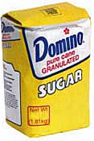
Expressing uniqueness
Often want to say that there is a single, unique object that satisfies a condition
There exists a unique x such that king(x) is true
∃x king(x) ∧ ∀y (king(y) → x=y)
∃x king(x) ∧ ¬∃y (king(y) ∧ x≠y)
∃! x king(x)
Every country has exactly one ruler
∀c country(c) → ∃! r ruler(c,r)
Iota operator: ι x P(x) means “the unique x such that p(x) is true”
The unique ruler of Freedonia is dead
dead(ι x ruler(freedonia,x))
syntactic sugar

Slide 21
Examples of FOL in use
Semantics of W3C’s Semantic Web stack (RDF, RDFS, OWL) is defined in FOL
OWL Full is equivalent to FOL
Other OWL profiles support a subset of FOL and are more efficient
FOL oriented knowledge representation systems have many user friendly tools
E.g.: Protégé for creating, editing and exploring OWL ontologies

Slide 22
Examples of FOL in use
Many practical approaches embrace the approach that “some data is better than none”
The semantics of schema.org is only defined in natural language text
Wikidata’s knowledge graph has a rich schema
Many constraint/logical violations are flagged with warnings
However, not all, see this Wikidata query that finds people who are their own mother or father

Slide 23
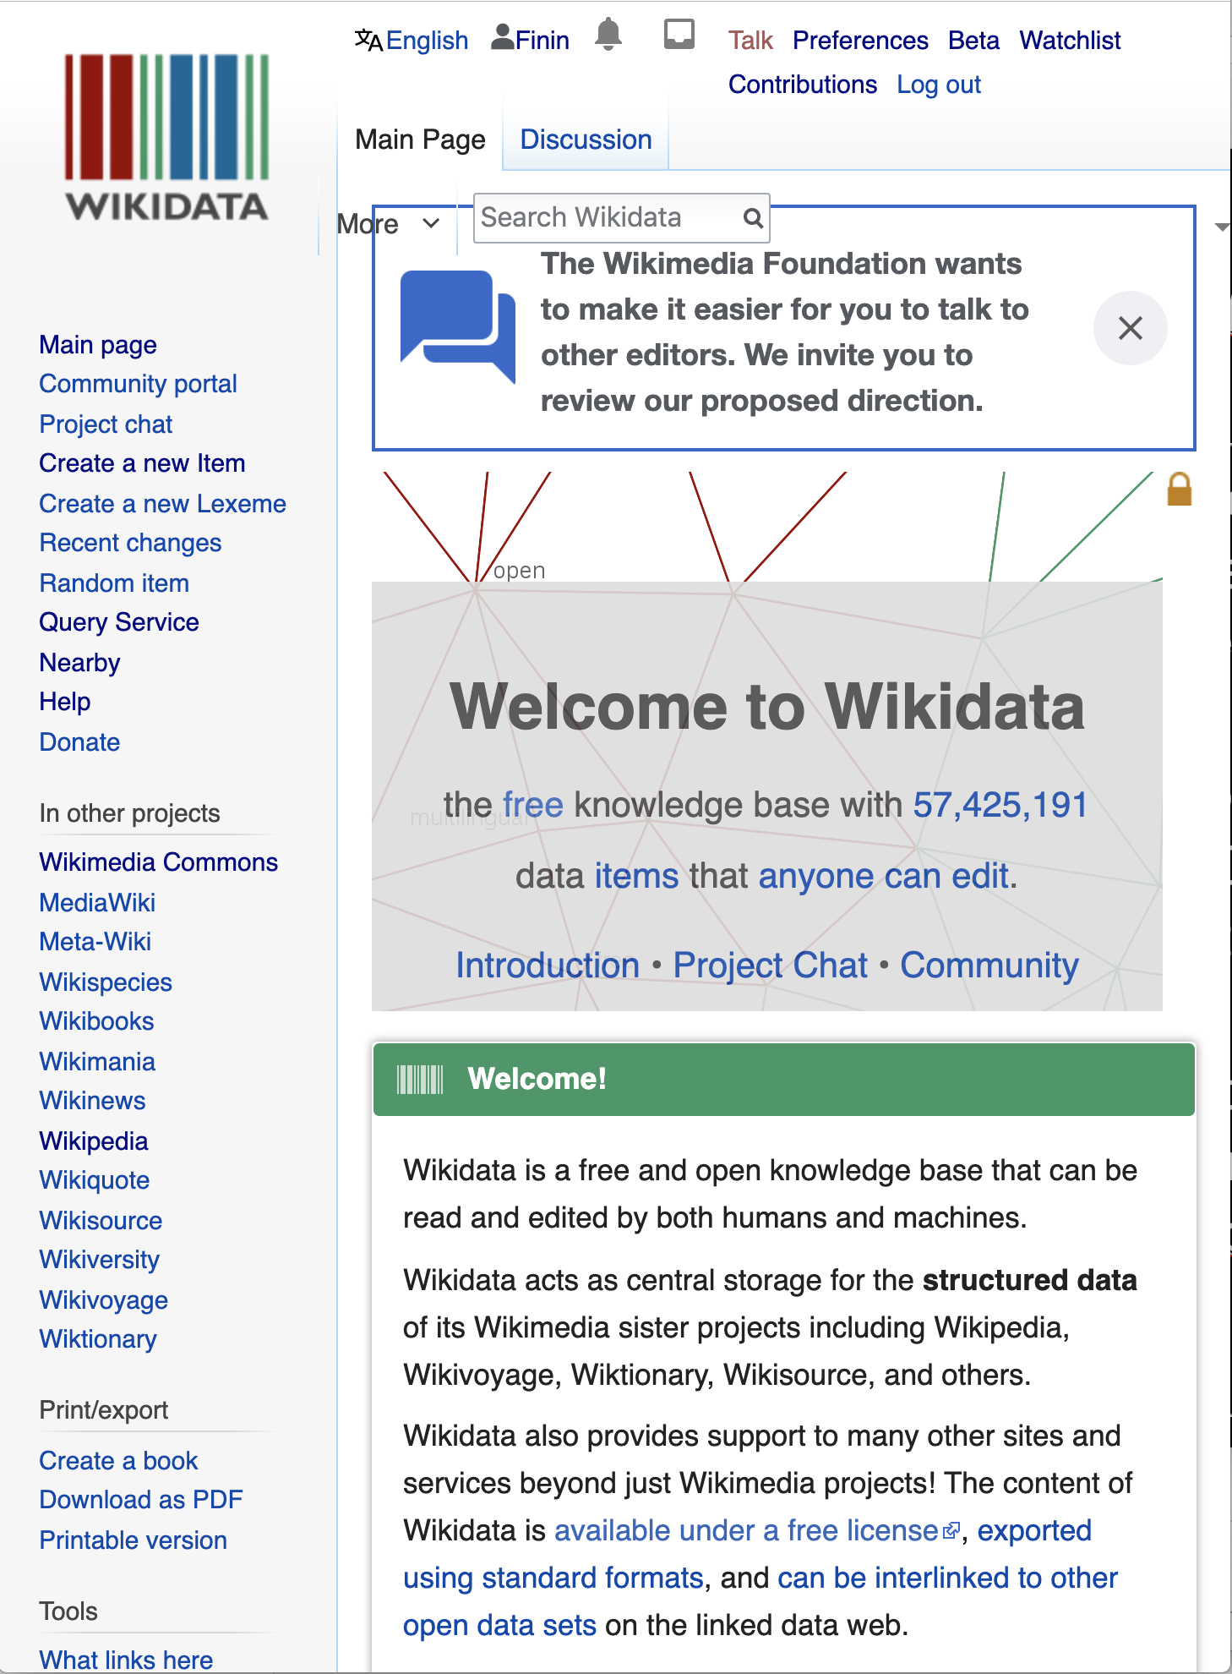
Wikidata
“collaboratively edited structured dataset used by Wikimedia sister projects and others”
Goal: consolidate knowable facts for use in the 200+ Wikipedia sites and other Wikimedia resources (e.g., in Infoboxes)
Integrates Wikimedia sites & links entities to ~7K external identifier systems (e.g., GeoNames ID)
Used by Google’s Knowledge Graph, digital assistants (Siri, Alexa), Wikipedia Infoboxes, etc.

Slide 24
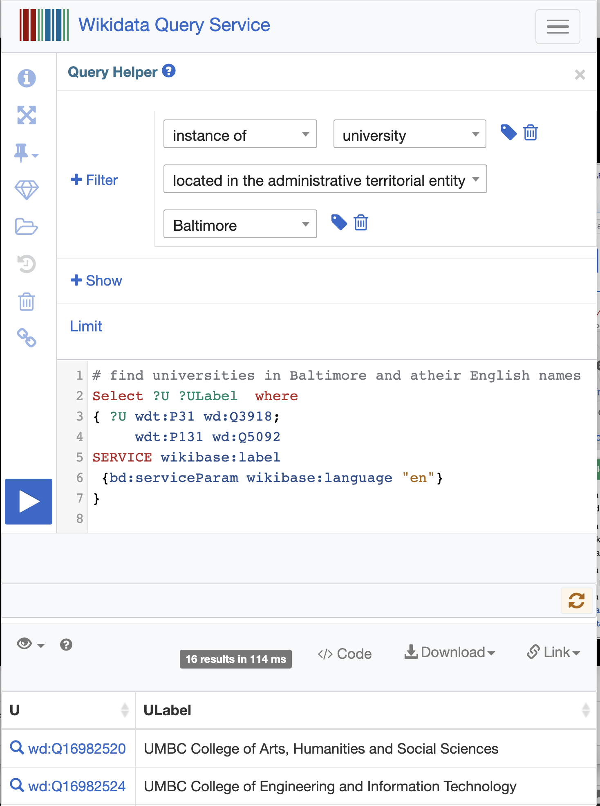
Wikidata
Knowledge graph with ~1B statements about ~93M items
Fine-grained ontology has ~2M types and ~5K properties
Data exposed as RDF triples
String values tagged with language id
Query using a standard SPARQL query service
Many community tools for search, visualization, update
Semantic Web realized !

Slide 25
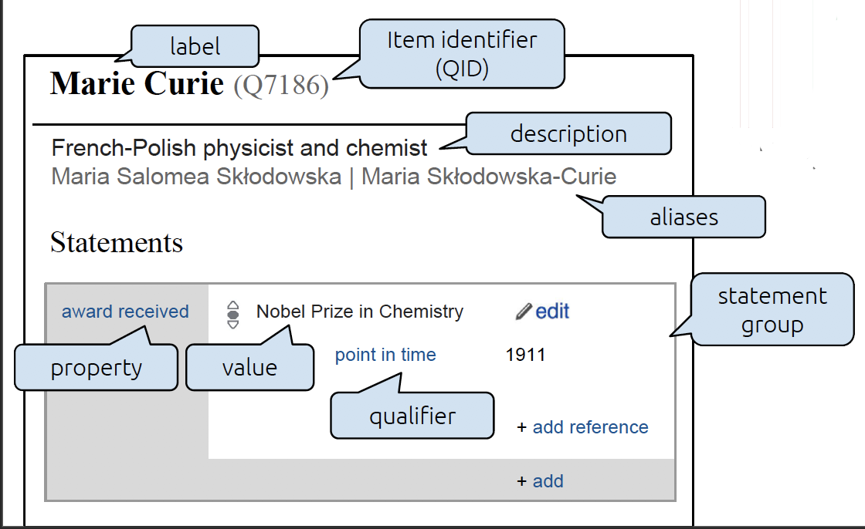
Wikidata Entity
Each Wikipedia entity has
Unique ID, e.g. Q7186
A label (canonical name), short description, ≥0 aliases in a set of languages
One or more types (e.g., Q5)
Collection of statements with optional qualifiers, references
Marie Currie is a human:
[wd:Q7186 wdt:P31 wd:Q5]

Slide 26
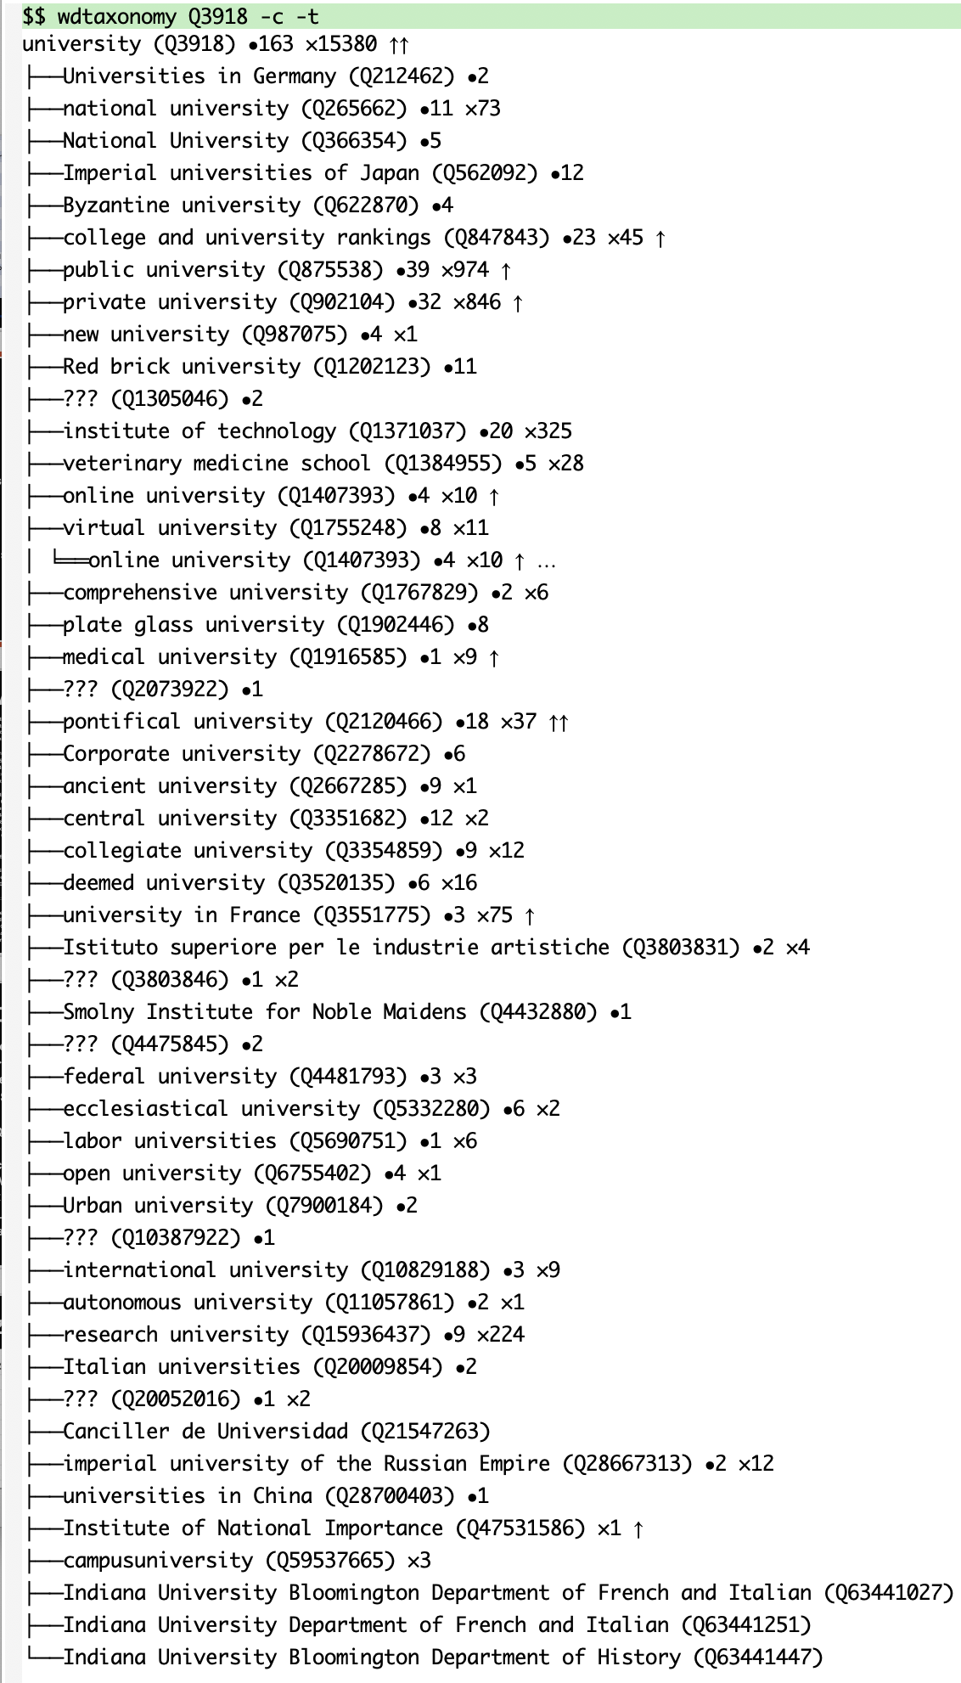
Ontology exploration
How can we understand an ontology with more than two million types?
wdtaxonomy is a useful tool for exploring the ontology
Given a type (e.g, Q3918, university) you can quickly see
Subtypes or supertypes (immediate or inferred),
Number of instances (immediate or inferred),
Direct instances
Number Wikimedia sites it’s in
Implemented in javascript with a command line script

Slide 27
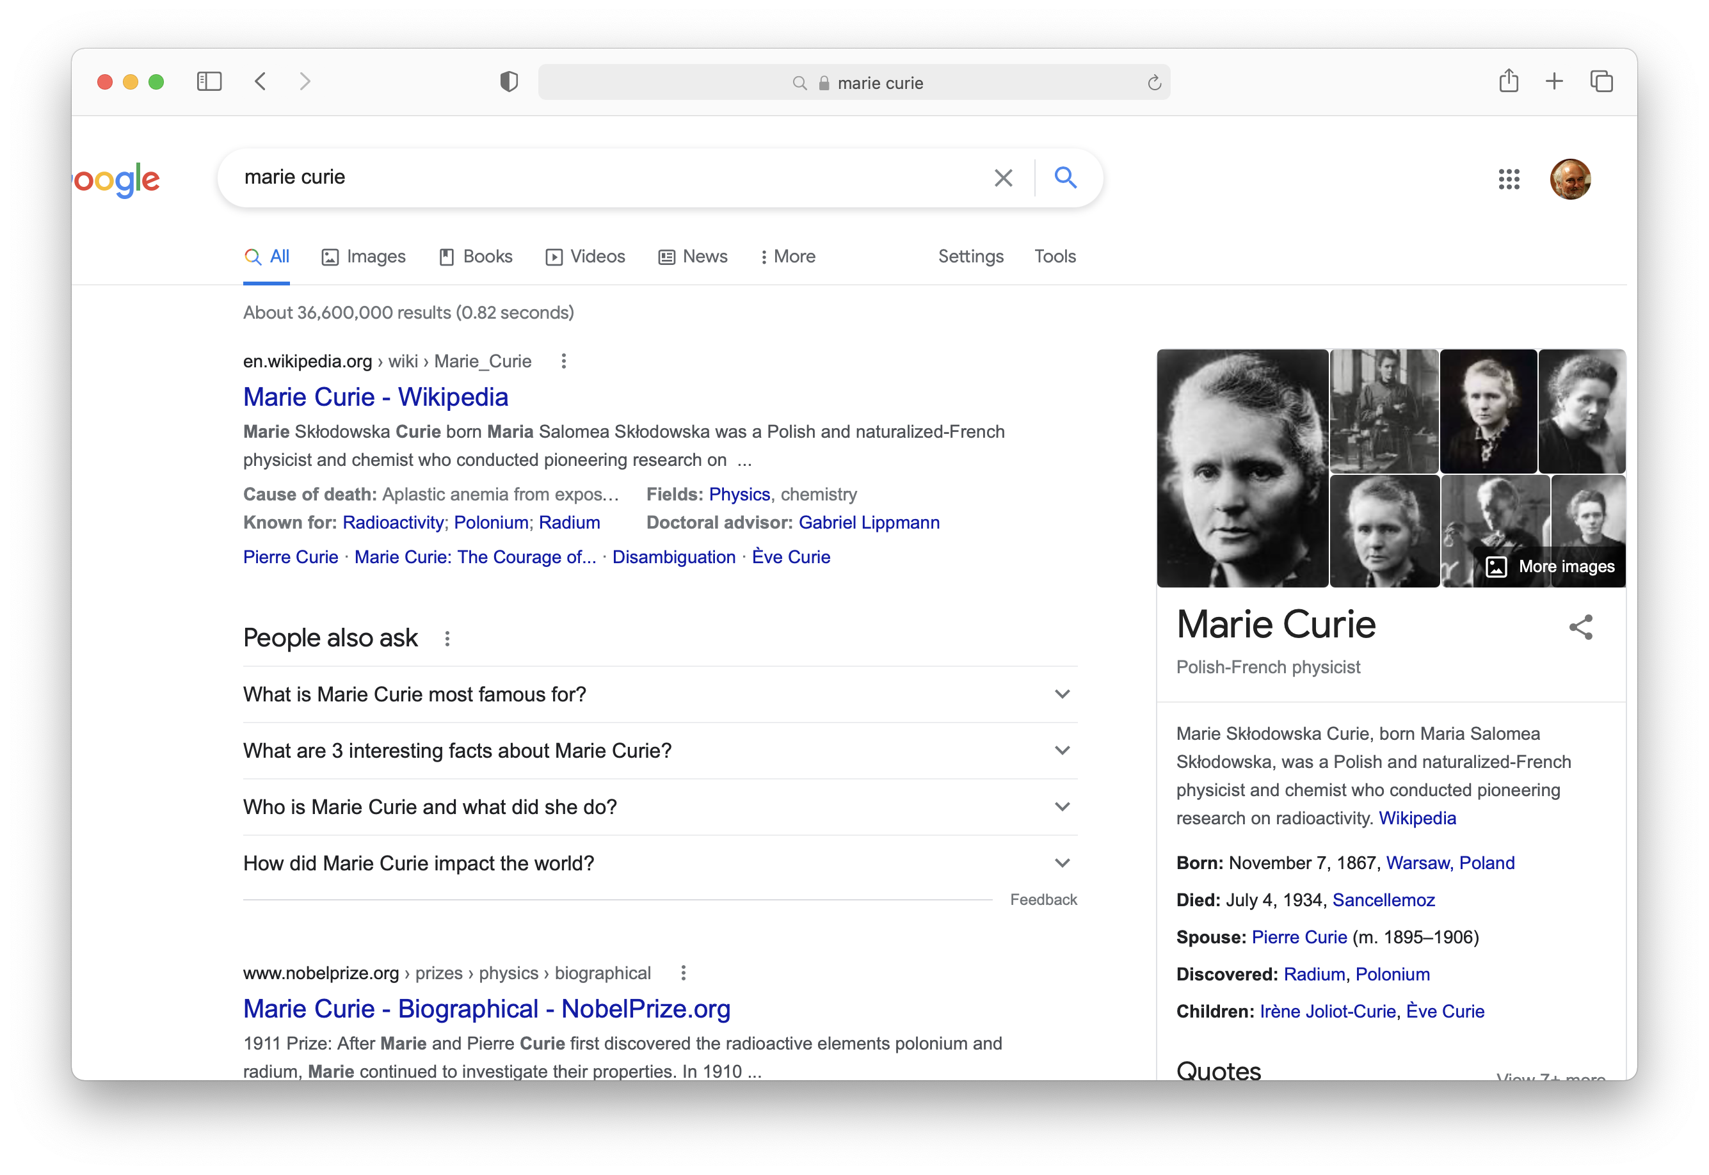
Wikidata and Infoboxes
Web search engines use custom knowledge graphs for infoboxes with informa-tion about queried items
Wikidata is an open-source knowledge graph that shares roots with these
They all draw on the same knowledge, like the ~300 Wikipedia & Wikimedia sites
Such knowledge graphs are often used by language understanding systems, e.g., for entity linking (who is Michael Jordan)

Slide 28
people who are their own mother or father
people who are their own grandparent

Slide 29
FOL Summary
First order logic (FOL) introduces predicates, functions and quantifiers
More expressive, but reasoning more complex
Reasoning in propositional logic is NP hard, FOL is semi-decidable
Common AI knowledge representation language
Other KR languages (e.g., OWL) are often defined by mapping them to FOL
FOL variables range over objects
HOL variables range over functions, predicates or sentences
Some practical systems avoid enforcing rigid FOL constraints due to having noisy data

Slide 30
Fin

