Slide 1
Animation
CMSC 435/634

Slide 2
Keyframe Animation
From hand drawn animation
Lead animator draws poses at key frames
Inbetweener draws frames between keys
Computer animation
Can have separate keys for different attributes

Slide 3
Squash and Stretch
Defining the rigidity and mass of an object by distorting its shape during an action
Ex:
Ball flattening during bounce
Facial animation -- cheeks squash during smile
Keys
Volume constant
Different materials respond differently
Need not deform
Use stretching to eliminate strobing from fast action
Method
Can use scale to conserve volume (up in one dimension down in others)

Slide 4
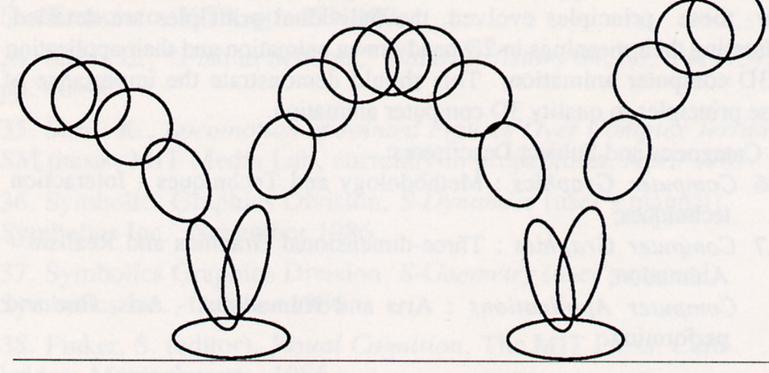

Slide 5
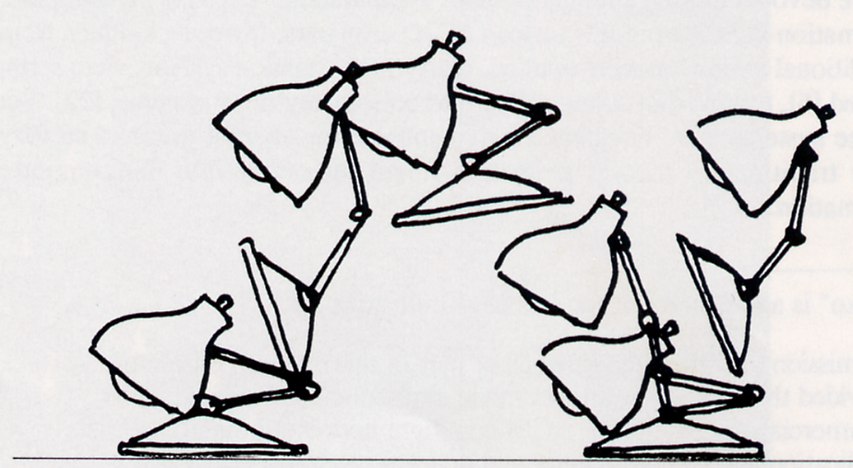

Slide 6
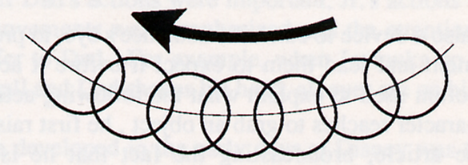

Slide 7
Anticipation
The preparation for an action
Ex:
Pull back foot to kick ball
Luxo: big lamp looks off stage before Jr.’s entrance
Keys
Direct attention to upcoming action
Anticipation can allow faster action

Slide 8
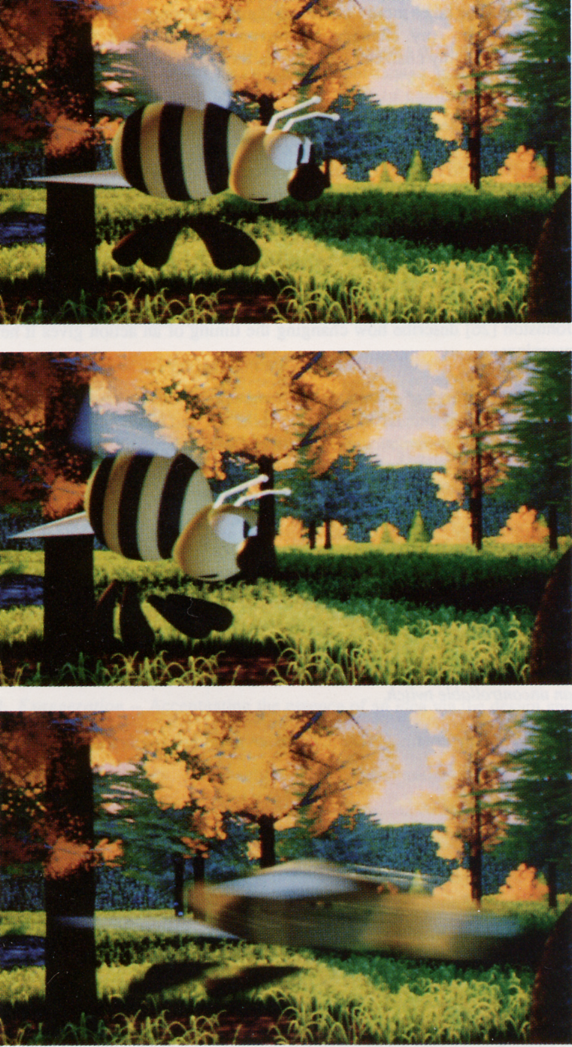

Slide 9
Slow In and Out
The spacing of the inbetween frames to achieve subtlety of timing and movement
Ex:
Moving from place to place: start and end slow
Keys
Think about continuity of second and third order motion
Timing chart

Slide 10
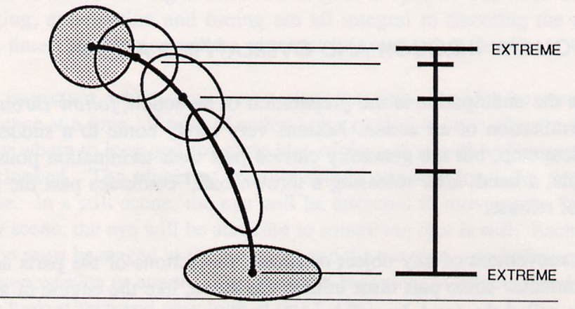

Slide 11
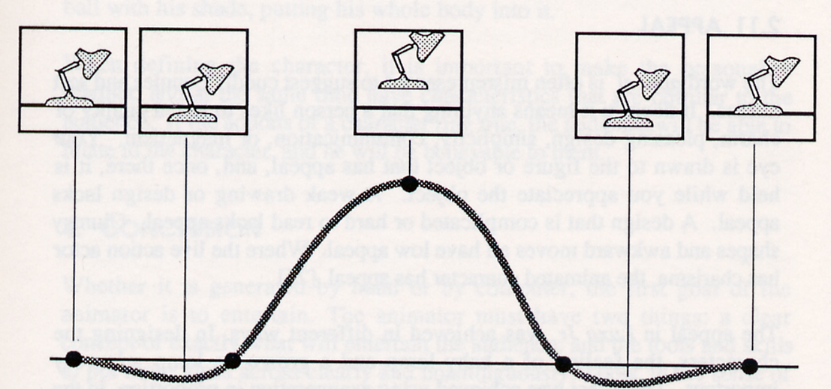

Slide 12
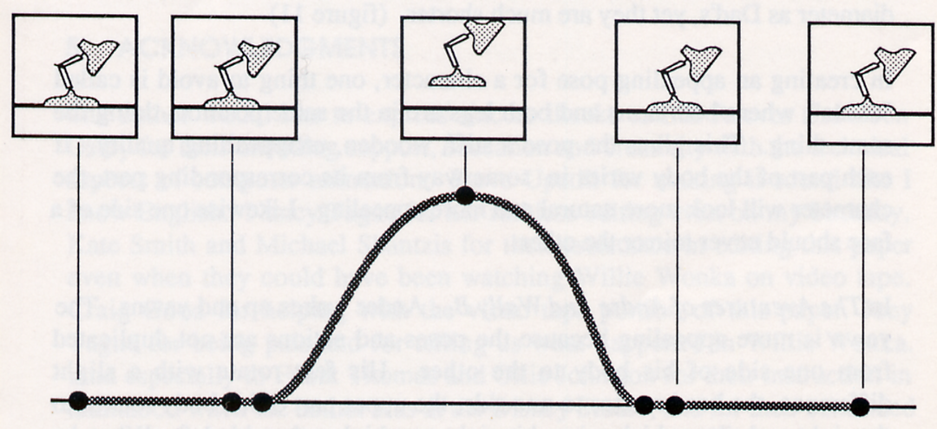

Slide 13
Arcs
The visual path of action for natural movement
Ex:
Thrown ball
Keys
Arc movements are more natural than straight lines

Slide 14
Spline
Set of polynomials
x = a_{x} t³ + b_{x} t² + c_{x} t + d_{x}
y = a_{y} t³ + b_{y} t² + c_{y} t + d_{y}
z = a_{z} t³ + b_{z} t² + c_{z} t + d_{z}
1 constraint per coefficient
Position at several t’s
Derivative (tangent) at several t’s
∂x/∂t = 3 a_{x} t² + 2 b_{x} t + c_{x}

Slide 15
Character Animation
Control
Hierarchical model
Forward kinematics
Inverse kinematics
Motion capture
Rendering
Skinning
Blend Shapes
Deformation

Slide 16
Hierarchical Model
Torso
Head
Left Shoulder
Upper Arm
Lower Arm
Hand
Hips
Left Upper Leg
Lower Leg
Foot

Slide 17
Forward Kinematics
Given a set of joint angles, where’s the hand?
(or foot or head or …)
End effector
Just apply nested transforms
We know how to do that!

Slide 18
Forward Kinematics
Character is holding something in their right hand, want to shift it to the left hand
Forward transform up tree
Inverse transform back down
Think of matrices as X_from_Y
X_from_Y⁻¹ = Y_from_X

Slide 19
Forward Kinematics
LHand_from_LLowerArm* LLowerArm_from_LUpperArm* LUpperArm_from_LShoulder* LShoulder_from_Body* Body_from_RShoulder* RShoulder_from_RUpperArm* RUpperArm_from_RLowerArm* RLowerArm_from_RHand
LLowerArm_from_LHand⁻¹* LUpperArm_from_LLowerArm⁻¹* LShoulder_from_LUpperArm⁻¹* Body_from_LShoulder⁻¹* Body_from_RShoulder* RShoulder_from_RUpperArm* RUpperArm_from_RLowerArm* RLowerArm_from_RHand

Slide 20
Inverse Kinematics
Find angles to match end effector position
Few joints: system of equations
Many joints: optimization
Often with constraints
(wrist doesn’t bend that way)
And heuristics
Minimal change
Load support
Physical data

Slide 21
Motion Capture (mocap)
Track markers on actor
Infer transforms
Often significant artistic cleanup

Slide 22
Skinning
Don’t like intersecting joints
Animate “skeleton”
Just joint transforms, no geometry
Each vertex in “skin”
Linear blend of one or more joint transforms
E.g. α Shoulder + β Arm
Can retarget same animation to different skins

Slide 23
Blend Shapes
Sculpted vertex positions in key poses
Blend positions
Good when skeletons don’t work well
Most often used for facial animation

Slide 24
Deformation
Nonlinear function p’ = f(p)
Affine transform as a function of position
Bend, twist
Free form deformation (FFD)
3D spline

Slide 25
Physics-based Animation
Generally: simulating the laws of physics to predict motion
Common applications:
Fluids, gas
Cloth, hair
Rigid body motion
Approach: model change as differential equations

Slide 26
Autonomous Objects/Groups
Generally: create complex group behavior by defining relatively simple individual behavior
Common applications:
Flocks, crowds
Particle systems
Approach: leverage AI techniques

