Slide 1
FINGER PRINTING BASED AUDIO RETRIEVAL
Query by example Content retrieval
Srinija Vallabhaneni

Slide 2
Summary
Applications
Parameters
Finger print extraction
Algorithm for searching the DB

Slide 3
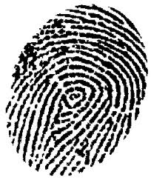
Why use fingerprinting?
Efficient mechanism to find perceptually equal objects without comparing the objects itself.
Smaller storage requirements.
Finger prints are used as an index to search for the multi-media metadata.
[3]

Slide 4
Applications
Broadcast monitoring
Playlist generation
Plagiarism identification
Illegal content sharing detection.
Automatic music library organization

Slide 5
Parameters
Robust
Severely degraded sample vs Original track.
Reliable
False positive vs False negative
Fingerprint size
Memory and storage
Granularity
Length of the sample to make identification
Search speed and scalability
How long does it take to search the DB?

Slide 6
Fingerprint extraction
Sample is segmented into frames.
Frame size: 11.6ms
A feature is extracted from frame
Fourier coefficient
Sub-fingerprint : compact representation of each frame.
Sub-fingerprint size : 32b
Fingerprint block: basic unit for identification
Fingerprint block size : 256 sub-fingerprints = 3sec

Slide 7
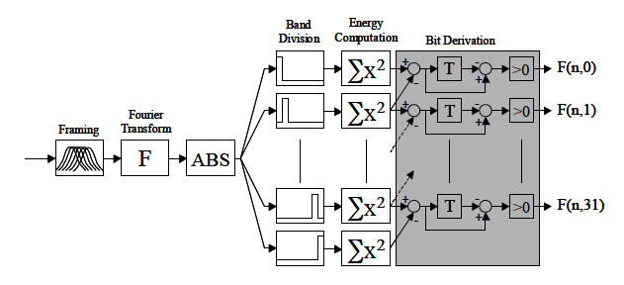
Fingerprint extraction
Band division: logarithmic spacing of 200Hz to 2KHz(range for HAS)
33 bands for 32bit fingerprint.

Slide 8
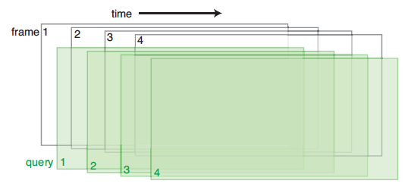
Fingerprint extraction
Sample is segmented into overlapping frames. Why?
Even if the query frame border is off by 5.8ms, there is still a greater amount of similarity to original track’s fingerprint block.

Slide 9
Database search
Brute force --- Definitely NO considering the constantly growing database.
Alternative?
Find candidate points that match atleast one sub-fingerprint.
Are we sure we can find one such error-free sub-fingerprint?
Additionally search candidate points with Hamming distance one.

Slide 10
References
[1] http://www.nhchau.com/files/AudioFingerprint-02-FP04-2.pdf
[2] http://delivery.acm.org/10.1145/1150000/1145312/p44-wang.pdf
[3] http://www.ee.columbia.edu/~dpwe/e4896/lectures/E4896-L13.pdf

Slide 11
Questions?

