Slide 1
VANET IR-CAS-RS: Integrating Information Retrieval in VANET with Reputation System
Chayutra Pailom
Department of Computer Science and Electrical Engineering,
University of Maryland, Baltimore County
May 5, 2015

Slide 2


Problem of Interest
70 MPH
I-95
Searching
“Best
Pad Thai”
Online Yellow Pages
Read all reviews
Make decision

Slide 3
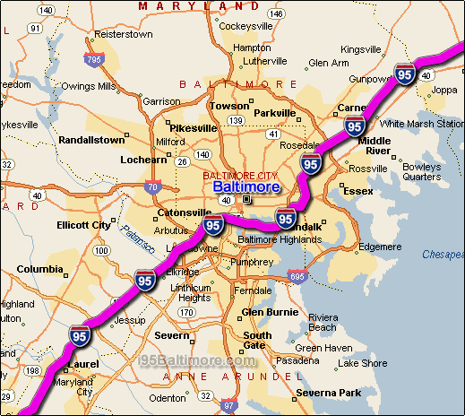



Problem of Interest
What if limited signal!
Google Search
Yelp, YP, etc
Read all reviews
Make decision
Too late!!!

Slide 4

Motivation and Contribution
To propose an integrated scheme
  VANET IR-CAS and the Reputation System
Information on the fly with speedy environment
Get what exact (almost) information you really want corresponding to query
Utilize the reputation system (both peers and centralized reputation server) on VANET
“Smart system”: Smart vehicle (with smart phone) and yes smart user

Slide 5
“VANET-IR-CAS”
Vehicular Adhoc Network
Information Retrieval
Context Awareness System

Slide 6
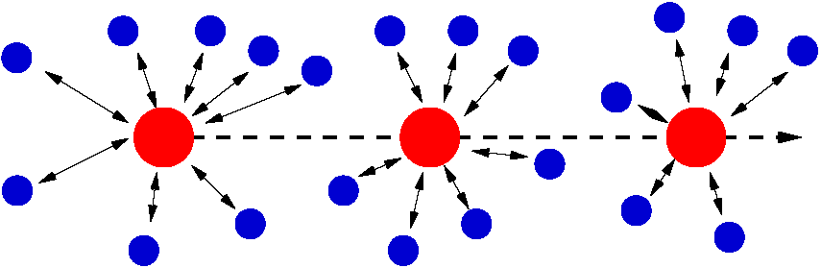
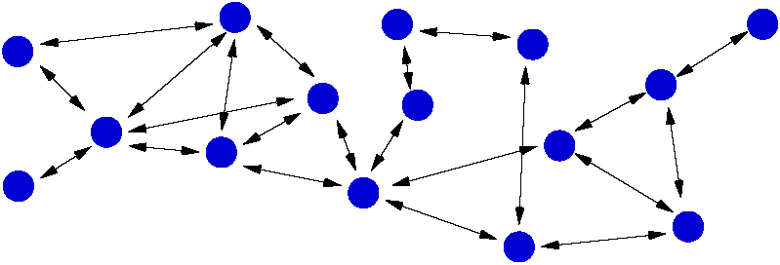






Ad-hoc Networks.
From Cellular to VANET.
Cellular
Cellular Network
MANET
Mobile Ad-hoc
NETwork
VANET
Vehicular Ad-hoc
NETwork
Notes:
MANETs
Militärischer Einsatz
Rettungskräfte und Krisenmanagement
Sensornetze
Roboterschwärme
Fahrzeuggestützte Netze
VANETs

Slide 7
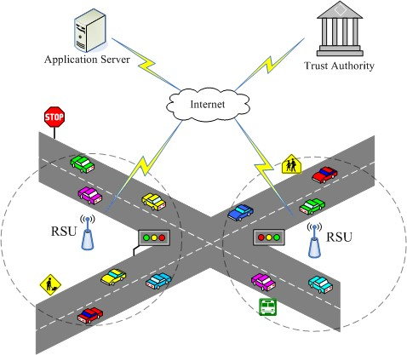
What is a Vehicular Ad Hoc Network (VANET)?
• VANET
– OBU (On-Board Units)
– communication devices mounted on vehicles
– RSU (RoadSide Units)
– communication units located
aside the roads
– OBU used to communicate with other vehicles or RSUs
– RSUs connect with application servers and trust authorities

Slide 8
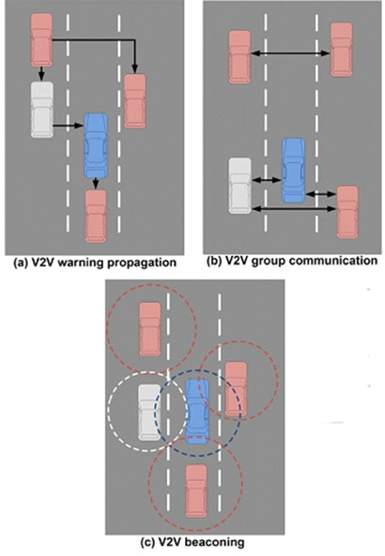
What is a VANET
(Vehicular Ad hoc NETwork)?
Communication: typically over the Dedicated Short Range Communications (DSRC) (5.9 GHz)
Example of protocol: IEEE 802.11p
Penetration will be progressive (over 2 decades or so)
http://www.gta.ufrj.br/ensino/eel879/trabalhos_vf_2010_2/lemos/Aplicacoes.html

Slide 9
A smart vehicle
(GPS)
Human-Machine Interface
http://81.47.175.201/compass/index.php?option=com_content&view=article&id=583:4201-vehicular-ad-hoc-network&catid=22:smart-cars

Slide 10
Well... what is “context?”
time , place , intent , weather , social setting, mood , product sales , application , interaction device …
“... it is diffcult to find a relevant definition satisfying in any discipline.”
Bazire & Brezillon

Slide 11
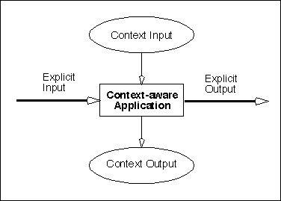
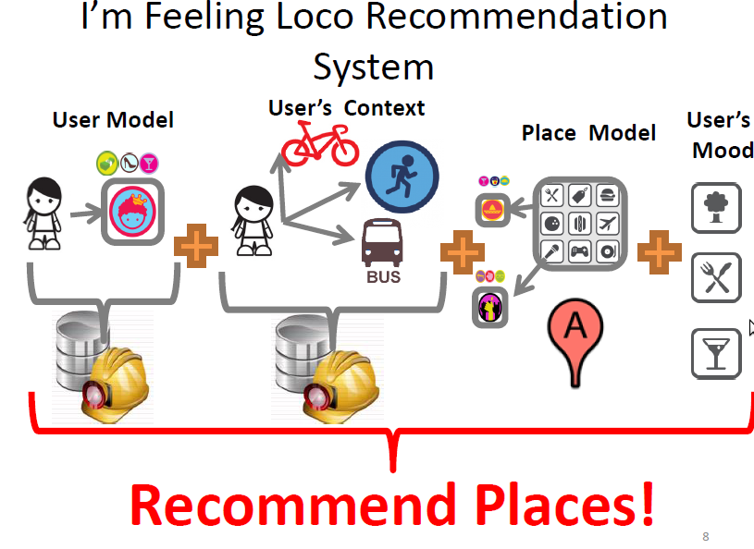
What is a Context Awareness System (CAS)?
• CONTEXT
– Any information that can be used to characterize the situation of an entity
– computing context,
– physical context,
– time context,
– user context
– Context model
– Define and store context data in a machine processable form
– Context processing
– Relevance calculation
– Dissemination mechanisms
– Deliver relevant services to interested nodes

Slide 12
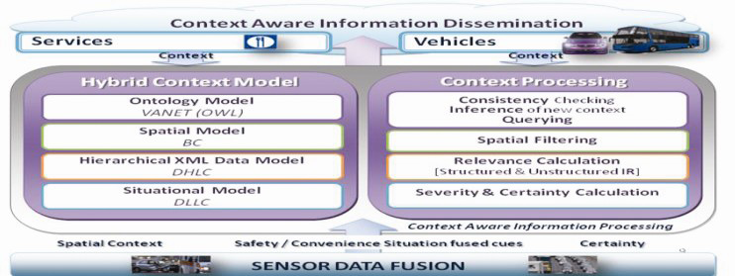
IR-CAS Layer Architecture

Slide 13
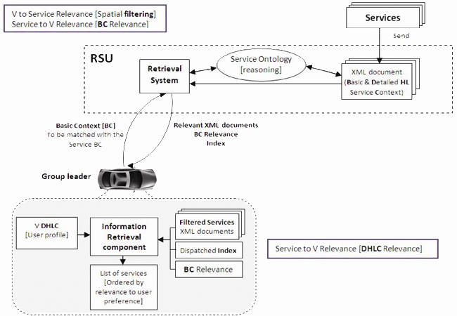
Context Processing for Commercial Services
RSU: Adding services & retrieval based on BC
BC
location, time, spatial and temporal range attributes plus a short keywords list.
DHLC
Name, Highest Price, Lowest Price, Contact, Type, Items, and Description.
Showing, querying & disseminating services
DLLC
A file with optimal values for the safety and convenience services DLLC is created; a file that represents the DLLC vector for the severe accident/congestion situation,

Slide 14
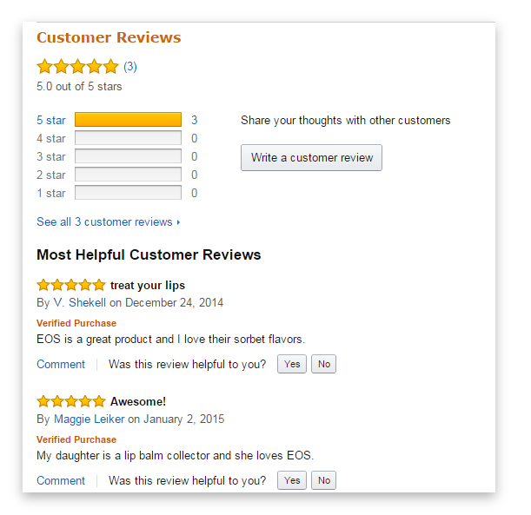
What is a Reputation System?
• Reputation and Recommendation
– Reputation is the opinion of the public toward a person, a group of people, an organization, or a resource
– A reputation system retrieves, filters, and evaluates the received recommendations about the past behavior of a given peer
– Provide to CAS as user context
– Recommendation retrieval methods
– flooding
– recommendation tree
– the storage peer

Slide 15
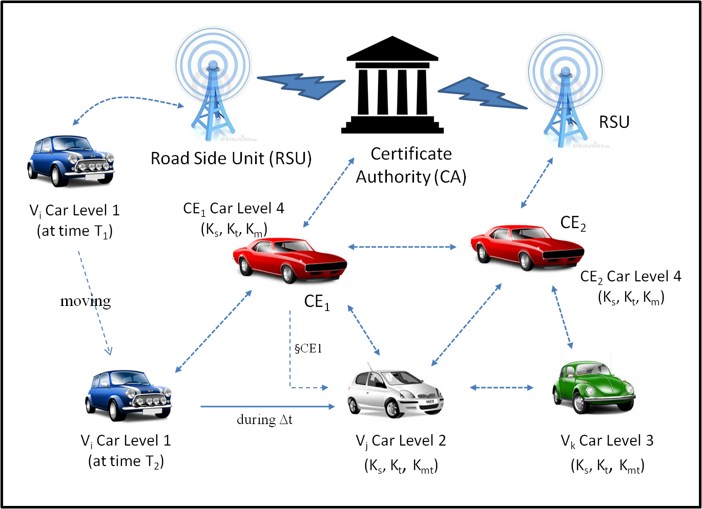
Reputation System Retrieval Model

Slide 16


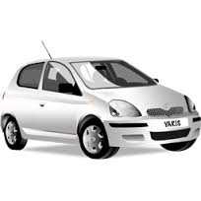
Reputation Ranking Retrieval Model
Reputation Server
User1
User2
User3
CS1
*****
CS2
***
CS3
****
Service
Document
RSU
CS4
*****
CS5
**
TF-IDF * RS
Indexing
Group Leader

Slide 17
VANET IR-CAS-RS
  User Ranking
  IR
  IR Ranking
IR-CAS-RS
  CAS
  Reputation system
  RS Ranking

Slide 18
Future Works
Turn this idea into mobile application
  Android app
A Context-Aware Retrieval System for Mobile Applications
A Contextual Recommendation
Increasing accuracy and robustness of IR part e.g. using BM25 instead of TF-IDF
De-centralized reputation system retrieval

Slide 19
Selected References
Nassar L., Karray F., Kamel M. & Sattar F. (2014). VANET IR-CAS: Utilizing IR Techniques in Developing Context Aware System for VANET. DIVANet '12 Proceedings of the second ACM international symposium on Design and analysis of intelligent vehicular networks and applications. 97-104. doi>10.1145/2386958.2386973
Hanna K. M., Neil B. & Manmatha L. R. (2003). Mobile Distributed Information Retrieval For Highly-Partitioned Networks. Network Protocols, 2003. Proceedings. 11th IEEE International Conference on. 38 – 47. DOI: 10.1109/ICNP.2003.1249755
Tyagi H. & Vatsa, A. K. (2011). Seamless Handoff through Information Retrieval in VANET Using Mobile Agent. IJCSI International Journal of Computer Science Issues, Vol. 8, Issue 4, No 2, 634 – 640. ISSN (Online): 1694-0814

Slide 20
Questions?

