Slide 1
How to build a device that cannot be built ???

Slide 2
How to Build a Device that Cannot Be Built
Samuel Lomonaco
University of Maryland Baltimore County (UMBC)
Email: Lomonaco@UMBC.edu
WebPage: www.csee.umbc.edu/~lomonaco
Talk Given November 18, 2016 at UMBC CSEE Seminar

Slide 3
Partially Supported by
Army Research Laboratory Faculty Summer Research Program
NASA Grant No. NNX15AK58
Oberwolfach Research Institute, Oberwolfach, Germany
The L-O-O-P Fund

Slide 4
PowerPoint slides can be found at: www.csee.umbc.edu/~lomonaco/Lectures.html

Slide 5
This talk is based on the following paper
Lomonaco, Samuel J., How to build a device that cannot be built, Journal of Quantum Information Processing, 15, 3, (2016), pp 1043-1056.
http://www.csee.umbc.edu/~lomonaco/pubs/Unbuildable-QIP.pdf

Slide 6
Which in turn is based on the following papers:
Mermin, N David, Quantum Mysteries Revisited, Am. J. Phys. 58, 750 (1990), pp 731-734.
Greenberger, D.M., M. Horne, & A. Zeilenger, Going beyond Bell’s theorem, in “Bell’s theorem, Quantum Theory, & Conceptions of the Universe,” ed. by M. Kafatos, (Kluwer Academic, Dordrecht, 1989),

Slide 7
The Meaning of Quantum Mechanics ???

Slide 8
Interpretation of Quantum Physics ???
Meaning of Q.M. ?
Group of Angry Physicists
Group of Friendly Physicists

Slide 9
The Dilemma of Quantum Physics ???
The Quantum Physics Conundrum:
There is almost universal agreement in regard to the laws of quantum mechanics.
But there is almost total disagreement as to their interpretation.

Slide 10
Interpretations of Quantum Mechanics
Copenhagen Interpretation
Many Worlds Interpretation
Consistent Histories Interpretation
Ensemble/Statistical Interpretation
Etc.
Irish Pub Interpretation

Slide 11
Dowling’s Irish Pub Interpretation
After 0 Beers: Clear as mud
After 1 Beer: Somewhat clear
After 2 Beers: Very clear
After 3 Beers: Obvious
After 4 Beers: Puzzling
After 5 Beers: Nonsense

Slide 12
What is Q.M. Trying to tell Us ???
Heisenberg’s Uncertainty Principle Simultaneous measurement of incompatible observables to unlimited precision not possible
Bell Inequalities – Violation of the Principle of Reality, or the Principle of Locality
Kochen-Specker Theorem - Ditto
Conway-Kochen Free Will Theorem – The past does not determine the future.

Slide 13
Objective of Talk
Objective: To investigate the Greenberger-Horne-Zeillenger (GHZ) Paradox using the tools of Quantum Information Science; and to push this investigation to its limits.
One Result: The second elementary symmetric Boolean function can be interpreted as a quantification of the nonlocality and/or indeterminism involved in the GHZ paradox.
We will also illustrate the subtlety of the distributed control of distributed quantum systems.

Slide 14
As Always …

Slide 15
A Connundrum

Slide 16
The Story:
A Tale of 3 Regions
Enter Stage Right: Supervisor
Build this physical System.
Or Else !!! ASAP !!!

Slide 17
R
G
R
G
Detector A
Detector B
Source
0
1
0
1
A
B
IN
IN
C
Blueprint
Blueprint
R
G
Detector C
0
1
IN

Slide 18
Detector
R
G
Detector
0
1
IN
Upon encountering a particle, the detector flashes either red R=1 or green G=0
Each detector has a switch with two settings 0 and 1, which can be randomly set at anytime before the particle arrives.

Slide 19
Source S
Source
A
B
C
A source containg 3 particles, and a little blue button, which when pressed, ejects the particles A, B, C toward their respective detectors A, B, & C

Slide 20
The supervisor is only interested in the switch settings for which an odd number of the three switches is set to 1 ,i.e.,
A B C 0 0 1
A B C 0 1 0
A B C 1 0 0
A B C 1 1 1
No other switch settings are important. He/she doesn’t care about remaining 4 settings.

Slide 21
Specifications:
Spec. 1: For switch settings 001, 010, 100 (after all 3 particles received), ONLY an odd number of the detectors flash RED R=1
Spec. 2: For switch setting 111 (after all particles received), ONLY an even number of detectors must flash RED R=1

Slide 22
Constraints
Constraint 1: Detectors cannot communicate with one another. They are separated by a spacelike distance, and hence physically independent.
Constraint 2: Upon leaving source, the particles can no longer communicate with one another.
Constraint 3: Each particle only communicates with a detector when it encounters the detector.

Slide 23
Supervisor leaves with an ominous command:
Build this system ASAP !!!

Slide 24
A Design Engineer’s Observations:
Enter stage left: Design Engineer
Since:
1) Detectors cannot communicate
2) After ejection, particles cannot communicate
3) Particles only communicate with detector upon impact
Ergo, each particle must carry instructions for its respective detector.

Slide 25
A Design Engineer’s Observations:
Particle B Instructions
Particle A Instructions
Particle C Instructions
Switch \ Ball | A | B | C
1 | Color1A | Color1B | Color1C
2 | Color2A | Color 2B | Color2C

Slide 26
Each particle must carry its on instructions for its detector.
Thus, particle A must carry a local instruction of of the form:
where and
In like manner, the remaining two particles must carry instructions and

Slide 27
Thus, for j = A, B, C, each local instruction is simply a Boolean function of the form:

Slide 28
Specifications:
Spec. 1: For switch settings 001, 010, 100 (after all 3 particles received), ONLY an odd number of the detectors flash RED R=1
Spec. 2: For switch setting 111 (after all particles received), ONLY an even number of detectors must flash RED R=1

Slide 29
Spec 1
Spec 2
The above system of linear equations is obviously inconsistent !!!

Slide 30
Ergo,
It can’t be built !!!

Slide 31
Oh, but it can be built !!!
Enter Stage Right:
A Quantum Computer Scientist

Slide 32
Source
Source S
A
B
C
Let the 3 particles in the source be photons in the entangled state:
where denotes a horizontally polarized state, & denotes a vertically polarized state

Slide 33
Please note that
is entangled. It cannot be factored into the tensor product of 3 separate qubit states.
The state of each qubit is indeterminate. But the state of all 3 is well defined !!!

Slide 34
The Detector
R
G
We insert a Hadamard transform at switch setting 2 .
H
0
1
IN
Hence,

Slide 35
Definition. A Boolean unitary transformation is a map from into a group of unitary transformations. In like manner, a Boolean Hermitian operator is a map from into an algebra of observables.
In other words, Boolean unitary and Boolean Hermitian operators are unitary and Hermitian transformations controlled by classical bits.

Slide 36
Boolean Unitaries and Boolean Obsevables
If b (= 0 or 1) and if U is a unitary operator, then will denote the Boolean unitary
where is the identity operator.
In like manner, if is an observable, then will denote the Boolean observable

Slide 37
The following wiring diagram describes how the unbuildable device can be built in a quantum computer laboratory:

Slide 38
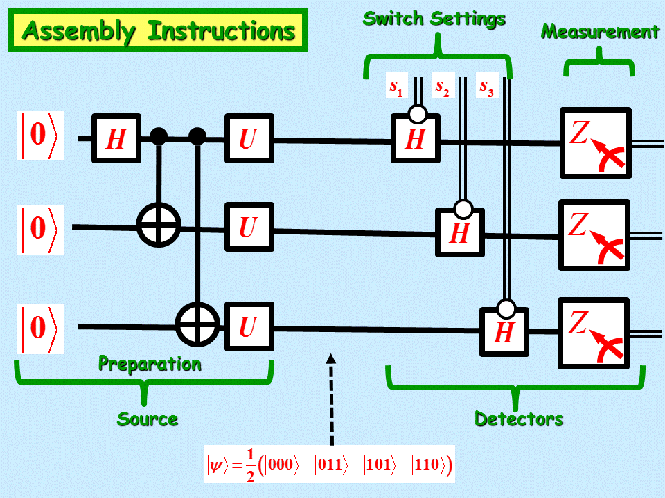

Slide 39
How to read the wiring diagram
Single lines represent qubits, and double lines represent classical bits
denotes the Controlled-NOT gate, a.k.a., CNOT given by the unitary transformation:

Slide 40
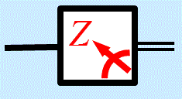
How to read the wiring diagram
denotes measurement with respect to the standard basis , , i.e., measurement with respect to the Pauli spin operator Z ,
where

Slide 41
How to read the wiring diagram
denotes the Boolean unitary op.

Slide 42
How to read the wiring diagram
Where denotes the gate
and where X, Y, Z denote the Pauli spin operators:

Slide 44
A Momentary Digression

Slide 45
Blackbox Equivalence
Classical Bits
Classical Bits
Hidden Quantum System
Input
Output
Quantum State
Quantum State
The same input/output behavior

Slide 46
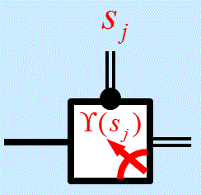
Simplifying the diagram
We can simplify the diagram by using the measurement gate
which is defined by

Slide 47
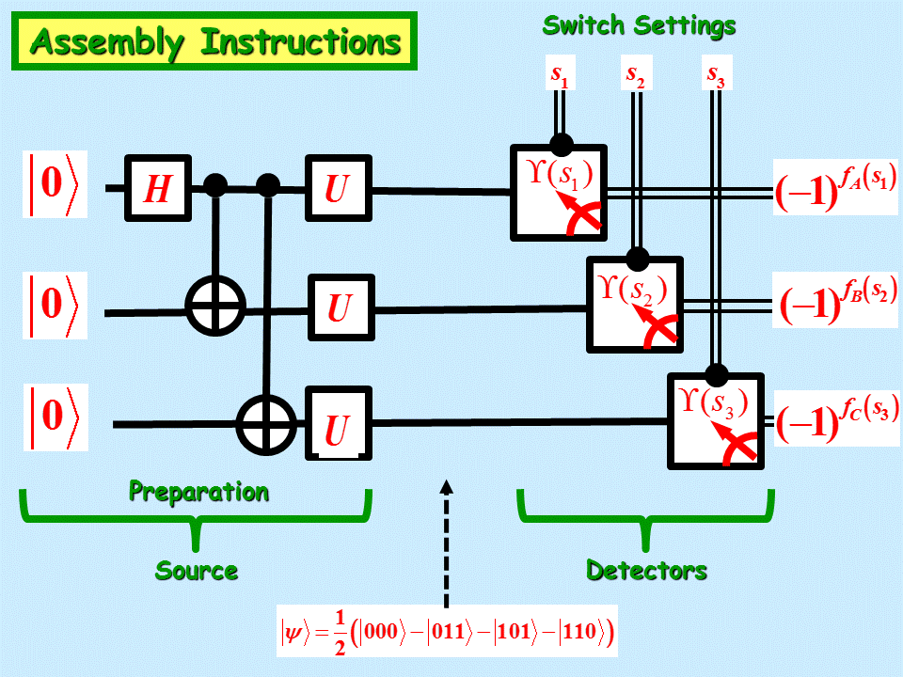
Blackbox Equivalent Q Sys

Slide 48
Back to the original Assembly Instructions

Slide 50
What do the 3 detectors see for each of the 4 possible legal switch settings ???
Switch Settings
State
111
001
010
100

Slide 51
What do the 3 detectors see for switch settings 111 ?
p = 1/4
000
011
101
110
GGG
GRR
RGR
RRG
Therefore, always an even number of REDs R

Slide 52
What do the 3 detectors see for switch settings 001 ?
p = 1/4
001
010
100
111
GGR
GRG
RGG
RRR
Therefore, always an odd number of REDs R

Slide 53
Why ???
So where has the proof of impossibility gone awry?
The proof of impossibility is based on the following proposition:
Proposition: There exist no set of Boolean functions
such that

Slide 54
The logic is flawless !!!
But the crux of the matter is that an argument is only as sound as the assumptions upon which it is based.

Slide 55
More explicitly, the argument fails because at least one of the following tacitly assumed two assumptions fails:
Premise 1. Reality Principle: What is measured is completely determined before it is measured.
Premise 2. Principle of Locality: Spacelike separated regions of spacetime are physically independent.

Slide 56
The above two premises lead to the following unfounded conclusions:
Unfounded Conclusion 1. Based on Premise 1 (The Reality Principle), the detector lamp instructions f_{A}, f_{B}, f_{C} must already be predetermined well-defined total functions at the time of particle ejection.
Unfounded Conclusion 2. Based on Premise 2 (The Principle of Locality), the detector lamp instructions f_{A}, f_{B}, f_{C} must be local. Hence, f_{j} is a function only of the j-th switch setting s_{j} and independent of the two other switch settings.

Slide 57
Corollary 1. For a switch settings of odd Hamming weight, the detector lamp instructions are the random partial functions given by:
with the Boolean algebraic dependence
where denotes the second elementary symmetric function

Slide 58
In other words, the GHZ paradox shows how to create three spacelike separated (hence, physically independent) probability distributions that have the above algebraic dependence.
The Boolean function quantifies the nonlocality of the GHZ paradox.

Slide 59
???
Q Wiring Diagram Kit

