Slide 1
Steerable Part Models
Hamed Pirsiavash and Deva Ramanan
Department of Computer Science
UC Irvine

Slide 2
Deformable part models (DPM)
Human pose estimation
Face pose estimation
Object detection
Felzenszwalb, Girshick, McAllester, Ramanan. "Object Detection with Discriminatively Trained Part-Based Models" TPAMI 2010
Yang & Ramanan, "Articulated Pose Estimation using Flexible Mixtures of Parts" CVPR 2011
Zhu & Ramanan, "Face Detection, Pose Estimation, and Landmark Localization in the Wild", CVPR 2012

Slide 3
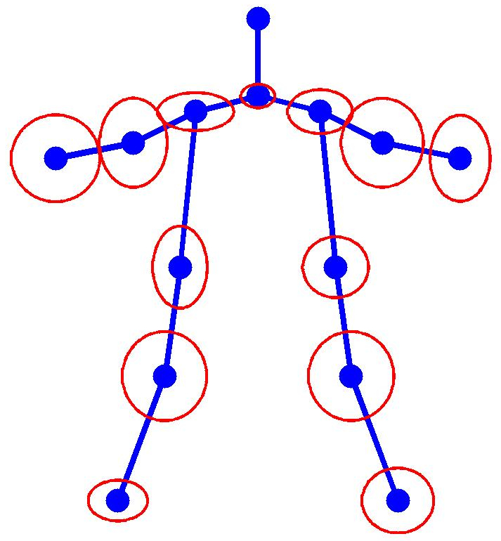
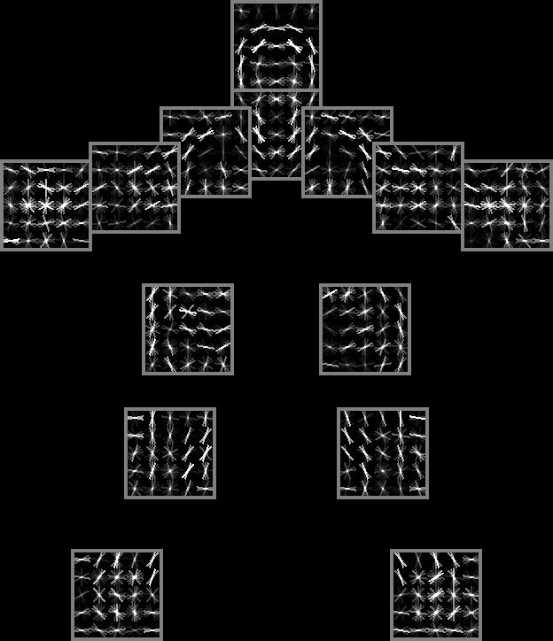
Deformable part models (DPM)
Human pose estimation

Slide 4
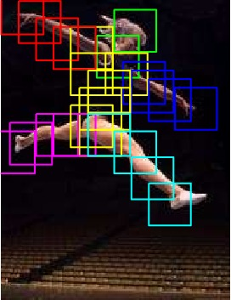
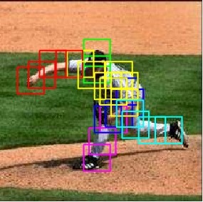
Sample results

Slide 5
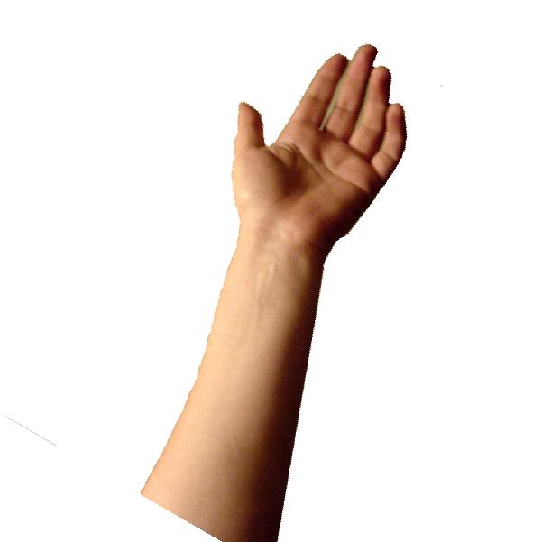
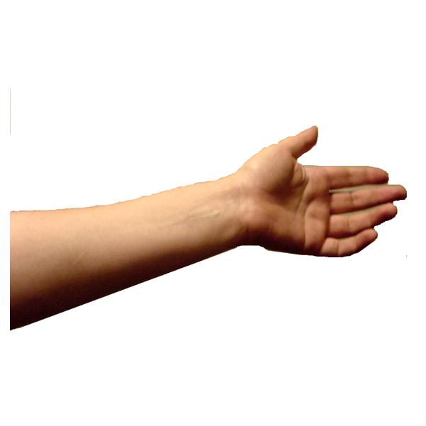
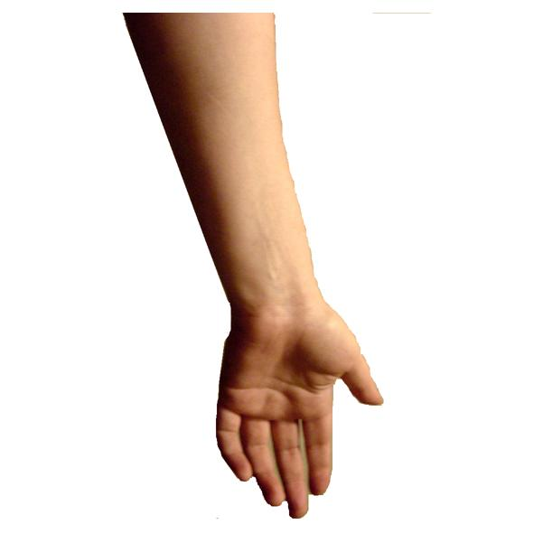
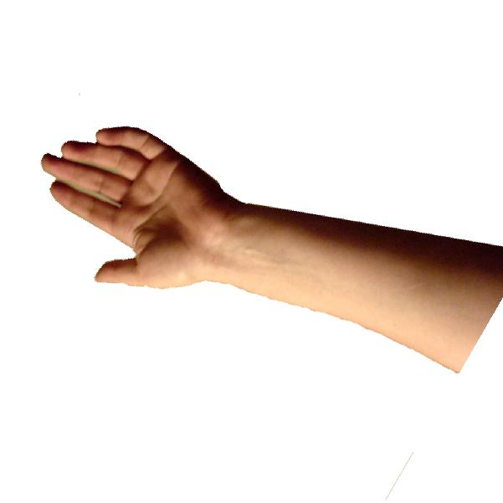
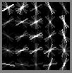
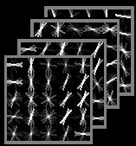
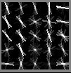
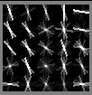
Motivation
Large variation in appearance
    Change in view point, deformation, and scale
Introduce mixtures
  Discretely handles appearance variation

Slide 6

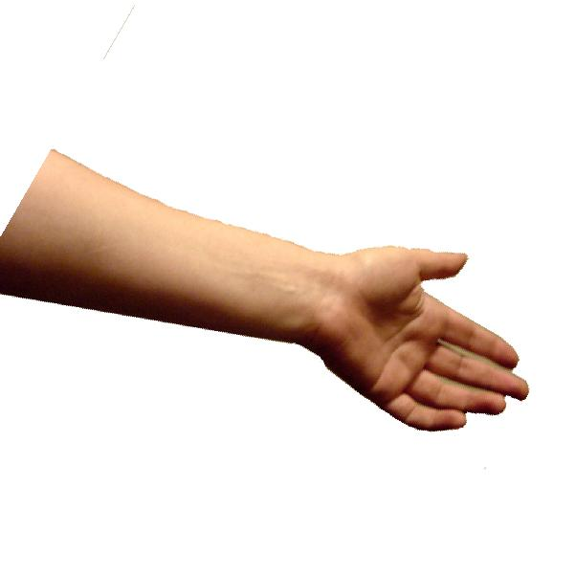
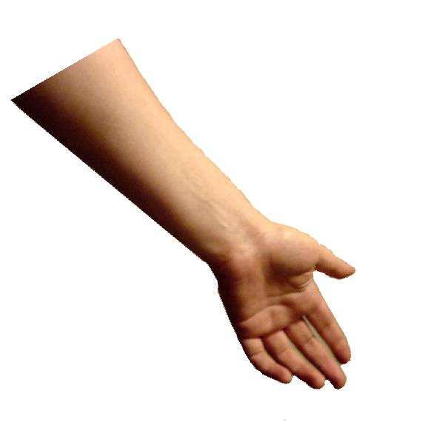
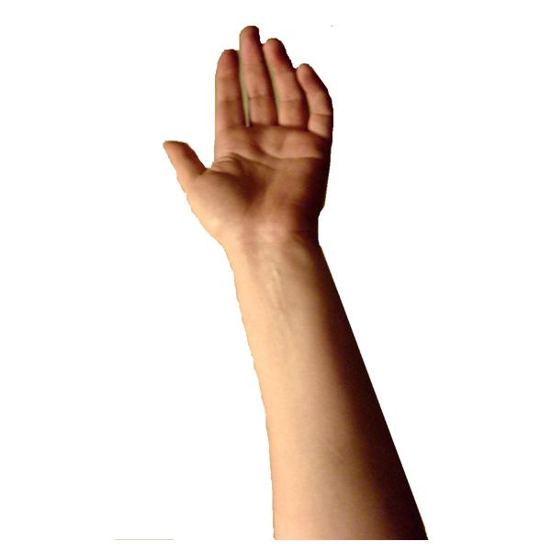
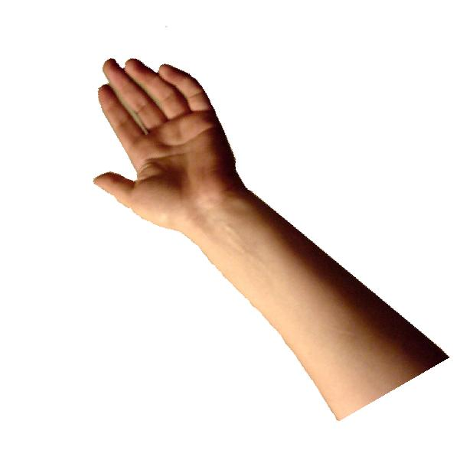
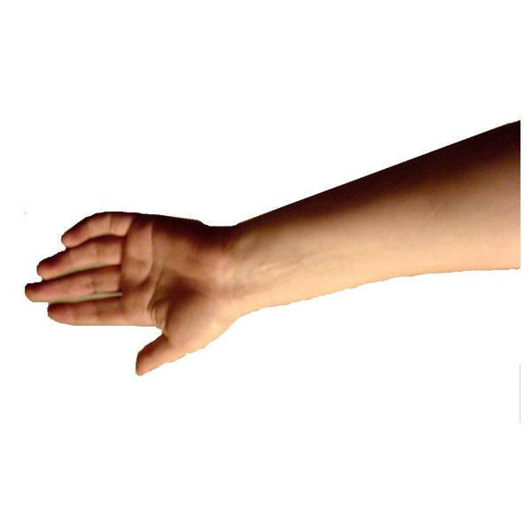
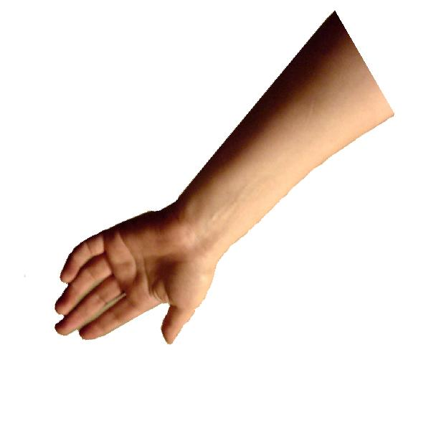
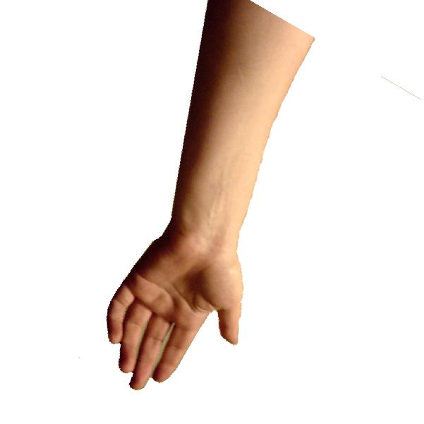
Steerable part models
Large number of mixtures?
  Not scalable to large number of frames and categories
    More than a week of computation on DARPA’s recent dataset
  Very high dimensional problem
  Over-fitting
Represent a large number of mixtures by a small set of basis
  Inspired by steerable filters in image processing
Manduchi, Perona, Shy “Efficient Deformable Filter Banks” IEEE Trans Signal Processing 1998

Slide 7
Sample parts
Vocabulary of parts
Steerable basis

Slide 8
Sample parts
Vocabulary of parts
Linear combination
Steerable basis

Slide 9
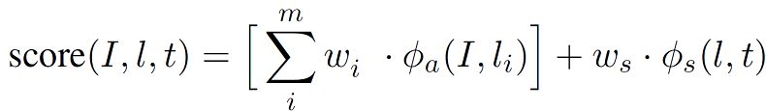
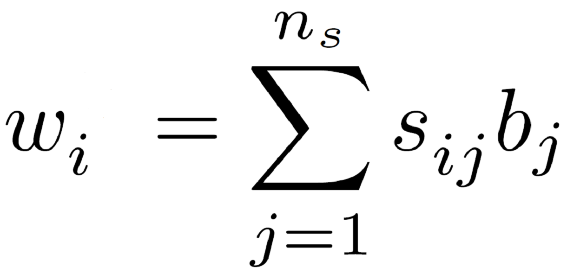

A general DPM scoring function
Steerable representation
Appearance features
Score of this placement
Score for the i’th filter
Score for all springs
Steering coefficients
For a fixed , pre-multiply features with it.
Notes:
The score function is linear in w_i so we can use a linear SVM to optimize and learn.
Now, for a fixed b_j, set of basis, we can plug in w_i from the bottom equation into the score function on the top and get a linear function in s_{ij}. So we can use the same machinery to inference, learn, and optimize.
Similarly, if we fix s_{ij}, the set of coefficients, using a simple linear algebra trick, we get a linear scoring function on b_j.
So we can use a coordinate descent algorithm to optimize it by fixing one set and optimizing the other at a time.

Slide 10
Can be written as a rank restriction on filter bank of parameters
Citation: Pirsiavash, Ramanan, Fowlkes,
“Bilinear Classifiers for Visual Recognition”, NIPS 2009

Slide 11
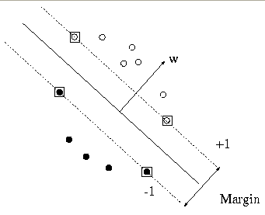
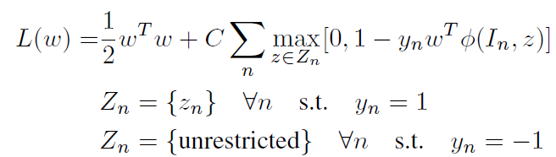
Learning
Structured SVM

Slide 12
Learning
Coordinate decent algorithm
1. Fix basis, learn coefficients
2. Fix coefficients, learn basis
3. Go back to 1.
Convex steps: Use an off-the-shelf SVM solver

Slide 13
Why is this a good idea?
  Sharing
    Share basis across different categories
  Regularization
    Less number of parameters
  Computation
    Score basis filters
    Then, reconstruct filter scores by linear combination

Slide 14
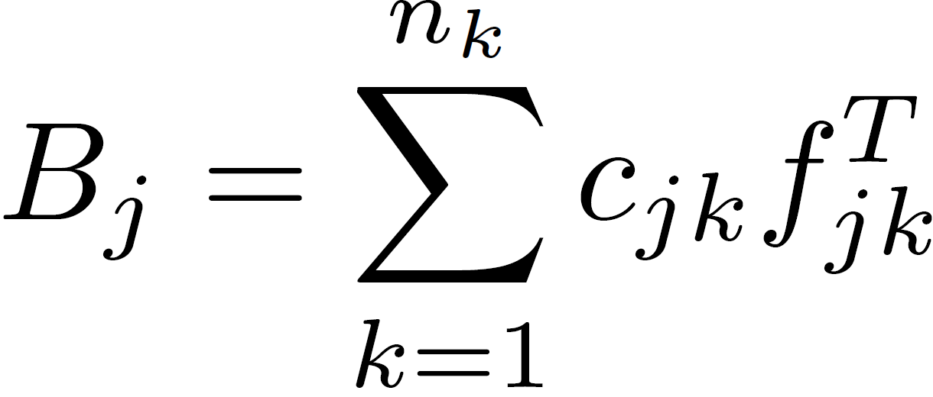

Steerability and Separability
itself is a matrix → write it in separable form
Share the sub-space by forcing
: Number of dimensions of subspace
Notes:
This slide is about separability and orthogonal to the previous stuff, so you may skip it:
We can write basis filters themselves in a separable form. So instead of having 5x5x32 basis parts, we will have 5x5x8 parts and a 32x8 projection matrix for HOG features. Here f_k is this projection matrix. Here n_k = 8.

Slide 15
Experiments
Human pose estimation
Face pose estimation
Object detection
Felzenszwalb, Girshick, McAllester, Ramanan. "Object Detection with Discriminatively Trained Part-Based Models" TPAMI 2010
Yang & Ramanan, "Articulated Pose Estimation using Flexible Mixtures of Parts" CVPR 2011
Zhu & Ramanan, "Face Detection, Pose Estimation, and Landmark Localization in the Wild", CVPR 2012

Slide 16
Human pose estimation
138 filters (800 dim each)
Reduction in the model size
PCP: Percentage of Correctly estimated body Parts
Original model
Reconstructed model
(20x smaller)
Yang, Ramanan,
CVPR’11
Pirsiavash & Ramanan, “Steerable Part Models” CVPR 2012
100x smaller

Slide 18
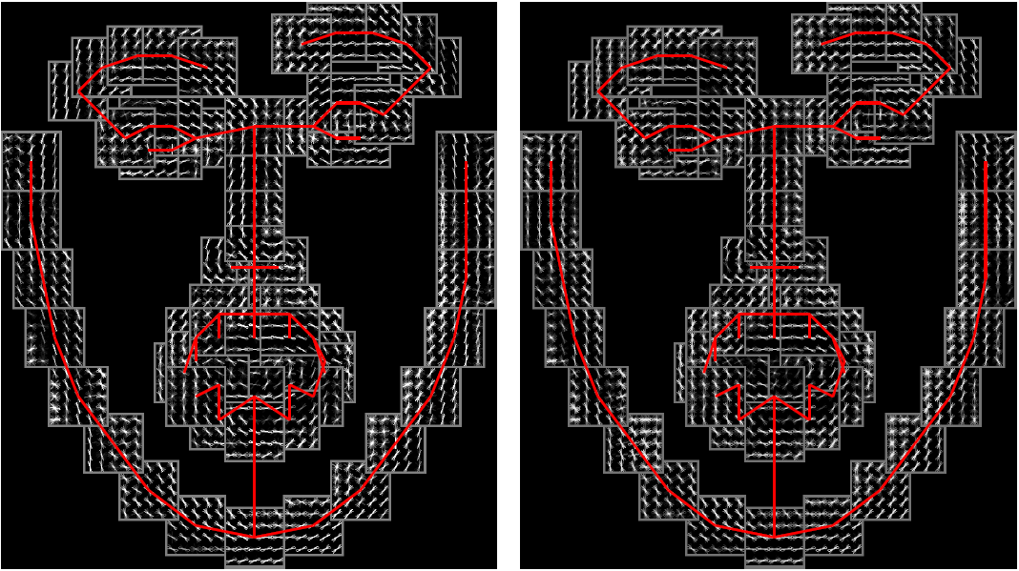
Face detection, pose estimation, and landmark localization
1050 filters (800 dim each)
Original model
Reconstructed model
(24x smaller)
Zhu & Ramanan, CVPR’12
Pirsiavash & Ramanan, “Steerable
Part Models” CVPR 2012

Slide 19
Face pose estimation and landmark localization
Our model outperforms manually defined “hard-sharing”
- “nose” in different views share the same filter

Slide 20
PASCAL object detection
20 object categories
24 filters per category (800 dim each)
Share basis across categories
  Soft sharing: a “wheel” template can be shared between “car” and “bike” categories
Felzenszwalb, Girshick, Mc Allester,
Ramanan, TPAMI 2010
Pirsiavash & Ramanan, “Steerable
Part Models” CVPR 2012

Slide 21
Conclusion
We write part templates as linear filter banks.
We leverage existing SVM-solvers to learn steerable representations using rank-constraints.
We demonstrate impressive results on three diverse problems showing improvements up to 10x-100x in size and speed.
We demonstrate that steerable structure can be shared across different object categories.

