Slide 1
Parsing Videos of Actions with Segmental Grammars
Hamed Pirsiavash (MIT)
Deva Ramanan (UC Irvine)
Notes:
This is a joint work with Deva Ramanan.

Slide 2
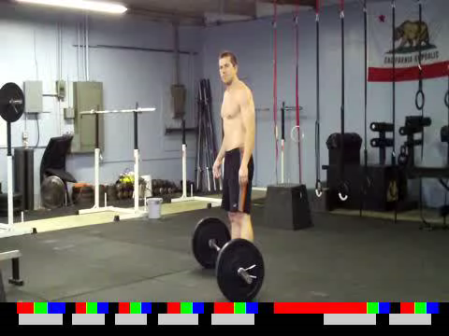
Action segments
White: action
Black: background (no action)
Notes:
This is a continuous video of multiple instances of an action.
The back and white bar shows action segments. White corresponds to an instant of action and black corresponds to background meaning no action is happening.
In this work, given a video, we are interested in predicting these action segments.

Slide 3
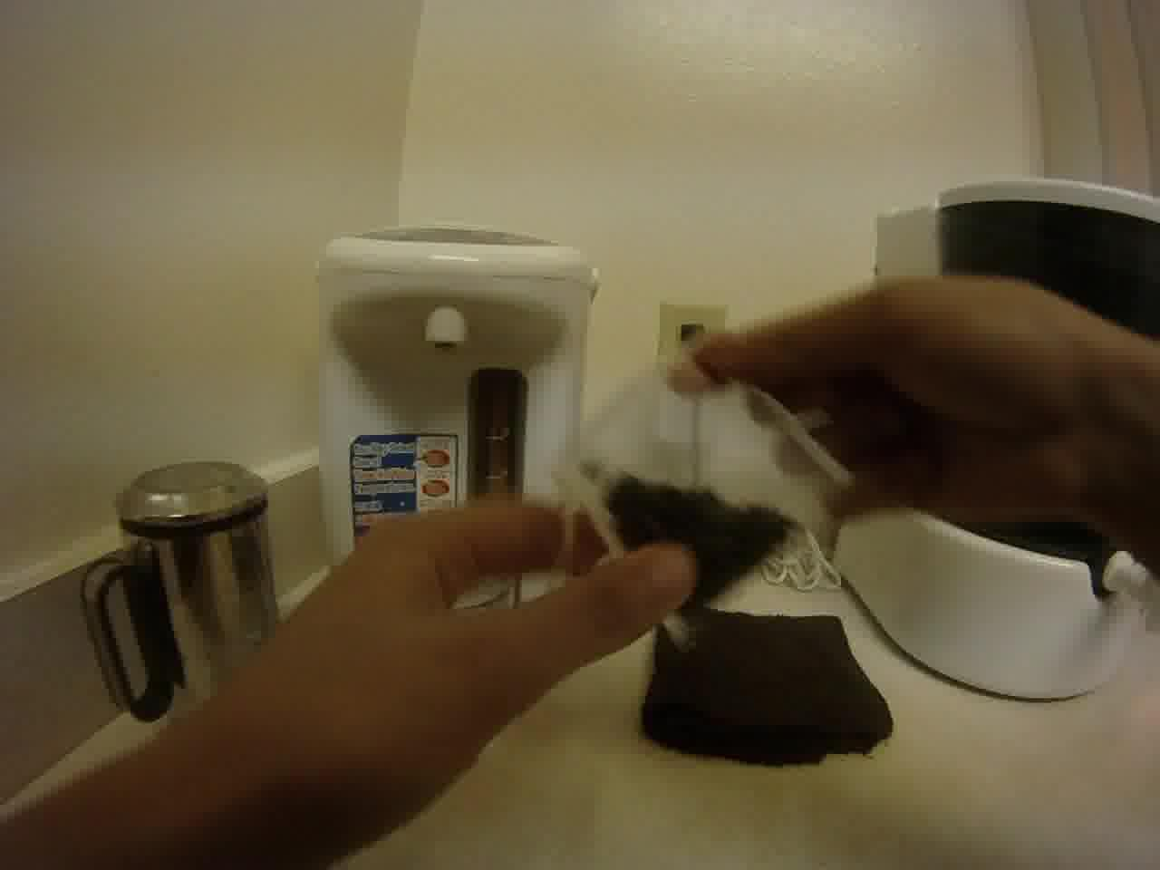

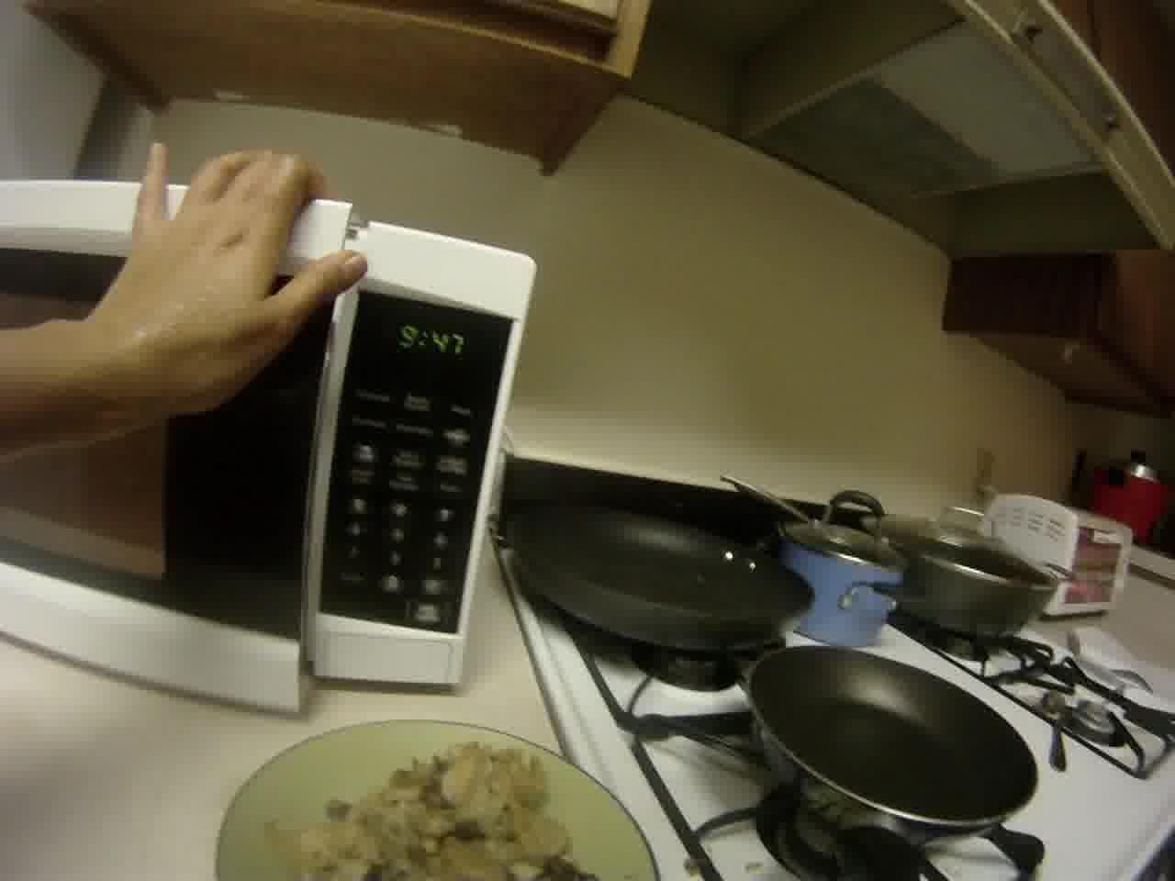
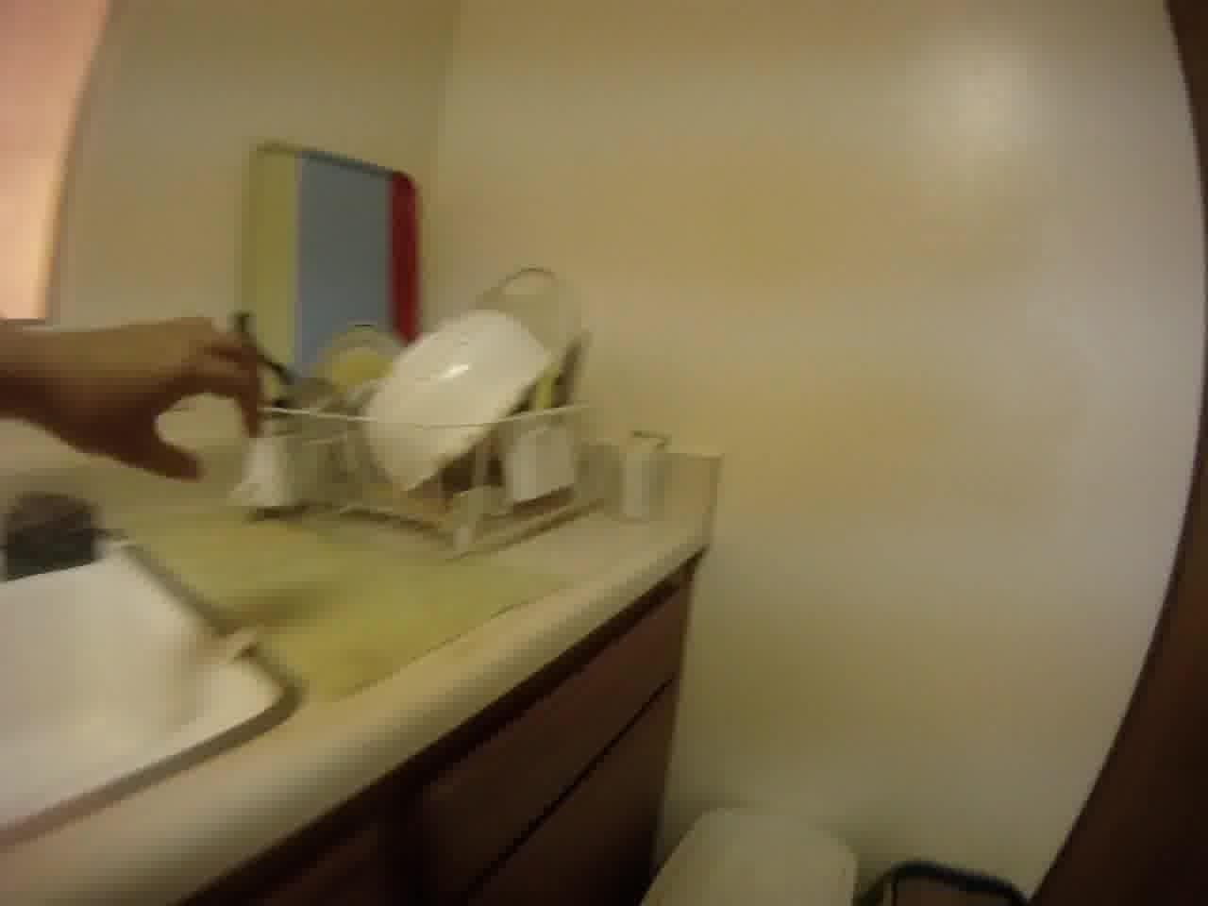
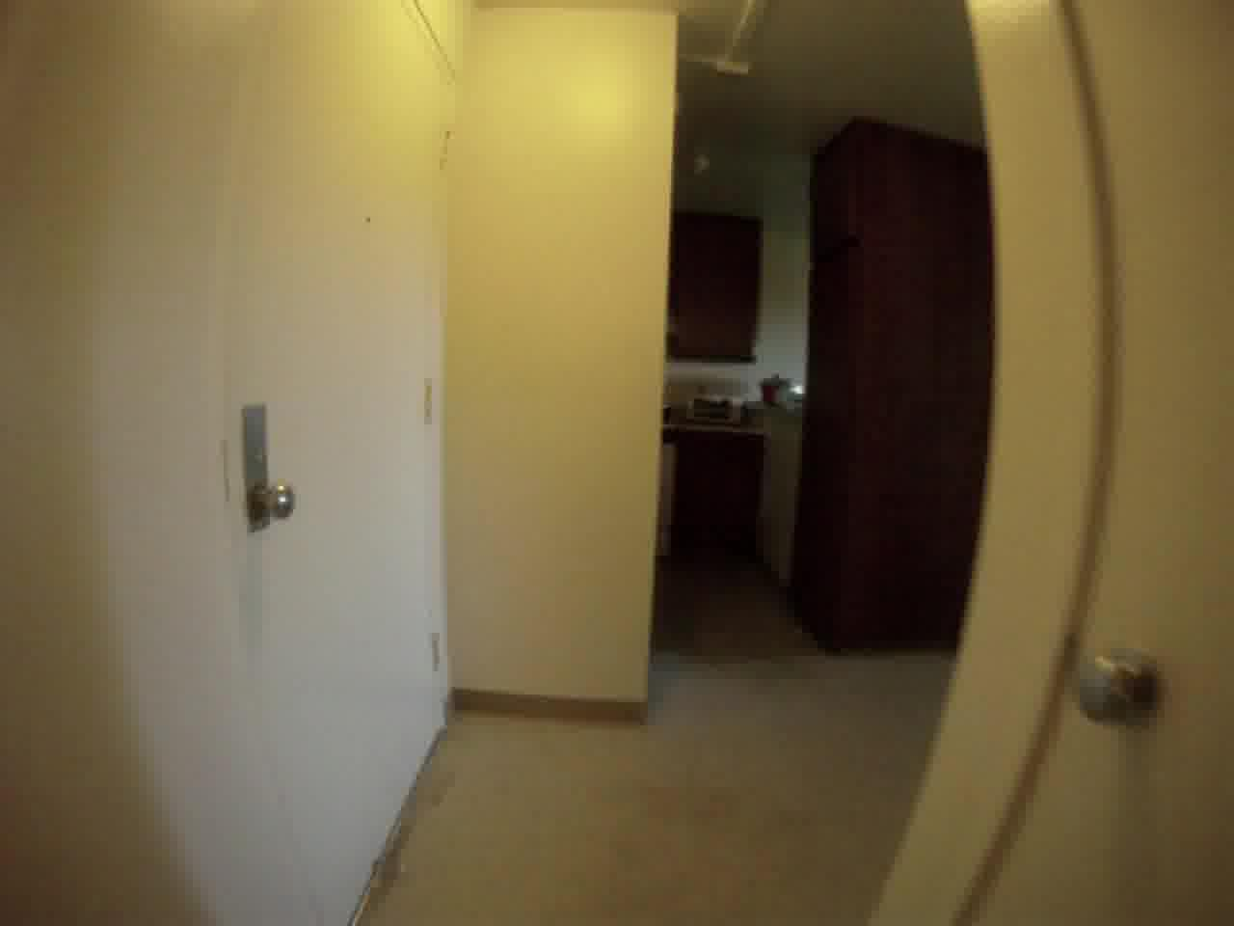
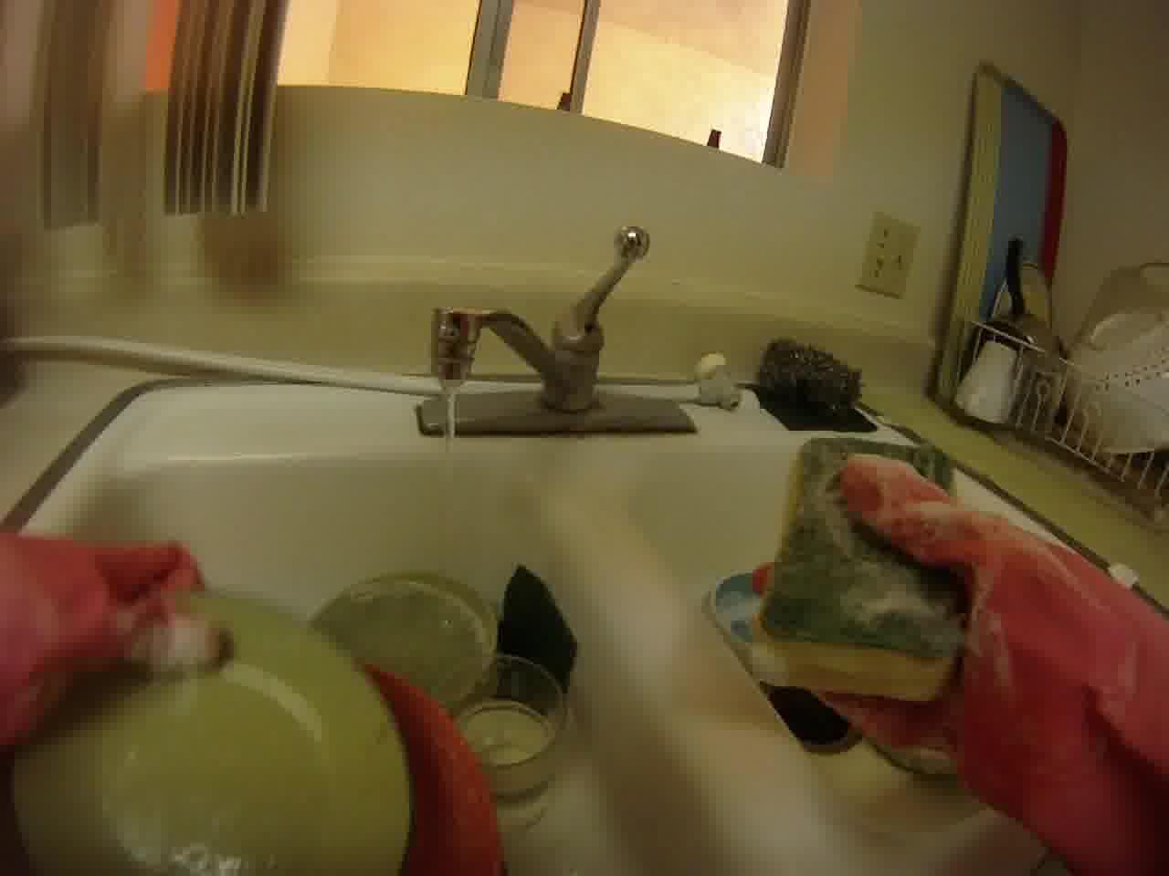
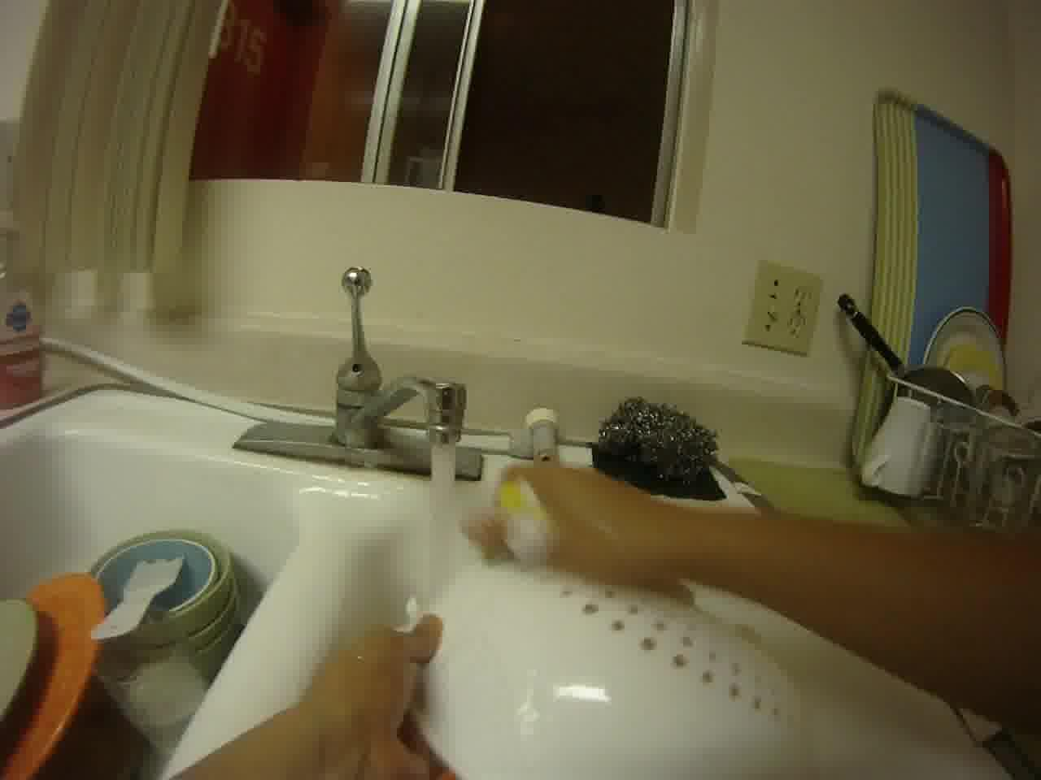
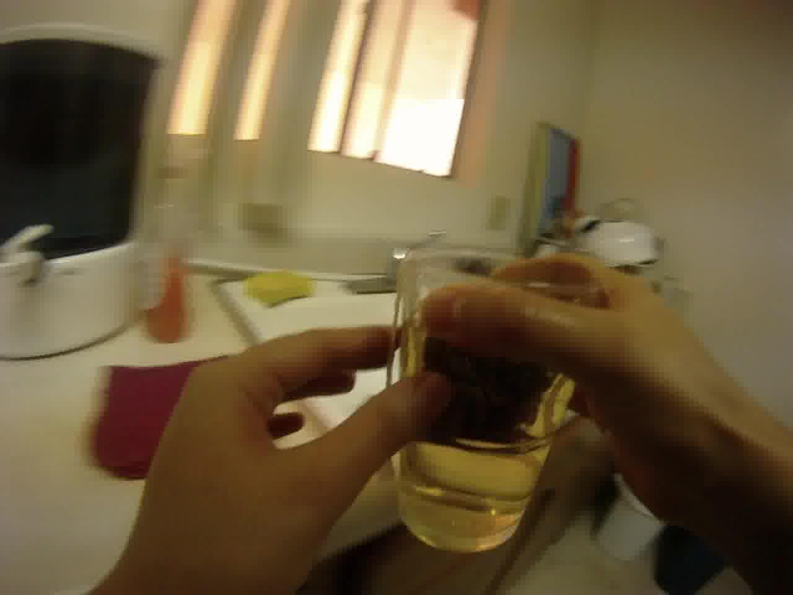
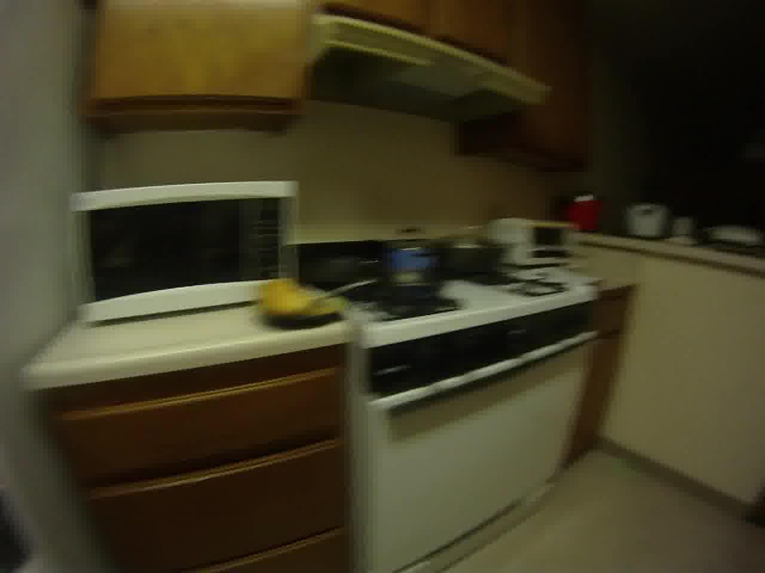
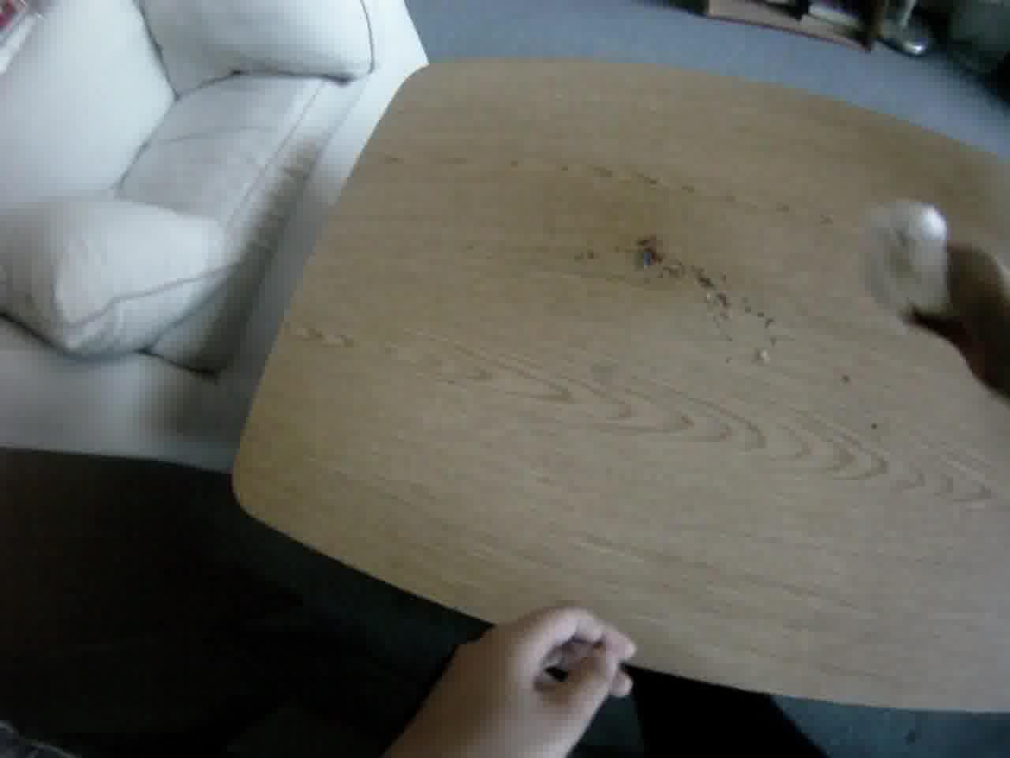
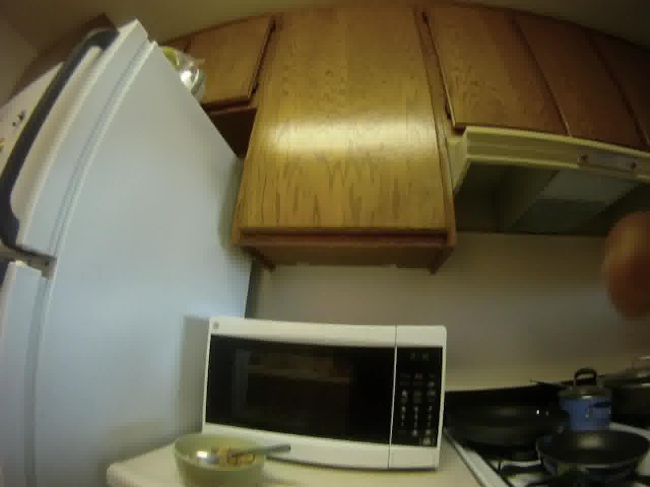
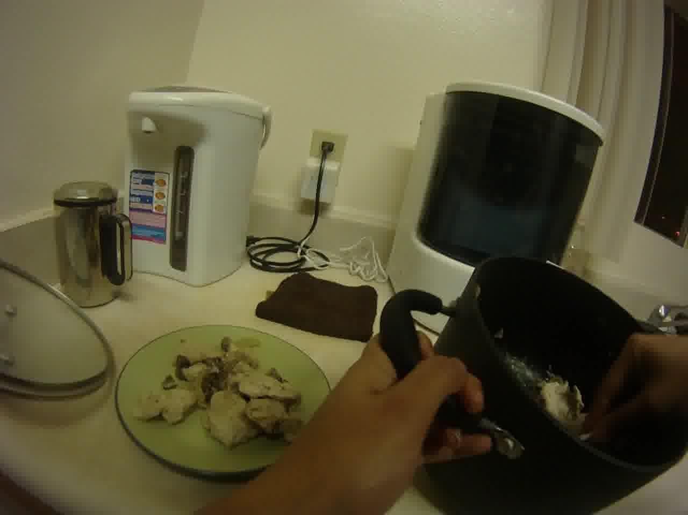
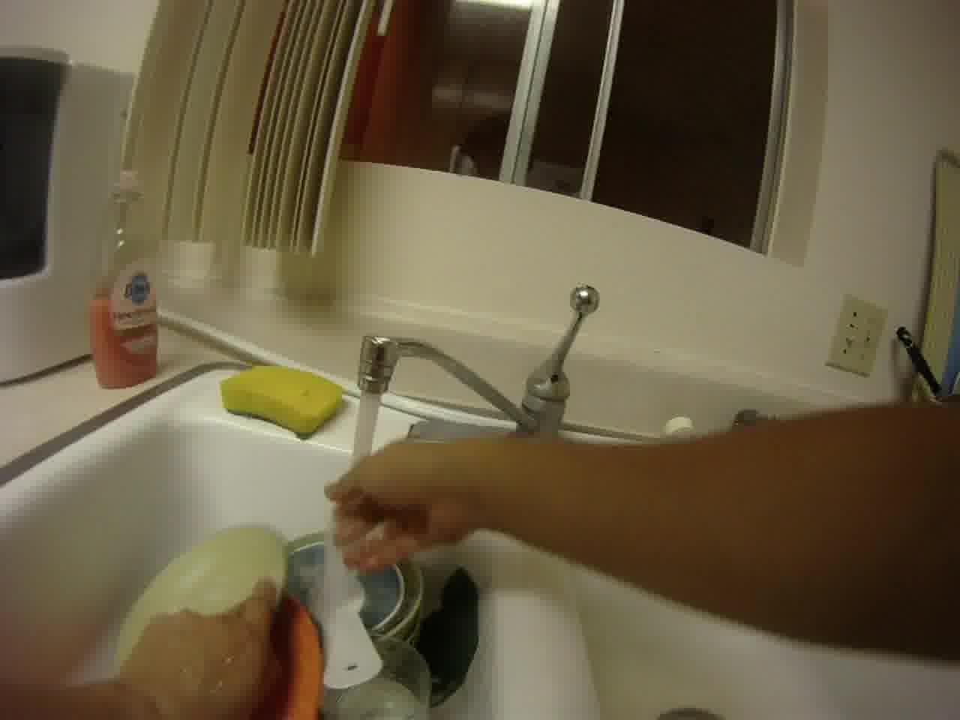
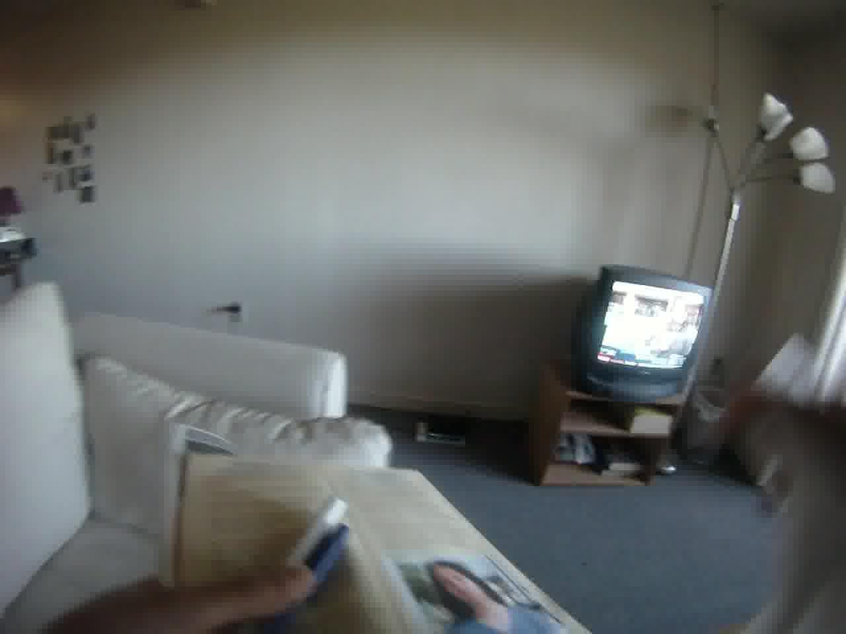
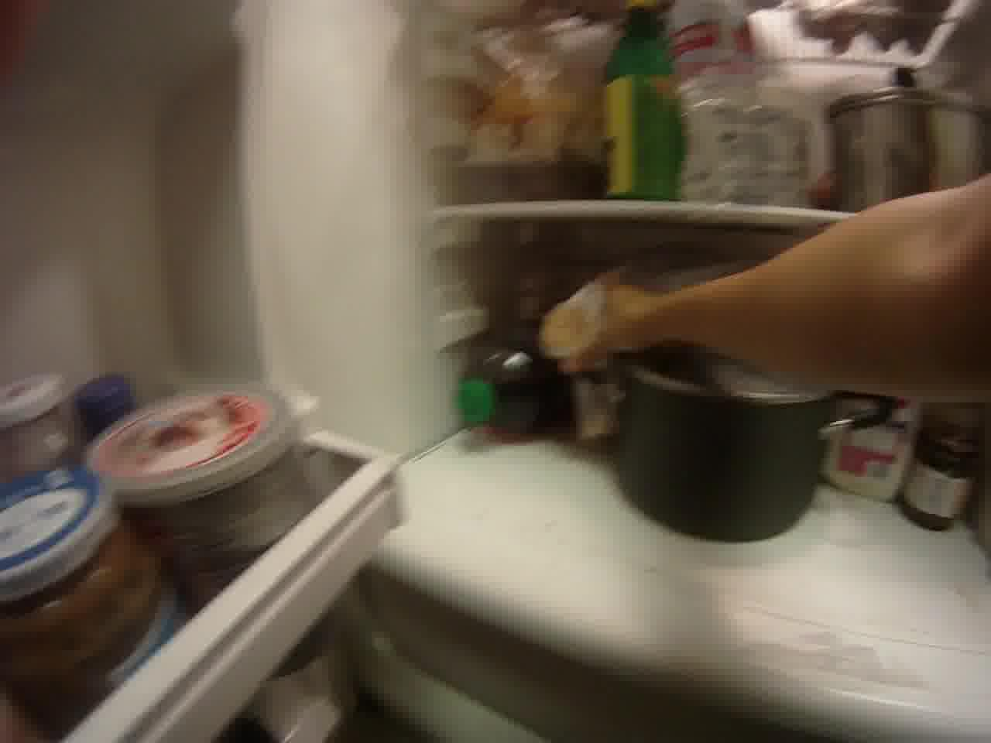
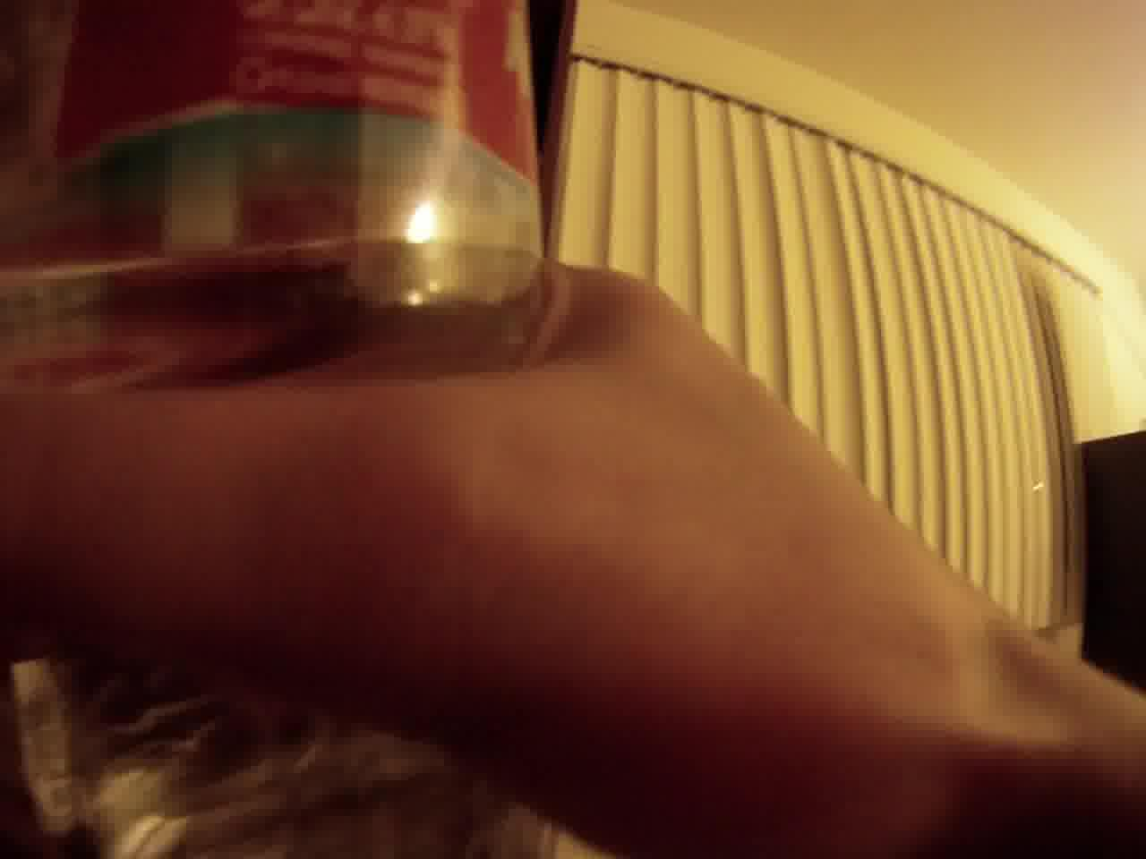
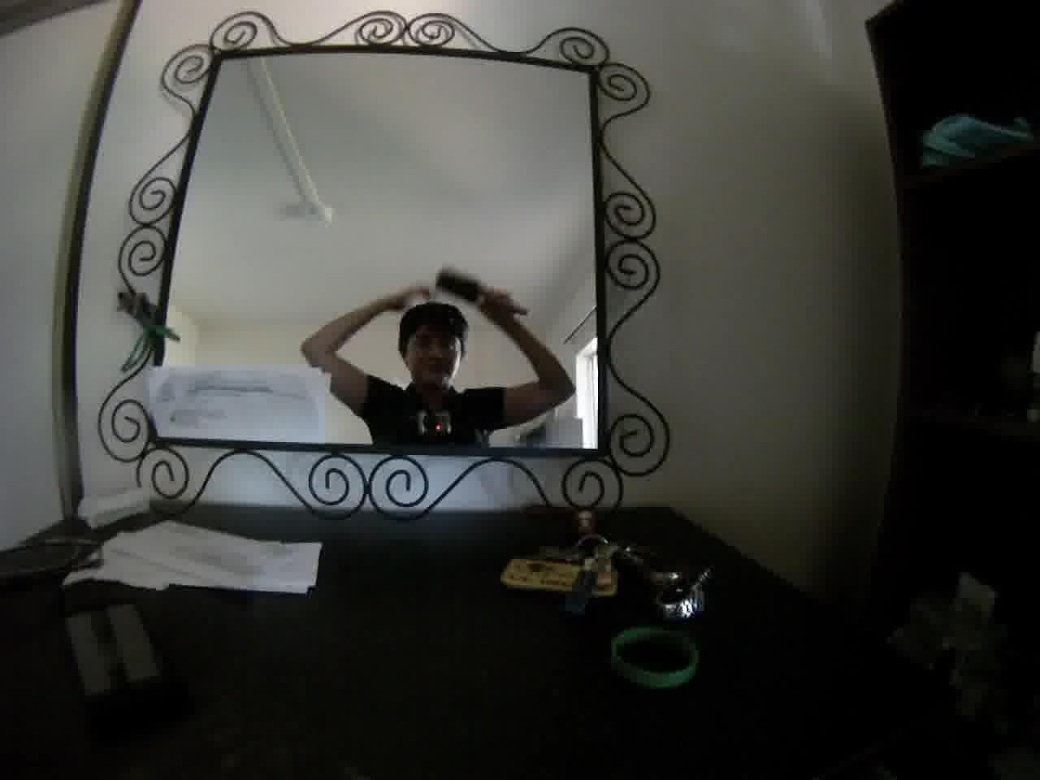
Our interest
Scalability in video length
  Infinitely “life long” temporal streams
  Big data in video
…
Notes:
We are inspired by the problem of processing long temporal streams.
Specifically focusing on applications such as …

Slide 4
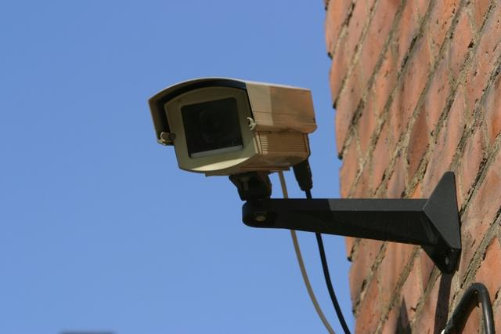
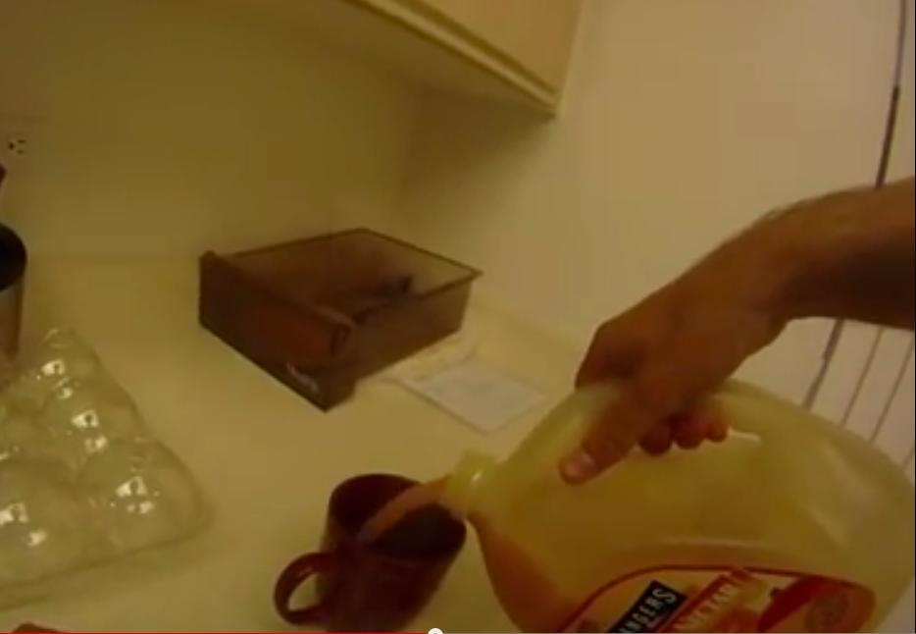
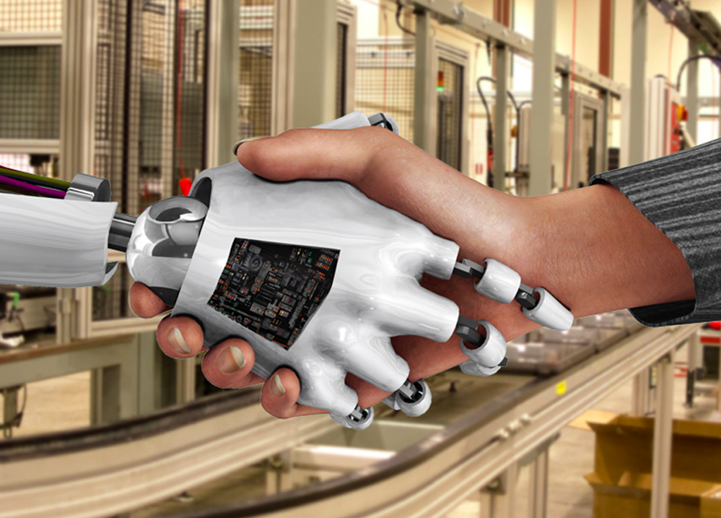

Applications
Surveillance
Egocentric (eg, Google glasses)
Human computer interaction
Gaming
Notes:
Surveillance,
egocentric videos. For instance wearing Google glasses for 24 hours and processing the stream.
Human computer interaction and gaming.

Slide 5
Our focus
Temporal structure at different scales
  Multiple action instances
time
Notes:
Our main focus is on modeling the temporal structure of actions in multiple scales.
First, instead of looking at clips of single actions, we are interested in looking at clips of multiple actions.
Here we see two instances of weight lifting action. The middle frame shows a background segment where no action of interest in happening.

Slide 6
Our focus
Temporal structure at different scales
  Multiple action instances
  Variability within a complex action
time
1. Yank
2. Pause
3. Press
Notes:
Also we are interested in modeling the temporal structure within actions. For instance a weight lifting can be composed of 3 subactions: Yanking, pausing, and then pressing. In fact, there is a variation of weightlifting that doesn’t have the middle subaction. The person should lift the weight directly from bottomn to the top and cannot pause in the middle. We are interested in learning this temporal structure within actions as well.

Slide 7
Our focus
Temporal structure at different scales
  Multiple action instances
  Variability within a complex action
time
1. Yank
2. Press

Slide 8
Parsing videos
time
Notes:
So given a long video, we want to parse it to multiple actions and subactions.

Slide 9
Parsing videos
time
Notes:
We propose a grammar model that produces this parse tree.

Slide 10
Parsing videos
time
Production rules:
across actions
within actions
Notes:
The grammar models consists of a set of production rules. The rules on the left capture the structure across actions and the one son the right model the within action structure.

Slide 11
Parsing videos
time
Production rules:
across actions
within actions
Notes:
For instance, this rules says a sequence can be composed of a background segment meaning no action is happening in the video.

Slide 12
Parsing videos
time
Production rules:
across actions
within actions
Notes:
Or this one says a sequence can be composed of another shorter sequence, an action B, and a background segment.

Slide 13
Parsing videos
time
Production rules:
across actions
within actions
Notes:
For instance, this rule is used in producing this sequence in the top.

Slide 14
Parsing videos
time
Production rules:
across actions
within actions
Notes:
An this rule says an action A is composed of two subactions: red and blue.

Slide 15
Past work: grammars
Context free grammars (CFG): Ivanov et al, PAMI'00, Moore et al, NCAI’02. Ryoo et al, IJCV'09. Si et al, ICCV'11.
Attribute grammars: Joo et al, CVPRW'06.
Logic networks: Tranet al,
ECCV'08. Kwaket al, PAMI'13.
Brendel et al, CVPR'11.
Parsing tends to be , so often use sparse pre-detected action primitives
Notes:
There is a literature in using grammar models in action detection. Context free grammars are the most well-known ones. One problem is that the parsing is O(N^3) which is very slow. That’s why most these works use a sparse set of pre-detected action primitives rather than all frames so that they can tackle the parsing problem.

Slide 16
Past work: grammars
Context free grammars (CFG): Ivanov et al, PAMI'00, Moore et al, NCAI’02. Ryoo et al, IJCV'09. Si et al, ICCV'11.
Attribute grammars: Joo et al, CVPRW'06.
Logic networks: Tranet al,
ECCV'08. Kwaket al, PAMI'13.
Brendel et al, CVPR'11.
Parsing tends to be , so often use sparse pre-detected action primitives
Past work: templates
Laptev et al, ICCV'07, Efros et al, CVPR'03, Rodriguez et al, CVPR'08, Polana et al, IJCV'97, Shechtman et al, PAMI'07, Ke e al, ICCV'07
Parsing is ,
(very efficient)
Needs post processing NMS
Notes:
In contrast another line of work uses action templates with a scanning window. The parsing for these is very efficient: O(NL) where N is the length of video and L is the maximum length of the window, so it is linear in the length of video. One issue is that the result is not a valid parse so we should resort to a post processing non-max-suppression.

Slide 17
Past work: grammars
Context free grammars (CFG): Ivanov et al, PAMI'00, Moore et al, NCAI’02. Ryoo et al, IJCV'09. Si et al, ICCV'11.
Attribute grammars: Joo et al, CVPRW'06.
Logic networks: Tranet al,
ECCV'08. Kwaket al, PAMI'13.
Brendel et al, CVPR'11.
Parsing tends to be , so often use sparse pre-detected action primitives
Past work: templates
Laptev et al, ICCV'07, Efros et al, CVPR'03, Rodriguez et al, CVPR'08, Polana et al, IJCV'97, Shechtman et al, PAMI'07, Ke e al, ICCV'07
Parsing is ,
(very efficient)
Needs post processing NMS
We focus on efficiency and scalability
Our algorithm: Special type of grammar
Parsing as fast as scanning window
Hierarchical structure for free
Globally optimal NMS and sub-action structure
Notes:
We focus on efficiency and scalability. Our algorithm is a special type of grammar. The parsing is as fast as scanning window, so basically, the hierarchical structure comes for free.
Also it is globally optimum so there is no need for any post processing.

Slide 18
Context Free Grammars vs Regular Grammars
Abstract symbols
Terminals
Data
Context free grammars
Regular grammars
Notes:
Now that we have described SRGs, we’ll now be precise and define the score associated with a video and a particular parse tree.

Slide 19
Context Free Grammars vs Regular Grammars
Abstract symbols
Terminals
Data
Context free grammars
Regular grammars
Segmental regular grammars
Notes:
Now that we have described SRGs, we’ll now be precise and define the score associated with a video and a particular parse tree.

Slide 20
Scoring a parse tree
Appearance
weights
Spring
weights
Rule
weights
Data
Data model
Temporal prior
Grammar model
Parse tree
Rules
Starting frame
Length
Notes:
A SRG parse tree can be represented with a set of triples describing segments. Each triple includes the rule deriving that segment, the starting frame and the length of that segment.
The total score is a summation of segment scores.

Slide 21
Scoring a parse tree
Appearance
weights
Spring
weights
Rule
weights
Data
Data model
Temporal prior
Grammar model
Parse tree
Rules
Starting frame
Length

Slide 22
Scoring a parse tree
Appearance
weights
Spring
weights
Rule
weights
Data
Data model
Temporal prior
Grammar model
Parse tree
Rules
Starting frame
Length

Slide 23
Scoring a parse tree
Appearance
weights
Spring
weights
Rule
weights
Data
Data model
Temporal prior
Grammar model
Parse tree
Rules
Starting frame
Length

Slide 24
Inference
Can be written in the form of a Semi Hidden Markov Model (SHMM) with
  Augmented states
  Sparse transition matrices

Slide 25
Inference
Can be written in the form of a Semi Hidden Markov Model (SHMM) with
  Augmented states
  Sparse transition matrices
Inference by dynamic programming
  Naturally online
  time and storage
  : length of video
  : max length of segments

Slide 26
Learning
The scoring function is linear in
: {Data weight ; Temporal prior ; Rule weight }

Slide 27
Learning
The scoring function is linear in
: {Data weight ; Temporal prior ; Rule weight }
Given training data , train a structural SVM
Fully-supervised
Training Labels

Slide 28
Learning
The scoring function is linear in
: {Data weight ; Temporal prior ; Rule weight }
Train a latent structural SVM with partial parses:
Fully-supervised
Training Labels
Weakly-supervised
Training Labels

Slide 29
Learning
The scoring function is linear in
: {Data weight ; Temporal prior ; Rule weight }
Train a latent structural SVM with partial parses:
Fully-supervised
Training Labels
Weakly-supervised
Training Labels
Latent learning of subactions

Slide 30
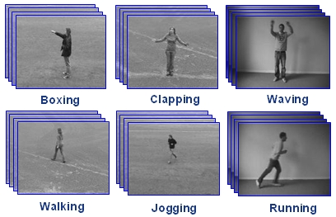
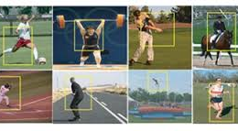
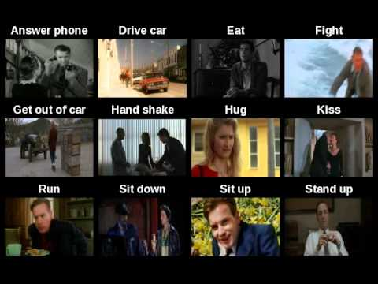
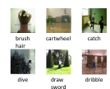
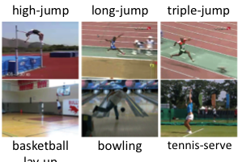
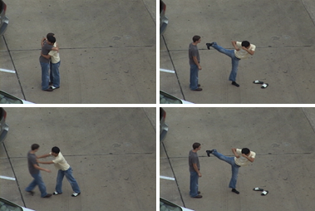
Existing datasets
KTH
UCF Sports
Hollywood
UT Interactions
HMDB 51
Stanford Olympics

Slide 31
Dataset
Continuous videos from Youtube
6 instances per video in average
8 sports action categories
5 hours: half a million frames

Slide 32
Ours
Ground truth
White: action
Black: background
Red, Green, Blue: three sub-actions

Slide 33
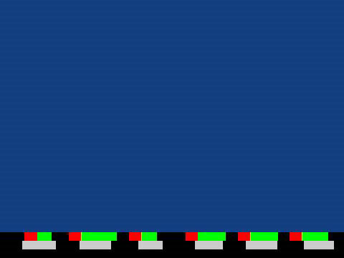
Ours
Ground truth
White: action
Black: background
Red and Blue: two sub-actions

Slide 34
Baseline comparison: Semi Markov Models
Tang et al, CVPR’12
Explicitly models sub-actions

Slide 35
Baseline comparison: Semi Markov Models
Tang et al, CVPR’12
Explicitly models sub-actions
Shi et al, IJCV’10, Hoai et al,, CVPR’11
Explicitly model action segments

Slide 36
Tang et al, CVPR’12
Explicitly models sub-actions
Shi et al, IJCV’10, Hoai et al,, CVPR’11
Explicitly model action segments
Our approach combines both into a single hierarchical model
A parser that is no more expensive than either method alone

Slide 37
Results: average precision
action | Scanning window [1]+NMS | No sub-action [2] | Ours | Ours No length prior
weightlifting | 20 | 27 | 53 | 13
javelin | 0.6 | 36 | 36 | 11
long-jump | 0 | 10 | 10 | 2
vault | 0 | 6 | 11 | 12
bowling | 0.7 | 21 | 25 | 8
diving | 0 | 2 | 8 | 10
hammer-throw | 0.6 | 16 | 23 | 4
tennis | 0 | 0 | 8 | 1
Average | 2.7 | 15 | 22 | 7.6
[1] K. Tang, L. Fei-Fei, and D. Koller. Learning latent temporal structure for complex event detection, CVPR'12 + NMS

Slide 38
Results: average precision
action | Scanning window [1]+NMS | No sub-action [2] | Ours | Ours No length prior
weightlifting | 20 | 27 | 53 | 13
javelin | 0.6 | 36 | 36 | 11
long-jump | 0 | 10 | 10 | 2
vault | 0 | 6 | 11 | 12
bowling | 0.7 | 21 | 25 | 8
diving | 0 | 2 | 8 | 10
hammer-throw | 0.6 | 16 | 23 | 4
tennis | 0 | 0 | 8 | 1
Average | 2.7 | 15 | 22 | 7.6
[1] K. Tang, L. Fei-Fei, and D. Koller. Learning latent temporal structure for complex event detection, CVPR'12 + NMS
[2] Q. Shi, L. Cheng, L. Wang, and A. Smola. Human action segmentation and recognition using discriminative semi-markov models, IJCV'10

Slide 39
Results: average precision
action | Scanning window [1]+NMS | No sub-action [2] | Ours | Ours No length prior
weightlifting | 20 | 27 | 53 | 13
javelin | 0.6 | 36 | 36 | 11
long-jump | 0 | 10 | 10 | 2
vault | 0 | 6 | 11 | 12
bowling | 0.7 | 21 | 25 | 8
diving | 0 | 2 | 8 | 10
hammer-throw | 0.6 | 16 | 23 | 4
tennis | 0 | 0 | 8 | 1
Average | 2.7 | 15 | 22 | 7.6
[1] K. Tang, L. Fei-Fei, and D. Koller. Learning latent temporal structure for complex event detection, CVPR'12 + NMS
[2] Q. Shi, L. Cheng, L. Wang, and A. Smola. Human action segmentation and recognition using discriminative semi-markov models, IJCV'10

Slide 40
Results: average precision
action | Scanning window [1]+NMS | No sub-action [2] | Ours | Ours No length prior
weightlifting | 20 | 27 | 53 | 13
javelin | 0.6 | 36 | 36 | 11
long-jump | 0 | 10 | 10 | 2
vault | 0 | 6 | 11 | 12
bowling | 0.7 | 21 | 25 | 8
diving | 0 | 2 | 8 | 10
hammer-throw | 0.6 | 16 | 23 | 4
tennis | 0 | 0 | 8 | 1
Average | 2.7 | 15 | 22 | 7.6
[1] K. Tang, L. Fei-Fei, and D. Koller. Learning latent temporal structure for complex event detection, CVPR'12 + NMS
[2] Q. Shi, L. Cheng, L. Wang, and A. Smola. Human action segmentation and recognition using discriminative semi-markov models, IJCV'10

Slide 41
Our contributions
Modeling hierarchical temporal structure “for free”
  Within actions
  Across actions
Efficient online parsing
  Linear in the length of video
  Constant in storage
Infer subactions with latent structural SVM
Annotation
Output parse

