Slide 1
Metareasoning: An Overview of Select Systems
Joshua Jones
3/4/2011

Slide 2
Outline
Overview of metareasoning
Gaia – A game-playing metareasoning system.
Abstraction Networks (ANs) – Domain knowledge adaptation.
MetaCognitive Loop (MCL) – A general-purpose metareasoning shell.
Key points

Slide 3
Metareasoning
Metareasoning (metacog) is knowledge (i.e. awareness) of one's cognitive processes and the efficient use of this self-awareness to self-regulate these cognitive processes. (Wikipedia)
Typically the intent in practical systems is to control and regulate some object-level reasoning process.

Slide 4
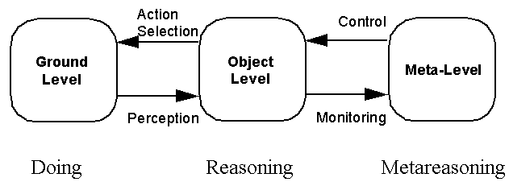
Metareasoning
Model of a Metareasoning Agent Adapted From Cox and Raja, 2007.

Slide 5
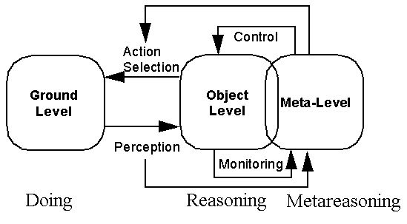
Metareasoning
Alternative models exist...

Slide 6
What kinds of things might the Meta-Layer do?
Select among various methods to achieve a goal.
Decide when to terminate or alter reasoning.
Fix errors in object-level knowledge and/or process.
Make judgments about skill at a task or quality of knowledge about a subject.
  (And accordingly direct computation/learning.)
Adapt a reasoning process to a new situation.

Slide 7
Psychological Studies
When solving problems, there is some evidence that it helps to explicitly force yourself to consider your thought process.
It seems that being explicitly prompted to attend to monitoring one's own reasoning leads to some improvements.
M. T. Cox. Metacognition in computation: A selected research review. Artificial Intelligence, 169(2):104–141, 2005.

Slide 8
Psychological Studies
Some contradictory evidence – people often make serious errors in making metacognitively based judgments.
The cost of metareasoning itself must also be considered, though its value is often in controlling cost of object-level processing.

Slide 9
Outline
Overview of metareasoning
Gaia – A game-playing metareasoning system.
Abstraction Networks (ANs) – Domain knowledge adaptation.
MetaCognitive Loop (MCL) – A general-purpose metareasoning shell.
Key points

Slide 10
Gaia
Gaia is an adaptive game-playing system.
Gaia uses an explicit teleological model of the object-level game player.
Gaia makes proactive adaptations in response to rule changes.
An earlier system, REM, worked in a similar way and could also make retrospective adaptations.

Slide 11
Gaia/REM References
REM: Murdock, J. W., and Goel, A. K. ICAPS-2003, JETAI 2008.
Gaia: Joshua Jones, Chris Parnin, Avik Sinharoy, Spencer Rugaber and Ashok Goel. Teleological Metareasoning for Automating Software Adaptation. Third IEEE International Conference on Self-Adaptive and Self-Organizing Systems, 2009.

Slide 12
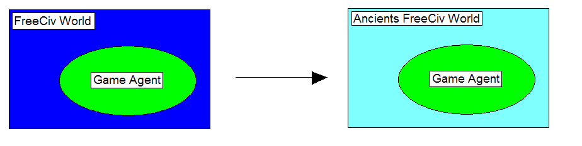
Problem
A piece of software is placed in a similar, but new environment.

Slide 13
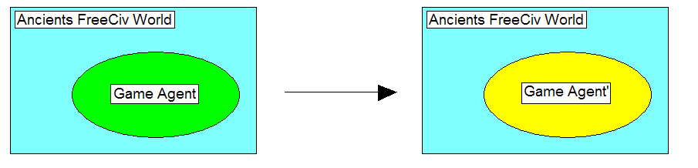
Problem
It must be adapted to better meet the new demands...

Slide 14
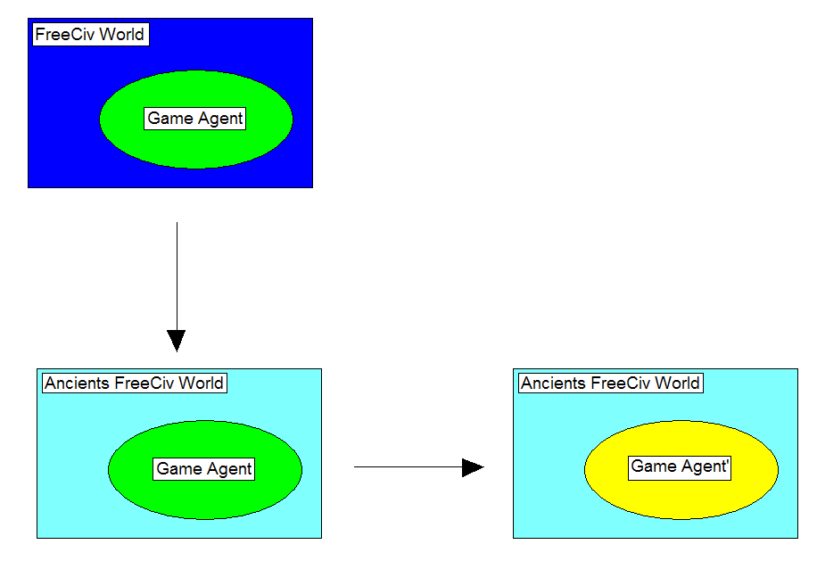
Problem
How can this be done automatically?

Slide 15
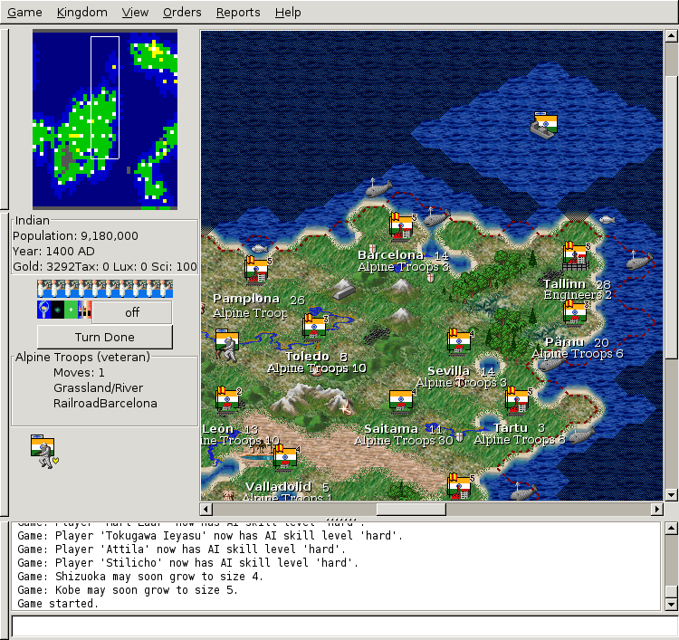
FreeCiv
Turn-based multiplayer strategy game
Massive number of game states and many(compound) actions
Interrelated subgoals (technology, population growth, military...)

Slide 16
Metacognition
Model of a Metareasoning Agent Adapted From Cox and Raja, 2007.

Slide 17
Adaptation Scenario
Adding a rule: luxury resources on map (e.g. gems, silks) will now contribute to happiness at a city if a city is connected (via roads, railroads) to the resource.
This rule is present in Civ3, but not in FreeCiv.

Slide 18
Automation
What knowledge is needed to make such an adaptation?
Goals – What is the purpose of system components?
Procedures – How are the actions that achieve these goals structured?
Plus, connections between goals and procedures.

Slide 19
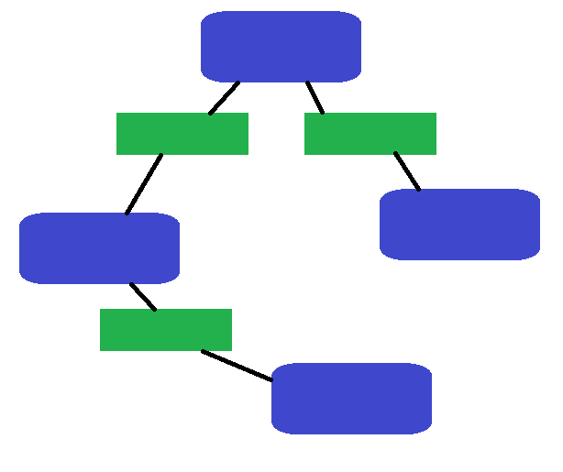
Task-Method-Knowledge (TMK)
TMK models provide the agent with knowledge of its own design.
TMK encodes:
  Tasks (including Subtasks and Primitive Tasks)
    Requirements and results (goals)
  Methods
    Composition and control (procedures)
  Knowledge
    Domain concepts and relations

Slide 20
Task-Method-Knowledge (TMK)
Explicitly connects a functional view of the system with a procedural view.
Thus, we have a teleological model that allows a reasoner to move between goals and processes.
This process where an agent reasons over and changes its own design is metareasoning – reasoning about reasoning.

Slide 21
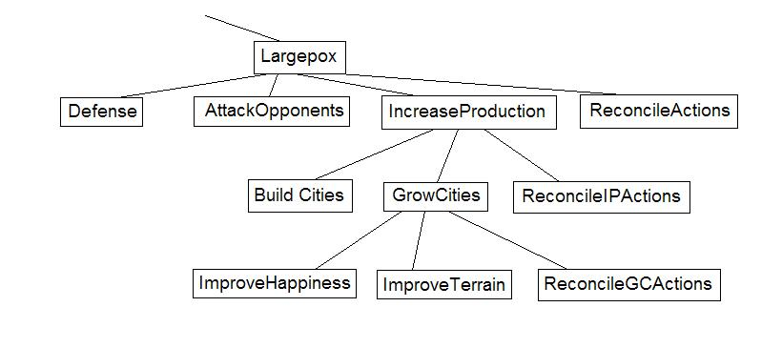
Partial TMKL Agent Model
The “largepox” strategy is the one affected by the change we are considering – “luxuries increase happiness”:

Slide 22
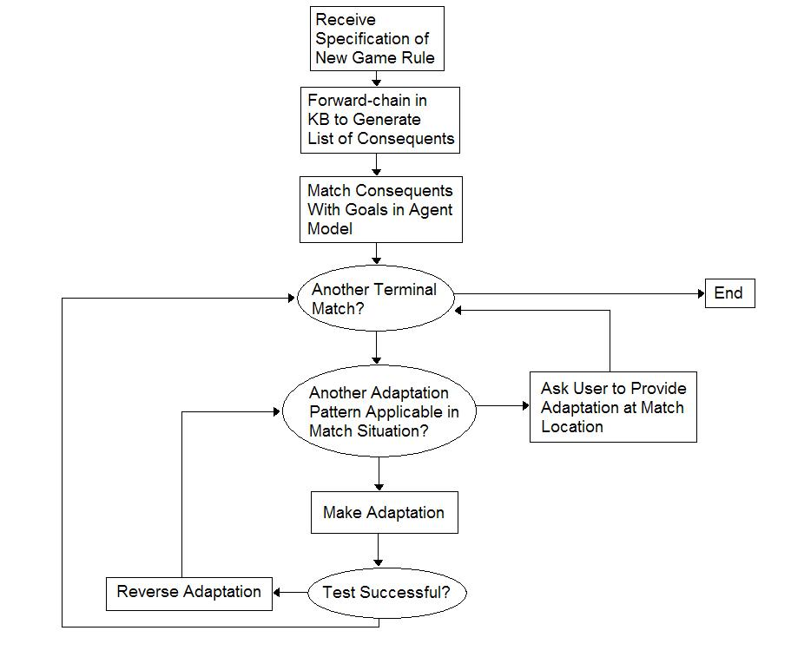
Proposed Proactive Adaptation Process

Slide 23
Outline
Overview of metareasoning
Gaia – A game-playing metareasoning system.
Abstraction Networks (ANs) – Domain knowledge adaptation.
MetaCognitive Loop (MCL) – A general-purpose metareasoning shell.
Key points

Slide 24
Abstraction Networks
Hierarchical classification structures.
Annotated with predictive grounding knowledge called Empirical Verification Procedures.
Metaknowledge is used for diagnosis; statistical techniques are used for repair.

Slide 25
AN Reference
Joshua Jones. Empirically-Based Self-Diagnosis and Repair of Domain Knowledge. Ph.D. Thesis, College of Computing, Georgia Institute of Technology. May 2010.
Ashok Goel and Joshua Jones. Meta-Reasoning for Self-Adaptation in Intelligent Agents. To appear in Meta-Reasoning, M. Cox and A. Raja (editors). MIT Press, 2011.

Slide 26
Reflection on object-level knowledge
What if a metareasoning process such as Gaia identifies a primitive task as the source of error?
Primitive tasks are those that are directly implemented by object-level knowledge.
Want reflective process to then descend into the task and reason about the knowledge.
Take as an example the primitive 'select city build action' task (under ‘build city’).

Slide 27
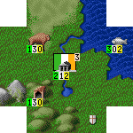
City Location Quality Subproblem
Predict shield (resource) production of a potential city over time
VS.
Notes:
Need to make reasoned decisions about the map location on which to place a city.
Contents of surrounding tiles (terrain, rivers, resources...) affect success of city
One important measure of city success is resource production, called “shields”

Slide 28
Object-level domain knowledge representation
A commonly used pattern of hierarchical classification is “structured matching” (Bylander, et al., 1991)
In structured matching, state features are progressively aggregated and abstracted.
Structured matching is efficient – linear in space and inference time with respect to input dimension.

Slide 29
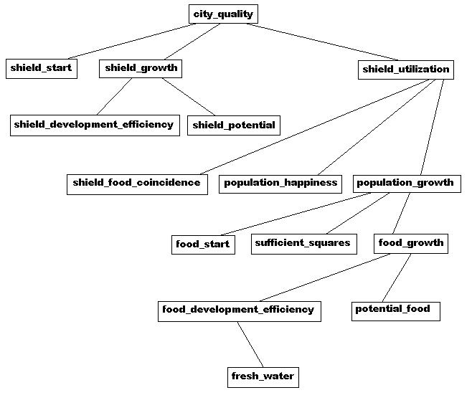
FreeCiv City Location Quality Knowledge Structure

Slide 30
Domain Characterization
Task: Compositional Classification
There is a set of “empirically determinable” features that share mutual information amongst themselves, and with the class label
Assume a known independence structure
Some features are only determinable after classification, and may have some cost

Slide 31
Empirical Verification Procedures
Gaia and REM provide theories of the kind of knowledge needed for metalevel reasoning over process – but what metaknowledge is needed for metareasoning over object-level knowledge?
Use metaknowledge that grounds the semantics of object-level knowledge in perception.
Can be exploited by the reflective layer to perform diagnosis over the object-level knowledge hierarchy

Slide 32
Inference
  observe feature values at leaves

Slide 33
Inference
  observe feature values at leaves
  use local knowledge at each node with observed children to predict the value of the associated feature

Slide 34
Inference
  observe feature values at leaves
  use local knowledge at each node with observed children to predict the value of the associated feature
  iterate the step above for all nodes with predicted or observed children

Slide 35
Learning
Exploit the empirical determinability of the represented features
Learning technique used within nodes is flexible, as is the internal knowledge representation
Different learning progressions based upon other design choices and problem characteristics; in all cases the EVPs are key in assigning fault to specific nodes.

Slide 36
Learning
  Nodes are recursively traversed from root, descending until verification succeeds

Slide 37
Learning
  Nodes are recursively traversed from root, descending until verification succeeds

Slide 38
Learning
  Nodes are recursively traversed from root, descending until verification succeeds

Slide 39
Experimentation
Rote “table update” learners, neural networks and kNN learners have been placed within nodes in our knowledge structures.
We have experimented in synthetic domains, in a variety of degraded settings, as well as in the FreeCiv example described, financial prediction and sports prediction.
Some positive results with several domain/learner configurations, please see papers for detail.
Some theoretical results also.

Slide 40
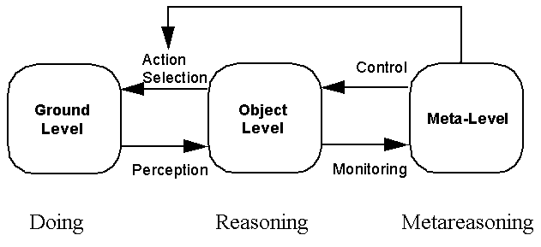
Metareasoning Architecture
Ground-level actions may be in service of reflective layer diagnosis; thus the metareasoning level may in some cases drive action selection.

Slide 41
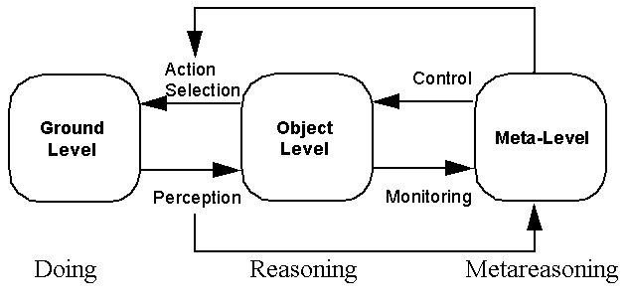
Metareasoning Architecture
Meta-knowledge here takes the form of an explicit representation of object-level knowledge semantics via connection to ground level percepts.

Slide 42
Metareasoning Architecture
Meta-knowledge is distributed over object-level knowledge structures, not confined to separate metareasoning level representations.

Slide 43
Outline
Overview of metareasoning
Gaia – A game-playing metareasoning system.
Abstraction Networks (ANs) – Domain knowledge adaptation.
MetaCognitive Loop (MCL) – A general-purpose metareasoning shell.
Key points

Slide 44
MetaCognitive Loop
MCL is a general-purpose shell that can be “attached” to various object-level reasoners.
Some interfacing knowledge must be authored.
MCL uses only weak models (vs. previous methods) and lightweight inference.

Slide 45
MCL Reference
Matthew Schmill, Michael Anderson, Scott Fults, Darsana Josyula, Tim Oates, Donald Perlis, Hamid Haidarian Shahri, Shomir Wilson, Dean Wright. The Metacognitive Loop and Reasoning about Anomalies. In Cox, M., Raja, A. (Ed.), Metareasoning: Thinking about Thinking. MIT Press, MA, USA, 2011.

Slide 46
MCL Overview
MCL performs retrospective adaptation or intervention.
MCL uses expectations embedded in object-level code to detect failure.
Expectation failures are abstracted to indications, which are mapped to failures (causes) and finally to responses.
Responses must then be made concrete and implemented by the object-level host.

Slide 47
The MCL Ontologies and Fringes.
(Figure due to Schmill)

Slide 48
Experimentation
MCL has been tested with example cases in domains such as:
  Video games (Bolo)
  Robotics domains (Simulated/Actual)
  Language domains (Chatbots/Alfred)
The goal is to establish generality.

Slide 49
Outline
Overview of metareasoning
Gaia – A game-playing metareasoning system.
Abstraction Networks (ANs) – Domain knowledge adaptation.
MetaCognitive Loop (MCL) – A general-purpose metareasoning shell.
Key points

Slide 50
Key Points
Metareasoning can be used to monitor, repair and guide the processing of a system. It is a particular approach that separates this processing distinctly from the object-layer.
It may take many forms:
  Proactive vs. Retrospective
  “Strong model” vs. “Weak model”
  Process vs. Knowledge

Slide 51
Key Points
In each case we have seen, predictive knowledge is used.
These predictions are directly tied to the function of the associated knowledge or procedural structure.
This predictive annotation can be seen as grounding the attached structure – and this grounding makes it possible to reason about the annotated entity.

