Slide 1
The Legal Landscape
Prof. Marie desJardins CMSC 304 - February 7, 2013

Slide 2
Overview
Definitions
Review of significant computer laws and cases
A very small sampling of relevant legal law
Only US-level law, but computer law also varies from country to country, state to state, and sometimes even between municipalities within a state
Group-based reading (one topic per team)
Share back

Slide 3
Landmark Laws in Computing

Slide 4
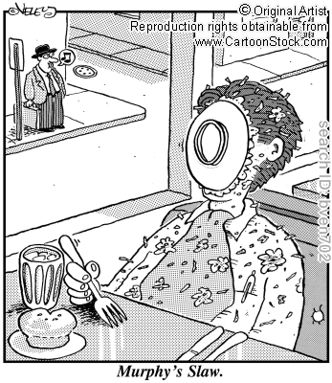
Murphy’s Slaw
http://www.cartoonstock.com/newscartoons/cartoonists/bve/lowres/bven702l.jpg

Slide 5
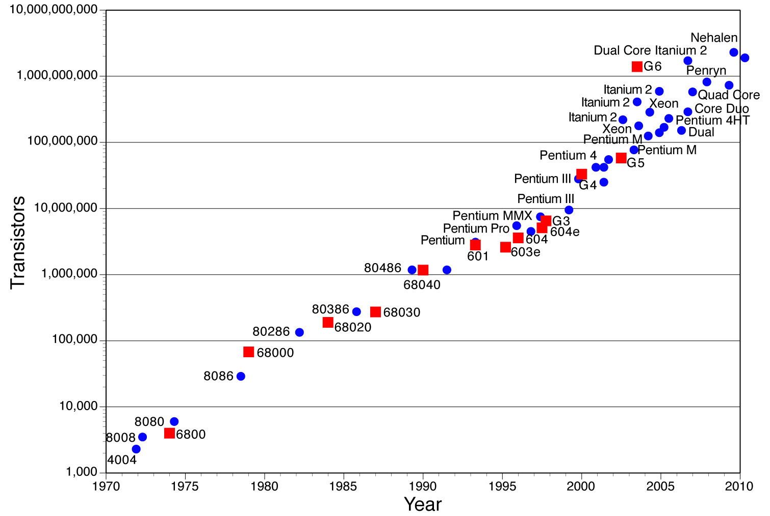
Moore’s Law
http://letshavetheconversation.blogspot.com/2011/11/moores-law-economics-of-abundance.html

Slide 6
Copyright
“Copyright: the exclusive legal right to reproduce, publish, sell, or distribute the matter and form of something (as a literary, musical, or artistic work)” [merriam-webster.com]
Article I, Section 8, U.S. Constitution: Congress shall have the power “To promote the Progress of Science and useful Arts, by securing for limited Times to Authors and Inventors the exclusive Right to their respective Writings and Discoveries...”
A copyright is a statutory monopoly in a work

Slide 7
Copyright Basics
You get a copyright by reducing something to a “tangible form” – no need to file it with anyone.
© 2013 All Rights Reserved
Music, art, books, magazines, dances, baseball play-by-play (without the express written permission of Major League Baseball)
E-mails, tweets, Facebook postings, snapshots can all be copyrighted if they are of sufficient length and uniqueness (low standard)
Copyright holder granted a “bundle of rights” – to use, to prevent use, to copy, display, public performance.
But some “fair uses” may be made

Slide 8
Copyright CyberLaw
Digital Millennium Copyright Act (DMCA)
1998 law based on World Intellectual Property Organization treaties
Controversial sections:
“anti-circumvention” – criminalizes the circumvention of access controls (even if you’re not violating a copyright law!)
Can you jailbreak your own phone, mod your own games, backup software, or create your own chipsets?
“safe harbors” – protects service providers from being prosecuted or sued over third-party violations that are hosted on their sites
Stop Online Piracy Act (SOPA)
Would essentially eliminate the “safe harbor” provision of the DMCA
Amid much controversy, was tabled in January 2012

Slide 9
Patents
“Patent: a property right granted by the Government of the United States of America to an inventor ‘to exclude others from making, using, offering for sale, or selling the invention throughout the United States or importing the invention into the United States’ for a limited time in exchange for public disclosure of the invention when the patent is granted.” [US Patent Technology Office]
A copyright protects the expression of an idea
A patent protects the invention of a process or artifact
Both are forms of “intellectual property”
[US Patent Technology Office] http://www.uspto.gov/main/glossary/index.html#p

Slide 10
Trademark
Trademark identifies the provider of goods; Service Mark identifies the provider of services.
You get a trademark by using it in commerce
Coke, Coca-Cola, font, red color, bottle shape: all trademarked
Many can share the same trademark (Kelly tires, Kelly temps, etc.) as long as not in same field and no “substantial likelihood of confusion”
What field is Apple in? Apple Computers v. Apple Records – the long and winding road
You can lose a trademark if it become generic – Jeep, Xerox, Jello

Slide 11
Software Patent Law
There isn’t a separate “software patent law”
Software may or may not be patentable, according to existing law
Patent law prohibits patenting “abstract ideas”
You would think that this would prevent patents on software/algorithms
But no...
Famous case: Gottschaik v. Benson – the defendants were not permitted to patent an algorithm for binary-to-decimal conversion
You would think this pretty much settled it. But no...
Patent trolls cost US businesses $29B in 2011*
* http://www.inc.com/lindsay-blakely/cost-patent-trolls-startups.html

Slide 12
Spam and Phishing
“Spam: Noun, A canned meat product made mainly from ham. Verb, Send the same message indiscriminately to (large numbers of recipients) on the Internet.” [google definitions]
“Phishing (sometimes called carding or brand spoofing) uses e-mail messages that purport to come from legitimate businesses that one might have dealings with.... Typically, they ask for verification of certain information, such as account numbers and passwords, allegedly for auditing purposes... [responses] may result in financial losses, identity theft and other fraudulent activity against them.”
* http://www.computerworld.com/s/article/89096/Phishing

Slide 13
Spamalawt [sorry...]
Controlling the Assault of Non-Solicited Pornography and Marketing (CAN-SPAM) Act of 2003
Whether you approve or not, that’s an awesome acronym!
Establishes requirements for commercial email and authorizes the FTC to enforce these rules
Mostly ineffective and unforced (gee, ya think?!)
“6 percent of unsolicited e-mail dumped on the Internet in November [2004] complied with the CAN-SPAM law passed by the U.S. Congress last year, according to MX Logic...”*
Identity Theft Penalty Enhancement Act (ITPEA)
A much lamer acronym
...it’s such a silly place..

Slide 14
Privacy
“Privacy: Invasion of privacy is the intrusion into the personal life of another, without just cause.... It encompasses workplace monitoring, Internet privacy, data collection, and other means of disseminating private information.” [uslegal.com]
Right to privacy stems from:
Fourth Amendment: Protection against excessive, unwarranted governmental intrusion
Fifth and Fourteenth Amendments: Require “due process” to deprive anyone of “life, liberty, or property”
There is no explicit statement in the Constitution about an individual’s right to privacy!
[uslegal.com] http://definitions.uslegal.com/i/invasion-of-privacy

Slide 15
Privacy CyberLaw
Alphabet soup:
Wiretap Act (1968 – amended 1986)
Protects wire communications (telephone/telegraph)
Information on the Internet was long considered to be less protected (because it is passed through and stored on third-party servers)
ECPA (Electronic Communications Privacy Act of 1986)
Protects the security and privacy of stored and transmitted electronic data (and places limits on government access)
FISA (Foreign Intelligence Surveillance Act of 1978)
FISA authorizes government surveillance of foreign powers and terrorist groups
USA PATRIOT (Uniting and Strengthening America by Providing Appropriate Tools Required to Intercept and Obstruct Terrorism) Act of 2001
With an acronym like that, how could you go wrong??
Greatly expanded permitted government surveillance (and detention)

Slide 16
Computer Crime
“The U.S. Department of Justice (DOJ), in its manual on computer crime, defines [computer] crime as ‘any violations of criminal law that involve a knowledge of computer technology for their perpetration, investigation, or prosecution.’” [uslegal.com]
Three major types of computer crime:
Theft of hardware and software
Attacks on a computer system
The use of a computer to commit a crime
[uslegal.com] http://definitions.uslegal.com/c/computer-crime

Slide 17
Computer Crime
What is the “crime” part of computer crime?
Theft
Fraud
Trespass
False Personation
Identity theft/fraud
Is “information” property – U.S. v. Aaron Swartz – “hacked” into MIT computer and accessed JSTOR files to put online for free.
What is computer trespass? What is “damage?”
What is “access”
What is without authorization – U.S. v. Lori Drew (Myspace suicide case)

Slide 18
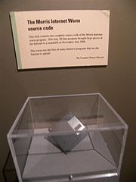
Cybercrime
First Internet worm:
November 2, 1988
Meant to be harmless – unintended consequences led to thousands of infected computers and possibly millions of dollars in damages/costs
Written by Robert Morris
Previously worked for CSEE lecturer John Park
Prosecuted by Dept. of Justice
First conviction under the Computer Fraud and Abuse Act of 1984
Prosecuted by then-DoJ attorney and occasional CSEE adjunct and guest lecturer (and high school buddy of John Park), Mark Rasch

Slide 19
Your Asssignment, Should You Choose to Accept It...

Slide 20
What Is the Law Now?
10:30-11:00:
Read the materials I’ve provided on your group’s randomly assigned topic
Identify the key provisions of the laws, or the key findings of the cases
What is permitted? What is prohibited? What are the consequences?
Conversely: What is not permitted? What is not prohibited?
What are your major open questions? (Feel free to dig deeper and look up other sources if time permits)
11:00-11:15:
Three minutes to share your key provisions/findings (permitted, nonpermitted behavior and consequences) and open questions
After class:
Share something you learned on Piazza (a link, an insight, a concern, a question)

Slide 21
Copyrights
Digital Millennium Copyright Act
http://en.wikipedia.org/wiki/Digital_Millennium_Copyright_Act
http://www.copyright.gov/legislation/pl105-304.pdf
Electronic Frontier Foundation sources: https://www.eff.org/issues/dmca
Article on jailbreaking and other exemptions: http://us.practicallaw.com/3-522-0934
SOPA
http://money.cnn.com/2012/01/17/technology/sopa_explained/index.htm
H.R. 3261 http://thomas.loc.gov/cgi-bin/bdquery/z?d112:h.r.3261:

Slide 22
Software Patents
Gottschaik v. Benson – 409 US 63 (1974)
https://supreme.justia.com/cases/federal/us/409/63/case.html
Richard Stallman speech on misuse of software patents (transcript)
http://www.gnu.org/philosophy/software-patents.html
Article about NewEgg anti-patent-troll case
http://arstechnica.com/tech-policy/2013/01/how-newegg-crushed-the-shopping-cart-patent-and-saved-online-retail/

Slide 23
Spam and Phishing
CAN-SPAM Act
http://uscode.house.gov/download/pls/15C103.txt
http://en.wikipedia.org/wiki/CAN-SPAM_Act_of_2003
http://en.wikipedia.org/wiki/E-mail_spam
Identity Theft Penalty Enhancement Act (ITPEA)
http://www.justice.gov/criminal/fraud/websites/idtheft.html
http://web-5.interliant.com/fsu/cn.nsf/369fe1f2c6e098818525711d00527bff/$FILE/IDTheftLegis.pdf

Slide 24
Wiretapping and Privacy
Wiretap Act
http://www.it.ojp.gov/default.aspx?area=privacy&page=1284
Electronic Communications Privacy Act
https://www.cdt.org/issue/wiretap-ecpa
USA PATRIOT Act
http://www.justice.gov/archive/ll/highlights.htm

Slide 25
Cybercrime
Computer Fraud and Abuse Act of 1984
http://en.wikipedia.org/wiki/Computer_Fraud_and_Abuse_Act
http://www.hg.org/computer-crime.html

