Slide 1
Data Visualization IS 101Y/CMSC 101 Computational Thinking and Design Thursday, October 10, 2013 Marie desJardins University of Maryland, Baltimore County

Slide 2
Midterm Preparation
All assigned class material is fair game:
Assigned readings from the three textbooks (St. Amant, Processing, MYM)
Other assigned readings and videos as listed in the class schedule
Lecture slides and in-class discussions
The focus is on conceptual understanding rather than memorization of details
Be able to define and answer questions about key concepts
Not memorizing details of examples mentioned in passing
Be able to write and interpret Processing programs
Not picky/”trick question” syntax questions
Format:
About 25 questions
Mix of true-false, multiple-choice, matching, and open-ended (short answer or write a program fragment) questions
Closed-book but with limited notes:
You may bring one page of notes (8.5”x11”, front and back, typewritten or handwritten, must be prepared by you but you can talk to other students as much as you want about what to include)

Slide 3
The purpose of computing is insight, not numbers.
Richard Hamming

Slide 4
Numbers
218 218 217 217 216 216 215 214 214 213 213 212 211 211 210 210 209 209 208 206 205 203 202 202 201 200 199 198 198 197 197 197 197 197 197 198 198 198 199 200 201 201 202 204 205 206 207 209 210 212 214 215 217 219 221 223 225 227 229 231 233 234 236 238 239 240 241 242 242 243 243 243 243 243 243 242 242 241 241 240 239 238 238 237 236 235 233 232 231 229 228 226 225 223 222 220 219 217 216 214 213 212 211 210 209 209 208 208 207 207 206 206 206 206 206 207 208 209 209 210 211 212 214 215 217 218 220 222 224 226 228 229 231 233 234 236 238 240 241 243 244 246 247 249 250 251 253 254 254 255 256 256 256 256 256 256 256 256 255 255 254 253 253 252 251 249 249 248 247 246 245 245 244 244 243 243 243 243 243 242 242 242 242 241 241 241 240 240 239 238 238 238 237 237 237 236 235 235 234 234 233 233 232 231 231 230 229 228 227 226 224 223 221 220 218 217 216 214 213 212 211 210 210 209 208 208 207 206 206 205 205 205 205 205 205 206 206 206 207 208 208 209 210 211 212 213 214 215 216 217 218 219 220 222 222 224 225 226 227 227 228 229 229 229 230 230 230 230 230 231 231 231 233 233 233 233 230 229 228 227 226 225 224 224 223 221 220 220 219 218 218 217 217 216 216 215 214 214 213 213 212 211 211 210 210 209 207 206 205 204 202 201 200 200 199 198 197 197 196 196 196 196 196 197 197 198 198 199 199 200 202 203 204 205 207 208 210 212 213 215 217 219 221 223 225 227 229 231 233 235 237 239 240 241 242 243 243 244 244 244 244 244 244 243 243 242 241 241 240 239 238 237 236 235 233 232 231 229 228 226 225 223 221 220 218 217 215 214 213 212 211 210 209 208 208 207 207 206 206 206 206 206 206 206 207 207 208 209 210 211 213 214 216 217 219 221 223 225 227 229 231 233 235 237 238 240 242 243 245 247 248 250 251 252 254 255 256 256 256 256 257 257 257 257 257 256 255 255 254 253 253 252 251 250 249 248 247 246 246 245 244 244 243 243 243 242 242 242 242 241 241 241 241 240 240 240 239 238 238 238 237 237 237 236 236 235 235 235 234 233 233 232 231 230 229 228 227 226 224 223 221 220 218 217 215 214 213 212 211 210 209 208 208 207 206 206 205 205 205 205 204 205 205 205 205 206 206 207 208 209 210 211 212 213 214 215 216 217 218 220 221 222 223 224 225 226 227 228 229 229 230 230 230 231 231 231 231 231 231 231 231 233 233 233 233 230 229 228 227 226 225 224 224 223 221 220 220 219 218 218 217 217 216 216 215 214 214 213 213 212 211 211 210 208 207 206 205 204 202 201 200 199 198 197 197 197 196 196 195 195 196 196 196 197 197 198 198 200 201 202 203 205 206 207 209 211 213 215 217 219 221 224 226 228 230 232 234 236 238 240 241 242 243 244 245 245 245 245 245 245 245 244 244 243 242 241 240 239 238 237 236 235 233 232 231 229 227 226 225 223 221 219 218 217 215 214 213 212 211 210 209 208 208 207 206 206 206 205 205 205 205 205 205 206 207 208 209 210 212 213 215 217 218 220 222 225 227 229 231 233 235 237 239 241 243 244 246 248 249 251 252 253 255 256 256 257 257 257 257 257 257 257 257 256 256 255 254 253 253 252 251 250 249 248 247 247 246 245 244 243 243 242 242 242 241 241 241 241 241 241 241 240 240 239 239 239 238 238 237 237 237 237 237 236 236 235 235 234 234 233 232 231 230 229 227 226 224 223 221 220 218 216 215 214 213 211 210 210 209 208 207 206 206 205 204 204 204 204 204 204 204 204 205 205 206 206 207 208 209 210 212 213 214 215 216 217 218 220 221 222 223 224 225 226 227 228 229 230 230 231 231 231 232 232 232 232 232 232 231 231 233 233 233 233 230 229 228 227 226 225 224 224 223 221 220 220 219 218 218 217

Slide 5
What information consumes is rather obvious: it consumes the attention of its recipients. Hence a wealth of information creates a poverty of attention, and a need to allocate that attention efficiently among the overabundance of information sources that might consume it.
Herb Simon

Slide 6
Lots of Numbers
Simulations
Sensors/scanners
Surveys
Equations
Tracking and data gathering
Data integration

Slide 7
A Medical Detective Story
London, 1854: Cholera outbreak (500 deaths in 10 days)
John Snow was a physician who investigated the outbreak; he suspected transmission through the water supply

Slide 8
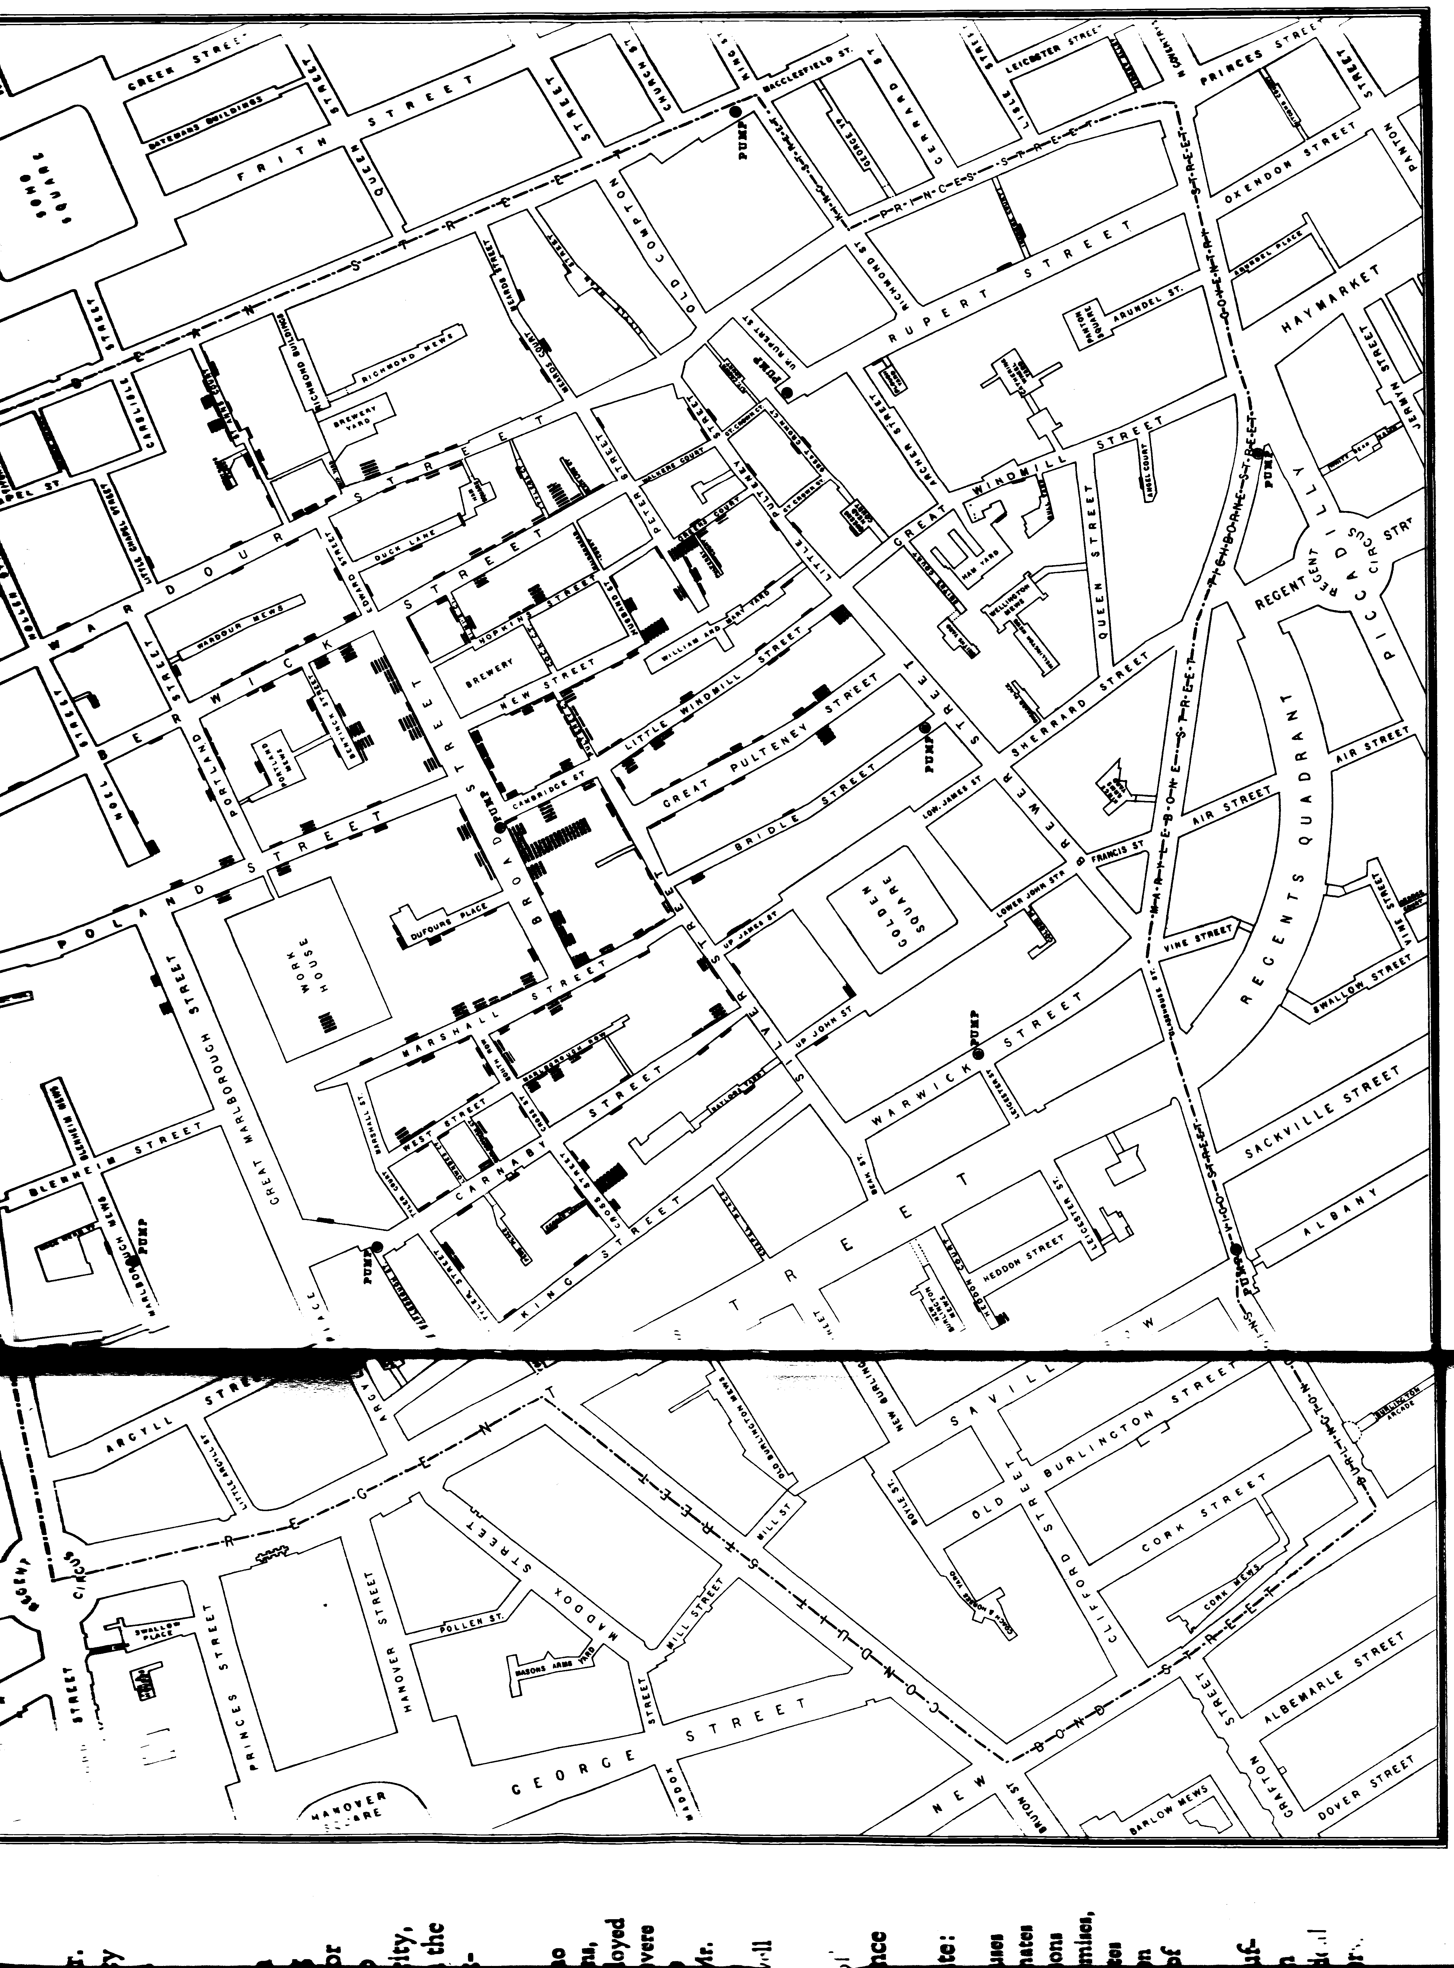

Slide 9
Logic of Display and Analysis
1. Place data in appropriate context for assessing cause and effect
Map vs list vs time series

Slide 10
Logic of Display and Analysis
2. Make qualitative comparisons (who escaped)

Slide 11
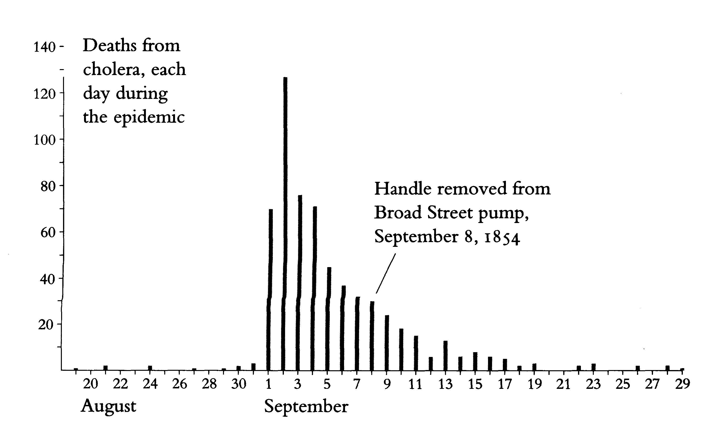
Logic of Display and Analysis
3. Consider alternative explanations and contrary cases

Slide 12
Logic of Display and Analysis
4. Assess possible errors in numbers reported
Missing addresses
Missing habit information

Slide 13
Aggregation Pitfalls
Voronoi Diagrams
Spatial

Slide 14
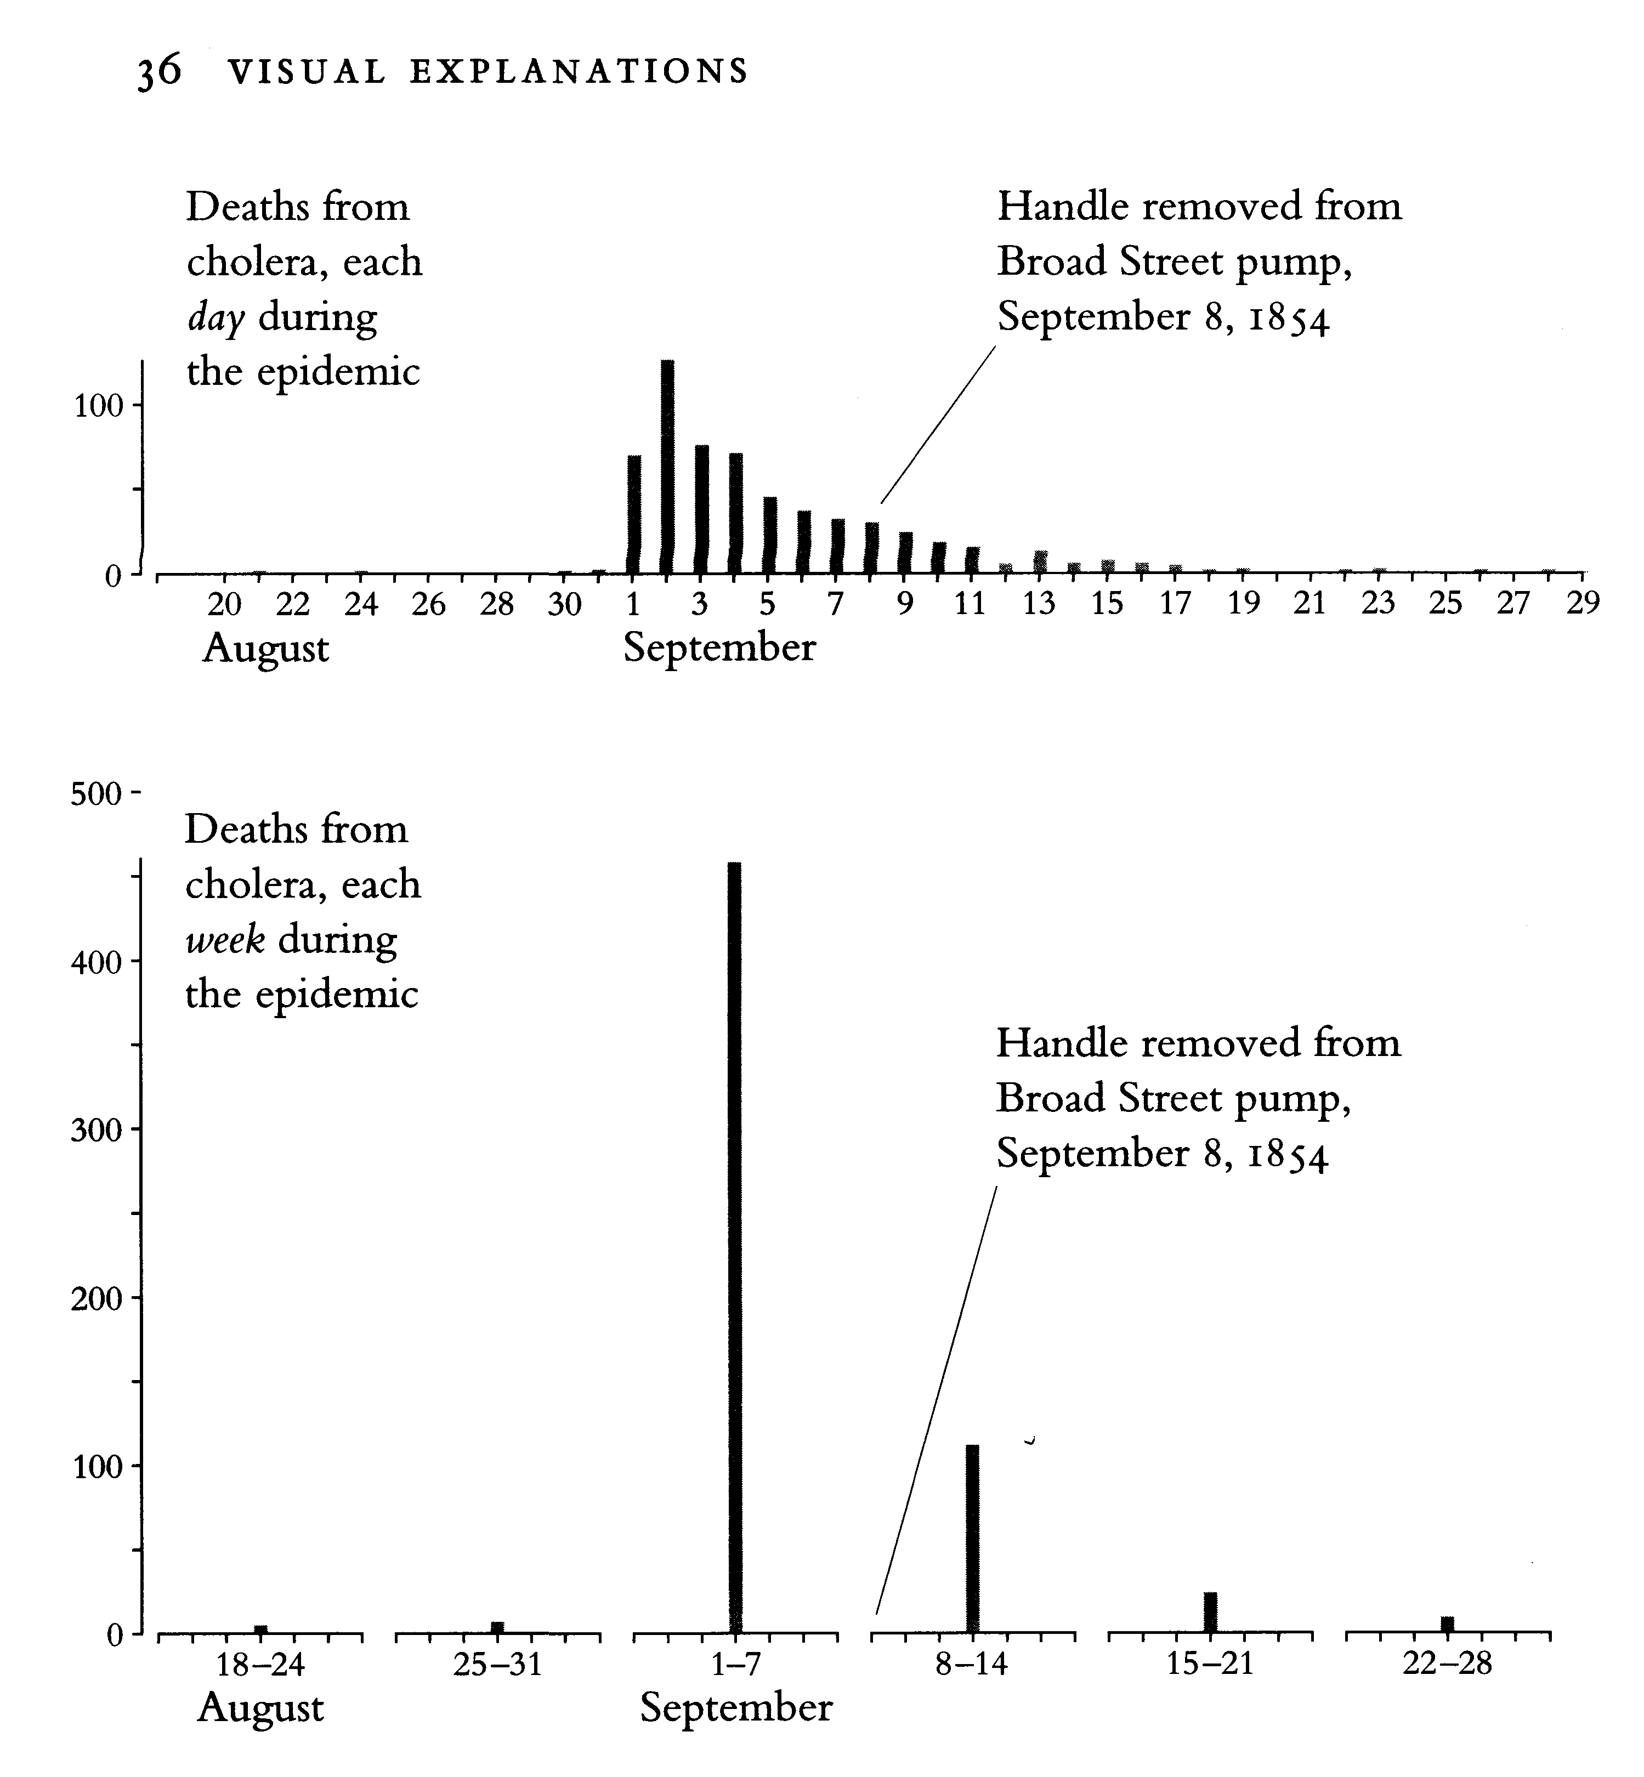
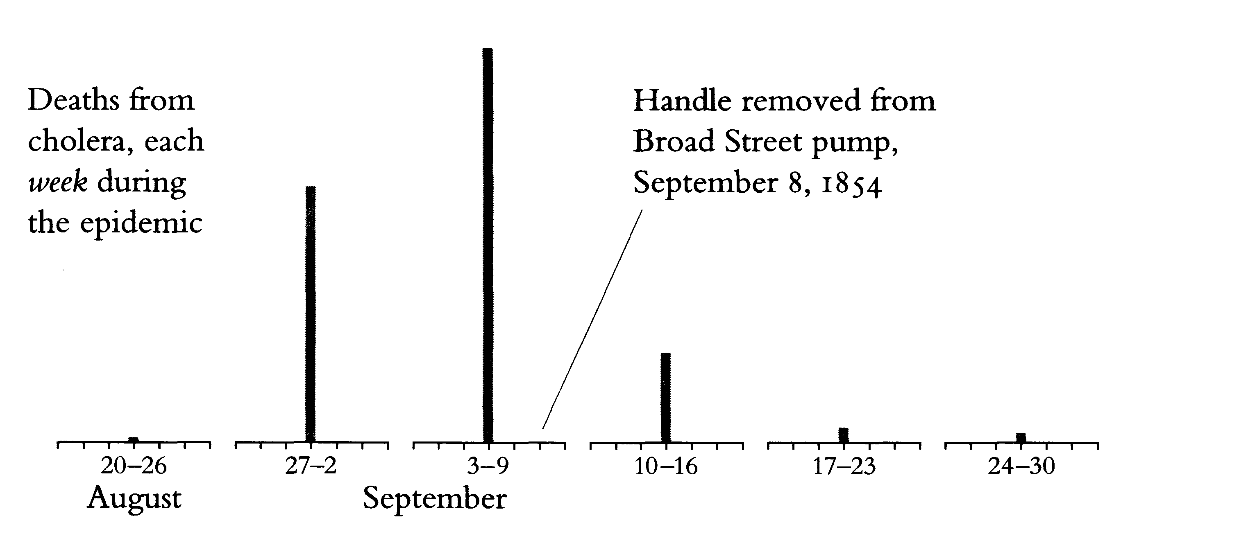
Aggregation Pitfalls
Temporal

Slide 15
Technologies of Knowledge Discovery
Machine learning
Data mining
Visualization
Visual analytics

Slide 16
What is Visualization?
Definition: visual representation of data
Connotations:
Computer-generated (mostly)
LOTS of data
Transforms the abstract and symbolic into the geometric
Harnesses the human visual perception and cognitive systems

Slide 17
Text Representation
218 218 217 217 216 216 215 214 214 213 213 212 211 211 210 210 209 209 208 206 205 203 202 202 201 200 199 198 198 197 197 197 197 197 197 198 198 198 199 200 201 201 202 204 205 206 207 209 210 212 214 215 217 219 221 223 225 227 229 231 233 234 236 238 239 240 241 242 242 243 243 243 243 243 243 242 242 241 241 240 239 238 238 237 236 235 233 232 231 229 228 226 225 223 222 220 219 217 216 214 213 212 211 210 209 209 208 208 207 207 206 206 206 206 206 207 208 209 209 210 211 212 214 215 217 218 220 222 224 226 228 229 231 233 234 236 238 240 241 243 244 246 247 249 250 251 253 254 254 255 256 256 256 256 256 256 256 256 255 255 254 253 253 252 251 249 249 248 247 246 245 245 244 244 243 243 243 243 243 242 242 242 242 241 241 241 240 240 239 238 238 238 237 237 237 236 235 235 234 234 233 233 232 231 231 230 229 228 227 226 224 223 221 220 218 217 216 214 213 212 211 210 210 209 208 208 207 206 206 205 205 205 205 205 205 206 206 206 207 208 208 209 210 211 212 213 214 215 216 217 218 219 220 222 222 224 225 226 227 227 228 229 229 229 230 230 230 230 230 231 231 231 233 233 233 233 230 229 228 227 226 225 224 224 223 221 220 220 219 218 218 217 217 216 216 215 214 214 213 213 212 211 211 210 210 209 207 206 205 204 202 201 200 200 199 198 197 197 196 196 196 196 196 197 197 198 198 199 199 200 202 203 204 205 207 208 210 212 213 215 217 219 221 223 225 227 229 231 233 235 237 239 240 241 242 243 243 244 244 244 244 244 244 243 243 242 241 241 240 239 238 237 236 235 233 232 231 229 228 226 225 223 221 220 218 217 215 214 213 212 211 210 209 208 208 207 207 206 206 206 206 206 206 206 207 207 208 209 210 211 213 214 216 217 219 221 223 225 227 229 231 233 235 237 238 240 242 243 245 247 248 250 251 252 254 255 256 256 256 256 257 257 257 257 257 256 255 255 254 253 253 252 251 250 249 248 247 246 246 245 244 244 243 243 243 242 242 242 242 241 241 241 241 240 240 240 239 238 238 238 237 237 237 236 236 235 235 235 234 233 233 232 231 230 229 228 227 226 224 223 221 220 218 217 215 214 213 212 211 210 209 208 208 207 206 206 205 205 205 205 204 205 205 205 205 206 206 207 208 209 210 211 212 213 214 215 216 217 218 220 221 222 223 224 225 226 227 228 229 229 230 230 230 231 231 231 231 231 231 231 231 233 233 233 233 230 229 228 227 226 225 224 224 223 221 220 220 219 218 218 217 217 216 216 215 214 214 213 213 212 211 211 210 208 207 206 205 204 202 201 200 199 198 197 197 197 196 196 195 195 196 196 196 197 197 198 198 200 201 202 203 205 206 207 209 211 213 215 217 219 221 224 226 228 230 232 234 236 238 240 241 242 243 244 245 245 245 245 245 245 245 244 244 243 242 241 240 239 238 237 236 235 233 232 231 229 227 226 225 223 221 219 218 217 215 214 213 212 211 210 209 208 208 207 206 206 206 205 205 205 205 205 205 206 207 208 209 210 212 213 215 217 218 220 222 225 227 229 231 233 235 237 239 241 243 244 246 248 249 251 252 253 255 256 256 257 257 257 257 257 257 257 257 256 256 255 254 253 253 252 251 250 249 248 247 247 246 245 244 243 243 242 242 242 241 241 241 241 241 241 241 240 240 239 239 239 238 238 237 237 237 237 237 236 236 235 235 234 234 233 232 231 230 229 227 226 224 223 221 220 218 216 215 214 213 211 210 210 209 208 207 206 206 205 204 204 204 204 204 204 204 204 205 205 206 206 207 208 209 210 212 213 214 215 216 217 218 220 221 222 223 224 225 226 227 228 229 230 230 231 231 231 232 232 232 232 232 232 231 231 233 233 233 233 230 229 228 227 226 225 224 224 223 221 220 220 219 218 218 217

Slide 18
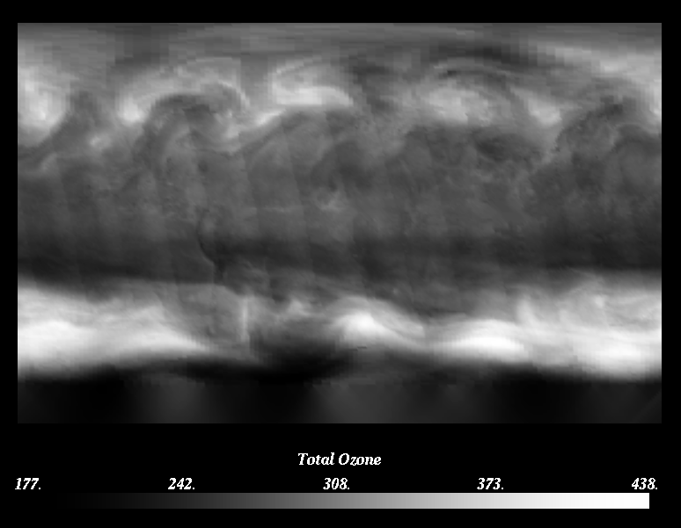

Slide 19
Visualization Tasks
See values
Extrema
Anomalies
Boundaries/thresholds
Distribution/structure/pattern
See multiple variables
Relationships
See flow/change
Understand process

Slide 20
Student Retention

Slide 21
Student Retention cont.

Slide 22
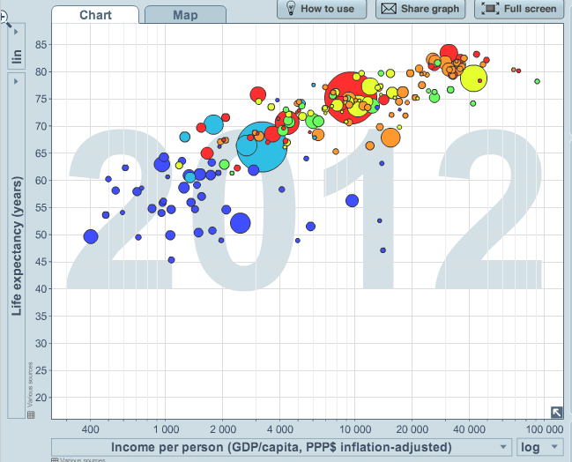
Data Exploration: GapMinder
Where’s the US?
Point out some
other countries
Outliers:
Richest country?
Poorest?
Longest-lived?
Shortest-lived?
Show time-varying visualization on www.gapminder.org

