Slide 1
Increasing Throughput in Disrupted Networks
Congestion Modeling Using Path Prediction
May 2nd, 2011
Ed Birrane
birrane1@umbc.edu

Slide 2
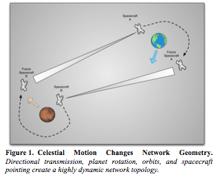
Definition What is a Delay/Disruption-Tolerant Network?
DTN is a subset of challenged networking dominated by delays in data processing incurred by link impairments and latencies.
Challenged Networks
Little power/comm infrastructure
Wireless data transmission
Mobile Platforms
Scalable Deployments
Hostile Environments
Per-Link Failures
Signal Propagation Delays
Intermittent Transmission Disruption
Data latency through the entire network
We will focus on a motivating example: The Solar System Internet

Slide 3
Core Enabling Functions How do they work?
Operator-in-the-loop management, pre-configuration, and small, dense population.
Durable Storage of Data in Transit
Store-and-forward operations where data survives interruptions in connectivity
Custody Transfer
Incremental data advances through the network
No requirement for end-to-end retransmission
Asserted Communications Parameters
Pre-planned parameters, push-methods, and error recovery
No requirement for discovery and negotiation in the network
Delegation
Capture universal functions in a logical overlay
Push heterogeneous function to supporting per-link layers.

Slide 4
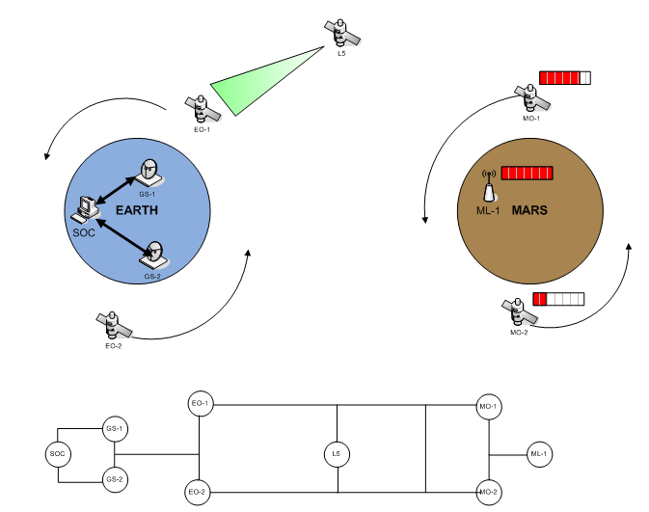
Problème du Jour How do we Increase Throughput Through the Network?
Assumptions
Semi-structured networks: Data has a general “direction” and node motion is somewhat regular
Vast expanse: Dense node populations unfeasible
Time Matters: Network topology constantly changing over time.
Problem Statement
Given local topological information, construct efficient paths through the network that consider both changes in topology and traffic-based congestion.
Hi! I’m NP Complete from Steiner Tree in Graphs!
Information at one node

Slide 5
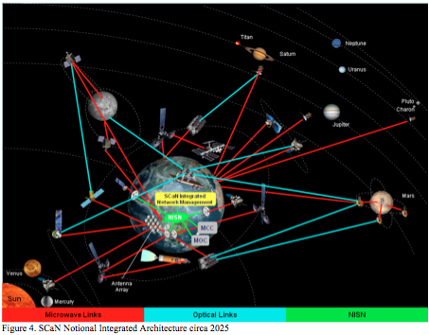
Importance Why do we need to be efficient?
You never get a second chance to make a first connection.
Sensing nodes fill up.
You will miss a critical event or science observation if your recorders are full.
Retransmission is expensive.
We have very power-constrained systems.
You might need to wait days or weeks for connectivity.
You might need to renegotiate access (NASA -> ESA -> JAXA)
Path set-up is costly, so get it right.
Slewing spacecraft
Power transmitters/receivers
Negotiating Deep Space Network time.

Slide 6
Prior Work How do we Route Data in Challenged Networks Now?
DTN routing is governed either by operator-in-the-loop configuration or epidemic/probabilistic multicast.
Space systems pre-configure everything.
Capturing and downlinking observations takes weeks to months of preparation.
Nothing is trusted for automation.
Mobile, Ad-Hoc Networks (MANets) flood.
Node mobility is random (ad-hoc)
Some heuristics for constrained multi-cast.
Contact-Graph Routing (CGR) is compromise.
Construct a contact graph at each local node.
Run your favorite graph algorithm to build a path.
Allows for asserted information (space systems)
Can be built over flooded information (MANets).
Doesn’t save path information! Forwarding only!

Slide 7
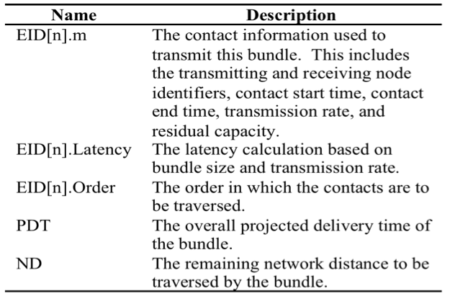
Bright Idea #1 Path Routing!
CGR calculates a full path, then discards it in lieu of constructing next-hop neighbors. Save the paths (dynamic programming)
Don’t re-calculate path at every node.
That’s computationally expensive
Propagate local node knowledge.
Downstream nodes know about upstream knowledge.
If they don’t match, can send backprop messages.
Make message travels deterministic.
Especially useful for overlay networks using multiple data link layers.
Absent, of course, error.
Augment messages with their calculated path (virtual circuit) and relevant contacts.

Slide 8
Bright Idea #2 Modify the Local Contact Graph with Capacity Information
If we know when a message will be where, we can remember how it affects the link capacity and avoid saturated links.
Builds congestion model around two important localities of reference
Spatial locality: Message types may follow common paths.
Temporal locality: Sensor report times may cause periodic bursts.
CGR naturally considered contact’s estimated capacity (EC)
Tweaking EC outside of the CGR algorithm causes the information to be auto-incorporated into the routing decision.
Gives a mechanism for backpressure
If path validation fails, can pass EC information upstream to inform stakeholders in some common path.

Slide 9
Conclusion and Future Work
Path routing with capacity modeling makes routing more efficient. Future work will demonstrate you can build contact graphs in less structured networks.
Routing in Challenged Networks
DTNs (especially sensing networks) support a semi-structure that may be exploited to improve routing efficiency.
Avoiding retransmission and congestion is important to getting the most data through the network at a given time.
Existing Methods Focus on Hand-Tuning or Near-Broadcast
Very few automated methods exploit the semi-structure of these networks.
CGR provides a foundation (when modified) to build path routing and congestion prediction.
Future Work
Working with CGR authors to spin the RFC to include path routing.
Working simulations to demonstrate throughput increase with these methods.
Following research to demonstrate ability to construct contact graphs in a variety of networks.

Slide 10
Questions?
http://theipadkids.com/toy-story-read-along-love-it
This isn’t Routing… It’s Forwarding with Style…

