Slide 1
CMSC 601: Publicity
Networking, CVs, and Websites
Some material adapted from slides by Marie desJardins
March 2011

Slide 2
Sources
Robert L. Peters, Getting What You Came For: The Smart Student’s Guide to Earning a Master’s or Ph.D. (Revised Edition). NY: Farrar, Straus, and Giroux, 1997.
Francine Berman, “Building a research career.” CRA-W Career Mentoring Workshops.
Susan Eggers, “Networking & Professional Social Interaction,” CRA-W Career Mentoring Workshop slides.

Slide 3
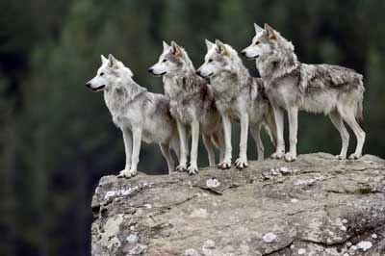
Humans are social animals

Slide 4
Networking

Slide 5
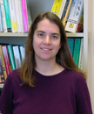
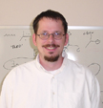
If you knew two people...

Slide 6
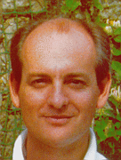
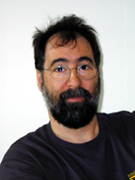
...and they knew two people....

Slide 7
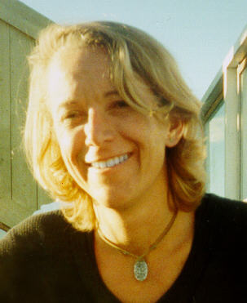
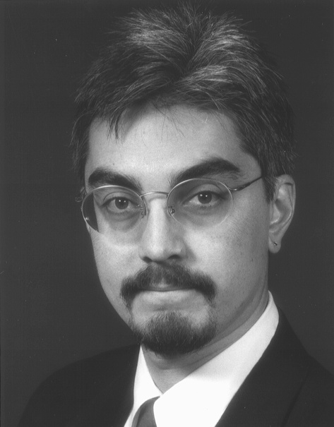
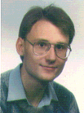
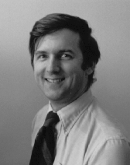
...and so on...

Slide 8
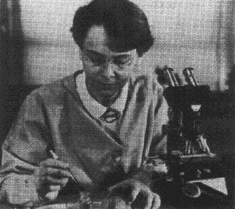
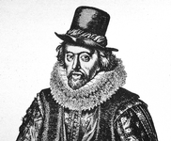
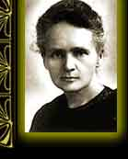
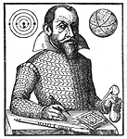
...and so on...

Slide 9
...and so on!

Slide 10
Why Network?
Get ideas for research
Get feedback for research
Get jobs someday
Get papers accepted
Become known in your field!

Slide 11
How to Network?
Publish your work in journals, conferences , blogs, newsgroups, mailing lists, etc.
Give talks
Meet people – make opportunities to meet people
Be useful – produce things (e.g., data, software) that make people come to you
Get involved – in student groups, professional societies, meetups, etc.
Use your connections – keep in touch
Follow up
Ask for help

Slide 12
When Network?
Ask questions in the discussion session of talks
Approach speakers after talks
Sign up to meet visitors to the department
Join lunch/dinner groups at conferences
Get people (especially your advisor!) to introduce you
NOT: Hang out with other UMBC graduate students
...unless they’re helping you network!

Slide 13
“Purposeful Networking”
Going to a conference?
Know who you want to meet
Make sure you meet them!
Think of an opening line to get a conversation going
Introduce yourself to
Other graduate students
Established researchers
People who might have jobs
Follow up with people you meet with an email message, if appropriate

Slide 14
But What Should I Say?
Talk about your research
Be prepared with a 30-second, 2-minute, and 5-minute spiel on your work
Ask about their research
Everybody loves to talk about their research
Look for connections
Both personal and professional

Slide 15
What if you are introverted?
Many of us are in fact very or at least some-what introverted
Force yourself to do some networking in person anyway
Exploit online networking via email and the Web if that’s easier
You can contribute to professional activities in significant ways even if you are quiet

Slide 16
CVs

Slide 17
CVs and Resumes
CV = Curriculum Vitae = courses of life
In US academic circles this is a complete history of your education and professional life
In the UK is is often a short history of your education and professional life
Resume
a summary of academic and work history and skills

Slide 18
CV vs. Resume
Academic focus
Long and very detailed
Highlights teaching and research experience
Publications are very important
Honors and awards, professional service, and professional affiliations are key
Professional focus
Short and concise
Highlights work exper-ience and technical skills
Publications often aren’t mentioned
Work experience and responsibilities are more important

Slide 19
CV Contents
Full contact information, including phone, e-mail, and URLs
Educational history (explain any gaps!)
Title of dissertation, often with a brief description
Thesis advisor and committee
Teaching experience
Other work experience
Professional memberships
Honors and awards
List of publications
Reverse chronological order (most recent first)
Full bibliographic citations, including all authors in order
Often grouped by type (journal, conference, workshop, etc.)
Other presentations
Professional service
...to the department, university, and community

Slide 20
Not Usually Included on a CV
Personal data (marital status, birthdate, ...)
Hobbies
Outside activities
Lots of details on job responsibilities
Technical skills (long listings of programming languages etc.)
Professional objective

Slide 21
You may need several documents
A comprehensive CV
A short CV with just the highlights
An NSF CV
Two pages, at most 10 publications, etc.
Many short resume’s created for particular reasons (e.g., seeking a development job, work in a startup, part-time teaching job, etc.)
One paragraph biosketch
My advice: maintain a comprehensive CV, update it often

Slide 22
Websites: Key Elements
Your name and full contact information
Research interests
Publications (full bibliographic citations and online versions of the actual papers)
Links to relevant websites (your lab, your department, collaborators)
Your CV
Try to keep the personal stuff separable from the professional stuff

Slide 23
Keep moving forward
Keep your web sites relatively current w.r.t. style and technology
These have a half-live of three to five years
Update old pages you left behind or delete them if no longer relevant
Leave forwarding pointers or metadata redirects if appropriate.

Slide 24
An Exercise for the Reader
Find three grad student websites you like
What makes them effective?
How could they be better?
Find three faculty websites you like
What makes them effective?
How could they be better?
Find three (non-academic) professional websites you like
What makes them effective?
How could they be better?

