Slide 1
Microdata and schema.org

Slide 2
Basics
Microdata is a simple semantic markup scheme that’s an alternative to RDFa
Developed by WHATWG and supported by major search companies (Goog,e, MSFT, Yahoo)
Like RDFa, it uses HTML tag attributes to host metadata
Vocabularies are controlled and hosted at schema.org

Slide 3
What is WHATWG?
Web Hypertext Application Technology Working Group
Community interested in evolving the Web with focus on HTML and Web API development
Ian Hickson is a key person, now at Google
Founded in 2004 by individuals from Apple, Mozilla and Opera after a W3C workshop
Concern about W3C's embrace of XHTML
Current work on HTML5
Developed Microdata spec

Slide 4
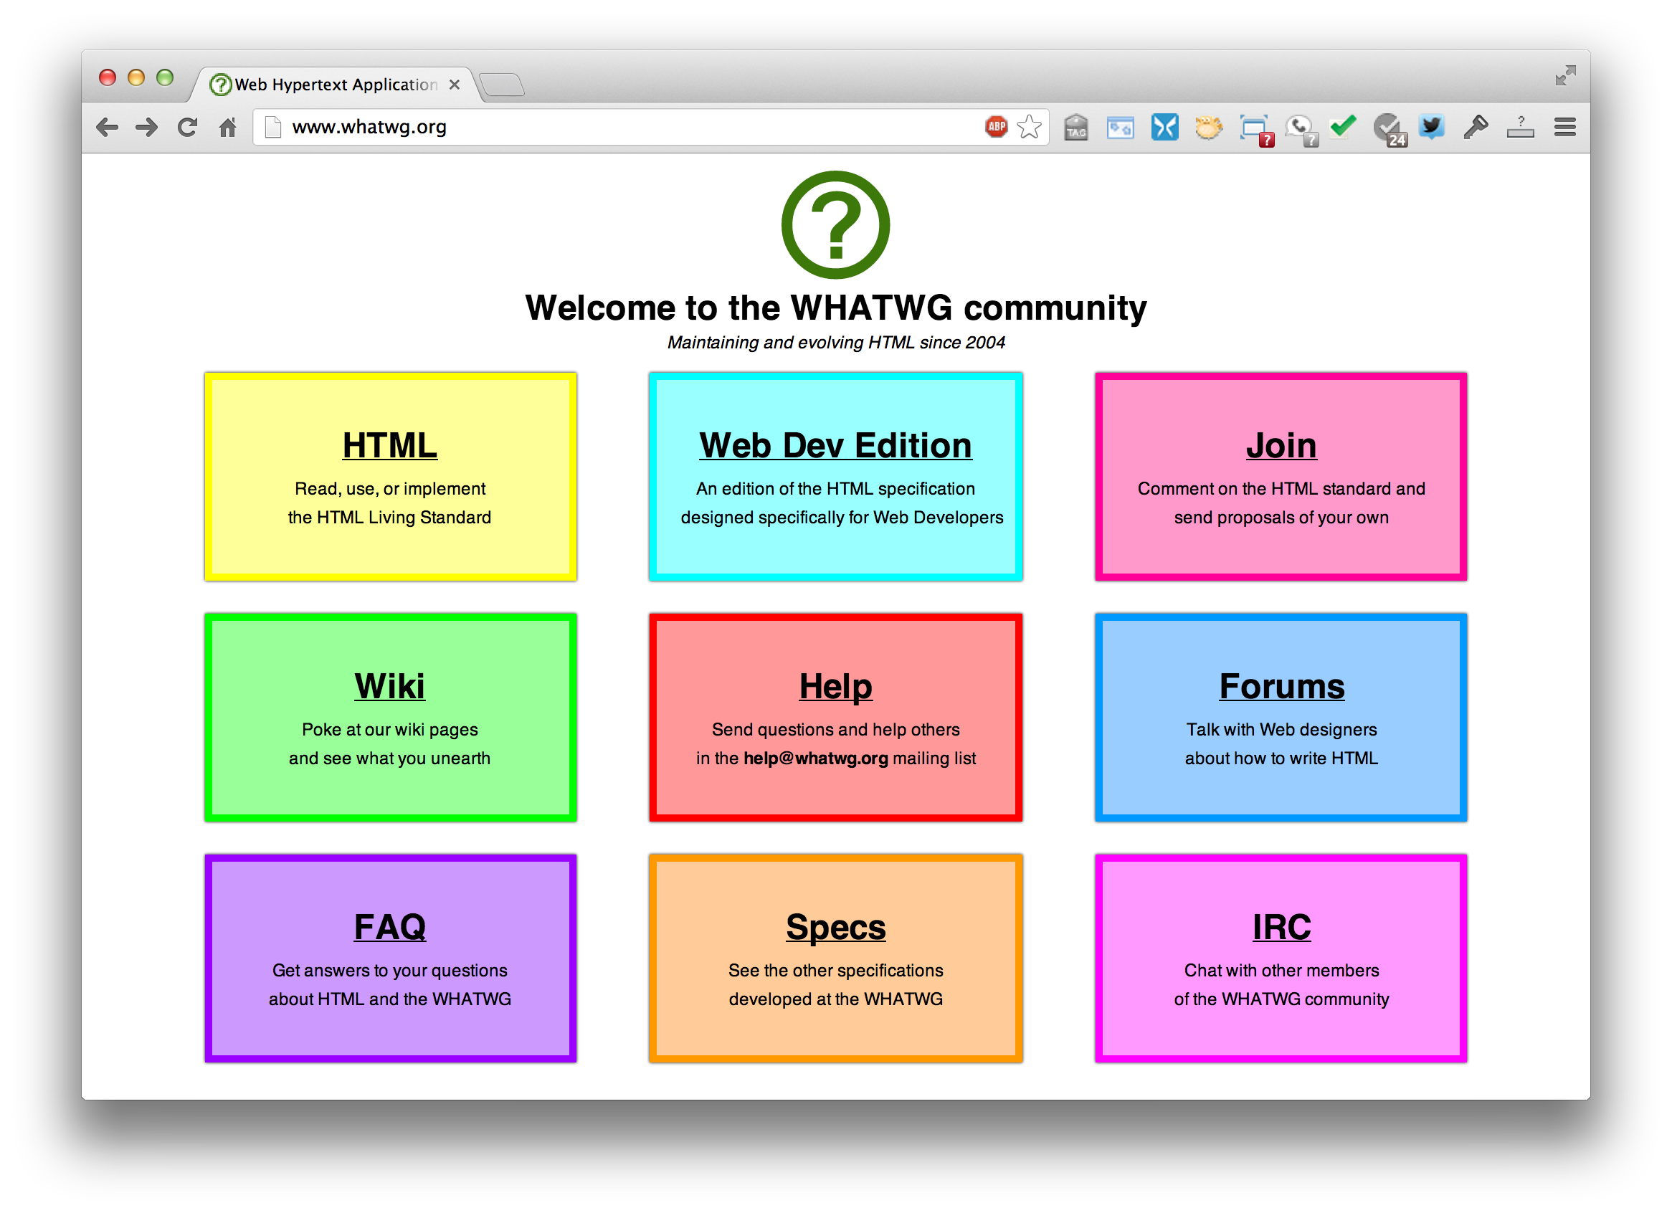
http://whatwg.org/

Slide 5
HTML5
Started by WHATWG as an alternative to XHTML, joined by W3C
A W3C candidate recommendation in 2012
WHATWG will evolve it as a “living standard”
HTML5 ≈ HTML + CSS + js
Native support for graphics, video, audio, speech, semantic markup, …
Partial support in current browsers + extensions

Slide 6
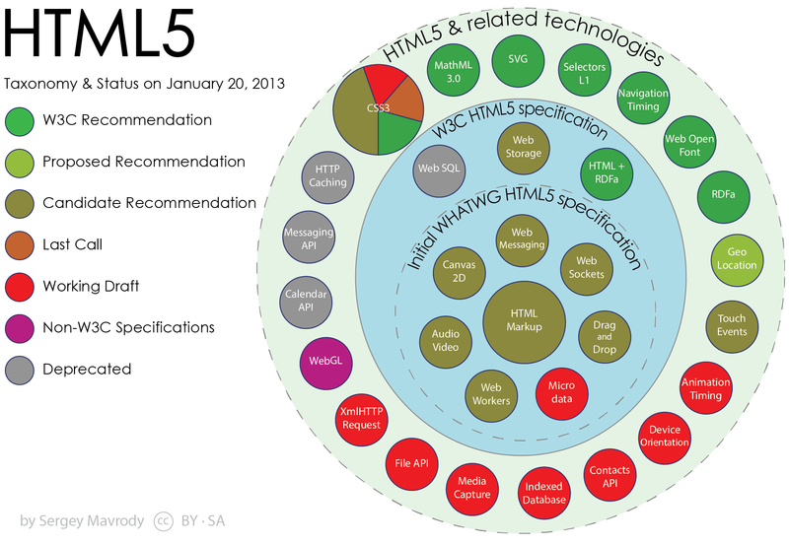
HTML taxonomy and status

Slide 7
Microdata
The microdata effort has two parts: markup and a set of vocabularies
The markup is similar to RDFa in that it provides a way to identify subjects, types, properties and objects
The sanctioned vocabularies are found at schema.org and include a small number of very useful ones: people, movies, etc.

Slide 8
An example
<div>
<h1>Avatar</h1>
<span>Director: James Cameron (born 1954) </span>
<span>Science fiction</span>
<a href=”avatar-trailer.html">Trailer</a>
</div>

Slide 9
An example: itemscope
An itemscope attribute identifies a content subtree that is the subject about which we want to say something
<div itemscope >
<h1>Avatar</h1>
<span>Director: James Cameron (born 1954) </span>
<span>Science fiction</span>
<a href=”avatar-trailer.html">Trailer</a>
</div>

Slide 10
An example: itemtype
An itemscope attribute identifies a content subtree that is the subject about which we want to say something
The itemtype attribute specifies the subject’s type
<div itemscope itemtype="http://schema.org/Movie">
<h1>Avatar</h1>
<span>Director: James Cameron (born 1954) </span>
<span>Science fiction</span>
<a href=”avatar-trailer.html">Trailer</a>
</div>

Slide 11
An example: itemprop
An itemscope attribute identifies a content subtree that is the subject about which we want to say something
The itemtype attribute specifies the subject’s type
An itemprop attribute gives a property of that type
<div itemscope itemtype="http://schema.org/Movie">
<h1 itemprop="name">Avatar</h1>
<span>Director: James Cameron (born 1954) </span>
<span itemprop="genre">Science fiction</span>
<a href=”avatar-trailer.html” itemprop="trailer">Trailer</a>
</div>

Slide 12
An example: embedded items
An itemprop immediately followed by another itemcope makes the value an object
<div itemscope itemtype="http://schema.org/Movie">
<h1 itemprop=“name”>Avatar</h1>
<div itemprop="director” itemscope itemtype="http://schema.org/Person">
Director: <span itemprop="name">James Cameron</span> (born <span itemprop="birthDate">1954</span>) </div>
<span itemprop=“genre”>Science fiction</span>
<a href=”avatar-trailer.html” itemprop="trailer">Trailer</a>
</div>

Slide 13
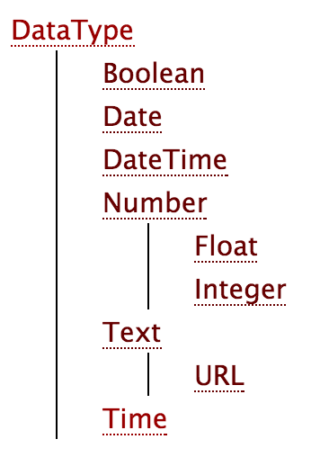
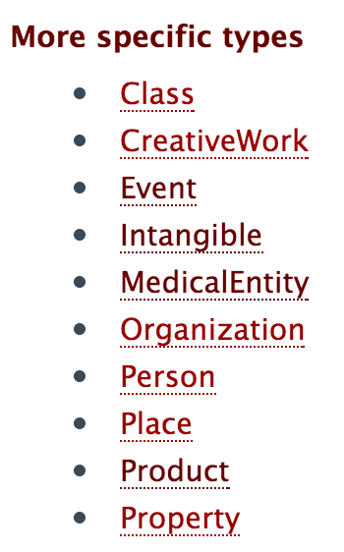
schema.org vocabulary
Full type hierarchy in one file
As of 4/23/13: 419 classes, 756 properties
Data types: Boolean, Date, DateTime, Number (Float, Integer, Text (URL), Time
Objects: Rooted at Thing with two ‘metaclasses’ (Class and Property) and eight subclasses

Slide 14
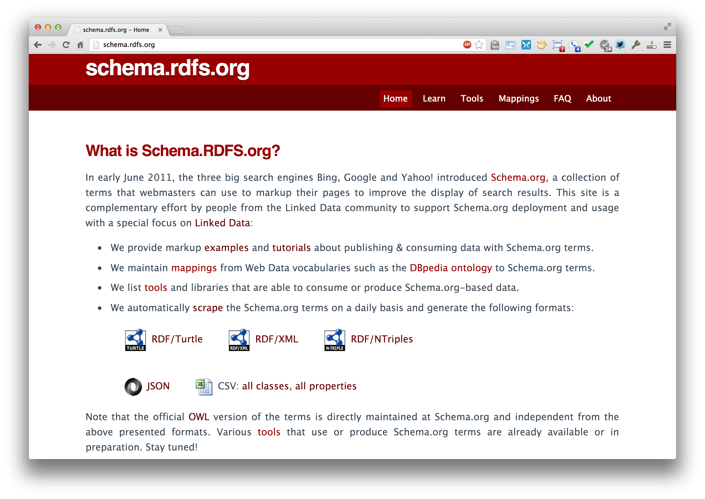
http://schema.rdf.org
x

Slide 15
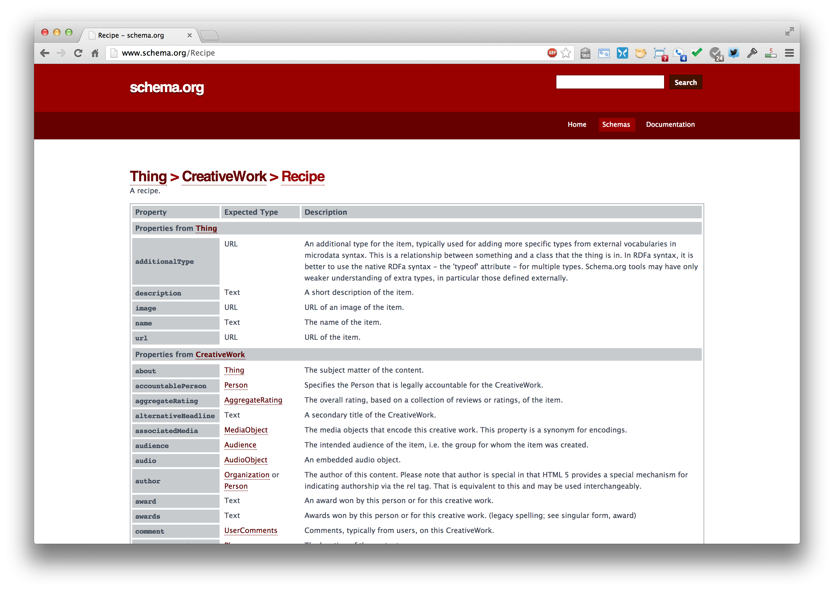
http://www.schema.org/Recipe

Slide 16
Microdata as a KR language
More than RDF, less than RDFS
Properties have an expected type (range)
Might be a string
A list of types, any of which are OK
Properties attached to one or more types (domain)
Classes can have multiple parents and inherit (properties) from all of them
No axioms (e.g., disjointness, cardinality, etc.)

Slide 17
Mixing markup from other vocabularies
Microdata is intended to work with one vocabulary – the one at schema.org
Advantages
Simple, organized, well designed
Controlled by the schema.org people
Disadvantages: too simple, controlled
Too simple, narrow, mono-lingual
Controlled by the schema.org people

Slide 18
Extending the schema.org ontology
http://www.schema.org/docs/extension.html
You can subclass existing classes
Person/Engineer
Person/Engineer/ElectricalEngineer
Subclass exisiting properties
musicGroupMember/leadVocalist
musicGroupMember/leadGuitar1
musicGroupMember/leadGuitar2

Slide 19
Extension Problems
Do agreed upon meaning
Through axioms supported by the language (e.g., equivalence, disjointness, etc.)
No place for documentation (annotations, labels, comments)
Without a namespace mechanism, your Person/Engineer and mine can be confused and might mean different things

Slide 20
Conclusions
Microdata is a good effort by the search companies to experiment with a simple semantic language
It’s not a great standard
RDFa has a more powerful encoding and works with the RDF stack
There’s a bit of infighting in the WEB community
RDFa Lite is maybe a good solution

