Slide 1
OWL 2
Web Ontology Language
Some material adapted from presentations by Ian Horrocks and by Feroz Farazi

Slide 2
Introduction
OWL 2 extends OWL 1.1 and is backward compatible with it
The new features of OWL 2 based on real applications, use cases and user experience
Adopted as a W3C recommendation in December 2009
All new features were justified by use cases and examples
Most OWL software supports OWL now

Slide 3
Features and Rationale
Syntactic sugar
New constructs for properties
Extended datatypes
Punning
Extended annotations
Some innovations
Minor features

Slide 4
Syntactic Sugar
OWL 2 adds features that
Don’t change expressiveness, semantics, complexity
Makes some patterns easier to write
Allowing more efficient processing in reasoners
New features include:
DisjointClasses
DisjointUnion
NegativeObjectPropertyAssertion
NegativeDataPropertyAssertion

Slide 5
Syntactic sugar: disJointClasses
It’s common to want to assert that a set of classes are pairwise disjoint
No individual can be an instance of 2 of the classes in the set
Faculty, staff and students are all disjoint
[a owl:allDisjointClasses;
owlmembers (:faculty :staff :students)]
In OWL 1.1 we’d have to make three assertions
:faculty owl:disjointWith :staff
:faculty owl:disjointWith :student
:staff owl:disjointWith :staff
Will be cumbersome for large sets

Slide 6
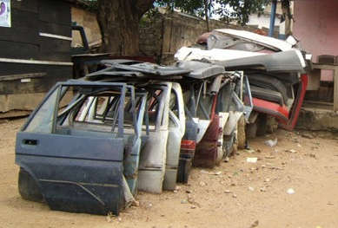
Syntactic sugar: disJointUnion
Need for disjointUnion construct
A :CarDoor is exclusively either
a :FrontDoor, a :RearDoor or a :TrunkDoor
and not more than one of them
In OWL 2 :CarDoor a owl:disjointUnionOf (:FrontDoor :RearDoor :TrunkDoor).
In OWL 1.1
:CarDoor owl:unionOf (:FrontDoor :RearDoor :TrunkDoor).
:FrontDoor owl:disjointWith :ReadDoor .
:FrontDoor owl:disjointWith :TrunkDoor .
:RearDoor owl:disjointWith :TrunkDoor .

Slide 7
Syntactic sugar: disJointUnion
It’s common for a concept to have more than one decomposition into disjoint union sets
E.g.: every person is either male or female (but not both) and also either a minor or adult (but not both)
foaf:Person
owl:disjointUnionOf (:MalePerson :FemalePerson);
owl:disjointUnionOf (:Minor :Adult) .

Slide 8
Syntactic sugar: negative assertions
Asserts that a property doesn’t hold between two instances or between an instance and a literal
NegativeObjectPropertyAssertion
Barack Obama was not born in Kenya
NegativeDataPropertyAssertion
Barack Obama is not 60 years old
Encoded using a “reification style”

Slide 9
Syntactic sugar: negative assertions
@prefix dbp: <http://dbpedia.org/resource/> .
@prefix dbpo: <http://dbpedia.org/ontology/> .
[a owl:NegativeObjectPropertyAssertion;
owl:sourceIndividual dbp:Barack_Obama ;
owl:assertionProperty dbpo:born_in ;
owl:targetIndividual dbp:Kenya] .
[a owl:NegativeDataPropertyAssertion;
owl:sourceIndividual dbp:Barack_Obama ;
owl:assertionProperty dbpo:age ;
owl:targetIndividual "60" ] .

Slide 10
Syntactic sugar: negative assertions
Note that the negative assertions are about individuals
Suppose we want to say that :john has no spouse?
Or to define the concept of an unmarried person?
Can we use a negativeassertion to do it?

Slide 11
Syntactic sugar: negative assertions
Suppose we want to say that :john has no spouse?
[a owl:NegativeObjectPropertyAssertion;
owl:sourceIndividual :john ;
owl:assertionProperty dbpo:spouse ;
owl:targetIndividual ????????] .
Notes:
There is no individual we can put here.

Slide 12
Syntactic sugar: negative assertions
The negativeassertion feature is limited
Can we define a concept :unmarriedPerson and assert that :john is an instance of this?
We can do it this way:
An unmarried person is a kind of person
and a kind of thing with exactly 0 spouses
Notes:
There is no individual we can put here.

Slide 13
John is not married
:john a :unmarriedPerson .
:unmarriedPerson a Person;
a [a owl:Restriction;
onProperty dbpo:spouse;
owl:cardinality “0”] .

Slide 14
New property Features
Self restriction
Qualified cardinality restriction
Object properties
Disjoint properties
Property chain
keys

Slide 15
Self restriction
Classes of objects that are related to themselves by a given property
For example, the class of processes that regulate themselves
It is also called local reflexivity
An example: Auto-regulating processes regulate themselves
narcissists are people who love themselves

Slide 16
Qualified cardinality restrictions
Qualifies the instances to be counted
Six varieties: {Data|Object}{Min|Exact|Max} Type
Examples
People with exactly 3 children who are girls
People with at least 3 names
Each individual has at most 1 SSN
Pizzas with exactly four toppings all of which are cheeses

Slide 17
Qualified cardinality restrictions
Done via new properties with domain owl:Re-striction, namely {min|max|}QualifiedCardinality and onClass
Example: people with exactly three children who are girls
[a owl:restriction;
owl:onProperty :has_child;
owl:onClass [owl:subClassOf :FemalePerson; owl:subClassOf :Minor].
QualifiedCardinality “3” .

Slide 18
Object properties
ReflexiveObjectProperty
Globally reflexive
Everything is part of itself
IrreflexiveObjectProperty
Nothing can be a proper part of itself
AsymmetricObjectProperty
If x is proper part of y, then the opposite does not hold

Slide 19
Disjoint properties
E.g: you can’t be both the parent of and child of the same person
DisjointObjectProperties
Deals with object properties
Pairwise disjointness can be asserted
E.g., connectedTo and contiguousWith
DisjointDataProperties
Deals with data properties
Pairwise disjointness can be asserted
E.g., startTime and endTime of a surgery

Slide 20
A Dissertation Committee
A dissertation committee has a candidate who must be a student and five members all of whom must be faculty. One member must be the advisor, another can be a co-advisor and two must be readers. The readers can not serve as advisor or co-advisor.

Slide 21
A Dissertation Committee
:DC a owl:class; [a owl:Restriction; owl:onProperty :co-advisor; owl:maxCardinality “1”] .
:candidate a owl:FunctionalProperty; rdfs:domain :DC; rdfs:range student.
:advisor a owl:FunctionalProperty; rdfs:domain :DC; rdfs:range faculty.
:co-advisor owl:ObjectProperty; rdfs:domain :DC; rdfs:range faculty, owl:propertyDisjointWith :advisor .
…

Slide 22
Property chain inclusion
Properties can be defined as a composition of other properties
The brother of your parent is your uncle
:uncle owl:propertyChainAxion (:parent :brother)

Slide 23
Keys
Individuals can be identified uniquely
Identification can be done using
A data property
An object property or
A set of properties
Example
foaf:Person owl:hasKey (foaf:mbox);
owl:hasKey (:homePhone :foaf:name).

Slide 24
Extended datatypes
Extra datatypes
Examples: owl:real, owl:rational, xsd:pattern
Datatype restrictions
Range of datatypes
For example, adult has an age >= 18
DatatypeRestriction(xsd:integer minInclusive 18)
Datatype definitions
New datatypes
DatatypeDefinition( :adultAge DatatypeRestriction(xsd:integer minInclusive 18))

Slide 25
Extended datatypes
Data range combinations
Intersection of
DataIntersectionOf( xsd:nonNegativeInteger xsd:nonPositiveInteger )
Union of
DataUnionOf( xsd:string xsd:integer )
Complement of data range
DataComplementOf( xsd:positiveInteger )

Slide 26
An example
:Teenager a [owl:Restriction ; owl:onProperty :hasAge ; owl:someValuesFrom _:y .]
_:y a rdfs:Datatype ; owl:onDatatype xsd:integer ; owl:withRestrictions ( _:z1 _:z2 ) .
_:z1 xsd:minInclusive "13"^^xsd:integer .
_:z2 xsd:maxInclusive "19"^^xsd:integer .

Slide 27
Punning
OWL 1 DL things can’t be both a class and an instance
E.g., :SnowLeopard can’t be both a subclass of :Feline and an instance of :EndangeredSpecies
OWL 2 DL offers better support for meta-modeling via punning
A URI denoting an owl thing can have two distinct views, e.g., as a class and as an instance
The one intended is determined by its use
A pun is often defined as a joke that exploits the fact that a word has two different senses or meanings

Slide 28
Punning Restrictions
Classes and object properties also can have the same name
For example, :mother can be both a property and a class of people
But classes and datatype properties can not have the same name
Also datatype properties and object properties can not have the same name

Slide 29
Punning Example
@prefix foaf: <http://xmlns.com/foaf/0.1/> .
@prefix owl: <http://www.w3.org/2002/07/owl#> .
@prefix rdfs: <http://www.w3.org/2000/01/rdf-schema#>.
foaf:Person a owl:Class.
:Woman a owl:Class.
:Parent a owl:Class.
:mother a owl:ObjectProperty;
rdfs:domain foaf:Person;
rdfs:range foaf:Person .
:mother a owl:Class;
owl:intersectionOf (:Woman :Parent).
validate via http://owl.cs.manchester.ac.uk/validator/

Slide 30
Annotations
In OWL annotations comprise information that carries no official meaning
Some properties in OWL 1 are considered as annotation properties, e.g., owl:comment, rdf:label and rdf:seeAlso
OWL 1 allowed RDF reification as a way to say things about triples, again w/o official meaning
[a rdf:Statement; rdf:subject :Barack_Obama; rdf:predicate dbpo:born_in; rdf:object :Kenya; :certainty “0.01” ].

Slide 31
Annotations
OWL 2 has native support for annotations, including
Annotations on owl axioms (i.e., triples)
Annotations on entities (e.g., a Class)
Annotations on annotations
The mechanism is again reification

Slide 32
Annotations
:Man rdfs:subClassOf :Person .
_:x rdf:type owl:Axiom ;
owl:subject :Man ;
owl:predicate rdfs:subClassOf ;
owl:object :Person ;
:probability “0.99"^^xsd:integer;
rdfs:label ”Every man is a person.” .

Slide 33
Inverse object properties
Some object property can be inverse of another property
For example, partOf and hasPart
The ObjectInverseOf( :partOf ) expression represents the inverse property of :part of
This makes writing ontologies easier by avoiding the need to name an inverse

Slide 34
OWL Sub-languages
OWL 1 had sub-languages: OWL FULL, OWL DL and OWL Lite
OWL FULL is undecidable
OWL DL is worst case highly intractable
Even OWL Lite turned out to be not very tractable (EXPTIME-complete)
OWL 2 introduced three sub-languages, called profiles, designed for different use cases

Slide 35
OWL 2 Profiles
OWL 2 defines three different tractable profiles:
EL: polynomial time reasoning for schema and data
Useful for ontologies with large conceptual part
QL: fast (logspace) query answering using RDBMs via SQL
Useful for large datasets already stored in RDBs
RL: fast (polynomial) query answering using rule-extended DBs
Useful for large datasets stored as RDF triples

Slide 36
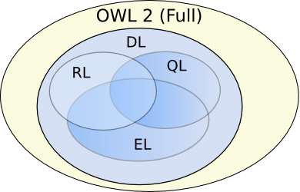
OWL Profiles
Profiles considered
Useful computational properties, e.g., reasoning complexity
Implementation possibilities, e.g., using RDBs
There are three profiles
OWL 2 EL
OWL 2 QL
OWL 2 RL

Slide 37
OWL 2 EL
A (near maximal) fragment of OWL 2 such that
Satisfiability checking is in PTime (PTime-Complete)
Data complexity of query answering is PTime-Complete
Based on EL family of description logics
Existential (someValuesFrom) + conjunction
It does not allow disjunction and universal restrictions
Saturation is an efficient reasoning technique
It can capture the expressive power used by many large-scale ontologies, e.g., SNOMED CT

Slide 38
Basic Saturation-based Technique
Normalise ontology axioms to standard form:
Saturate using inference rules:
Extension to Horn fragment requires (many) more rules
Saturation is a general reasoning technique in which you first compute the deductive closure of a given set of rules and add the results to the KB. Then run your prover.

Slide 39
Saturation-based Technique (basics)
Example: infer that a heart transplant is a kind of organ transplant

Slide 40
Saturation-based Technique (basics)
Example:

Slide 41
Saturation-based Technique (basics)
Example:

Slide 42
Saturation-based Technique (basics)
Example:

Slide 43
Saturation-based Technique (basics)
Example:

Slide 44
Saturation-based Technique (basics)
Example:

Slide 45
Saturation-based Technique (basics)
Example:

Slide 46
Saturation-based Technique (basics)
Example:

Slide 47
Saturation-based Technique (basics)
Example:

Slide 48
Saturation-based Technique (basics)
Example:

Slide 49
Saturation-based Technique (basics)
Example:

Slide 50
Saturation-based Technique (basics)
Example:

Slide 51
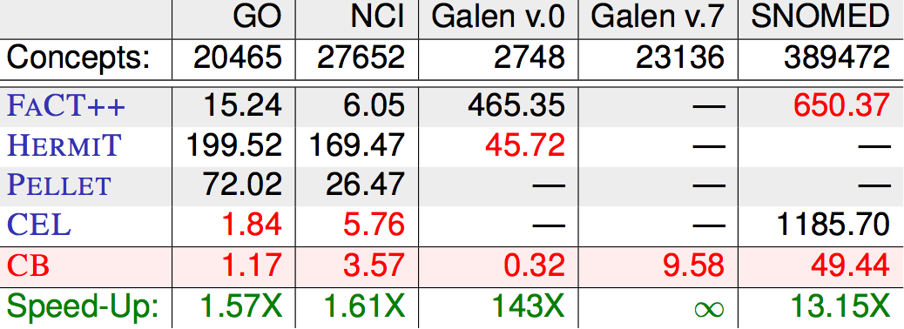
Saturation-based Technique
Performance with large bio-medical ontologies
Galen and Snomed are large ontologies of medical terms; both have OWL versions. NCI is a vocabulary of cancer-related terms. GO is the gene ontology.

Slide 52
OWL 2 QL
The QL acronym reflects its relation to the standard relational Query Language
It does not allow existential and universal restrictions to a class expression or a data range
These restrictions
enable a tight integration with RDBMSs,
reasoners can be implemented on top of standard relational databases
Can answer complex queries (in particular, unions of conjunctive queries) over the instance level (ABox) of the DL knowledge base

Slide 53
OWL 2 QL
We can exploit query rewriting based reasoning technique
Computationally optimal
Data storage and query evaluation can be delegated to standard RDBMS
Can be extended to more expressive languages (beyond AC⁰) by delegating query answering to a Datalog engine

Slide 54
Query Rewriting Technique (basics)
Given ontology O and query Q, use O to rewrite Q as Q⁰ such that, for any set of ground facts A:
ans(Q, O, A) = ans(Q⁰, ;, A)
Resolution based query rewriting
Clausify ontology axioms
Saturate (clausified) ontology and query using resolution
Prune redundant query clauses

Slide 55
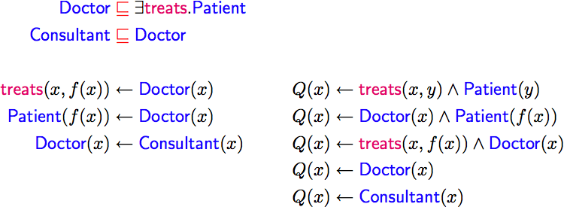
Query Rewriting Technique (basics)
Example:
Q(x) is our query: Who treats people who are patients?

Slide 56
Query Rewriting Technique (basics)
Example:
Translate the DL expressions into rules.
Note the use of f(x) as a Skolem individual. If you are a doctor then you treat someone and that someone is a patient

Slide 57
Query Rewriting Technique (basics)
Example:
For each rule in the rules version of the KB we want to enhance the query, so that we need not use the rule in the KB.

Slide 58
Query Rewriting Technique (basics)
Example:
Since Doctor(X) implies treats(x, f(x)) we can replace it, but we have to also unify f(x) with y, so we edn up with the second way of satisfying our query Q(x).

Slide 59
Query Rewriting Technique (basics)
Example:

Slide 60
Query Rewriting Technique (basics)
Example:
Applying the KB second rule to the 1st query rule gives us another way to solve the Q(x)

Slide 61
Query Rewriting Technique (basics)
Example:

Slide 62
Query Rewriting Technique (basics)
Example:
Since Doctor(x) imples treats(x, f(x)) we can derive Q(X) if Doctor(x) and Doctor(x), which reduces to the third query rule.

Slide 63
Query Rewriting Technique (basics)
Example:

Slide 64
Query Rewriting Technique (basics)
Example:

Slide 65
Query Rewriting Technique (basics)
Example:

Slide 66
Query Rewriting Technique (basics)
Example:
Remove useless redundant query rules

Slide 67
Query Rewriting Technique (basics)
Example:
For DL-Lite, result is a union of conjunctive queries (UCQ)

Slide 68
Query Rewriting Technique (basics)
Data can be stored/left in RDBMS
Relationship between ontology and DB defined by mappings, e.g.:
UCQ translated into SQL query:

Slide 69
OWL 2 RL
The RL acronym reflects its relation to Rule Languages
OWL 2 RL is designed to accommodate
OWL 2 applications that can trade the full expressivity of the language for efficiency
RDF(S) applications that need some added expressivity from OWL 2
Not allowed: existential quantification to a class, union and disjoint union to class expressions
These restrictions allow OWL 2 RL to be implemented using rule-based technologies such as rule extended DBMSs, Jess, Prolog, etc.

Slide 70
Profiles
Profile selection depends on
Expressiveness required by the application
Priority given to reasoning on classes or data
Size of the datasets

Slide 71
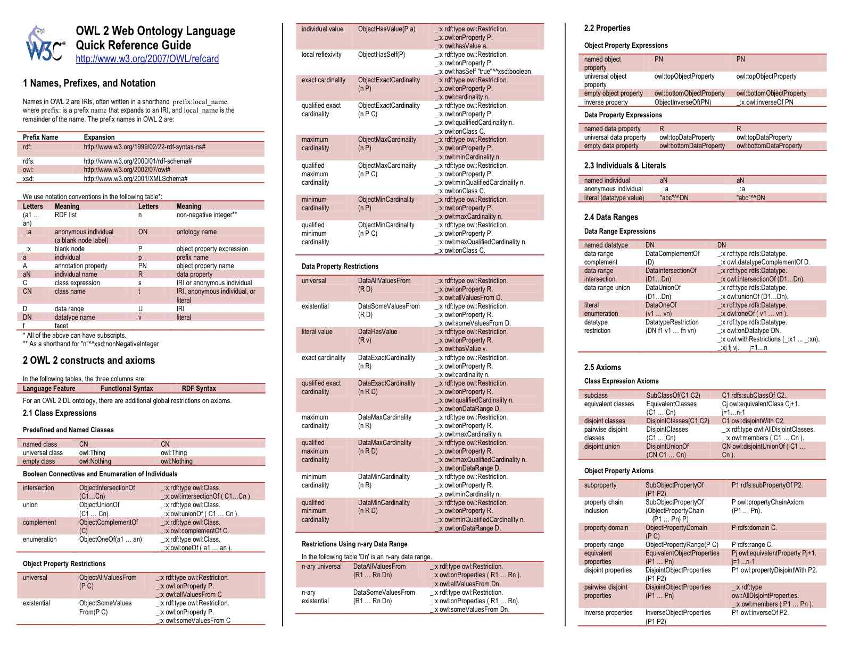

Slide 72
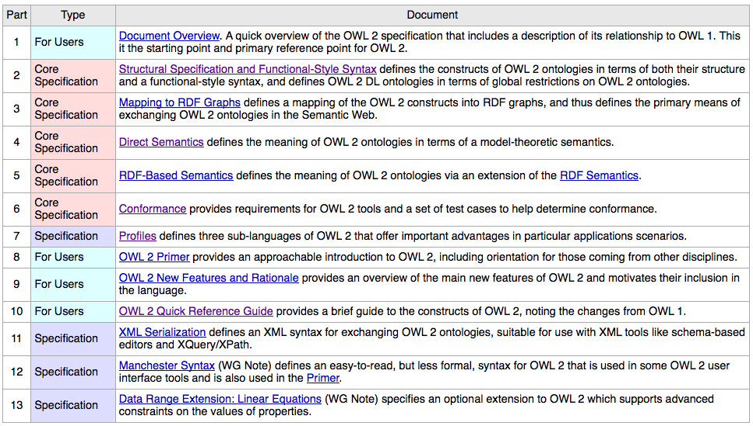
Key OWL 2 Documents
http://w3.org/TR/2009/WD-owl2-overview-20090421/

Slide 73
Conclusion
Most of the new features of OWL 2 in comparing with the initial version of OWL have been discussed
Rationale behind the inclusion of the new features have also been discussed
Three profiles – EL, QL and RL – are provided that fit different use cases and implementation strategies

