Slide 1
JSON-LD

Slide 2
JSON as an XML Alternative
Light-weight XML alternative for data-interchange
JSON = JavaScript Object Notation
It’s really language independent
Most programming languages can easily read it and instantiate objects
Defined in RFC 4627
Started gaining traction ~2006, now widely used
http://json.org/ has more information

Slide 3
Example
{"firstName": "John",
"lastName" : "Smith",
"age" : 25,
"address" :
{"streetAdr” : "21 2nd Street",
"city" : "New York",
"state" : "NY",
”zip" : "10021"},
"phoneNumber":
[{"type" : "home",
"number": "212 555-1234"},
{"type" : "fax",
"number” : "646 555-4567"}]
}
This is a JSON object with five key-value pairs
Objects are wrapped by curly braces
There are no object IDs
Keys are strings
Values are numbers, strings, objects or arrays
Arrays are wrapped by square brackets

Slide 4
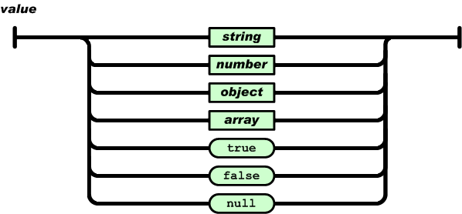
The BNF is simple

Slide 5
Evaluation
JSON is simpler than XML and more compact
No closing tags, but if you compress XML and JSON the difference is not so great
XML parsing is hard because of its complexity
JSON has a better fit for OO systems than XML, but not as extensible
Preferred for simple data exchange by many
MongoDB: ‘NoSQL’ database for JSON objects
ElasticSearch: Lucene-based IR system using JSON to represent documents

Slide 6
JSON-LD
JSON-LD: 2014 W3C recommendation for representing RDF data as JSON objects
{"@context": {
"name": "http://xmlns.com/foaf/0.1/name",
"homepage": {
"@id": "http://xmlns.com/foaf/0.1/workplaceHomepage",
"@type": "@id"
},
"Person": "http://xmlns.com/foaf/0.1/Person"
},
"@id": "http://me.markus-lanthaler.com",
"@type": "Person",
"name": "Markus Lanthaler",
"homepage": "http://www.tugraz.at/"
}

Slide 7
In the beginning
{
"name": "Manu Sporny",
"homepage": "http://manu.sporny.org/",
"image": "http://manu.sporny.org/images/manu.png"
}

Slide 8
A bit better
{
"http://schema.org/name": "Manu Sporny",
"http://schema.org/url": { "@id": "http://manu.sporny.org/" }
"http://schema.org/image": { "@id": "http://manu.sporny.org/images/manu.png" }
}
The '@id' keyword means 'This value is an identifier that is an IRI'

Slide 9
Define a context
{ "@context":
{
"name": "http://schema.org/name", % [1]
"image": {
"@id": "http://schema.org/image", % [2]
"@type": "@id" % [3]
},
"homepage": {
"@id": "http://schema.org/url", % [4]
"@type": "@id" % [5]
} } }
[1] means 'name' is short for 'http://schema.org/name'
[2] means 'image' is short for 'http://schema.org/image'
[3] means a string value associated with 'image' should be interpreted as an identifier that is an IRI
[4] means 'homepage' is short for 'http://schema.org/url'
[5] means a string value associated with 'homepage' should be interpreted as an identifier that is an IRI

Slide 10
Reference an external context
{
"@context": "http://json-ld.org/contexts/person.jsonld",
"name": "Manu Sporny",
"homepage": "http://manu.sporny.org/",
"image": "http://manu.sporny.org/images/manu.png"
}

Slide 11
Add context inline
{"@context":
{
"name": "http://schema.org/name",
"image": {
"@id": "http://schema.org/image",
"@type": "@id"
},
"homepage": {
"@id": "http://schema.org/url",
"@type": "@id"
}
},
"name": "Manu Sporny",
"homepage": "http://manu.sporny.org/",
"image": "http://manu.sporny.org/images/manu.png"
}

Slide 12
External Context?
Fetch http://json-ld.org/contexts/person.jsonld
curl http://json-ld.org/contexts/person.jsonld
Returns a JSON object defining the context
Fetch http://schema.org/
curl –L http://schema.org/
Returns HTML page, since its default application/type is HTML
Fetch
curl --header "Accept: application/ld+json" -L http://schema.org/
Notes:
-L says to follow redirects

Slide 13
Making assertions about things
{
"@context": {
...
"Restaurant": "http://schema.org/Restaurant",
"Brewery": "http://schema.org/Brewery"
}
"@id": "http://example.org/places#BrewEats",
"@type": [ "Restaurant", "Brewery" ],
...
}

Slide 14
Adding a default vocabulary
{
"@context": {
"@vocab": "http://schema.org/"
}
"@id": "http://example.org/places#BrewEats",
"@type": "Restaurant",
"name": "Brew Eats"
...
}

Slide 15
Mixing vocabularies
{"@context":
{
"xsd": "http://www.w3.org/2001/XMLSchema#",
"foaf": "http://xmlns.com/foaf/0.1/",
"foaf:homepage": { "@type": "@id" },
"picture": { "@id": "foaf:depiction", "@type": "@id" }
},
"@id": "http://me.markus-lanthaler.com/",
"@type": "foaf:Person",
"foaf:name": "Markus Lanthaler",
"foaf:homepage": "http://www.markus-lanthaler.com/",
"picture": "http://twitter.com/account/profile_image/markuslanthaler"
}

Slide 16
Embedding other objects
{
...
"name": "Manu Sporny",
"foaf:knows":
{
"@type": "Person",
"name": "Gregg Kellogg",
}
...
}

Slide 17
Google looks for JSON-LD
Google looks for and uses some JSON-LD markup (e.g., for organizations)
Put a JSON-LD object in head or body of web page wrapped with script tags:
<script type="application/ld+json">
{...}
</script>

Slide 18
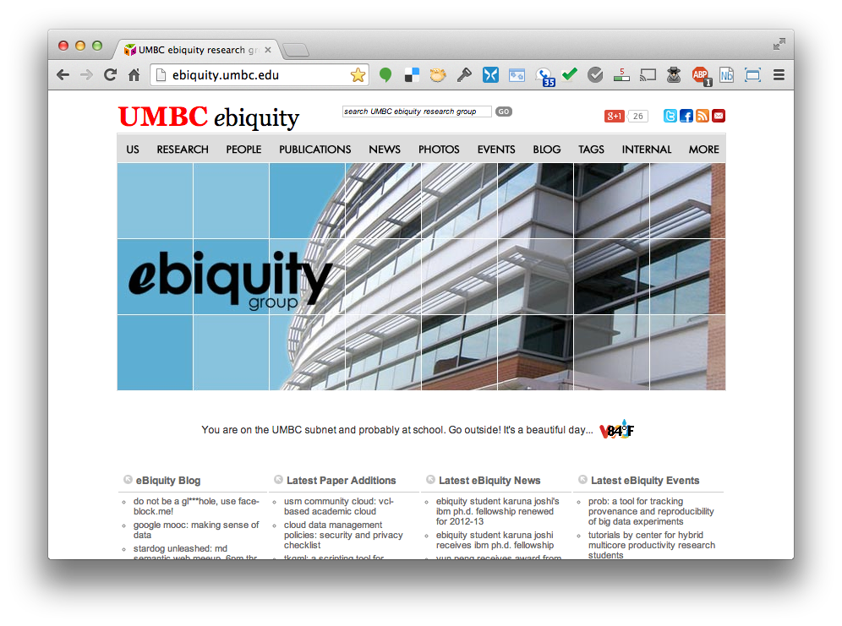

Slide 19
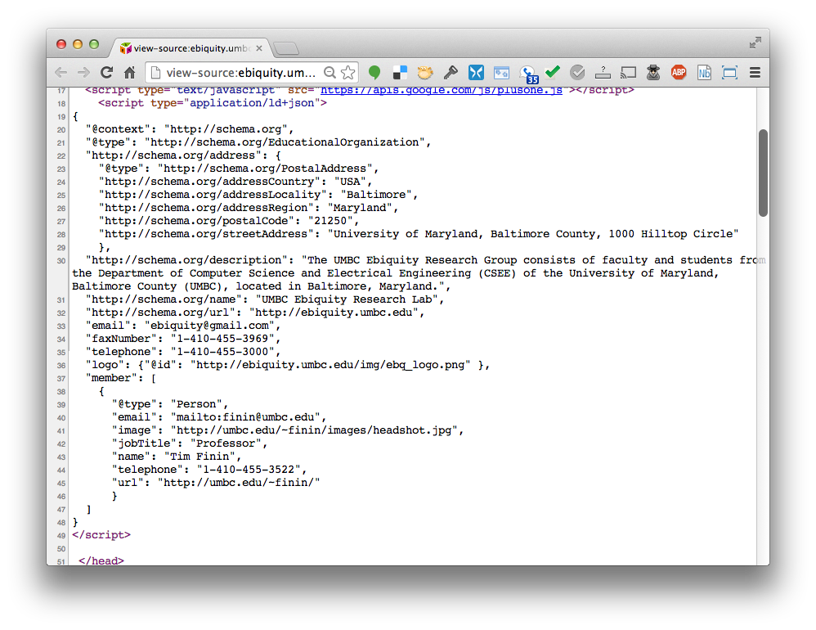

Slide 20
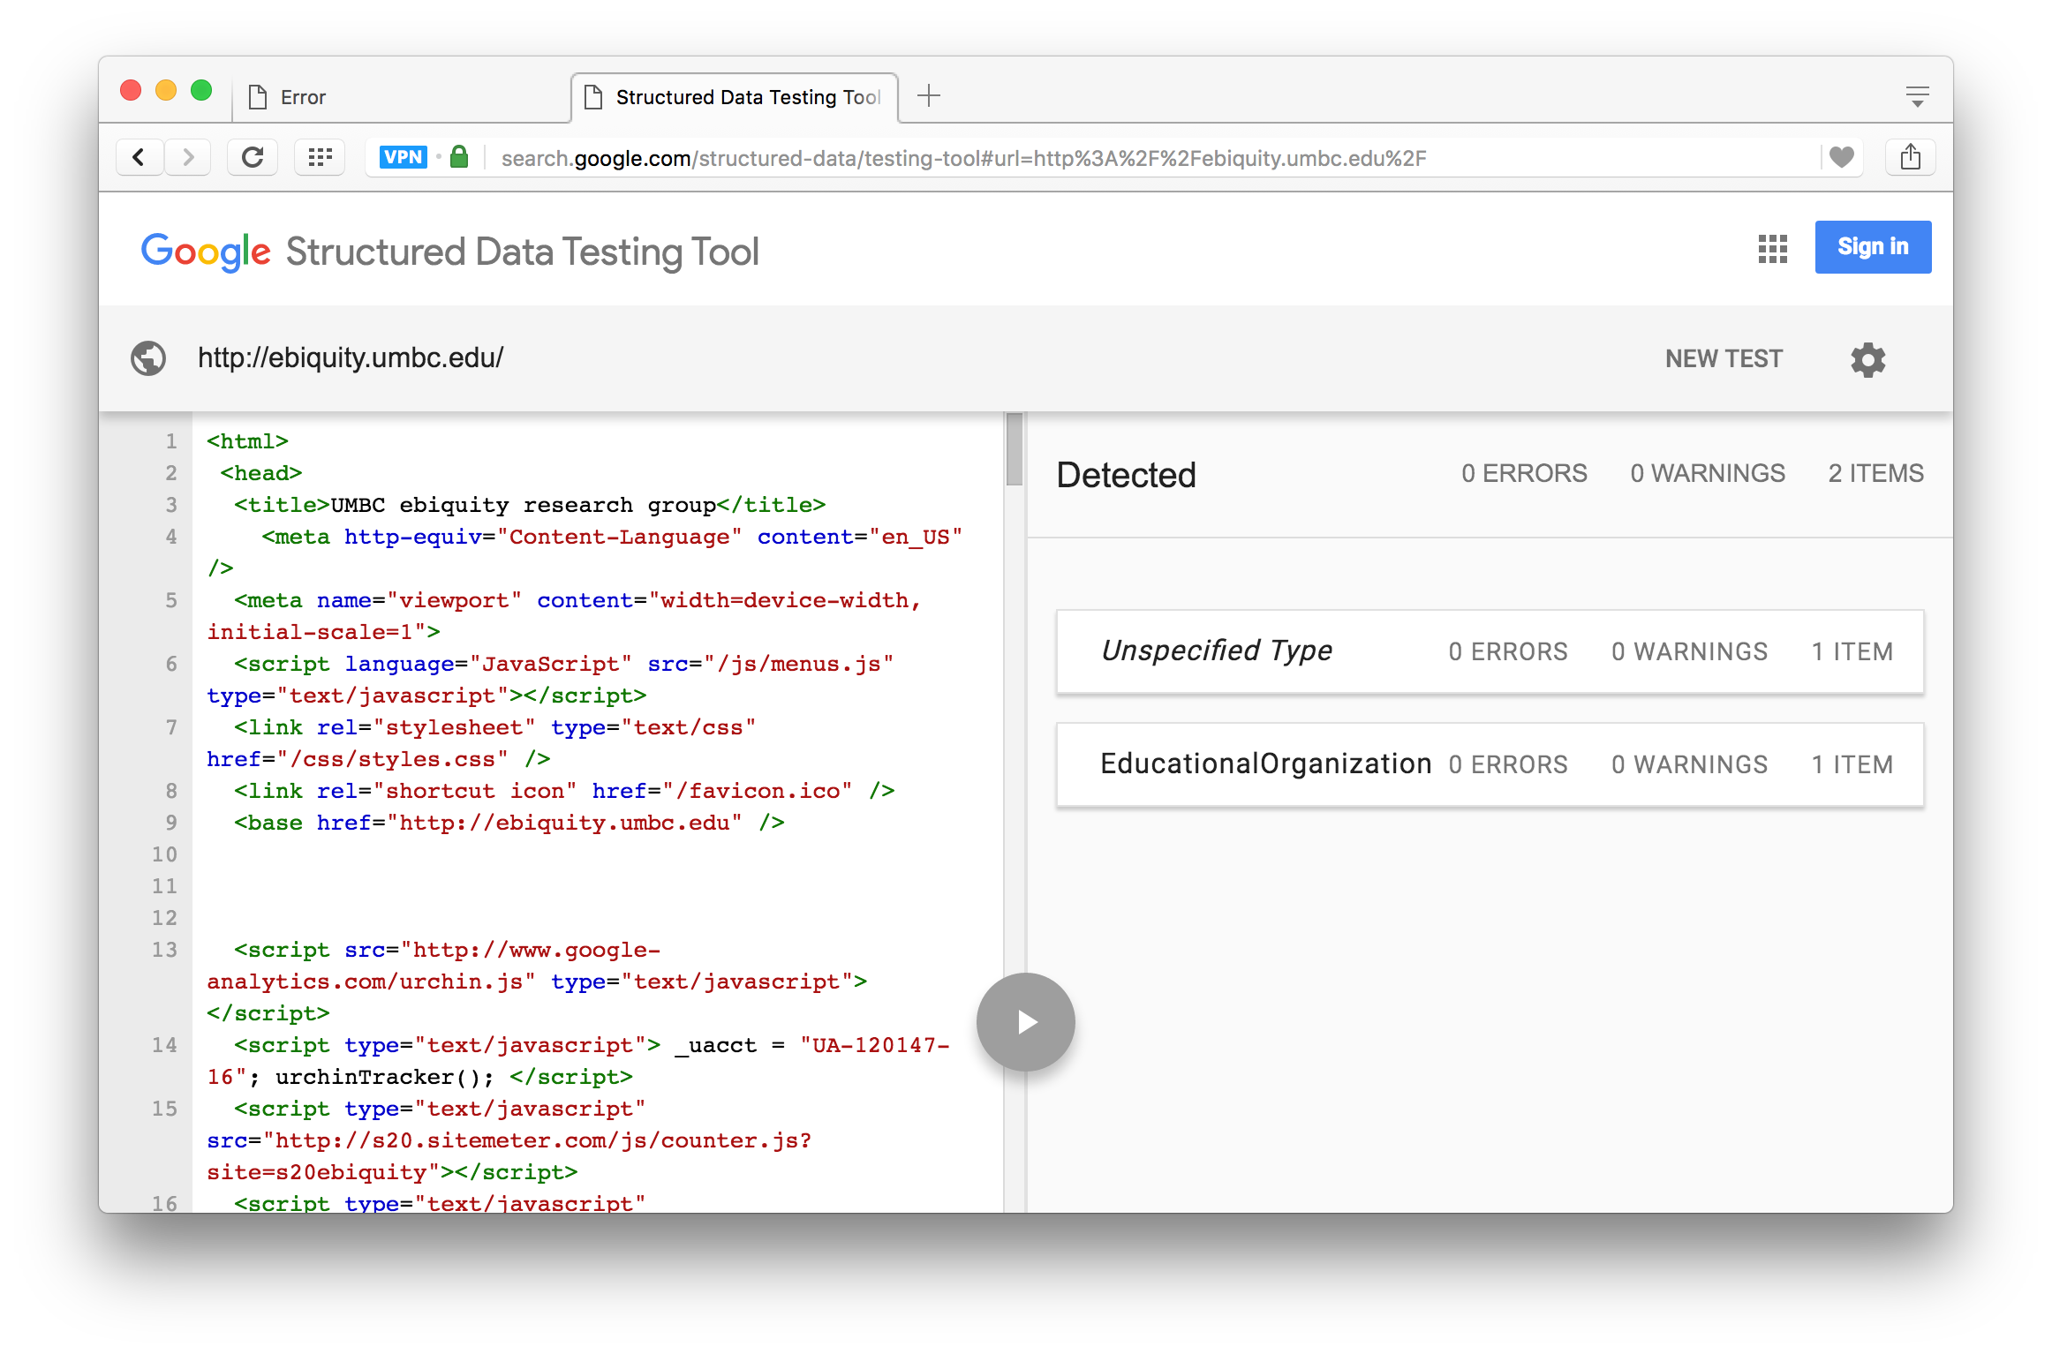
https://search.google.com/structured-data/testing-tool

Slide 21
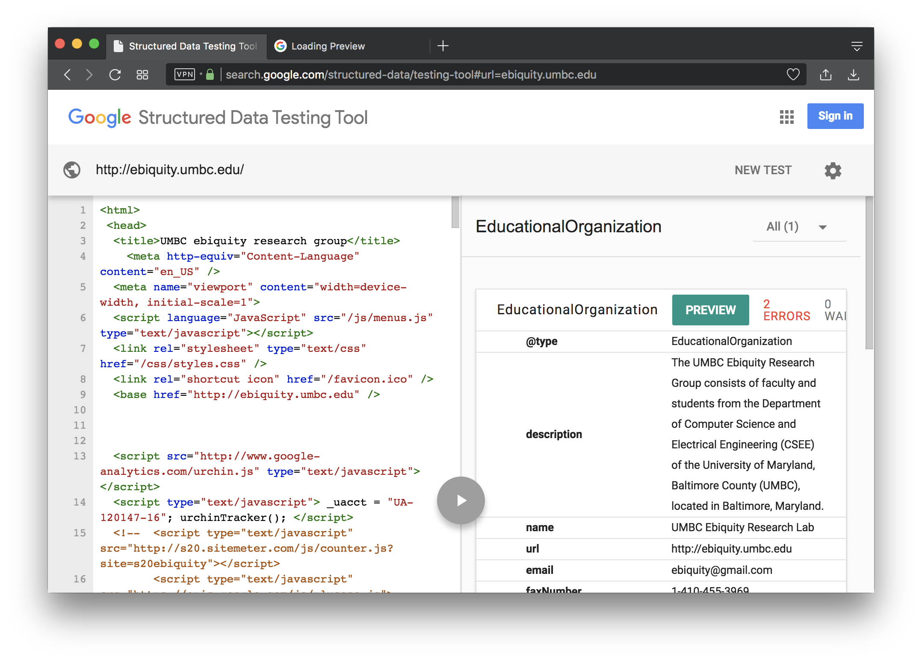

Slide 22
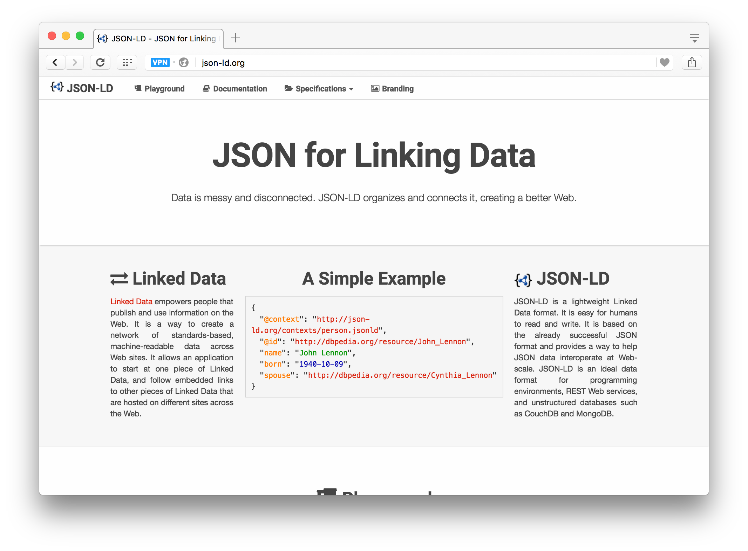
http://json-ld.org/

Slide 23
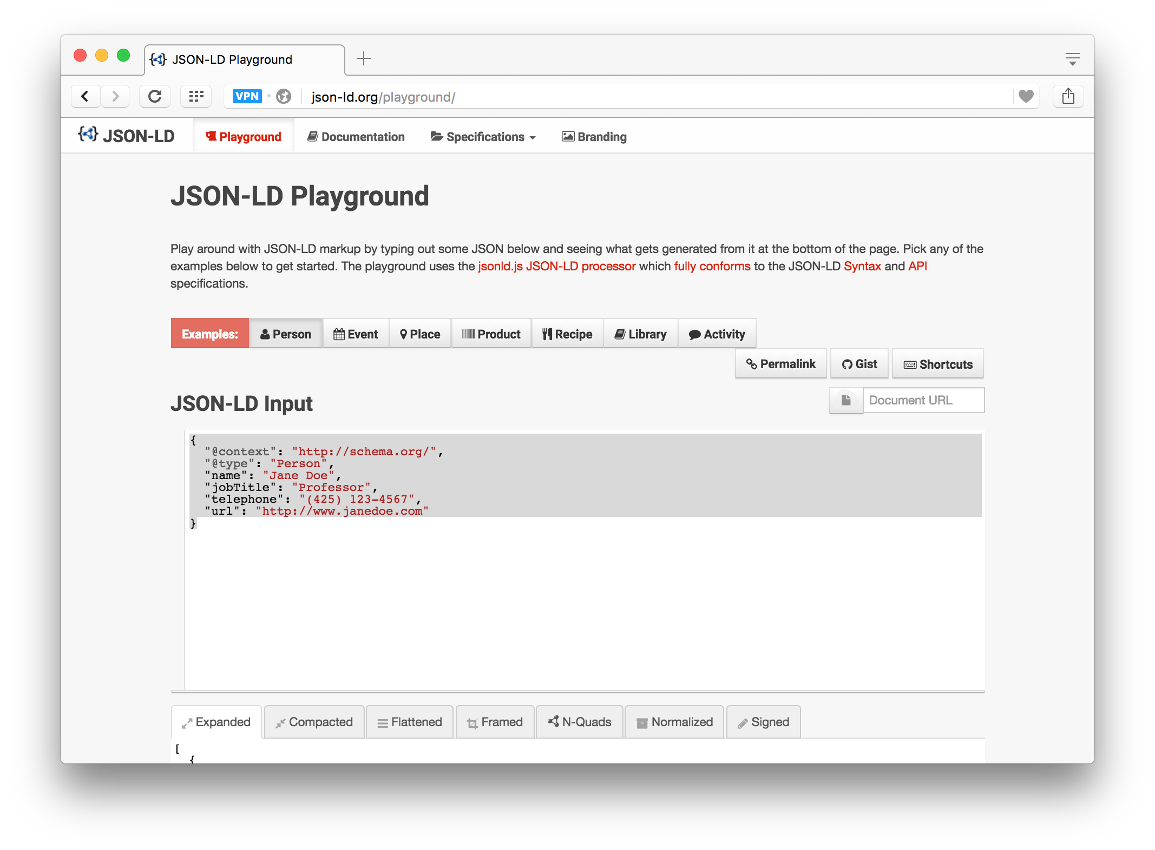
JSON-LD Playground

Slide 24
Conclusion
JSON-LD is a good solution to putting blocks of semantic data on web pages
Aimed at publishing linked data, not ontologies, i.e., ABOX not TBOX
Tools available for extracting RDF triples
Search engines look for and use JSON-LD that use vocabularies they understand (i.e., schema.org)

