Slide 1
Chapter 2 RDF Syntax 1

Slide 2
RDF Overview
RDF data model
RDF syntax?
RDF serializations: XML, Turtle, N3, ntriples
RDF Schema (RDFS)
Semantics of RDF and RDFS
Axiomatic Semantics
Operational semantics based on rules
Querying RDF via SPARQL

Slide 3
Introduction
Problem: What does an XML document mean?
XML is about data structures
The meaning (semantics) not apparent to machines
RDF is more a data model than a language
It is realized in many different formats
RDF defines very basic semantics
RDFS and OWL define more RDF vocabulary for building rich data models
RDF remains domain independent

Slide 4
Example 1
<academicStaffMember> Grigoris Antoniou </academicStaffMember>
<professor> Michael Maher </professor>
<course name="Discrete Mathematics">
<isTaughtBy> David Billington </isTaughtBy>
</course>
What does this mean?
Are professors also academic staff members?
If someone teaches a course, are they an academic staff member?
Can’t say in XML, but can say so in RDFS

Slide 5
Example 2
<course name="Discrete Mathematics">
<lecturer>David Billington</lecturer>
</course>
<lecturer name="David Billington">
<teaches>Discrete Mathematics</teaches>
</lecturer>
<teachingOffering>
<lecturer>David Billington</lecturer>
<course>Discrete Mathematics</course>
</teachingOffering>
Embedding of elements is just a syntactic constraint
No meaning is defined
Meaning is in documentation or viewer’s minds
Does the machine have a mind?

Slide 6
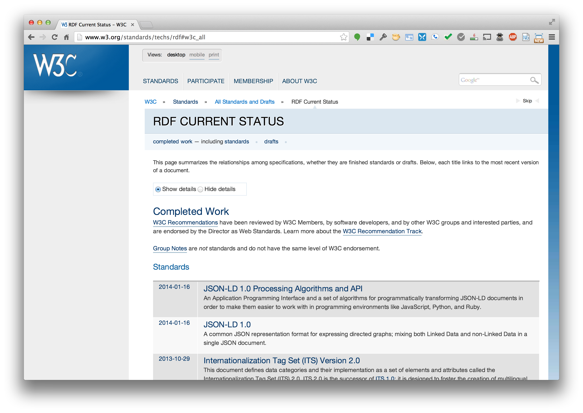
Key RDF documents: standards
http://w3.org/standards/techs/rdf

Slide 7
Topics
Basic concepts of RDF
Resources, properties, values, statements, triples
URIs and URIrefs
RDF graphs
Literals, qnames
Vocabularies and modeling
Vocabularies
Blank nodes, data modeling, types, reification
Lists, bags, collections
Serialization of RDF graphs
XML, Turtle, Ntriples
Critique of RDF

Slide 8
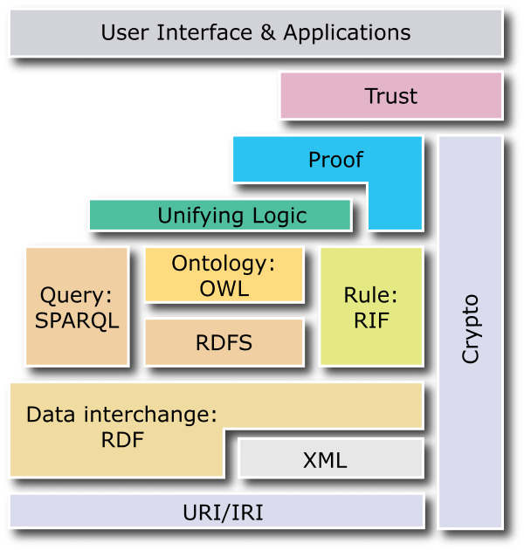
What is RDF?
A data model for representing information (esp. metadata) about resources in the Web
Can represent information about things that can be identified on the Web, even when not retrievable (e.g., a book)
Usecases: provide data for applications rather than directly to people

Slide 9
RDF Basics
Core idea: identify resources using Web identifiers and describing resources in terms of simple properties and property values
RDF data model is as a “pure” graph model
To identify resources, RDF uses Uniform Resource Identifiers (URIs) and URI references (URIrefs).
Definition: A resource is anything that is identifiable by a URIref

Slide 10
Example
Consider the following information:
“there is a Person identified by
http://www.w3.org/People/EM/contact#me,
whose name is Eric Miller, whose email
address is em@w3.org, and whose title is
Dr.”

Slide 11
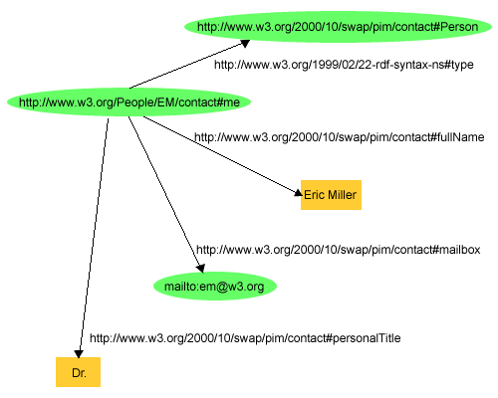
Example (cont’d)

Slide 12
Basics
Resources being described have properties that have values, and resources are described by making statements specifing those properties and values
The part that identifies the thing the statement is about is the subject
The part that identifies the property of the subject the statement specifies is the predicate
The part that identifies the property’s value is the object

Slide 13
Example
http://www.example.org/index.html has a creator whose value is “John Smith”
The subject is the URL http://www.example.org/index.html
The predicate is the word "creator"
The object is the phrase “John Smith”

Slide 14
RDF Triples
RDF statements can be written as triples
Simple ntriples notation has a set of triples terminated by a periods, where URI’s are inside angle brackets
<http://www.example.org/index.html> <http://purl.org/dc/elements/1.1/creator> <http://www.example.org/staffid/85740> .
<http://www.example.org/index.html> <http://www.example.org/terms/creation-date> "August 16, 1999" .
<http://www.example.org/index.html> <http://purl.org/dc/elements/1.1/language> "en" .

Slide 15
Graphs: pure and impure

Slide 16
Pure graph model
A pure graph model consists only of edges between pairs of nodes
Can be directed or undirected; can be labeled or not
A graph can be represented as an unordered collection of (subject, predicate, object) triples
If directed, predicate goes from subject to object
Nodes not the subject or object of a triple are not even allowed
(John, likes, Mary),
(Mary, likes, Bill),
( John, hates, Bill)
john
mary
likes
hates
likes
bill

Slide 17
RDF graph model
RDF is like this with a few caveats
Subjects and predicates are identified by a URI
Object can also be a URI but can also be a literals, i.e., a string or a number
RDF defines some special URIs and gives them specific meaning
http://www.w3.org/1999/02/22-rdf-syntax-ns#type
RDF has simple conventions for representing both ordered and unordered sequences and a few other data structures
john
mary
likes
hates
likes
bill

Slide 18
Property graphs
Graph databases have become popular in the past ten years
A common extension of the pure graph model is to allow nodes and edges to have properties
A simple version: properties are key/value pairs, e.g.
Age : 25
Date : 1990-09-21”
We might give the spouse edge from John to Mary two properties: start with value “1999-09-1” and end with value “2016-01-11”

Slide 19
URIs and URIREFs

Slide 20
Uniform Resource Identifiers (URIs)
URIs identify resources on the Web
Unlike URLs, they aren’t limited to identifying things with network locations
No organization controls who makes URIs or how they can be used
Some URI schemes (http: URL’s) depend on centralized systems such as DNS
Others are completely decentralized

Slide 21
URI Reference (URIref)
A URIref is a URI with an optional fragment identifier at the end, e.g:
http://example.org/index.html#section2
Fragment usecase:
HTML fragments refer to a place in a page
RDF fragments refer to resources in a RDF graph that the URI denotes, e.g., subjects, predicates or objects
http://www.w3.org/2004/02/skos/core : vocabulary for describing topics
http://www.w3.org/2004/02/skos/core#broader : the broader concept in SKOS Core vocabulary
Like URLs, URIrefs may be either absolute or relative
Note: the empty URI refers to the resource it’s in

Slide 22
URIrefs in RDF (cont’d)
RDF and Browsers use URIrefs to identify things, but interpret URIrefs slightly differently:
Browsers also use URIrefs to retrieve things
RDF uses URIrefs only to identify things and these might not even be retrievable
Linked Data best practice is to use HTTP URIs that return RDF data for every URI

Slide 23
Content Negotiation
What does HTTP stand for?

Slide 24
Content Negotiation
What does HTTP stand for?
HTTP == Hypertext Transfer Protocol
Lets Web client (browser, program) and server (apache) do many things (e.g., authentication)
E.g.: specify format of data returned, e.g., as RDF data in one of several formats or as HTML
Consider
http://dbpedia.org/page/Alan_Turing
curl –LI http://dbpedia.org/page/Alan_Turing
curl –LH "Accept:application/rdf+xml" http://dbpedia.org/page/Alan_Turing

Slide 25
RDF Graphs

Slide 26
RDF Graphs
RDF models statements by nodes and arcs in a graph
A statement is represented by a node for the subject, a node for the object and an arc for the predicate (subject => object)
A node may be identified by a URIref or it can be a literal or a blank node
An arc is identified by a URIref
Note: We will draw RDF graphs as directed graphs
But an arc can be the subject of an RDF statement
:has_parent owl:inverseOf :has_child

Slide 27
Example
Consider the following statements:
http://www.example.org/index.html has a creation-date whose value is August 16, 1999.
http://www.example.org/index.html has a language whose value is English.

Slide 28
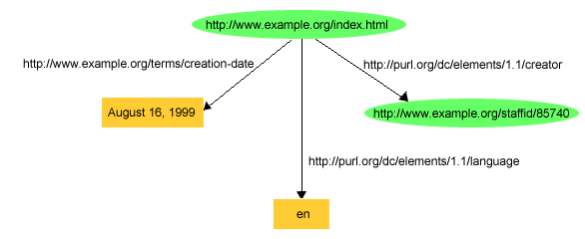
The RDF Graph of the Example
Note: http://purl.org/dc/elements/1.1 is prefix for the Dublin Core vocabulary/ontology
http://www.example.org/… is uses for examples

Slide 29
RDF and Related Data Models
In terms of the relational model, an RDF statement is like a tuple in a relation Graph with columns Subject, Predicate, Object
For first-order logic, an RDF statement is like an atomic formula triple(subj, pred, obj) where triple is a FOL predicate and subj, pred and obj are constants
Alternativedly in logic: pred(subj, obj)

Slide 30
Literals and QNames

Slide 31
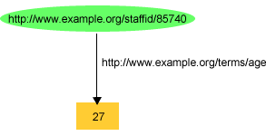
Literals
What is 27? Number or string?
Notes:
Answer: 27 is a plain literal here !!!!!

Slide 32
Plain and Typed Literals
RDF has two kinds of literals: plain and typed
Plain literals have a lexical form (their lexical value) and optionally a language tag, e.g:
"27" , "Hello world"@en, "Bonjour le monde" @fr
RDF typed literals are formed by pairing a string with a URIref for a particular XMLS datatype, e.g.:
“27”^^http://www.w3.org/2001/XMLSchema#integer
”27"^^xsd:int

Slide 33
Data Types for Literals
In practice, the most widely used data typing scheme is the one by XML Schema
But any externally defined data typing scheme is allowed in RDF documents
XML Schema predefines many data types
E.g. Booleans, integers, floating-point numbers, times, dates, etc.

Slide 34
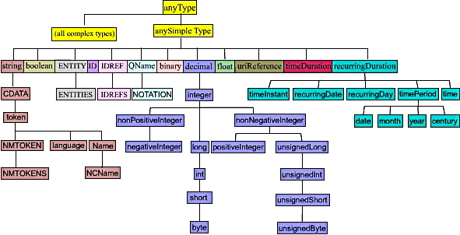
XMLSchema Datatypes
http://www.w3.org/TR/xmlschema-2/

Slide 35
Qnames for URIrefs
The ntriples notation results in very long lines
We can use an XML qualified name (QName) w/o brackets for a full URI reference
http://dbpedia.org/page/Alan_Turing
dbp:Alan_Turing
Qnames have a prefix that’s been assigned to a namespace URI, a colon and a local name
How to assign a prefix to a URI varies by serialization
The concepts of names and namespaces used in RDF originate in XML

Slide 36
Topics
Basic concepts of RDF
Resources, properties, values, statements, triples
URIs and URIrefs
RDF graphs
Literals, qnames
Vocabularies and modeling
Vocabularies
Blank nodes, data modeling, types, reification
Lists, bags, collections
Serialization of RDF graphs
XML, Turtle, Ntriples
Critique of RDF

