Slide 1
Program Design CMSC 201

Slide 2
Motivation
We’ve talked a lot about certain ‘good habits’ we’d like you guys to get in while writing code. There are two main reasons for this: readability, adaptability.

Slide 3
Readability
Having your code be readable is important, both for your sanity and someone else’s.
Having highly readable code makes it easier to:
Figure out what you’re doing while writing the code
Figure out what the code is doing when you come back a year later
Have other people read your code.

Slide 4
Readability
Ways to improve readability:
Comments
Meaningful variable names
Breaking code down into functions
Following your own naming conventions
Language choice
File organization

Slide 5
Adaptability
A lot of times, what a program is supposed to do evolves and changes as time goes on. Well written flexible programs can be easily altered to do something new, whereas rigid, poorly written programs take a lot of work to modify.
When writing code, always take into account the fact that you might want to change / extend something later.

Slide 6
Adaptability: Example
Remember how early in the class, we talked about not using “magic numbers”?
Bad:
def makeGrid():
temp = []
for i in range(0, 10):
temp.appen([0] * 10)
return temp
Good:
GRID_SIZE = 10
def makeGrid():
temp = []
for i in range(0, GRID_SIZE):
temp.appen([0] * GRID_SIZE)
return temp

Slide 7
Adaptability: Example
GRID_SIZE = 10
def makeGrid():
temp = []
for i in range(0, GRID_SIZE):
temp.appen([0] * GRID_SIZE)
return temp
Imagine in this program we use GRID_SIZE a dozen times or more, and we suddenly want a bigger or smaller grid. Or a variable sized grid. If we’ve left it as 10, it’s very hard to change. GRID_SIZE however is very easy to change. Our program is easier to adapt.

Slide 8
Top Down Design
It’s easier to solve small problems than big ones
Computer programmers use a divide and conquer approach to problem solving:
a problem is broken into parts
those parts are solved individually
the smaller solutions are assembled into a big solution
These techniques are known as top-down design and modular development.

Slide 9
Top Down Design
Top-down design is the process of designing a solution to a problem by systematically breaking a problem into smaller, more manageable parts.

Slide 10
Top Down Design
First, start with a clear statement of the problem or concept – a single big idea.

Slide 11
Top Down Design
Next, break it down into several parts.

Slide 12
Top Down Design
Next, break it down into several parts.
If any of those parts can be further broken down, then the process continues…

Slide 13
Top Down Design
… and so on.

Slide 14
Top Down Design
… and so on.
The final design might look something like this organizational chart, showing the overall structure of separate units that form a single complex entity.

Slide 15
Top Down Design
An organizational chart is like an upside down tree, with nodes representing each process.

Slide 16
Top Down Design
The bottom nodes represent modules that need to be developed and then recombined to create the overall solution to the original problem.
Top-down design leads to modular development.

Slide 17
Modular Development
Modular development is the process of developing software modules individually…

Slide 18
Modular Development
Modular development is the process of developing software modules individually…
…then combining the modules to form a solution to an overall problem.

Slide 19
Modular Development
Modular development of computer software:
makes a large project more manageable
is faster for large projects
leads to a higher quality product
makes it easier to find and correct errors
increases the reusability of solutions

Slide 20
Modular Development
… makes a large project more manageable.
Smaller and less complex tasks are easier to understand than larger ones and are less demanding of resources.

Slide 21
Modular Development
… is faster for large projects.
Different people can work on different modules, and then put their work together. This means that different modules can be developed at the same time, which speeds up the overall project.

Slide 22
Modular Development
…leads to a higher quality product.
Programmers with knowledge and skills in a specific area, such as graphics, accounting, or data communications, can be assigned to the parts of the project that require those skills.

Slide 23
Modular Development
…makes it easier to find and correct errors.
Often, the hardest part of correcting an error in computer software is finding out exactly what is causing the error. Modular development makes it easier to isolate the part of the software that is causing trouble.

Slide 24
Modular Development
… increases the reusability of solutions.
Solutions to smaller problems are more likely to be useful elsewhere than solutions to bigger problems.
They are more likely to be reusable code.

Slide 25
Modular Development
Reusable code makes programming easier because you only need to develop the solution to a problem once; then you can call up that code whenever you need it.
Most computer systems are filled with layers of short programming modules that are constantly reused in different situations.

Slide 26
Modular Development
Modules developed as part of one project, can be reused later as parts of other projects, modified if necessary to fit new situations.
Over time, libraries of software modules for different tasks can be created.
Libraries of objects can be created using object-oriented programming languages.

Slide 27
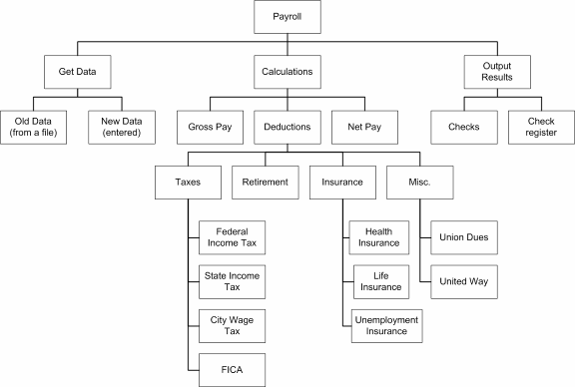
Modular Development

Slide 28
In Class Exercise
What functions would you need to write a tic tac toe program that plays from the terminal? How would they interact? Draw a diagram!
Notes:
I would do this on the board—a checkWin() broken down into diagonal, horizontal, vertical and draw detection, a function for making moves, one for printing the menu, etc.

