Slide 1
Hardware
UMBC Graphics for Games

Slide 2
CPU Performance

Slide 3
CPU Architecture
Start 1-4 instructions per cycle
Pipelined, takes 8-16 cycles to complete
Memory is slow
1 cycle for registers ≈ 2⁰ = 1
2-4 cycles for L1 cache ≈ 2² = 4
10-20 cycles for L2 cache ≈ 2⁴ = 16
50-70 cycles for L3 cache ≈ 2⁶ = 64
200-300 cycles for memory ≈ 2⁸ = 256

Slide 4
CPU Goals
Make one thread go very fast
Avoid pipeline stalls
Branch prediction
Don’t wait to know branch target (misprediction ~64 instructions)
Out-of-order execution
Don’t wait for one instruction to finish before starting others
Memory prefetch
Recognize common access patterns, get data to fast levels of cache early
Big caches
Though bigger caches add latency

Slide 5
CPU Performance Tips
Avoid unpredictable branches
Specialize code
Avoid virtual functions when possible
Sort similar cases together
Avoid caching data you don’t use
Takes time to fetch, takes cache space that could be used for useful data
Structure of Arrays organization
struct{P, V}[N] vs. struct{P[N], V[N]}
Avoid unpredictable access
O(N) linear search faster than O(log N) binary up to 50-100 elements
Linear access = can prefetch; branch predictable (keep looping) until final iteration
Asymptotically worse, but for small N, constants matter
Don’t underestimate how big small N can be

Slide 6
Models of Behavior
All of CS is built on simplified models of how things work
Don’t need to know differential equations for transistors to program
Models allow you to reason about performance
Compare to Physics
An atom is … The smallest unit of matter? A nucleus with electrons orbiting around it? A nucleus with electron probability clouds? A complex collection of quarks?
Model misses something important?
Code is not as fast as it could be
Trying to make it faster might actually make it slower

Slide 7
Revised CPU Model
CPUs execute instructions sequentially
Arithmetic operations are a small fixed cost
Random memory accesses are expensive
Unpredictable branches are expensive

Slide 8
Entity Component Systems
Compact lists of each type of component
Physics component, collision component, rendering component
Fast cache- and branch-friendly iteration over components
Mapping from each entity to its components (& back)
Reference / pointer in entity?
Entity ID with hash map?

Slide 9
Data Oriented Design
General term for optimizing for cache and branch performance
Organize data into compact tables
E.g. components, though often finer grained
Functions process or transform tables
Tables of active elements avoid branching
Data organization ends up looking very similar to database tables

Slide 10
Data Oriented Design Choices
Prefer arrays over linked lists
Linked list traversal = likely cache miss at each link
Cross linked hash(key) ➞ index / dense array(index) ➞ (key,data)
Allow fast processing of elements
Also SOA form: KeyArray(index) ➞ key; DataArray(index) ➞ data
If hash uses open addressing, may use index in hash table instead of key
Prefer functions operating on arrays to member functions
Avoid branching in processing loop
Avoid virtual functions

Slide 11
Packed-table Transforms
Generate
Create list from external source; procedural generation
In-place
Operate on elements; transform elements
A to B transform
Generate one list from another; Filter list to active elements
Dispatch
Generate sub-lists; Split for parallelization
Gather
Combine multiple lists into one

Slide 12
GPU Performance

Slide 13
CPU vs GPU Goals
CPU
Make one thread go very fast
Avoid pipeline stalls
Complex control
Continue work past stalls
Predict work before the stall
GPU
Make 1000’s of threads running the same program go very fast
Hide stalls
Share hardware
All running the same program
Swap threads to hide stalls
Large, flexible register set
Enough for active and stalled threads

Slide 14
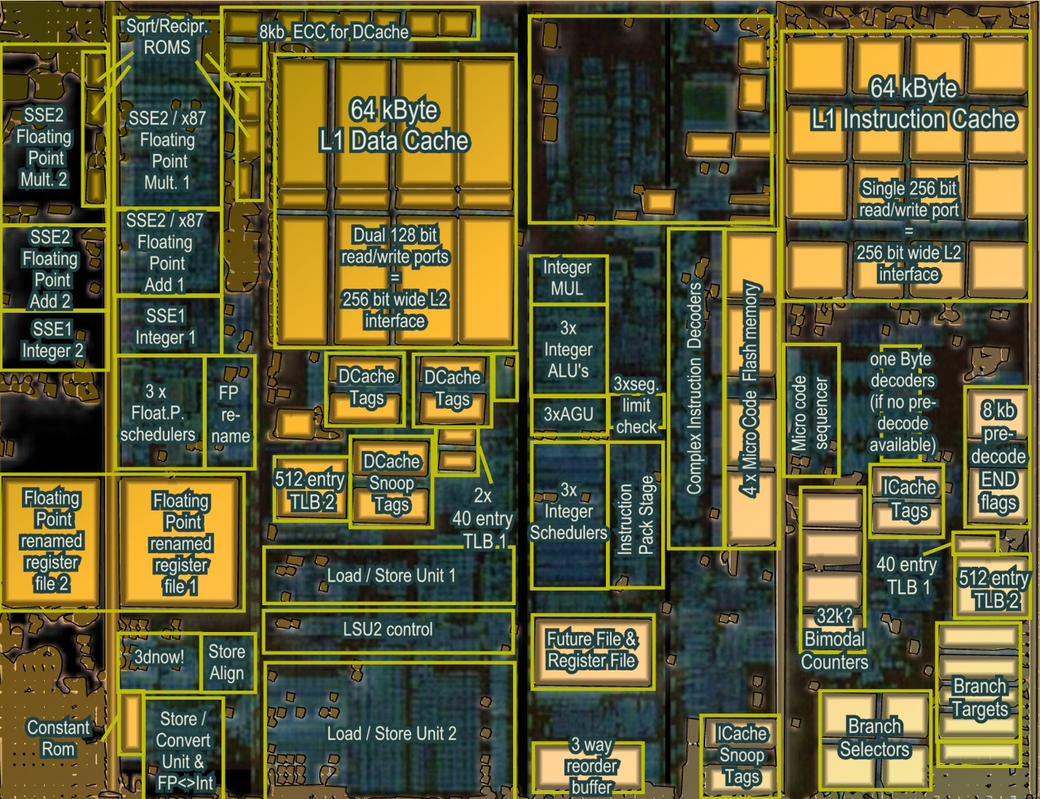
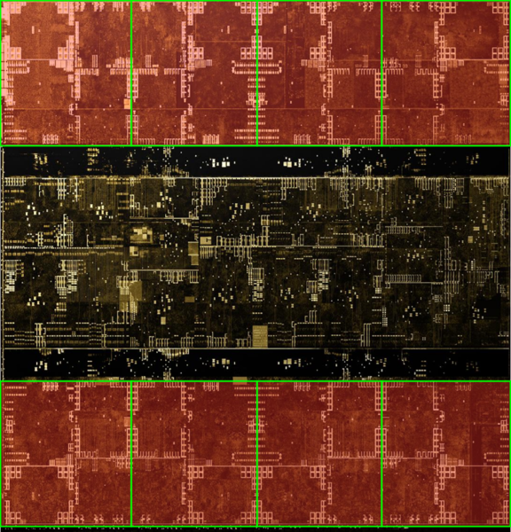
Architecture (MIMD vs SIMD)
Actual computational Units
SIMD (GPU-Like)
MIMD (CPU-Like)
(AMD K10 chip-architect.org)
(NVIDIA Volta / wikichip.org)
Flexibility
Horsepower
Ease of Use

Slide 15
SIMD Branching
if( x ) // mask threads
{
// issue instructions
}
else // invert mask
{
// issue instructions
} // unmask
Threads agree
Threads disagree
or
THEN

Slide 16
SIMD Looping
Active
% Active = Utilization
Inactive
while(x) // update mask
{
// do stuff
}
Everyone runs as long as slowest
This example: 36% utilization (64 blocks useful work / 176 blocks potential work)

Slide 17
GPU Programming Model
Vertex
Vertex Shader
Runs on one vertex at a time
Rasterizer
Collects sets of three vertices
Pixel
Runs on one pixel at a time
Texture/ Buffer/ Cache
Rasterize
Displayed Pixels
Pixel
Z-buffer/ Blend

Slide 18
GPU Processing Model
SIMD for efficiency
Same processors for vertex & pixel
SIMD Batches
Limits on # of vertices & pixels that can run together
Improve Utilization
Limit divergence
Basic scheduling
If batch of pixels, run it
Otherwise run some vertices to make more pixels
Texture/ Buffer/ Cache
Vertex
Displayed Pixels
Pixel
Z-buffer/ Blend
Rasterize

Slide 19
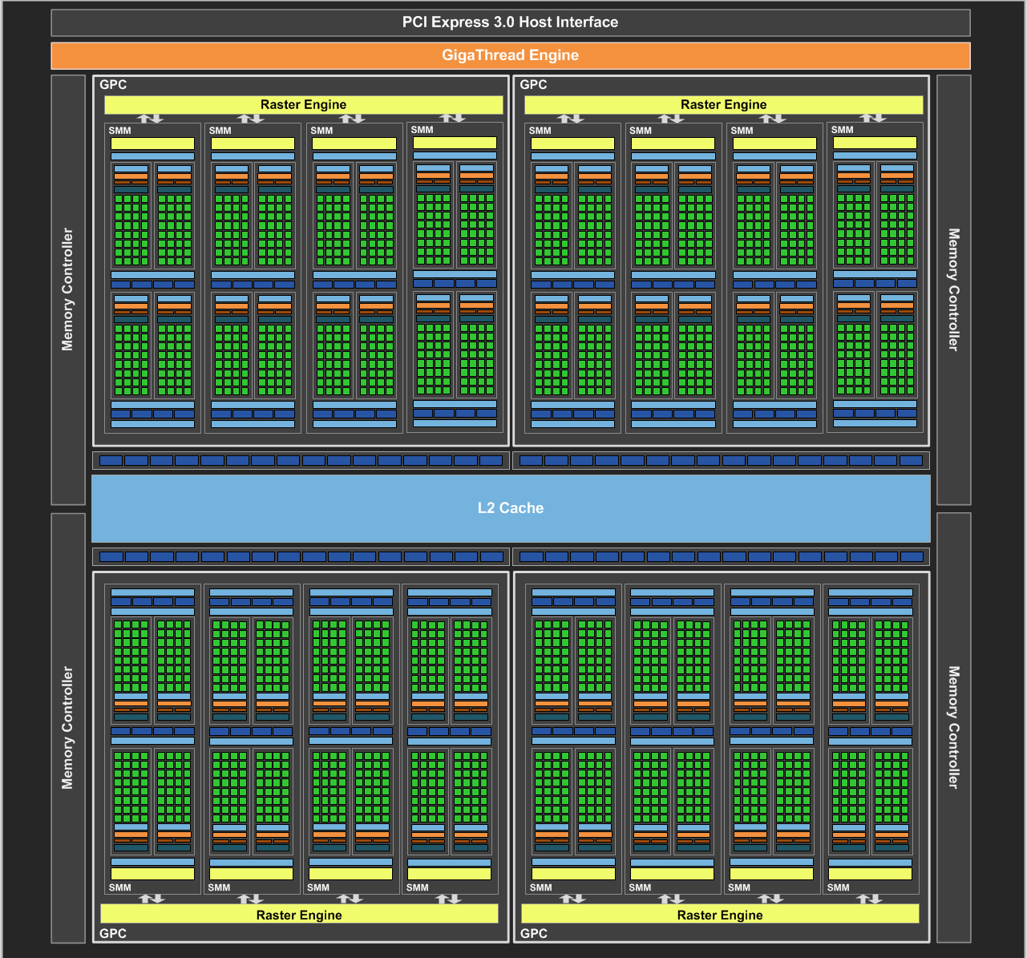
NVIDIA Maxwell
[NVIDIA GeForce GTX 980 Whitepaper, 2014]

Slide 20
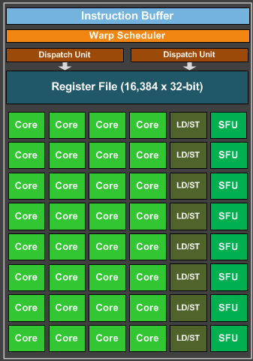
Maxwell SIMD Processing Block
32 Cores
8 Special Function Units (SFU)
Double precision, trig, …
Still issue 1/thread, but run ¼ rate
8 Load/Store
Hide latency by interleaving threads
Wave (AMD) / Warp (NVIDIA)
One set of lanes (AMD) / threads (NVIDIA)
Want at least 4-8 interleaved
% of max = Occupancy

Slide 21
GPU Registers
Scalar General Purpose Register (SGPR)
Same value for all threads
AMD term — Pixar’s RenderMan (& GLSL) called these uniform
Vector General Purpose Registers (VGPR)
Different value in every thread
AMD term — Pixar & GLSL called these varying
# wavefronts usually limited by VGPR

Slide 22
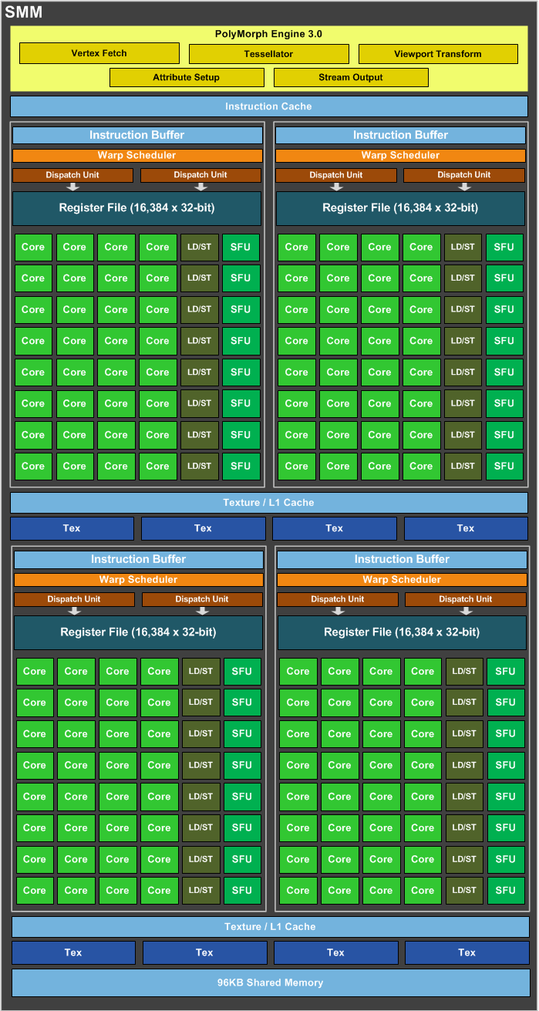
Maxwell Streaming Multiprocessor (SMM)
4 SIMD blocks (128 total cores)
Share L1 Caches
Between-core shared memory
Communication through this memory is fast
Share tessellation HW
Hardware support for tessellation shaders

Slide 23
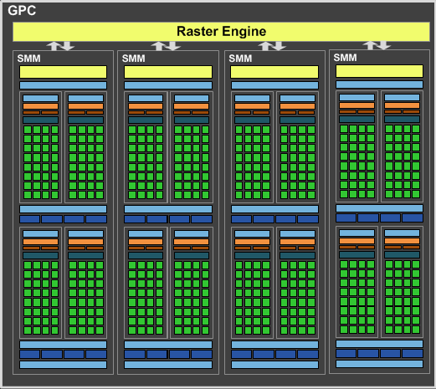
Maxwell Graphics Processing Cluster (GPC)
4 SMM (512 total cores)
Share rasterizer

Slide 24
Full NVIDIA Maxwell
4 GPC (2048 total cores)
Share L2
Share dispatch
Decides which threads to launch and when

Slide 25
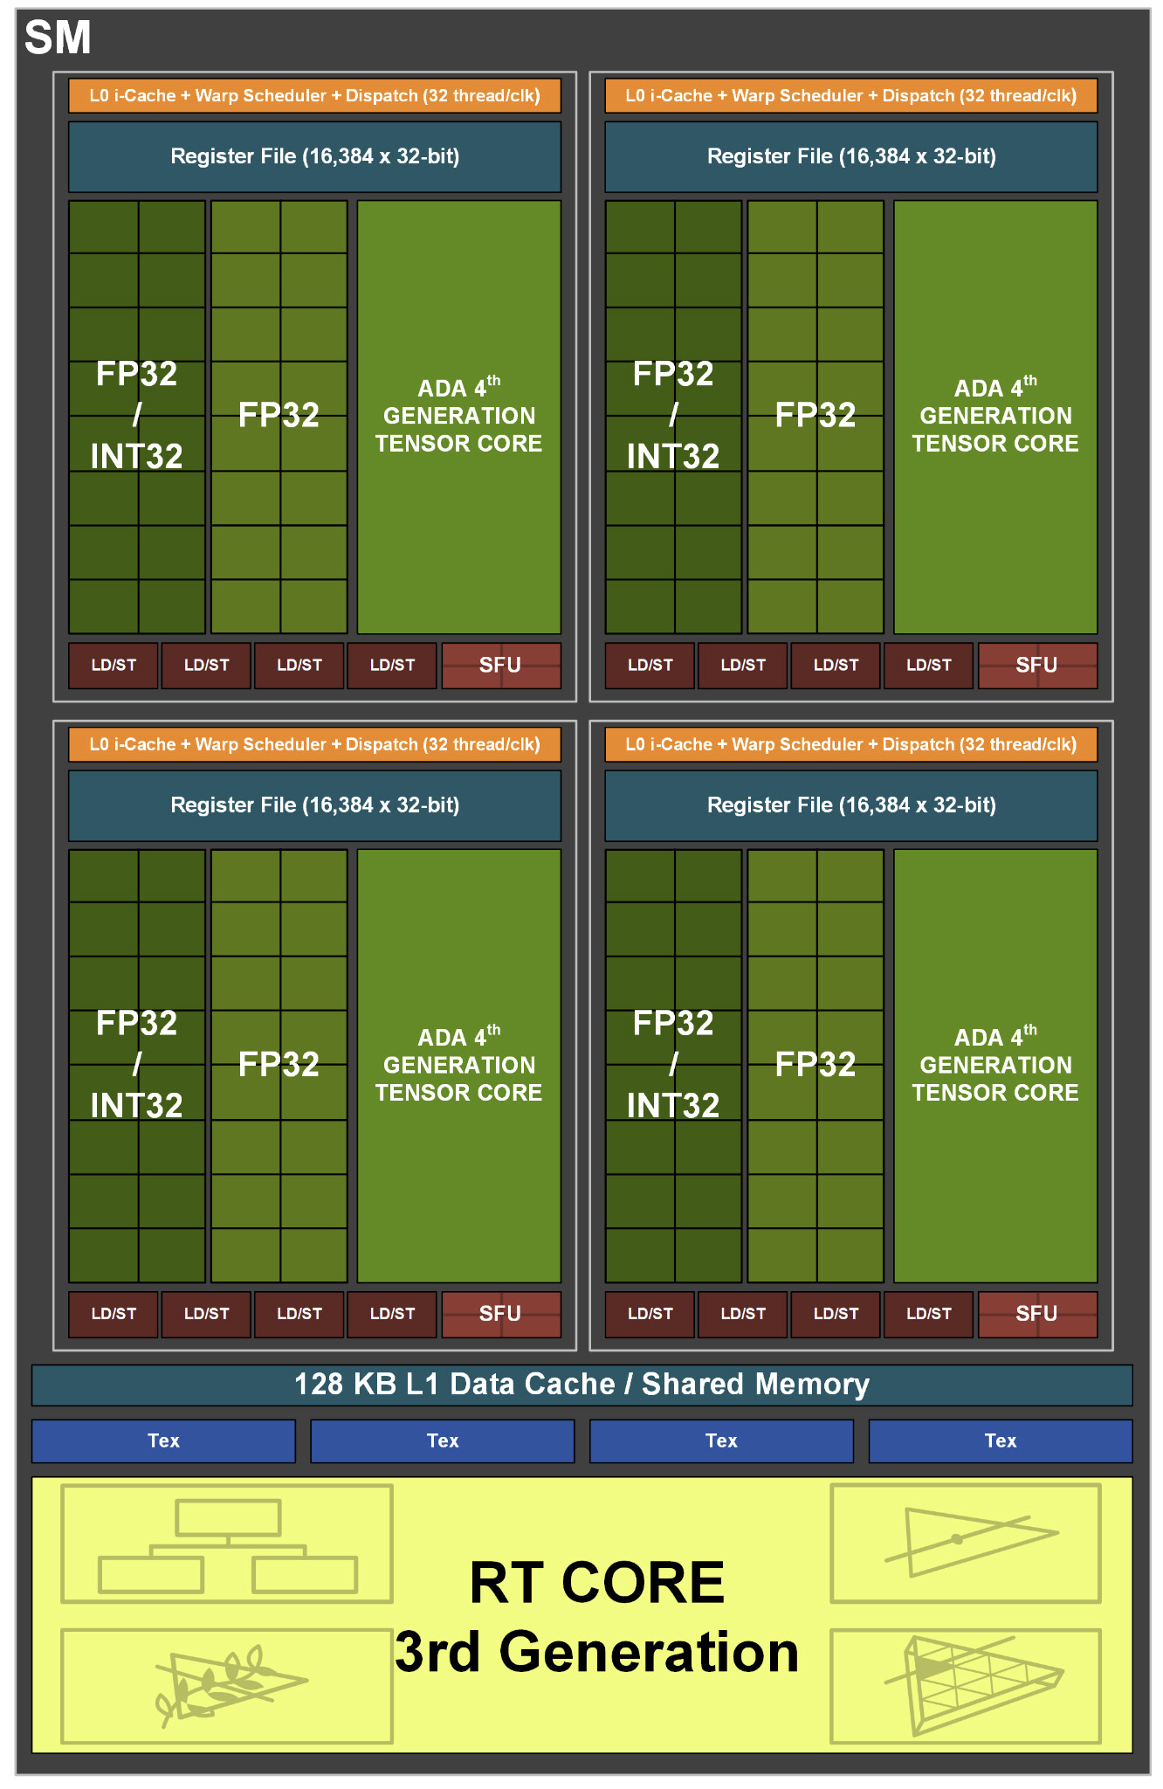
Things in newer GPUs
MMMMMOOOORRRRREEEE CORES
NVIDIA Ada: up to 18,432 cores
“Tensor cores” = bunch of 4/8/16-bit multiply-add/matrix multiply cores
Targeting AI applications, but general purpose
Hardware support for new shader types
Mesh shaders
Ray tracing hardware at SM level
Adjust balance of float, int, and memory units
[NVIDIA Ada GPU Architecture, 2022]

Slide 26
Graphics System Architecture
Your Code
Engine
Display
GPU
GPU
GPU(s)
API / Driver
Produce
Consume
Current Frame
(Buffering Commands)
Previous Frame(s)
(Submitted, Pending Execution)

Slide 27
Care and Feeding of a GPU

Slide 28
Parallel Submission
Any thread can build Command Lists & submit to GPU when ready
A Command List includes all necessary state, can execute in any order
Command list execution will overlap on GPU
Tell GPU about resource dependencies (Barriers / Transitions)
Enforces partial ordering of command list execution

Slide 29
Resource Transitions
What kind of memory operations does this buffer need to support?
(CPU/GPU) (read/write) (once/many times)
CPU write once, GPU read once; GPU write once, GPU read many times; …
Source/Target stage for the transition
When is it ready? When will it be used?
What use should it be optimized for?
CPU staging, Texture, Render Target, Depth Buffer, Vertex Buffer, Index Buffer, Graphics read/write unordered access view (UAV), Compute buffer, …
Explicitly transition between these
E.g. between render target write in command list A and texture read in command list B

Slide 30
Setting up a Command List
What do I write?
Render Targets, UAVs
Transition/barrier to make sure anyone else reading or writing them is done
What do I read?
Transition if just written or in a different format
What shader(s) am I using?
What shader parameter blocks?
Given by Descriptors & Root Signature

Slide 31
Setting up a Graphics Command List
Begin Pass / End Pass
Primarily necessary for batching on mobile
Rendering Graphics Pipeline State Object (PSO)
Primitive Type: triangle list, fan, strip, quad, points, …
Rasterizer State: Solid/wire frame, two sided / CW side / CCW side, MSAA
Depth/Stencil State: Comparison (<, ≤,=,≠, ≥, >), update?
Blend State:
Transparent layer with opacity 𝛼: 𝛼 * new + (1 - 𝛼) * old
Generalize to (a * new ^{<op>} b * old) for limited selection of a, b, and ^{<op>}

Slide 32
GPU Performance Tips

Slide 33
GPU Performance Tips: Communication
Reading results derails the CPU → GPU train…..
Buffer to read answer 2-3 frames later
Significant data will still be slow (e.g. read entire frame buffer)
CPU-GPU communication should be one way
If you must read, do it a few frames later…
Timing, occlusion queries

Slide 34
GPU Performance Tips: API & Driver
Merge shader/texture/constant sets
Traverse engine data structures to generate render list; sort render list; traverse list to issue draw command lists
Minimize Draw calls
One instanced draw is much more efficient than many static draws
Minimize CPU → GPU traffic
Use static vertex / index buffers if you can
Copy from CPU to GPU once, then leave there
Use dynamic buffers if you must
With discarding locks: region being updated / region in queue / region being rendered

Slide 35
GPU Performance Tips: Dependencies
Be aware of dependencies between command lists
Can cause poor utilization
Use a tool like PIX to identify
Example: transparent objects
Render & blend directly into deferred shading result buffer?
Can’t start until prior pass is done
Render into separate transparent buffer, then composite?
Extra mem, but overlap drawing
Opportunities to overlap & improve utilization can allow “free” work.

Slide 36
GPU Performance Tips: Shaders
No unnecessary work!
Precompute constant expressions
Divide by constant → Multiply by reciprocal
x*(1./3.) vs. x/3.
Not always the same in float math, compiler is not allowed to make that optimization
Minimize fetches
Prefer compute (generally)
If ALU/TEX < 4+, ALU is under-utilized
4 = LD/ST to core ratio on Maxwell, worse on newer GPUs
Worse if incoherent accesses, not in cache
If combining static textures, bake it all down…

Slide 37
GPU Performance Tips: Shader Occupancy
Know what’s limiting you
Memory bandwidth limited, compute limited, local/shared memory capacity limited, VGPR limited, …
Limit VGPR usage by specializing shaders
In UE, #ifdefs in shaders, compiles versions with different #define choices
But… exponential growth in number of shader variants to compile
Limit VGPR usage with computation that’s constant across the warp
Can re-merge with cross-wave primitives

Slide 38
GPU Performance Tips: Shaders
Careful with flow control
Avoid divergence
Flatten small branches (map to conditional move / predicated instructions)
Prefer simple control structure
Specialize shader (though can lead to 1000’s of shaders)
Double-check the compiler
Shader compilers are getting better…
Look over artists’ shoulders
Material editors give them lots of rope….

Slide 39
GPU Performance Tips: Vertices
Cull invisible geometry
Coarse-grained (few thousand triangles) is enough
“Heavy” Geometry load is ~20MTris and rising
Epic released Paragon assets when game was cancelled: characters ~75k triangles
Minimize vertex data
E.g. (position, normal, texture coordinate); (position, normal); (position); …
Or index into separate UAV buffers for each vertex component used
Optimize index buffer
Vertices executed in a full wave with duplicates removed & only run once.
0,1,2, 1,2,3, 2,3,4 ➞ 0,1,2,3,4

Slide 40
GPU Performance Tips: Pixels
Small triangles hurt performance
GPU always renders 2x2 pixel blocks (for texture filtering)
Renders extra “fake” pixels to fill block → Waste at triangle edges
UE5 Nanite does compute shader rendering of small primitives to avoid this
Do work per vertex
There are usually less of those (see small triangles)

Slide 41
GPU Performance Tips: Pixels
HW is very good at Z culling
Early Z, Hierarchical Z
If possible, submit geometry front to back
“Z Priming” is commonplace (UE5 does this)
Render with simple shader to z-buffer
Then render with real shader
Helps a ton for complex forward shaders, but useful even for G-buffer

Slide 42
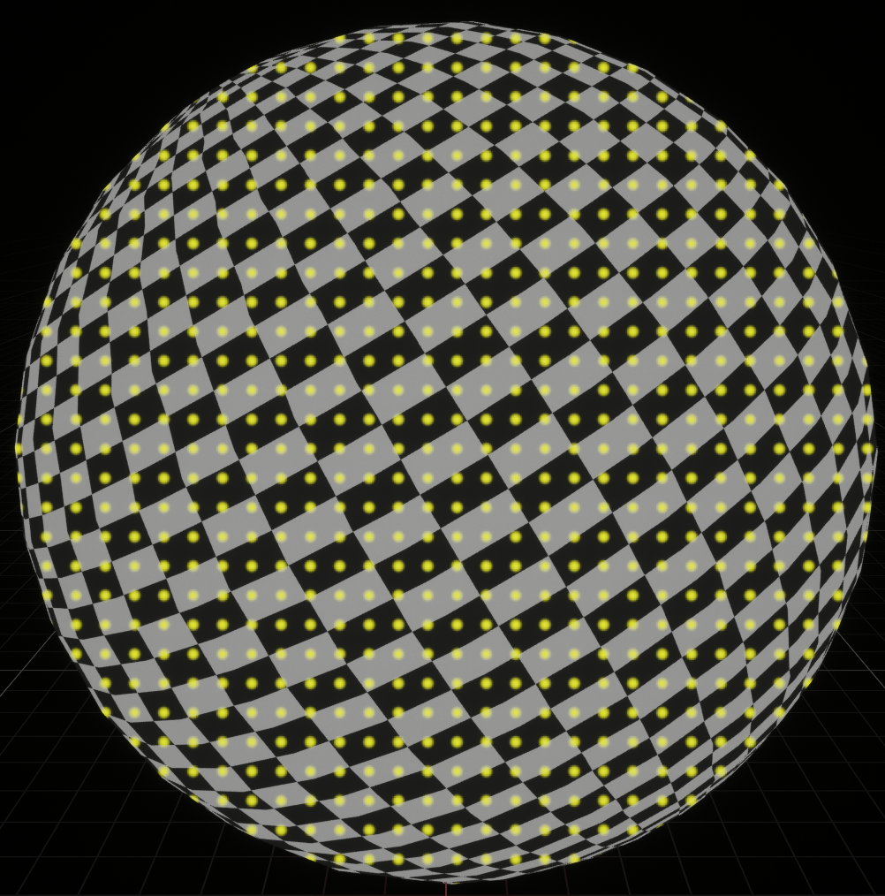
GPU Performance Tips: Textures
Respect the texture cache
Adjacent pixels should touch same or adjacent texels
Use mipmap if you can, adjacent in high mip level is cache miss in lowest level
Use the smallest possible texture format
Per texel sizes: DXT5 4b / RGBA8 4B / RGBA16F 8B / RGBA32F 16B
Avoid incoherent texture reads
Commonly from texture used as data table

Slide 43
GPU Performance Tips: Frame Buffer
Turn off what you don’t need
Alpha blending
Color/Z writes
Minimize redundant passes
Multiple lights/textures in one pass
As long as it doesn’t kill your occupancy
Use the smallest possible pixel format
8-bit components for 0-1, 1/255 ≈ 0.004 between values
16-bit float when range (±65,504) & precision is good enough
Consider clip/discard in transparent regions
Throws out pixels instead of blending them, does not require sorting

Slide 44
GPU Performance Tips: Overall
Learn as much as possible about GPU internals
Use that to guide your optimization decisions
Benchmark, don’t assume
Complex interrelationships can surprise you
Build a good A/B test timing framework
UE has abtest console command: do console command A, time a bit, do B, time a bit, …
Do at least big-picture optimizations early
“Premature optimization is the root of all evil” — Knuth

