Slide 1
CMSC 691: Systems for Smart Home Automation
Nilanjan Banerjee
University of Maryland
Baltimore County
nilanb@umbc.edu
http://www.csee.umbc.edu/~nilanb/teaching/691/
Smart Home Automation

Slide 2
Course inspired by the following Microsoft Vision
http://www.youtube.com/watch?v=Wh-LV28Quqs

Slide 3
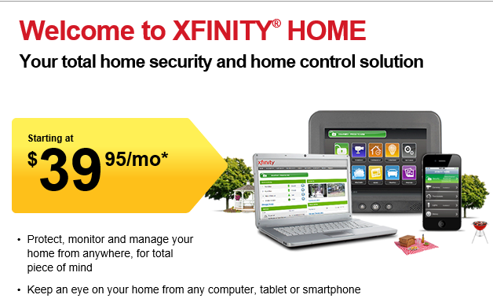
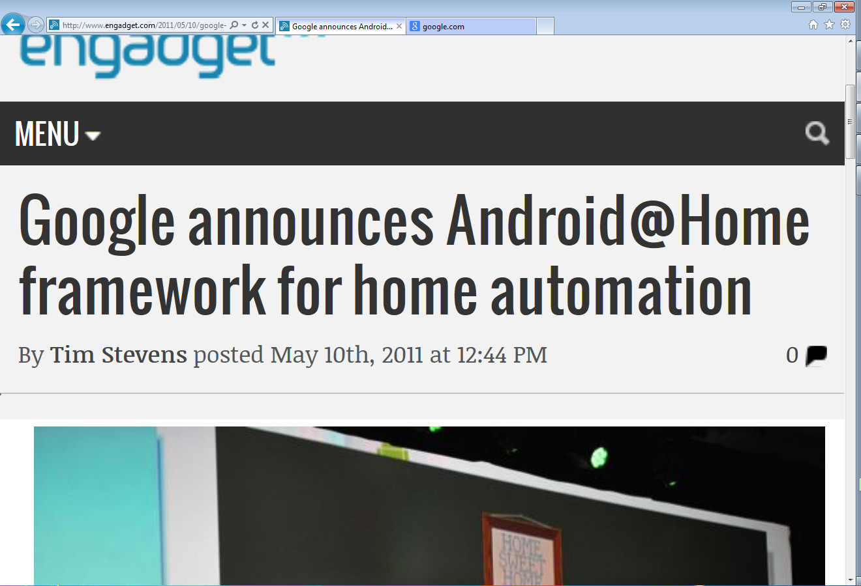
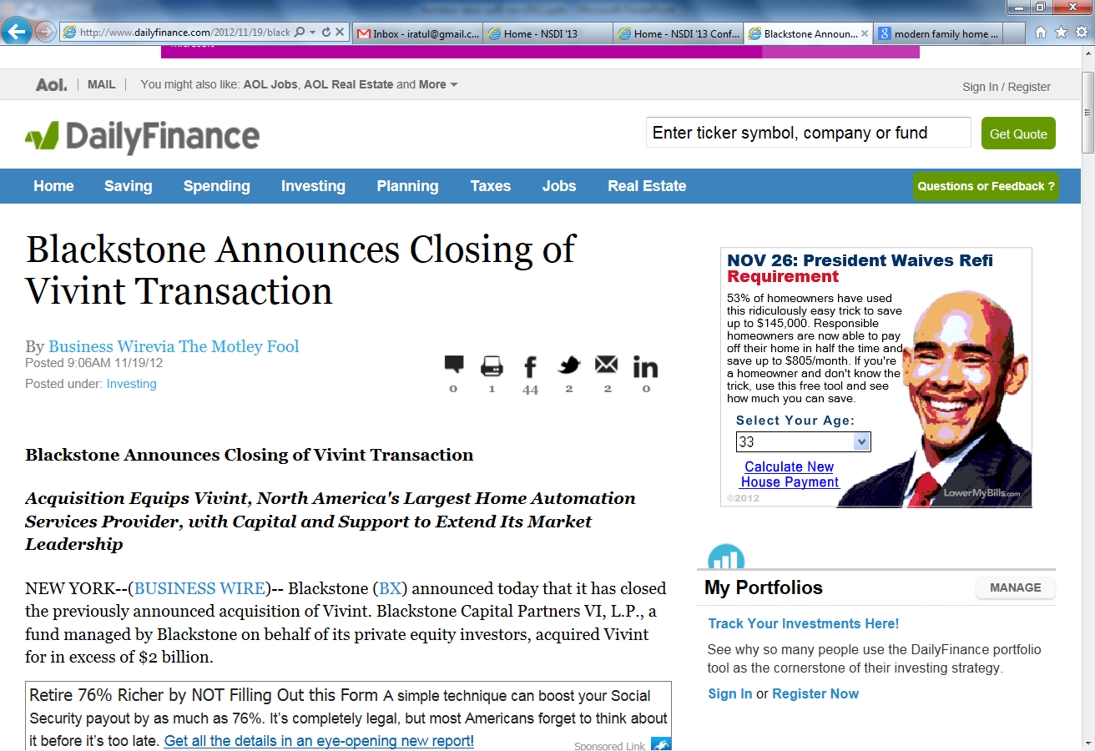
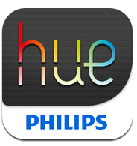
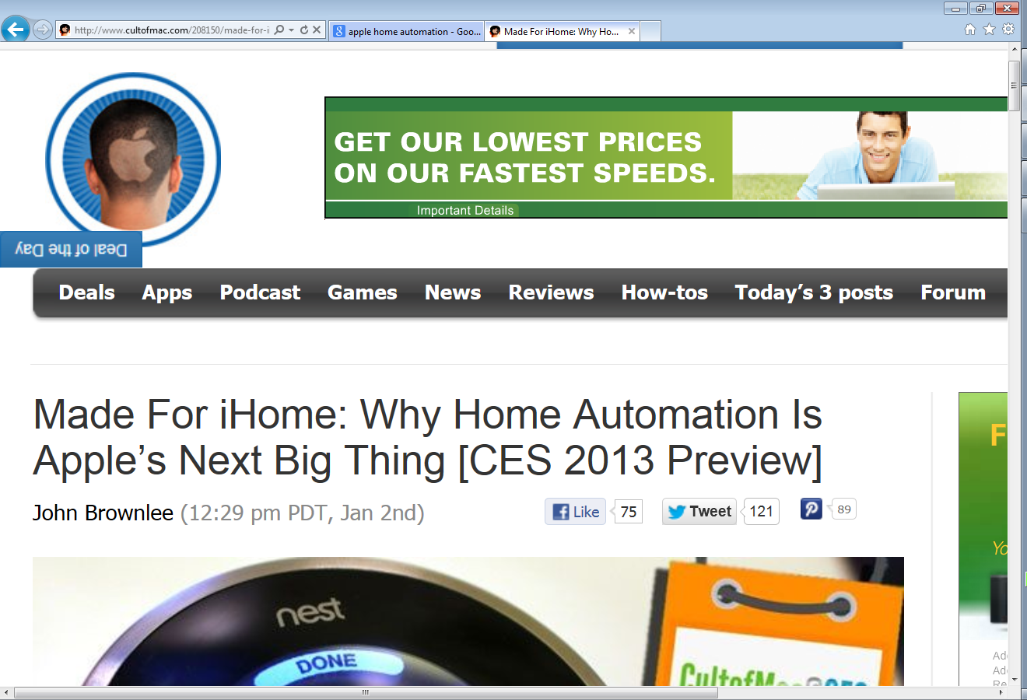
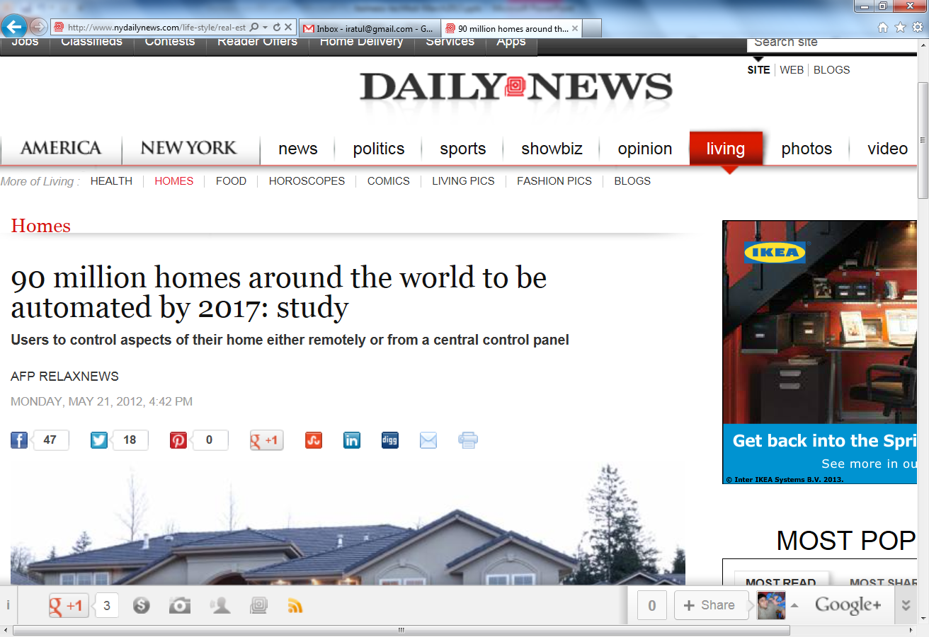
Homes are the epicenter of sensors/analytics/automation
Slide credit: Ratul Mahajan, Accelerating innovation in Home Technology
Notes:
A small sampling of headlines over the past year or so …
90M smart homes; market cap of $6 bn.

Slide 4
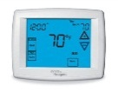

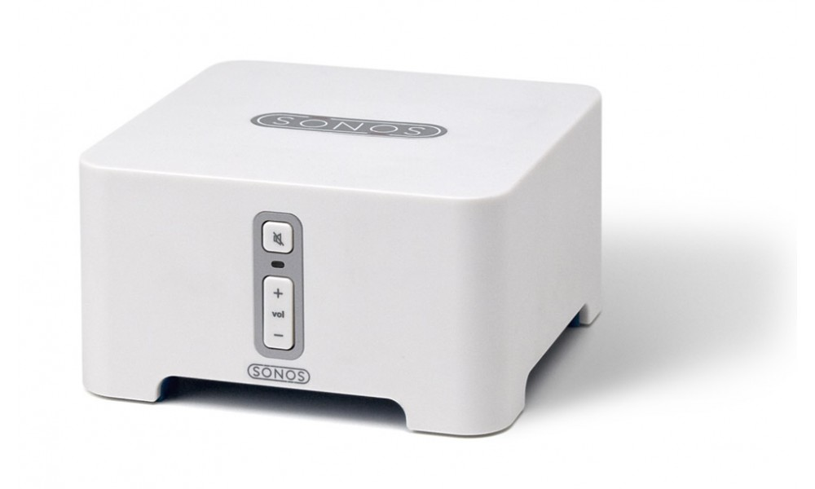
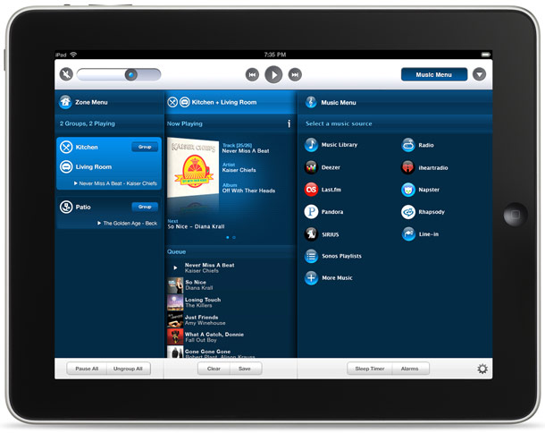


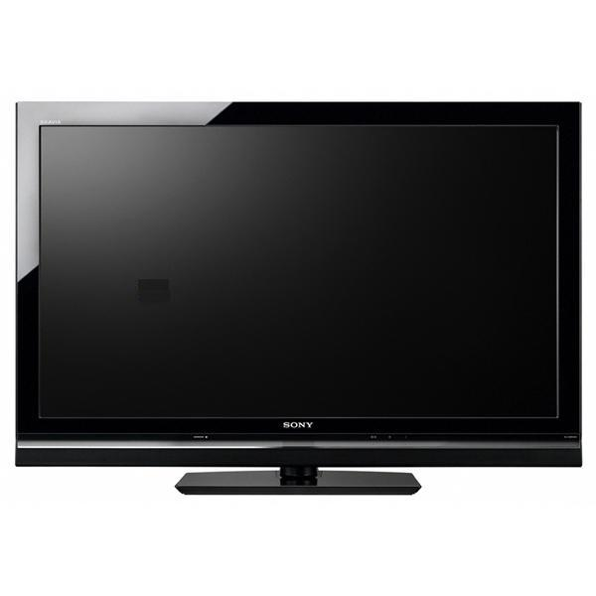
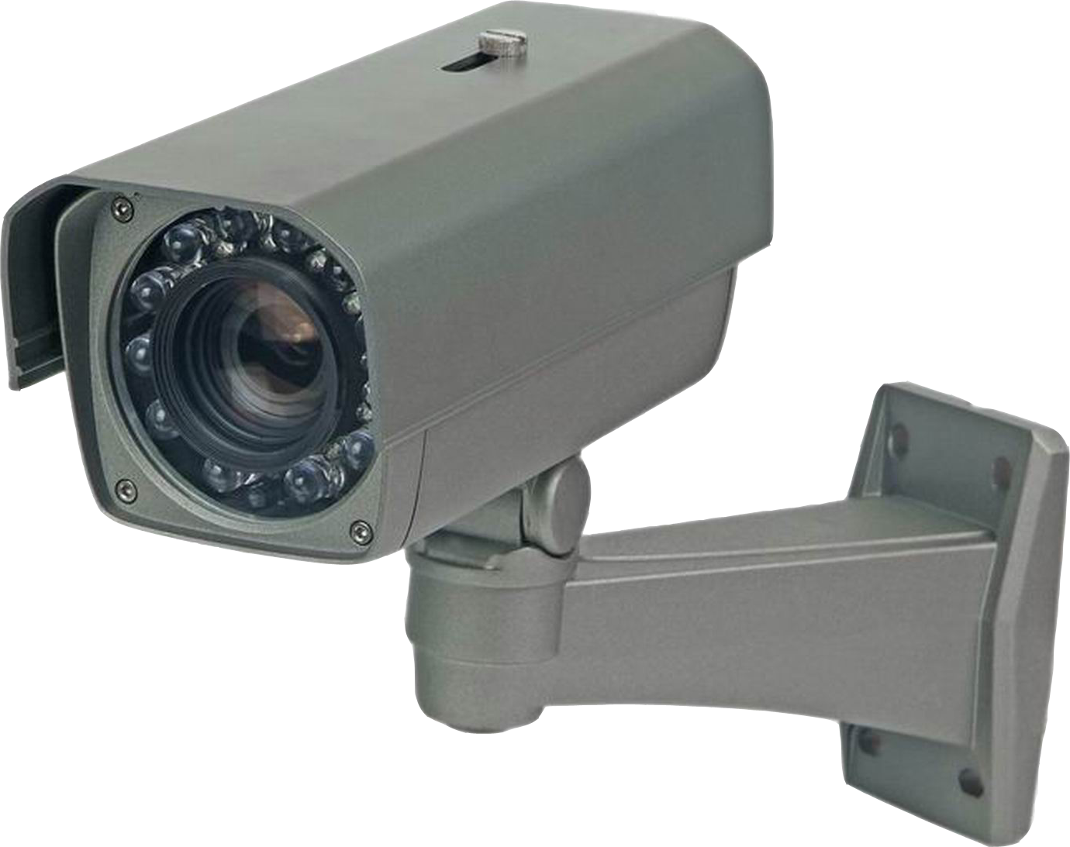
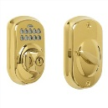
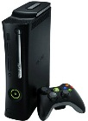
Homes are the epicenter of sensors/analytics/automation
Tasks (software)
Energy monitoring
Alerts w/Photos
Climate
control
Keyless entry
Remote lock
Devices
(hardware)
Slide credit: Ratul Mahajan, An Operating System for the Home
Notes:
Really, this project started by asking one question: It’s the future, where’s my smart-home?
Multiple devices cooperate to cater to users’ wishes with little or no effort”. PCs, cameras, thermostats, locks, TVs and pretty much everything else. Think of logical tasks that span these devices to accomplish something useful, like climate control, an alert system or keyless entry.
Devices are 50-100$

Slide 5
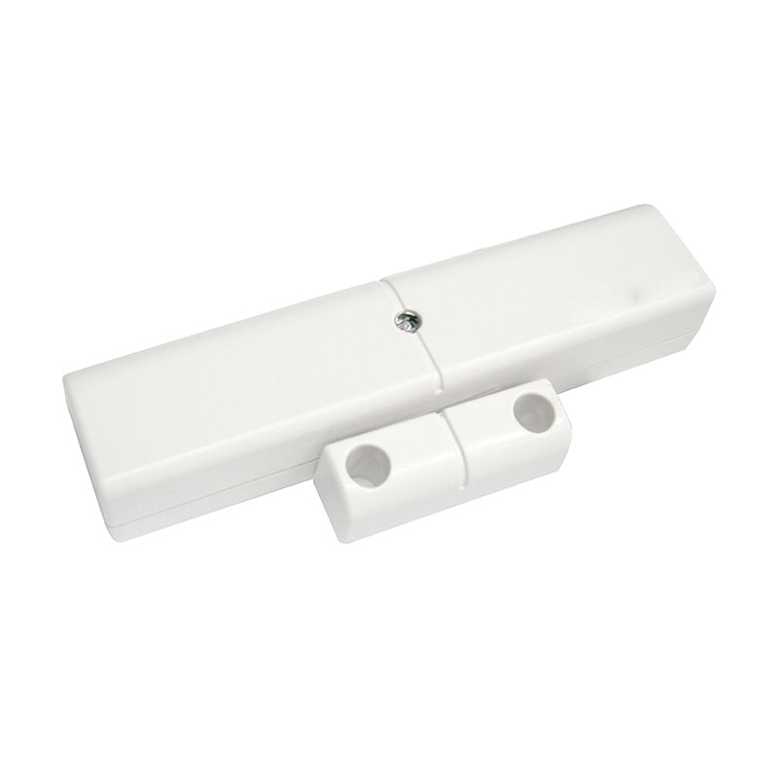
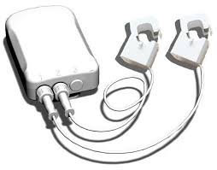
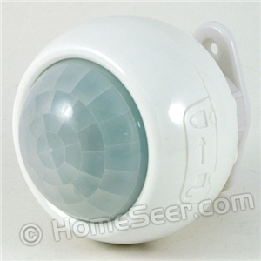
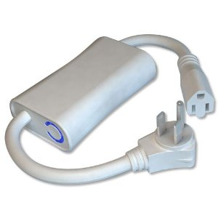
What sort of sensors are used in homes nowadays?
Door and windows sensors
Clamp meters for whole home energy consumption
Multisensor for temperature, humidty,
and motion detection
Energy meter for appliance energy consumption

Slide 6
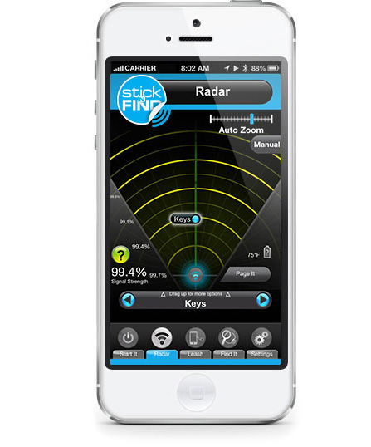
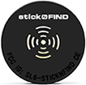

What sort of sensors are used in homes nowadays?
Stick-N-Find to locate items in the home

Slide 7
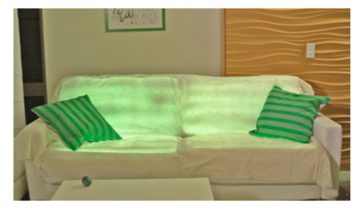
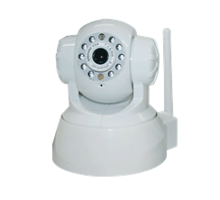
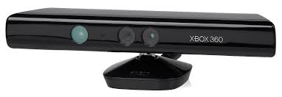
What sort of sensors are used in homes nowadays?
Vibration sensors and light sensors
Designed to catch emotions when using
a couch*
Kinect/IP Camera
*Mennicken et al., EmotoCouch: Exploring the Emotions of Furnitures

Slide 8
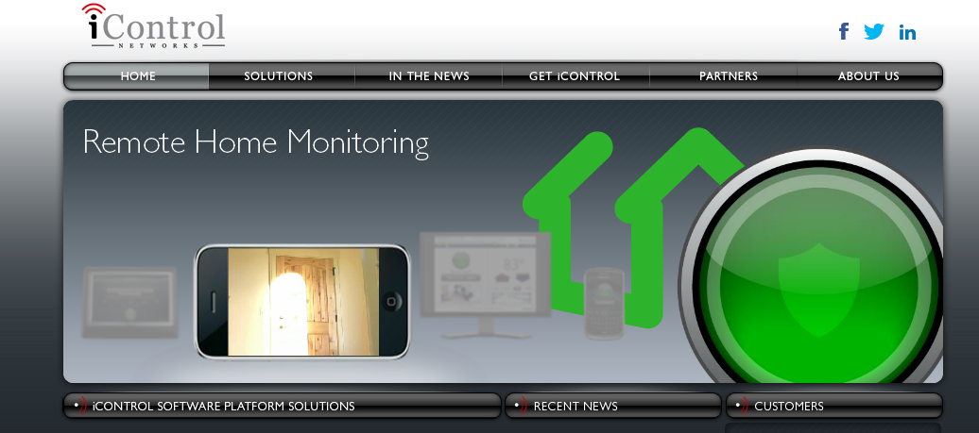
Some commercial products.

Slide 9

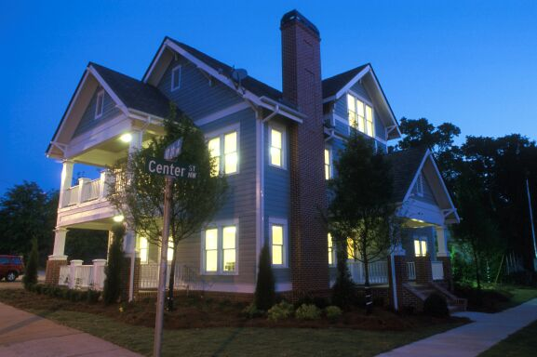
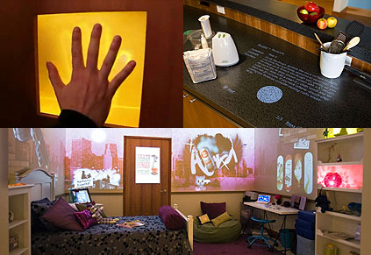
Gap between potential and reality in Smart Home Automation
Envisioned by many researchers and companies
Struggling to break into the mainstream
  Despite commercial availability since 1970s
Slide credit: Ratul Mahajan, An Operating System for the Home
Notes:
Most things cost ~$50–100 these days: locks, lights, thermostats, even window-blind actuators
Pictures: Georgia Tech Aware Home, Microsoft Home of the Future, Disney’s Smart House

Slide 10




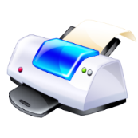

Understanding the gap
Pre-Study of homes with modern automation
  31 people across 14 households
  Enjoyed convenience, peace of mind and control
  But, had difficulty in two key areas:
Poor extensibility | Management pain
or
Adding devices and tasks
Access control
Slide credit: Ratul Mahajan, An Operating System for the Home
Notes:
We also learned from these people why the smart-home technology is not ready for mainstream.

Slide 11
Gap – Details
Hardware inflexibility: networking wires, low-voltage wiring
Extensibility: Organic growth
Management: Security
  Currently the choice is between security and inconvenience (guest / remote access)
Slide credit: Ratul Mahajan, An Operating System for the Home

Slide 12
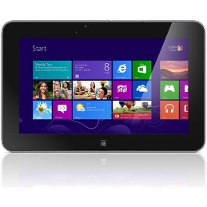







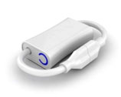

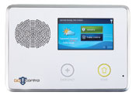
A primer into the platform we would use: Lab-of-things
App
UI
Home store
Security
Climate
……..
Home hub
Z-Wave, DLNA, WiFi, etc.
Notes:
1. HomeOS logically centralizes all technology in the home.
2. Cross-device functionality is implemented by applications, not users or devices
3. Users interact with HomeOS rather than individual devices, which makes them easy to manage.
4. HomeOS provides applications simple APIs to access these devices
5. HomeStore simplifies the tasks of finding compatible devices and applications.

Slide 13
Ok! Tell me what the course contents are
Primer into C#
  basics of C#, Visual Studio Professional
Introduction to Lab-of-things
  HomeHub: Based on Home Operating System
  Cloud components
Programming using Lab-of-things [Core of the class]
  Concept of Drivers
  Concept of Scouts
  Concept of Apps
Programming Specific Sensors [Core of the class]
  Energy meters, Window and door sensors, Multisensor
  Proximity Sensors
  Kinect
Cloud services [Core of the class]
  Storage, webservices
Control
  Smartphone applications (simple)

Slide 14
Is this course for me?
Should have knowledge of object-oriented programming.
Should have working knowledge of networking and operating system concepts
This is not a book-oriented course. Your creativity will be tested in the assignments, class discussions, and final projects.

Slide 15
How will I be graded?
Assignments in groups of two (2-3 total) (30 points)
  Building simple LoT drivers and applications.
In-class midterm (15 points)
  Testing design skills and mobile programming skills
Final project groups of 2 (45 points)
  Hopefully we will have a poster/demo session
In class discussions (10 points)
  Discussions related to research papers in the area.

Slide 16
Assignments
Two to Three assignments on design problems
  Involve coding using Lab-of-Things
Groups of two solving the assignments
Grading
  Source code (7 points)
  Video --- every group will make a video of their assignment and upload it on youtube. (3 points)
  I will share the video and everyone in the class votes on it (best video gets an extra 5 points on the assignment)

Slide 17
Midterm
In-class midterm
Design and coding problems
Grading
  15 points towards final grade

Slide 18
Group Project
  Will have to do some coordination for the project.
  There is a $500 first prize for the BEST project, sponsored by Microsoft Research.
Here is what I am envisioning for the final poster/demo session
http://research.microsoft.com/en-us/um/redmond/projects/homeos/homeos-demos.htm

Slide 19
Group formation semantics
You should create a google site per group
Google site should be *just* shared with me and the grader
  My email address (nilanb@umbc.edu)
  Grader to be decided
The google site would form the portal for the following.
  Submitting your assignments.
  Keeping track of your final projects.

Slide 20
Lecturing style
Demo-oriented Lecturing
bring your laptops if you have one
Discussions on interesting papers in the area.

Slide 21
Resources you will need
Visual Studio professional
  UMBC has a license of Visual Studio and it is installed in CSEE classrooms ITE 240, 242, 375.
  CSEE has renewed its Dreamspark license. You should be able to download it on your personal computers
  To start, you can download the Visual Studio professional trial version. You can download a virtual machine if you do not have Windows on your personal machine
We will work with real sensors (I will provide them)
  Energy meters, multisensors, door and window sensors, proximity sensors, kinect etc.

Slide 22
Administrivia…
Course webpage and reading list
  www.csee.umbc.edu/~nilanb/teaching/691/
  My email id: nilanb@umbc.edu
  Discussion Group
    Piazza
  Class hours: 1:00pm – 2:15 pm (Mon, Wed)
  Office hours: 9:45 – 10:30 (Monday) or by appointment
Grader: TBD
  Office hours: TBD.
Come and talk to me if you
  To discuss project ideas
  Group formation and other semantics

Slide 23
Next Lecture
Start with Primer on C#

